Slide 1
Welcome to Hampton Court Palace

Slide 2
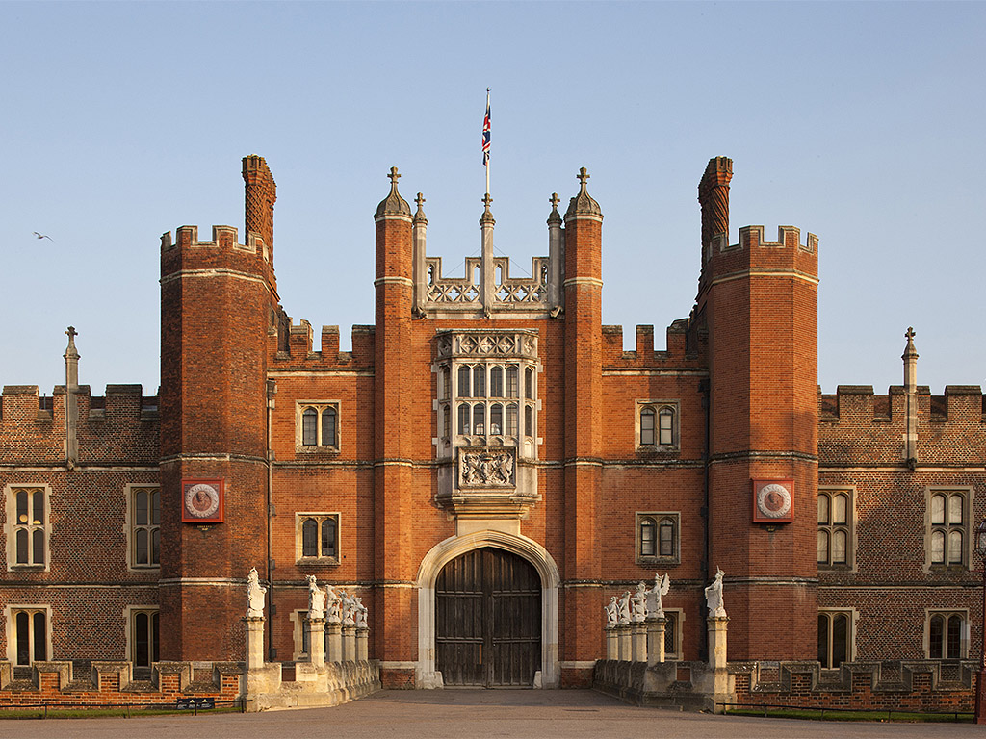
This is Hampton Court Palace. Come and look inside.

Slide 3
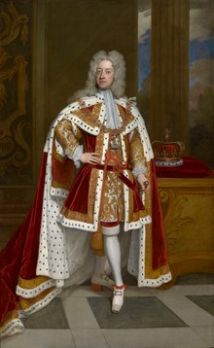
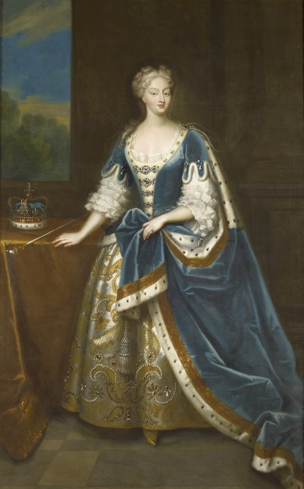
George II and Queen Caroline lived at Hampton Court Palace 300 years ago.

Slide 4
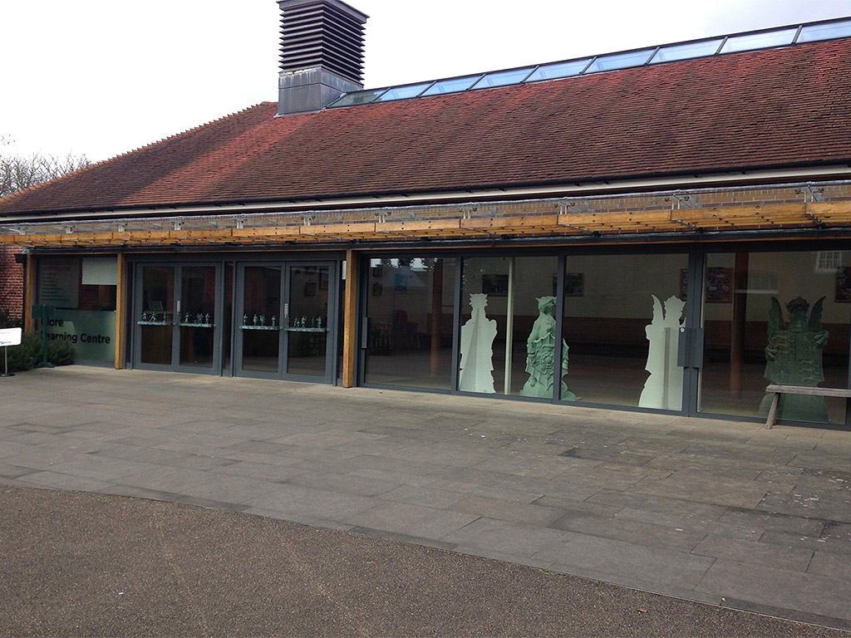
When you arrive you will first come to this building.

Slide 5
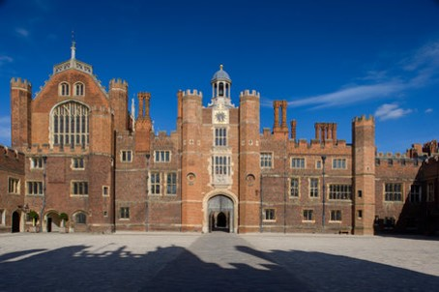
You will then go into the Palace and walk through this big place.

Slide 6
You will see the sign for the Georgian rooms.

Slide 7
You will stand below this staircase and listen to music.

Slide 8
You can look up to see this object.

Slide 9
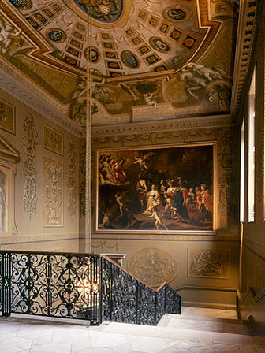
You can hold onto this handrail to climb the stairs.

Slide 10
There is a also a lift you can use to go to the First Floor.

Slide 11
You will see this sculpture in the Guard Chamber.

Slide 12
You can look at this portrait in the Presence Chamber.

Slide 13
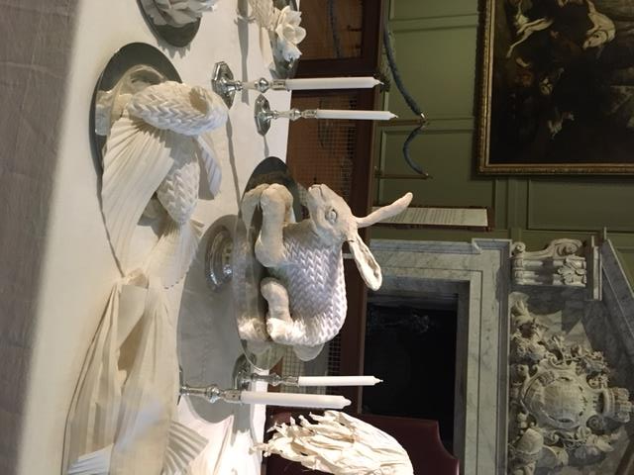
You will see this table in the Public Dining Room.

Slide 14
Look for this special chair in the Queen’s Privy Chamber.

Slide 15
You will see this mural in the Queen’s Drawing Room.

Slide 16
Hampton Court Palace is busy.

Slide 17
There are staff called Warders who can help you when you are exploring the palace.

Slide 18
We hope you enjoy your visit.

