Slide 1
Welcome to Hampton Court Palace

Slide 2
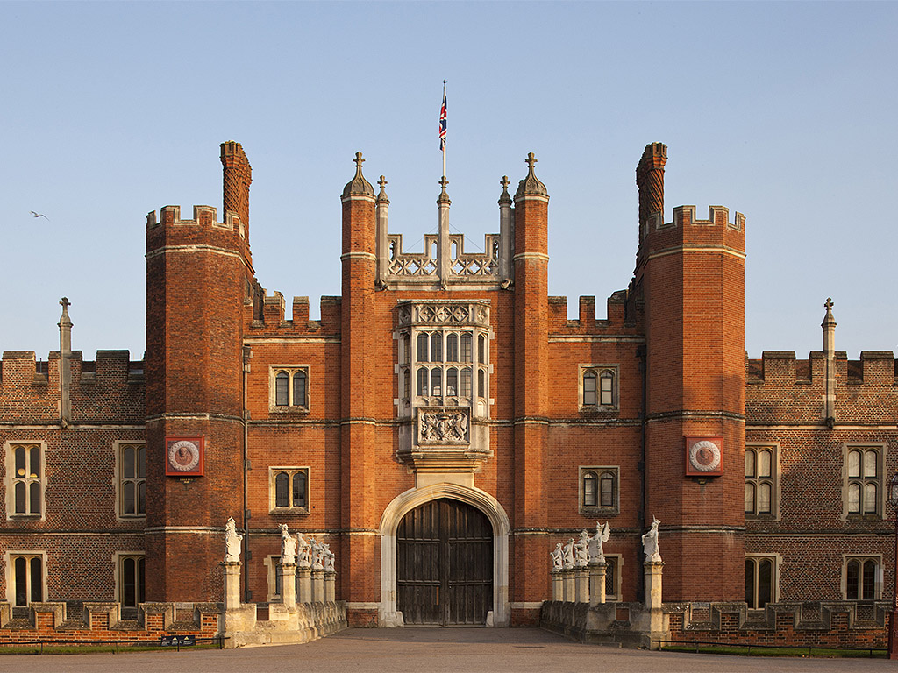
This is Hampton Court Palace. Come and look inside.

Slide 3
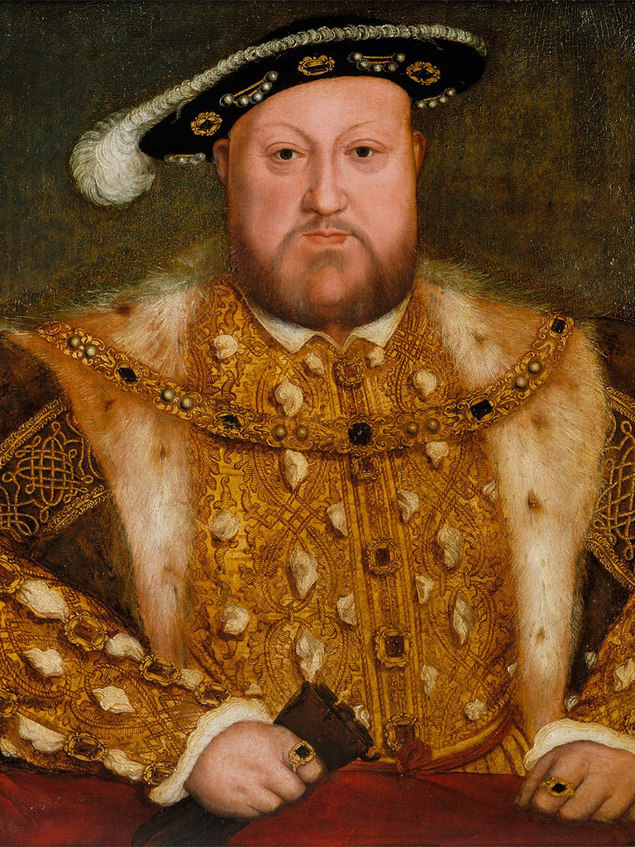
Henry VIII lived at Hampton Court Palace 500 years ago.
Royal Collection Trust/© Her Majesty Queen Elizabeth II 2017

Slide 4
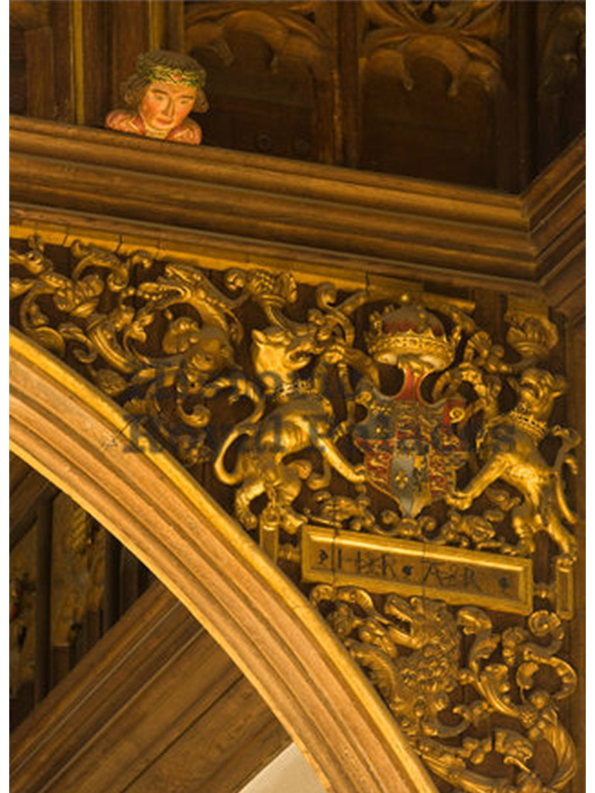
Many things at Hampton Court Palace are a gold colour.

Slide 5
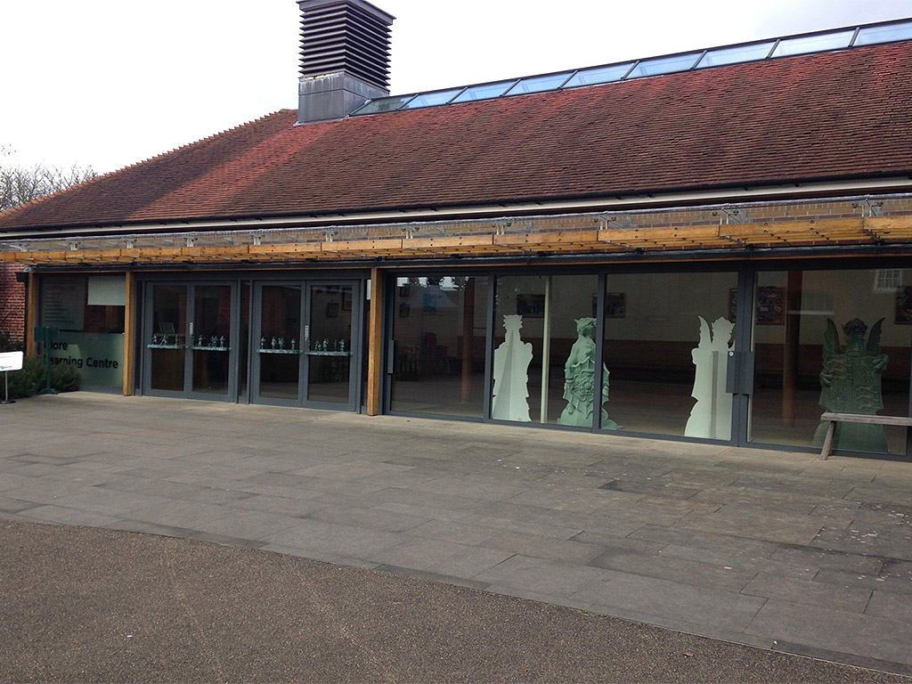
When you arrive you will first come to this building.

Slide 6
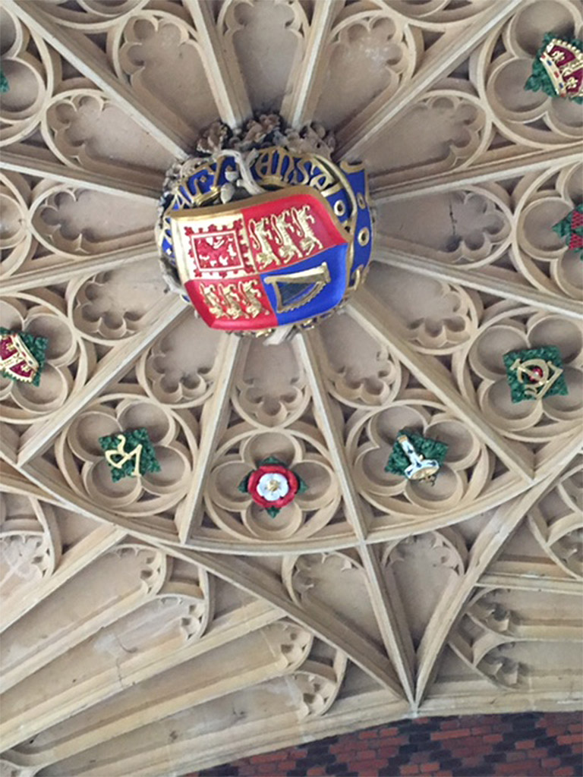
You can look up to see this.

Slide 7
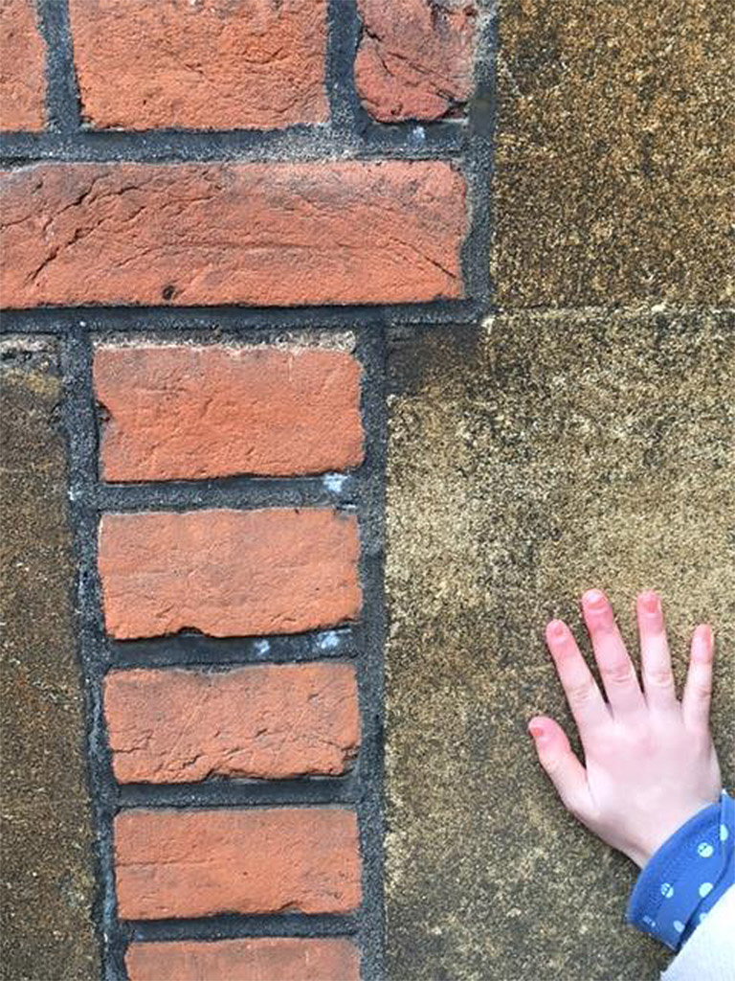
You can also feel the brickwork.

Slide 8
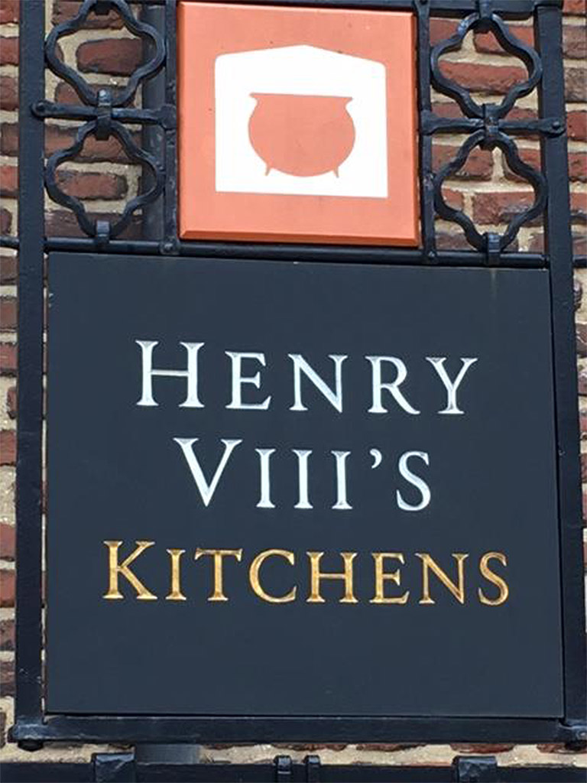
You will see the sign for the Tudor kitchens.

Slide 9
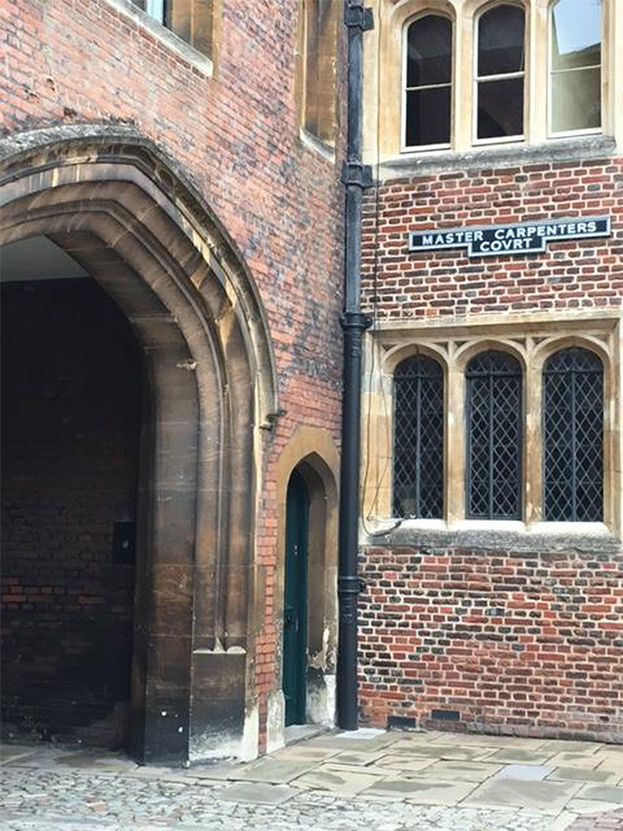
You can stand under this archway and listen to a sound.

Slide 10
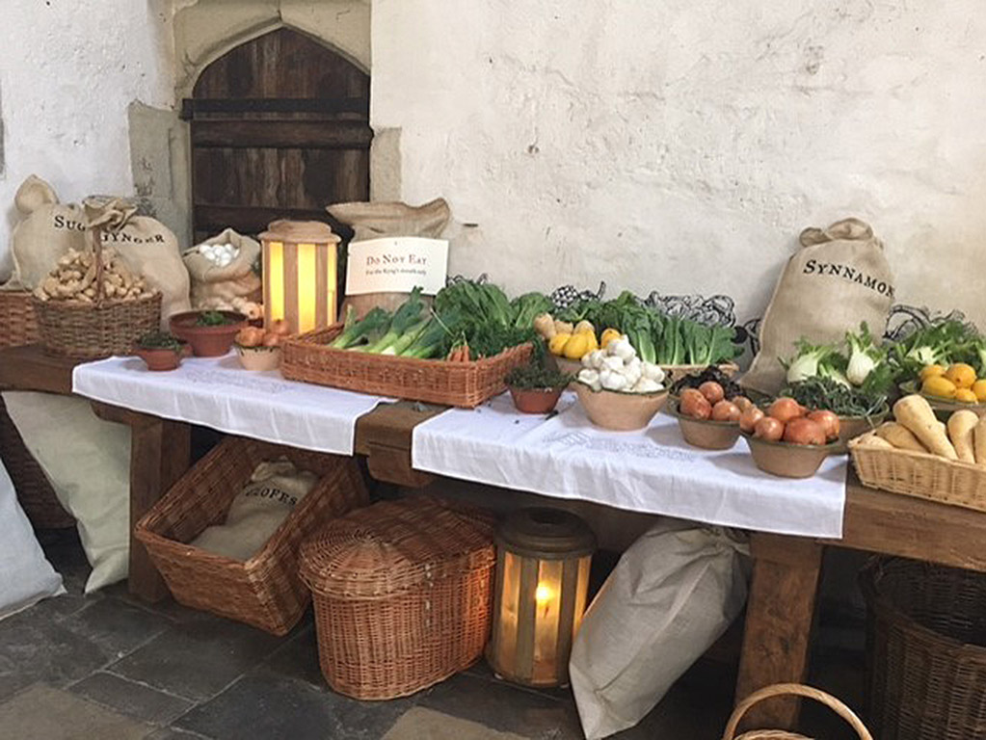
You can look inside the Tudor kitchens.

Slide 11
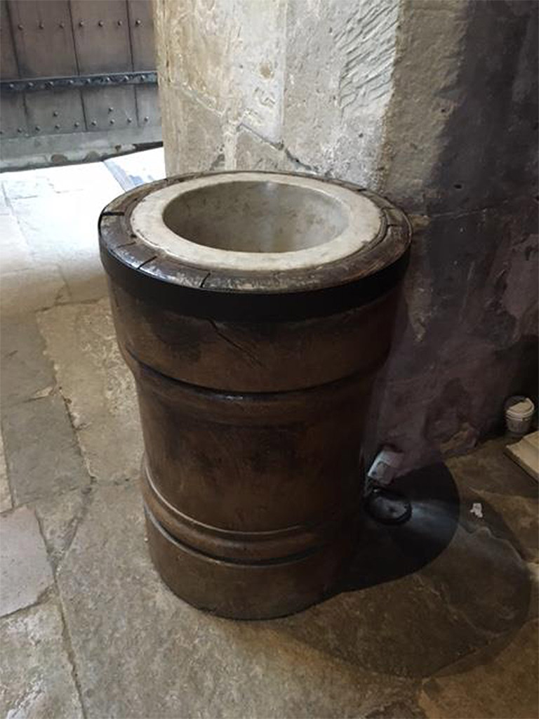
Look out for this big object in the great kitchen.

Slide 12
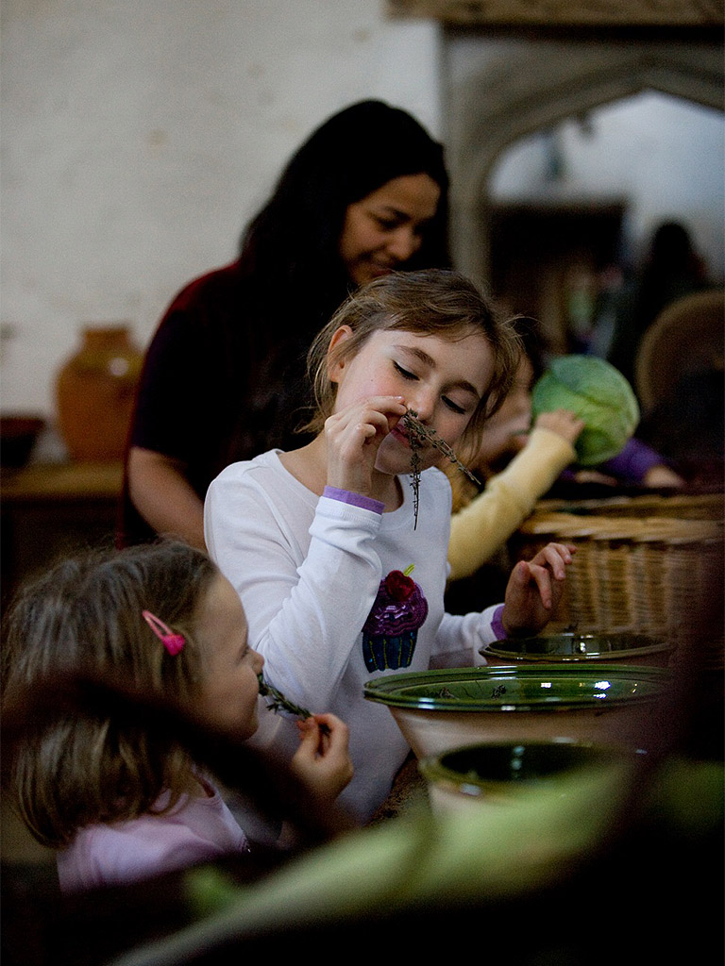
You can touch vegetables and smell some herbs.

Slide 13
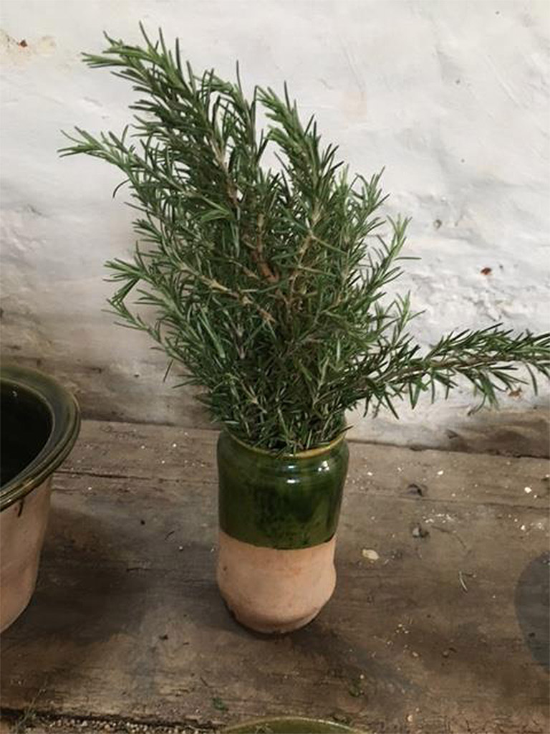
This is one of the herbs you can smell.

Slide 14
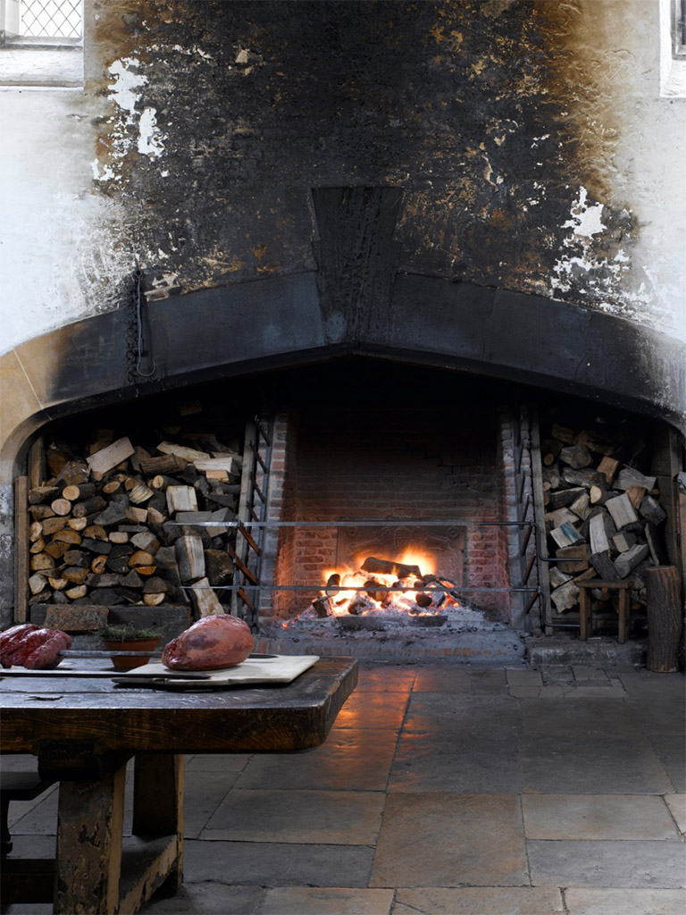
You will see and smell the great fire.

Slide 15
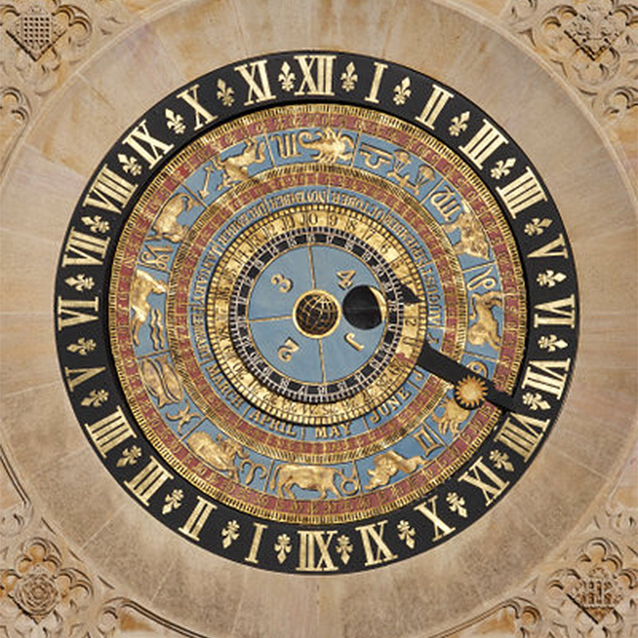
You might see this special object at Hampton Court Palace.

Slide 16
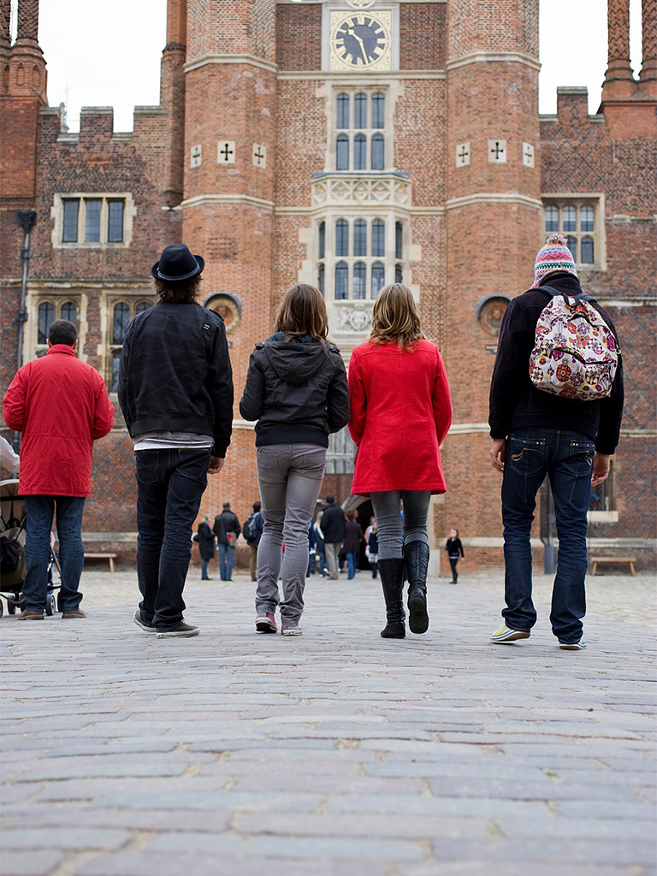
Hampton Court Palace is busy.

Slide 17
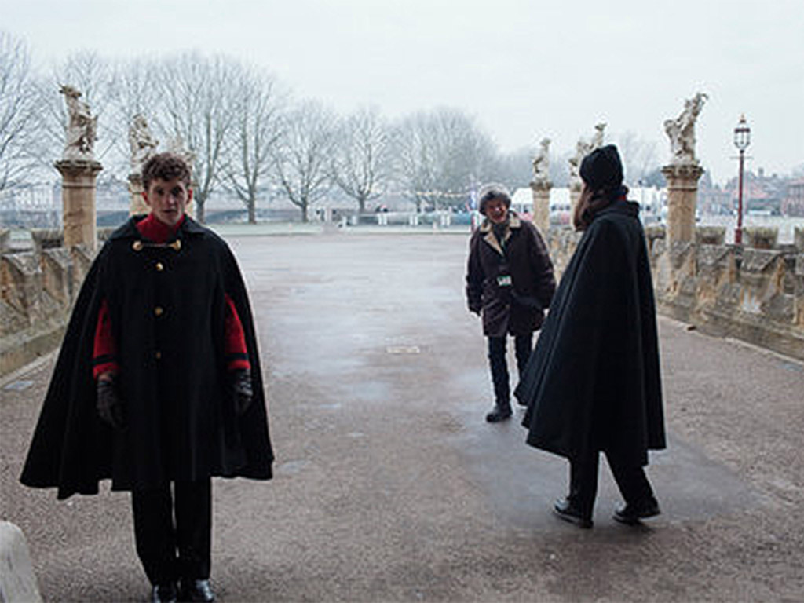
There are staff called Warders who can help you when you are exploring the palace.

Slide 18
We hope you enjoy your visit.

