Slide 1
Welcome to the Tower of London

Slide 2
This is the Tower of London. Come and look around.

Slide 3
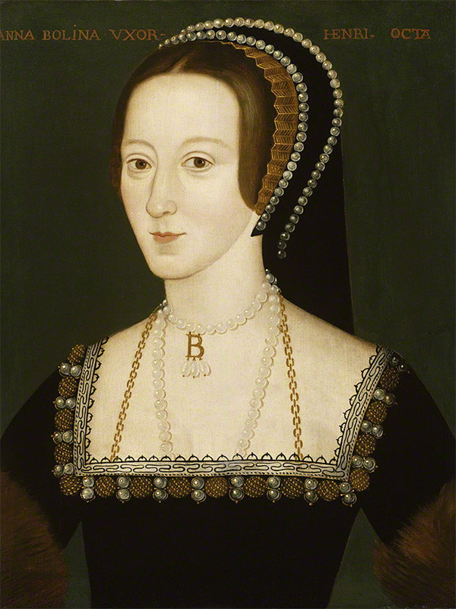
Anne Boleyn was at the Tower of London 500 years ago.
© National Portrait Gallery, London

Slide 4
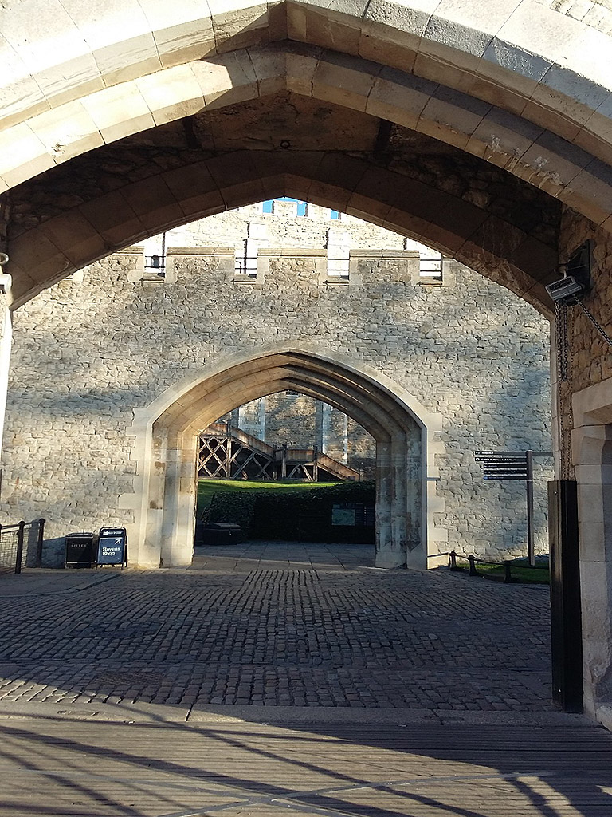
At the Group Entrance, you will enter through this archway.

Slide 5
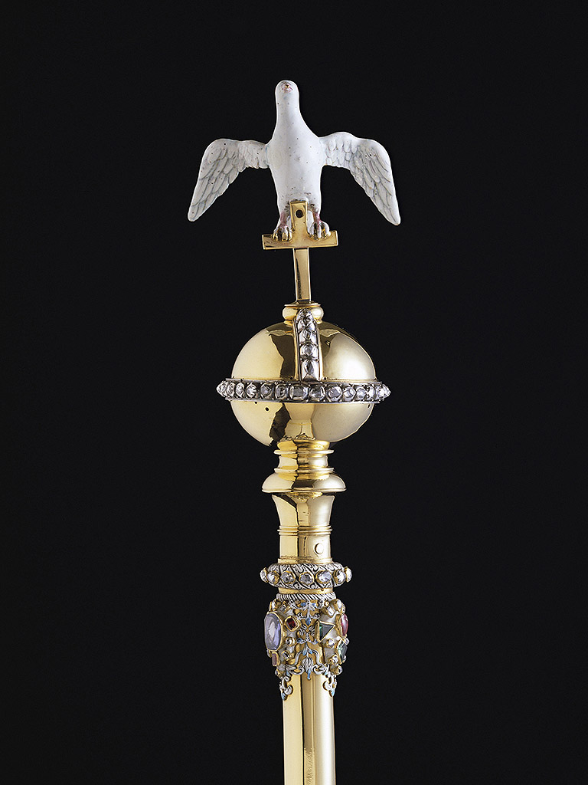
Many things at the Tower of London are white or silver in colour
(© HM Queen Elizabeth II, 2001)

Slide 6
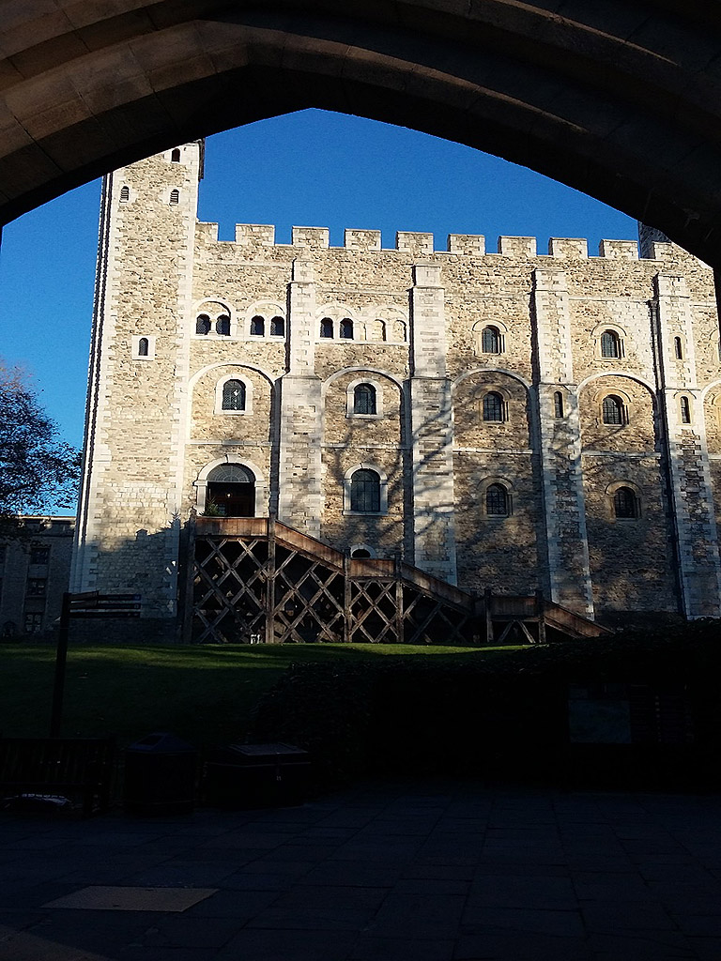
You can see the famous White Tower from here!

Slide 7
Look out for this sculpture of a polar bear on the way.

Slide 8
You can look for and listen to the sound of the ravens.

Slide 9
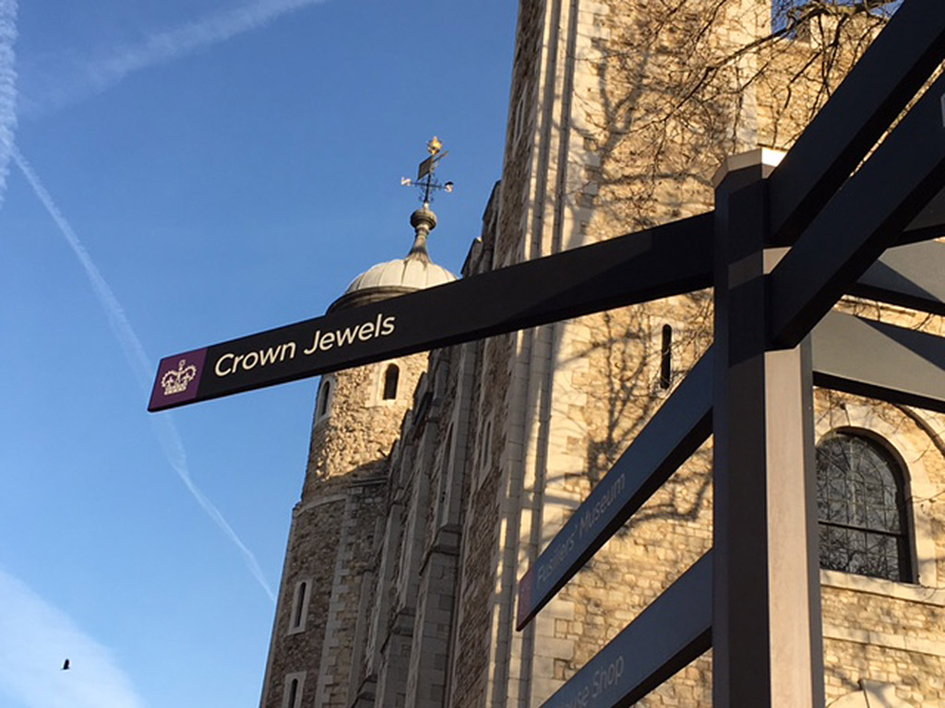
Y You can look out for this sign for the Crown Jewels.

Slide 10
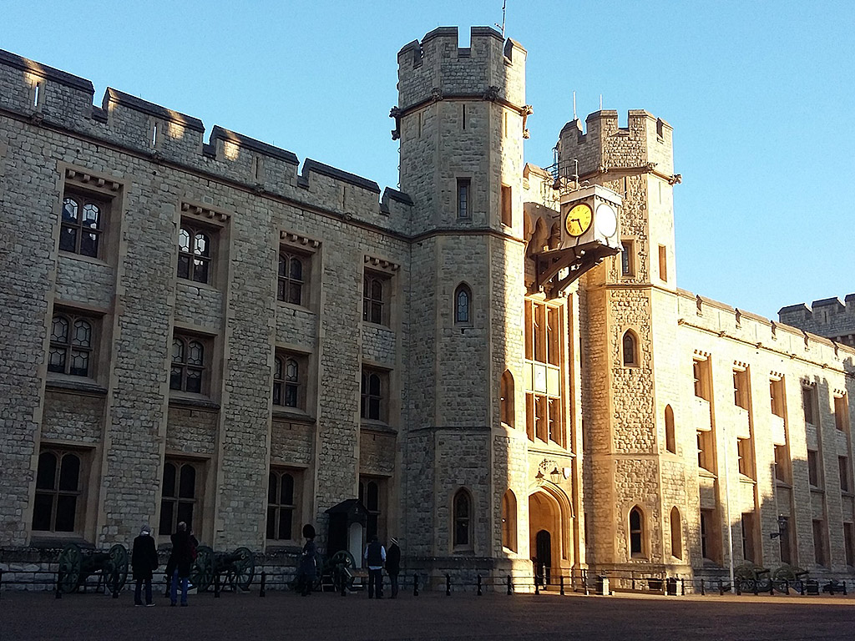
You can go inside the Jewel House to see the Crown Jewels. It is dark and busy inside.

Slide 11
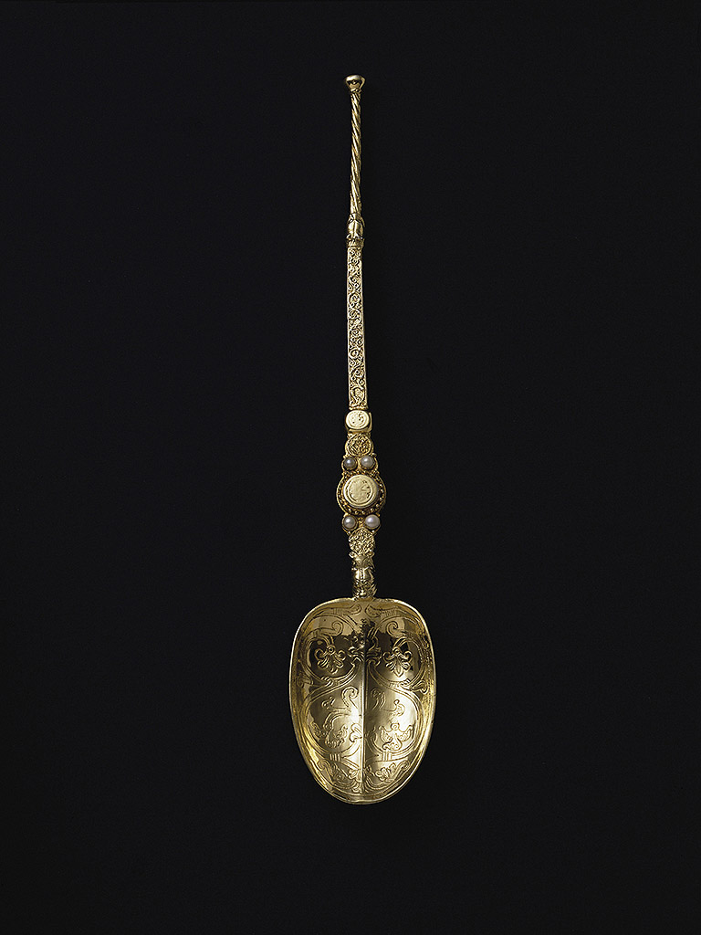
You might see this special object at the Tower of London.
(© HM Queen Elizabeth II, 2001)

Slide 12
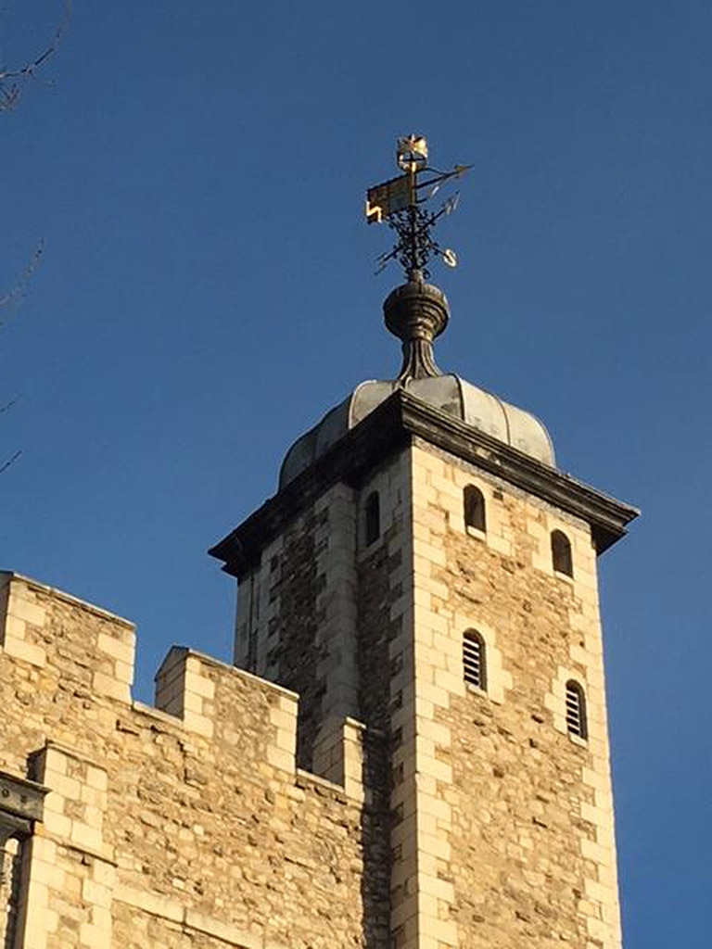
You can look up to see this.

Slide 13
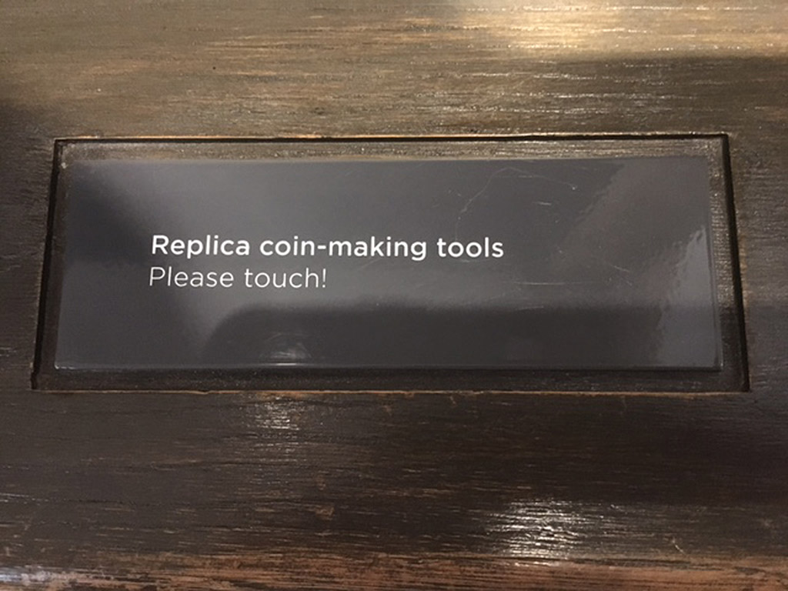
If you have time there are things you can touch.

Slide 14
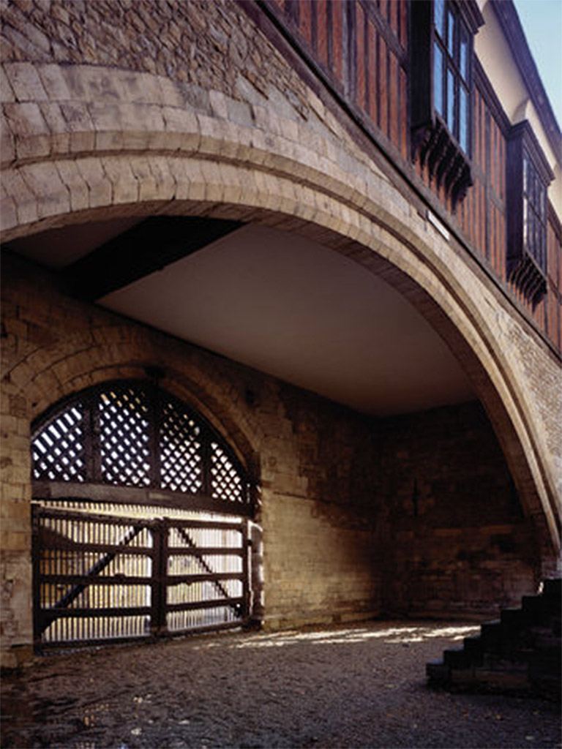
Look out for this famous gate when you leave.

Slide 15
If you need help or have any questions, you can ask someone in uniform.

Slide 16
We hope you enjoy your visit.

