Slide 1
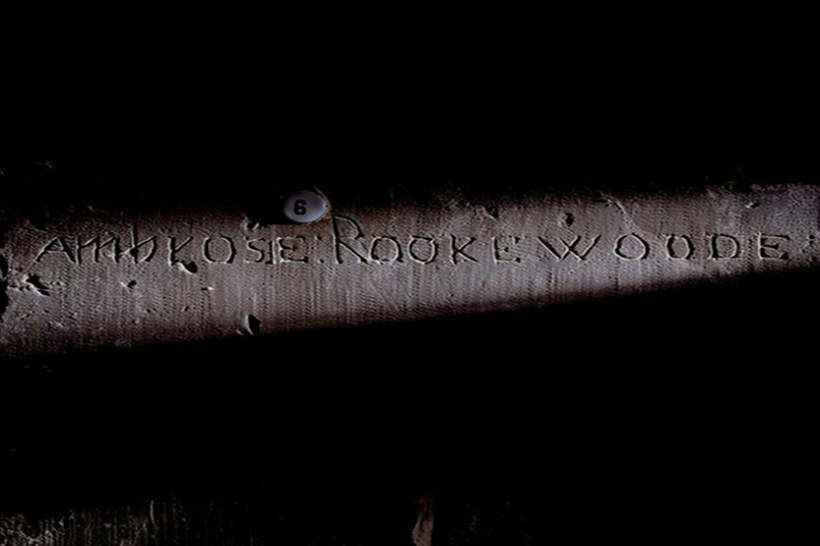
© Historic Royal Palaces
Find more details in the ‘Notes’ section below the slide.
Notes:
This graffiti was made by one of the plotters, Ambrose Rookwood.
Rookwood was imprisoned in the Tower before being taken to Westminster in January 1606 to be hanged, drawn and quartered for his involvement in the Gunpowder Plot. During his imprisonment, he carved his name into the wall of the Martin Tower, where it can still be seen today.

Slide 2
© Historic Royal Palaces
Notes:
The King's House, looking South West across Tower Green, with The Shard beyond. The King's House is one of the few timber-framed domestic buildings that has survived the Great Fire of 1666, and in time it has become associated with infamous prisoners kept at the Tower.

Slide 3
© Historic Royal Palaces
Notes:
Inside the Council Chamber, King’s House at the Tower of London. This is the location of Guy Fawkes’ interrogation.

Slide 4
© Historic Royal Palaces
Notes:
Guy Fawkes signature before and after he was questioned about his part in the Gunpowder Plot.

Slide 5
© Historic Royal Palaces
Notes:
This monument is in the Council Chamber of the King’s House at the Tower of London. It was created to commemorate the defeat of the Gunpowder Plot (created 1608). The Latin texts praise the King and his family, extoll the virtues of the Privy Councillors who foiled the Plot and condemn the wickedness of the plotters, whose names are listed.
However, the monument also had another, more sinister, purpose. The Council Chamber was designed as a room in which to interrogate prisoners and the monument acted as a warning that uncooperative prisoners could suffer the same grisly fate as the Gunpowder Plotters.

Slide 6
© Historic Royal Palaces
Notes:
Close up of the Gunpowder Plot monument, showing the plotters’ names.

Slide 7
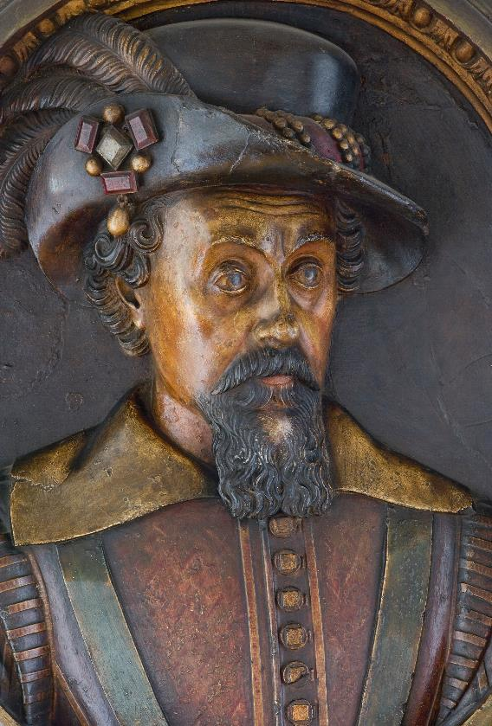
© Historic Royal Palaces
Notes:
This is a carved stone portrait of King James the VI and I (1566-1625). It is located in the King’s House at the Tower of London. It shows King James VI and I in half relief wearing a wide brimmed hat with an ostrich feather and the Three Brothers jewel.
The date of the carving is not recorded, but it is possible it was created around the same time as a large marble monument that commemorated the defeat of the Gunpowder Plot (created 1608).

Slide 8
© Historic Royal Palaces
Notes:
The illustration shows: Thomas Bates (1567-1606), Robert Catesby (1573-1605), Guy Fawkes (1570-1606), Thomas Percy (1560-1605), Robert Winter (1568-1606), Thomas Winter (1572-1606), Christopher Wright (1570?-1605) and John Wright (1568?-1605) From 'Old and New London: A Narrative of its History, its People and its Places', Vol II by Walter Thornbury, 1872-8, published over 200 years after the events of the Gunpowder Plot.

