Slide 1
HOW TO USE - NOTES FOR TEACHERS
These resources from Historic Royal Palaces are multi-purpose. They are ready for you to tweak and use in your lessons.
For the best experience, download and open the file in the PowerPoint desktop app.
Answers are found under the slide. Click on the notes symbol at the bottom of the screen.
Delete text and images to make your own worksheets.
Disclaimer and Use Terms
We are the owner or the licensee of all intellectual property rights in these resources which are protected by copyright laws and treaties around the world. All such rights are reserved. These resources, and the content included within them, may be used by you for educational purposes only. This means that you may download the resources and use or share them solely in educational environments (including for home school lessons) or as part of homework. You may not share the resources other than for the above purposes and you must not use the resources, or any part of them, for any commercial purpose.

Slide 2
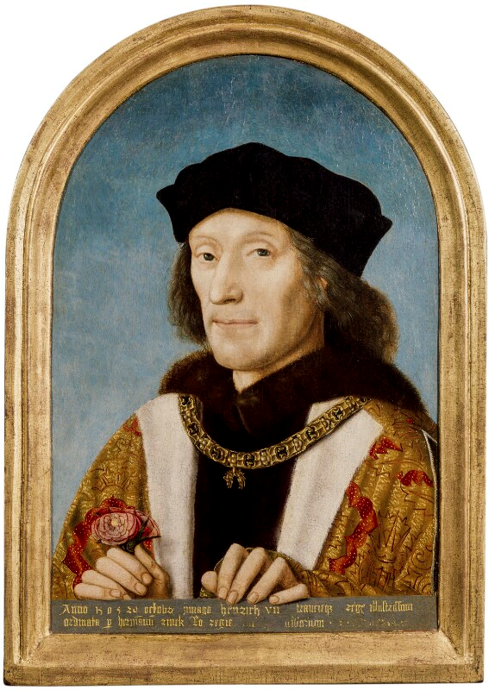
HENRY VII
Founder of the Tudor dynasty
Henry VII’s grandmother was Katherine of France. She had been married to Henry V. This meant Henry VII was part of the House of Lancaster.
He became king after the Battle of Bosworth in 1485, where King Richard III was killed. Henry did not have a strong claim to the throne. He made his claim stronger by marrying Elizabeth who was part of the York family.
Together, they united the two royal houses of Lancaster and York. He combined the two families' emblems, the red and white roses, and created a new Tudor emblem.
Henry created personal bodyguards called Yeoman of the Guard, also known as ‘Beefeaters’. The Beefeaters still have duties at Tower of London today.
Defeated two uprisings that were led by imposters.
Made the power and reputation of the monarchy stronger.
Reduced the power of nobles by banning private armies.
Increased taxes.
Henry arranged marriages for his children to help make alliances with other countries and keep peace.
His son Arthur married Katherine of Aragon in 1501. His daughter Margaret married James IV of Scotland in 1503.
When he died, he left behind a stable country, a secure throne and a full treasury.
He enjoyed sports and games including tennis, hunting and playing cards.
Q:
How did Henry make sure the Tudors were in a strong position on the throne when he died?
© National Portrait Gallery, London
His mother was only 13 when he was born.
Reigned: 1485 - 1509
Lived: 1457 - 1509 | Birthplace: Wales
Q:
Do you think Henry was a popular king?
Notes:
Henry VII notes:
Henry married Elizabeth of York which added weight to the Tudor’s claim to the throne. He also planned marriages for his children to form alliances with other countries. He put down uprisings and reduced the power of the nobles.
Some people might think that Henry was popular because he restored peace and stability after the Wars of the Roses. Others might say he was unpopular because he increased taxes.

Slide 3
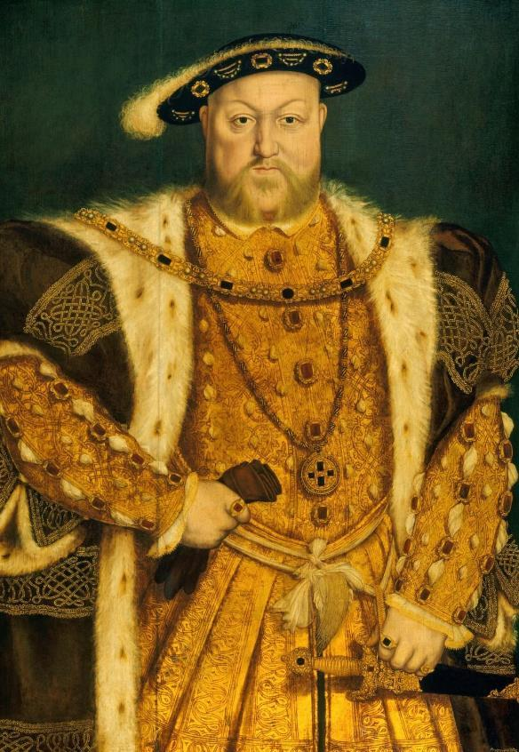
HENRY VIII
The King who married six times and created the
Church of England
Henry VIII was the second son of Henry VII. His elder brother, Arthur, died in 1502. Henry VIII became king aged 17.
Wrote music and poetry.
Graceful dancer and excellent sportsman.
Married his brother’s widow, Katherine of Aragon.
In 1516, their daughter Mary was born.
During his time as king, he had two main challenges: having a male heir and getting the Pope’s permission for a divorce (which led to the English Reformation.)
Henry and Katherine did not have a son to become heir. Henry thought God was punishing him for marrying his brother’s widow. He asked the Pope to declare that their marriage had been invalid, but the Pope refused. So, Henry broke away from the Roman Catholic Church.
Married his second wife Anne Boleyn in 1533.
Created a separate Church of England.
Made himself the Supreme Head of the Church of England.
In 1534, got Parliament’s support to make changes to the way the Church was run, and this started the English Reformation.
Henry and his chief minister, Thomas Cromwell, closed hundreds of monasteries, and took land and treasure. Henry used this wealth for, developing England’s navy and building projects at Hampton Court Palace.
He and Anne had one child, Elizabeth, but not long after he accused Anne of treason, and she was executed. Around this time, he had an accident whilst jousting where he was knocked unconscious for a few hours.
His third wife, Jane Seymour, gave birth to his only son Edward at Hampton Court Palace. He married three more times, and executed another of his wives, Catherine Howard.
When Henry died, he was buried with Jane Seymour in the Chapel at Windsor Castle.
Q:
Henry was very popular when he first became king. Why do you think that was?
Royal Collection Trust / © His Majesty King Charles III 2024
Q:
Why was Henry determined to end his marriage to Katherine of Aragon?
Reigned: 1509 – 1547
Q:
How does the artist convey Henry’s power in the portrait?
Lived: 1491 - 1547 | Birthplace: London
Notes:
Henry VIII notes:
Henry might have been a popular because he was tall, young, sporty and cultured. Some people thought this would be a new era, with a new young king and his wife.
Henry wanted to end his marriage because he wanted a son to inherit the throne. The Wars of the Roses was still in living memory. Henry might have feared that leaving the throne to a woman might result in a civil war and the end of the Tudor dynasty.
In his portrait, Henry stands in a dominant pose. His expensive, fashionable clothes, encrusted with jewels, emphasise both his immense wealth and his physical size. One hand rests on his sword, which adds to the impression of a powerful, masculine, ruler.

Slide 4
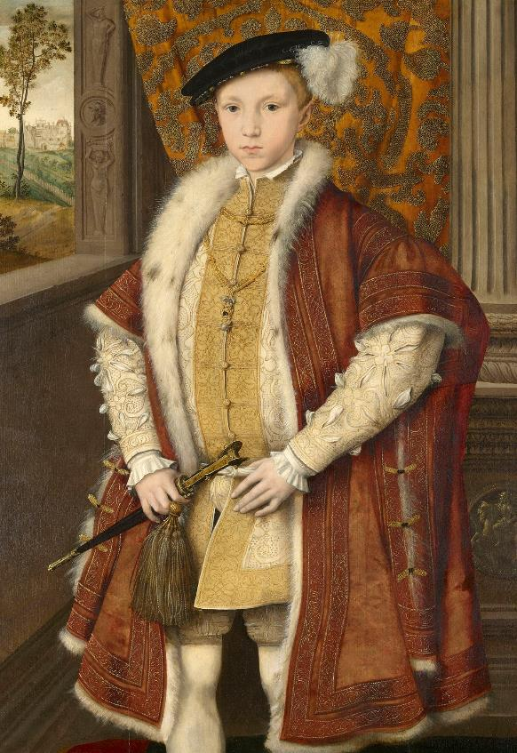
EDWARD VI
The Boy King and first English monarch brought up as a Protestant
Edward was born at Hampton Court Palace. His mother, Jane Seymour, died a few days later. He was taught by Protestant tutors and grew up a dedicated Protestant. He had two older half-sisters, Mary and Elizabeth.
At nine years old, he became king when his father, Henry VIII, died. Before he died, Henry VIII’s ordered that Edward would be the next ruler, even though his sisters were older. Henry VIII was worried a female ruler might unsettle the country and lead to rebellions.
Since Edward was young, a council was set up to rule until he was older. This led to a power struggle. Edward's eldest uncle, Edward Seymour made himself Lord Protector.
Edward Seymour wanted to force Protestant faith on whole country.
Young Edward supported this.
Many Catholic traditions were banned, including statues and stained-glass windows in churches.
From 1549, churches had to use the new Book of Common Prayer in English, not Latin.
This led to uprisings in the West of England.
Edward became ill, probably suffering from tuberculosis. He wanted the next ruler to be a male Protestant.
He did not want his half-sisters to be next in line for the throne, and none of his cousins had sons. So, he named his protestant cousin, Lady Jane Grey, as heir. He died aged 15.
He was fluent in several languages including French, Greek and Latin.
Q:
The portrait is thought to have been completed just before Edward became king. What impression of the Prince does it create?
Royal Collection Trust / © His Majesty King Charles III 2024
He acted in masques at Hampton Court Palace.
Reigned: 1547 - 1553
Q:
What evidence is there that Edward was intelligent and well-educated?
Lived: 1537 - 1553 | Birthplace: London
Notes:
Edward VI notes:
The portrait is thought to have been completed just before Edward became king. What impression of the Prince does it create?
What evidence is there that Edward was intelligent and well-educated?

Slide 5
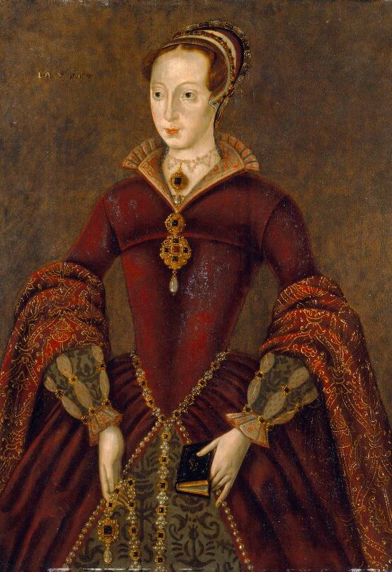
LADY JANE GREY
The ‘Nine Day Queen’
Jane’s mother, Lady Frances, was Henry VIII’s niece. They were a high-status family and Jane was well-educated. She learnt Latin, Greek, French and Italian.
When she was 10, she was sent to live in Thomas Seymour’s household. He was the uncle of King Edward VI. It was a strongly Protestant household.
Married Lord Guildford Dudley in 1553.
His father was a duke and may have suggested to Edward VI that Jane should be next in line to inherit the throne.
Edward died in 1553 and the duke told Jane she was now the Queen.
She was reportedly surprised and upset by this.
She arrived at the Tower of London to prepare for her coronation.
However, Edward’s half-sister Mary did not agree that Lady Jane Grey should be the next queen. Mary had a loyal army and many supporters which was a huge threat. Jane was queen for only nine days before the plans were changed and Mary became queen instead.
Mary was angry at Jane’s attempt to take the throne. Many of the people who had supported Jane becoming queen – including her own parents - changed sides to save themselves.
Jane and her husband became high-status prisoners and were held separately in the Tower of London. They were well-treated, and records suggest Mary wanted to pardon Jane. However, Jane refused to change to the Catholic faith.
In 1554, Jane and her husband were sentenced to death for treason. Guildford was beheaded. Jane saw his body brought back to the Tower of London before her own execution.
‘Lord, into thy hands I commend my spirit.’
Jane’s last prayer before her execution.
She was given a comfortable place to stay whilst imprisoned.
© National Portrait Gallery, London
Reigned: 1553
Q:
After Jane’s death she was viewed by Protestants as a martyr. Later she was seen as an innocent victim. How do you view her?
Lived: 1537 - 1554 | Birthplace: Leicestershire
Notes:
Lady Jane Grey notes:
There are many ways to remember Lady Jane Grey. Some might take the view that Jane was a martyr because she chose to die a Protestant rather than save herself by converting to Catholicism. Others might say she was an innocent victim, a very young girl used by others to increase their own power.

Slide 6
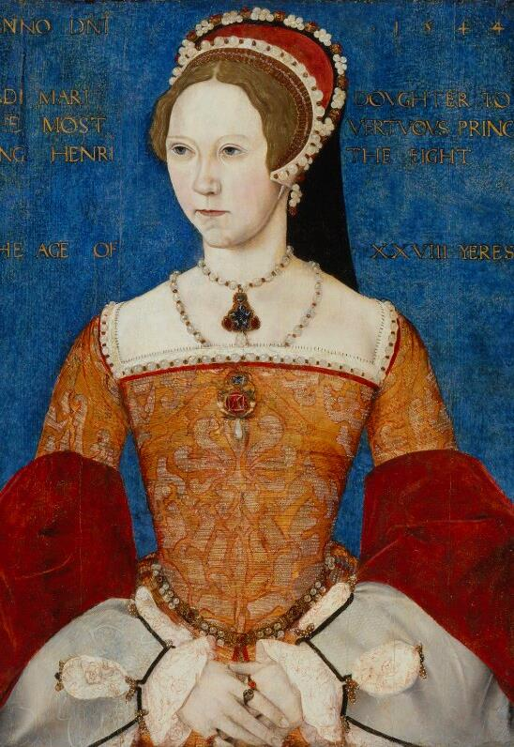
MARY I
The first female monarch to rule England in her own right
Mary had a loyal army and many supporters which was a huge threat. Jane was queen for only nine days before the plans were changed and Mary became queen instead. Lady Jane Grey was executed.
Mary wanted to restore the Catholic faith in England.
Brought back Roman Catholic bishops.
Executed Protestants who refused to change religion.
Around 300 Protestants were burnt as heretics.
She wanted to have children so there would be a Catholic heir. In 1554, she married Catholic Philip of Spain, but this was a very unpopular decision and led to Protestant rebellions.
When she died, she had no children. She was forced to agree that her half-sister Elizabeth would be the next queen.
Mary was the daughter of Henry VIII and his first wife, Katherine of Aragon. She was well-educated and brought up a devout Catholic.
She was declared illegitimate when her father remarried in 1533. This meant she was no longer called Princess Mary but Lady Mary.
Banned from seeing her mother.
Remained a loyal Roman Catholic.
Refused to recognise her father as the Head of the Church of England.
Despite this, Henry VIII included Mary in his will. He ordered that she would be second in line to be the next ruler. When Edward became king, he banned many Catholic traditions. When he died a few years later Mary did not agree that Lady Jane Grey should be the next queen.
Q:
Look closely at the portrait. What date was it painted? Hint: look at the corners.
When she was two years old, plans were made for her to marry the French heir.
She thought she was pregnant twice, but these were false alarms.
© National Portrait Gallery, London
Q:
What was Mary’s title at this time and how old was she?
Reigned: 1553 - 1558
Q:
After her death, she became known as ‘Bloody Mary’. Do you think this is a fair nickname?
Lived: 1516 - 1558 | Birthplace: London
Notes:
Mary I notes:
The date 1544 is written in the top right-hand corner of the portrait.
Mary’s title at the time of the painting was Lady Mary. She was twenty-eight years old. (There is evidence for both in the biography and on the painting.)
Students might say that it is because of the number of people she burnt at the stake. Others might argue that, although her persecution of Protestants is shocking by today’s standards, other monarchs in the 1500s also tortured and executed people. There is evidence that, in other ways, she was a good queen.

Slide 7
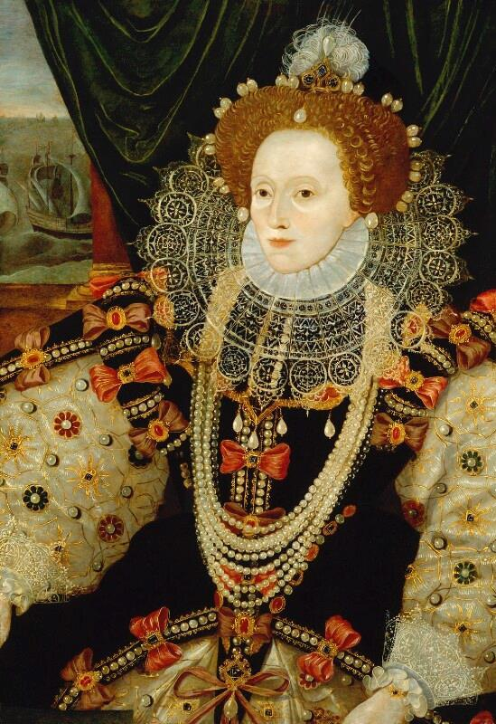
ELIZABETH I
Last and longest reigning Tudor monarch – a queen who ruled alone
Elizabeth was the daughter of Henry VIII and his second wife, Anne Boleyn. When she was three, her mother was executed for treason. Elizabeth was well-educated by Protestant tutors.
After her half-brother Edward died, Elizabeth supported Mary becoming queen. However, this changed as Mary tried to return the country to the Catholic faith. Elizabeth was accused of plotting against Mary and in 1554, she was briefly imprisoned in the Tower of London. Mary thought Elizabeth was involved in a Protestant Rebellion.
When Mary died, Elizabeth became queen at age 25. She had a magnificent procession from the Tower of London to celebrate.
She wanted to find a religious compromise and heal tension in England. In 1559, the Elizabethan Religious Settlement began which aimed to end religious struggles between Catholics and Protestants.
Carefully chose chief ministers and inspired loyalty.
Supported explorers and adventurers such as Francis Drake and Walter Raleigh.
Led to expansion of trade routes and first English colony in America.
Refused to get married and lose or share her power.
In 1588, King Philip of Spain planned an invasion of England and launched the Spanish Armada. This was a mighty fleet of 150 ships. The Armada was defeated by Elizabeth’s much smaller English navy, and this was celebrated as a great victory. She died without an heir and is buried in Westminster Abbey.
Fluent in several languages including Latin, French, Spanish and Italian.
Q:
What clues are there that this portrait was painted to celebrate the defeat of the Spanish Armada?
Some wore her mother’s necklace under her clothes.
© National Portrait Gallery, London
Reigned: 1558 - 1603
Lived: 1533 - 1603 | Birthplace: London
Q:
How is Elizabeth portrayed?
Notes:
Elizabeth I notes:
In the portrait, we can see scenes from the defeat of the Spanish Armada on the wall behind the Queen. This suggests it was painted to celebrate the defeat of the Spanish Armada. (English fireships setting out on the left, and Spanish ships being wrecked in storms on the right.) Also, Elizabeth’s hand rests on a globe, perhaps representing England’s command of the seas.
In the portrait, only Elizabeth’s face and hands are visible. Her body is encased in her magnificent dress and enormous ruff. She wears several pearl necklaces and many more are sewn onto her clothing. (Pearls were a symbol of purity). Some may suggest she appears more as a symbol of power and majesty, rather than as a real woman.

Slide 8
TEMPLATE WORKSHEET
_____________
_____________
_____________
_____________
Image credit:
Image credit:
Lived: _______
Lived: _______
Birthplace: _______
Birthplace: _______
Q:
Q:

Slide 9
VOCABULARY LIST
alliance | agreement between people or countries to help each other
bishop | important and powerful member of the Christian church
Catholic | member of the Roman Catholic Church. A type of Christianity that follows the teachings of the Pope
Church of England | the Christian church in England based on the Protestant faith, established by King Henry VIII, with the king or queen as its head
colony | group of people from one country who build a settlement in another land
council | group of people who advise the king or queen and help make decisions
divorce | the legal ending of a marriage
dynasty | series of leaders from the same family
emblem | picture of an object used to represent something else, such as membership of a group or an idea
English Reformation | name given to ending the Pope's control of the English Church and the religious changes that followed
Elizabethan Religious Settlement | laws passed by Parliament in 1559 which made the Church of England the country’s official religion
government | group of people that have the authority to rule a country
heir person who will become the next king or queen
heretic | someone who holds opinions or beliefs opposite to accepted Christian teaching at the time
imposter | person who pretends to be someone else

Slide 10
VOCABULARY LIST 2
VOCABULARY LIST
illegitimate | child whose parents were not legally married to each other when they were born
invalid | not legal
jousting | sport developed in the Middle Ages as training for soldiers who fought on horseback
Lancaster | one side of the Plantagenet royal family who fought in the Wars of the Roses; their emblem was the Red Rose
Lord Protector | title used by someone in charge of a country, when the king or queen is unable to rule (if they are unwell or a child, for example)
martyr | person who chooses to die rather than give up their religious beliefs
masque | show with music, poetry and dancing, and fantastic sets and costumes
merchant | person who buys and sells things in large amounts
minister | someone with a lot of power and responsibility in government
monarch | ruler of a kingdom or empire, such as a king or queen
monarchy | system of government with a king or queen as its head
monastery | building or buildings where religious communities of men called monks live and worship
navy | ships built and maintained to defend a country
nobles | people of high rank in society
Parliament | the group of people elected to make and change laws in a country; in the past only very rich and powerful people were Members of Parliament
Plantagenet | royal family who ruled England from 1154 to 1485

Slide 11
VOCABULARY LIST 3
VOCABULARY LIST
playwright | someone who writes (‘makes’) plays
plot/plotting | secretly plan to harm someone, especially a government or ruler
Pope | the head of the Roman Catholic Church
power struggle | a fight for control between two or more people or groups
procession | a number of people (sometimes on horses) moving in an orderly fashion
Protestant | A type of Christianity that believes people do not need officials (such as the Pope or Bishops) to communicate with God
rebellion | a fight by a large group of people against the government or ruler
Roman Catholic Church | Christian religion with the Pope as its head
Supreme Head | the highest in rank
treason | the crime of acting against your own country, especially by trying to kill the king or queen, or overthrow the government
treasury | place or building where money is stored
tuberculosis | infectious disease that affects the lungs
uprisings | protests against the government or ruler by people who are angry and want change; usually in one part of the country and often violent
Yeoman of the Guard | the king or queen’s bodyguards, set up by Henry VII in 1485
Wars of the Roses | name given to battles fought in England between 1455 and 1485 between members and supporters of two different sides of the Plantagenet family
wealth | a large amount of money, property, land and valuable possessions

Slide 12
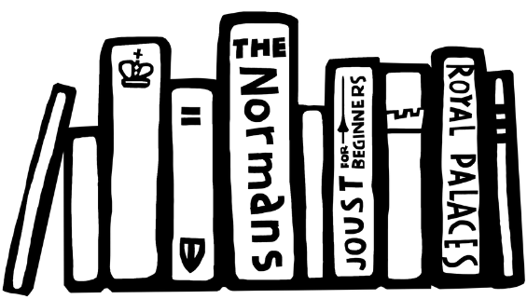
VOCABULARY LIST 4
VOCABULARY LIST
widow | woman whose husband has died
York | one side of the Plantagenet royal family who fought in the Wars of the Roses; their emblem was the White Rose

