Slide 1
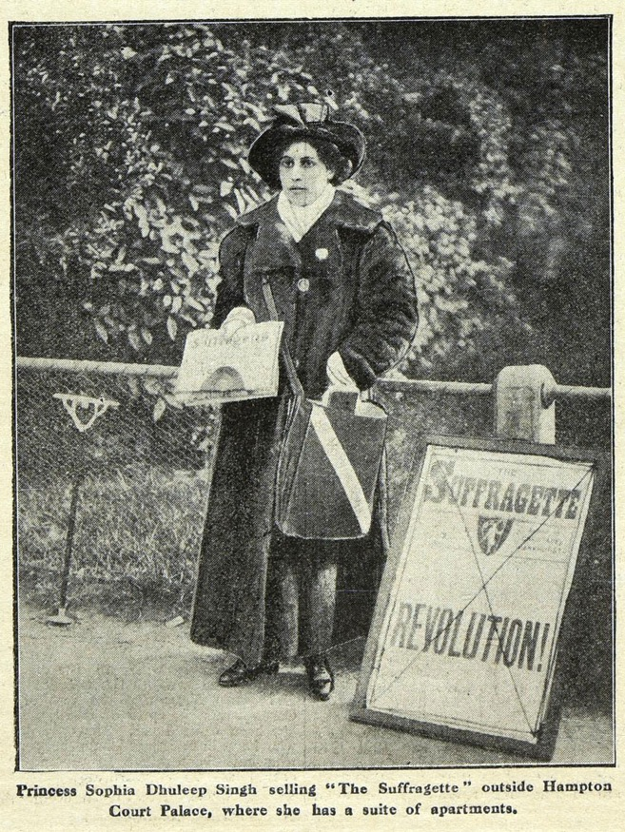
Princess Sophia Duleep Singh – source task
Princess Sophia Duleep Singh
– Source Task –
Notes:
Image credit:
The National Archives

Slide 2
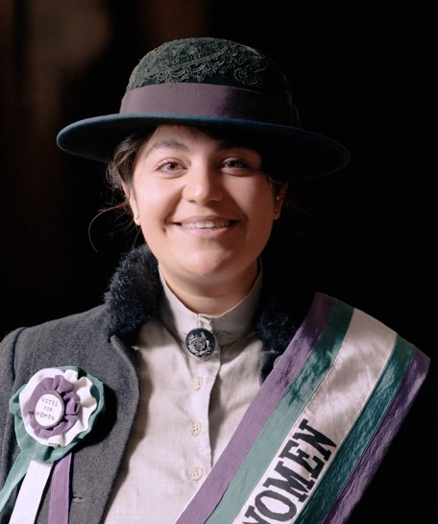
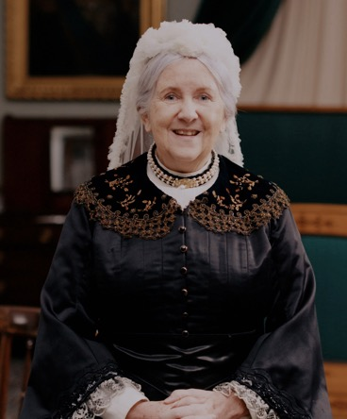
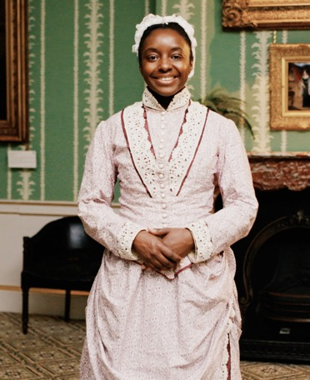
Have you watched me tell my story?
Have you watched me tell my story?
Queen Victoria
Ina Sarah Forbes Bonetta
Princess Sophia Duleep Singh
Notes:
Watch the videos: https://youtube.com/playlist?list=PLmQztN3936tL1ZgIHlfwlsKaRAqEDNQf1&feature=shared

Slide 3
Vocabulary
history | Learning about people, places and events from a long time ago to understand what life was like in the past.
source | Items from the past that help us learn about what happened. These might be portraits or documents.
evidence | Clues that help us understand and explain what life was like in the past.
portrait | A picture or artwork of a person. It can be a painting, a photograph or even a sculpture.
monarch | A king or queen who leads a country and makes important decisions.
empire | A group of countries that were ruled over by one monarch or another country.
suffragette | A woman who campaigned for the right to vote in elections. Suffragettes often broke the law to draw attention to their cause.
god-daughter | A child who has godparents. A godparent is a special adult chosen to guide and support a child as they grow up, especially in their faith.
Notes:
Teacher notes:
These terms are useful in the context of the video of this source task and the original video. It would be useful for children to be aware of them however you do not need to memorise or discuss all of them on this slide.

Slide 4
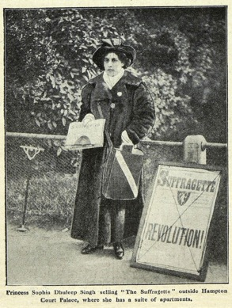
When did Sophia live?
When did
Sophia live?
Sophia was born
over 100 years ago!
VICTORIAN PERIOD
Queen Victoria’s life
Sophia’s life
Further into the past
Now
Notes:
Teacher notes:
The purpose of this slide is for children to understand that this period of history is a long time in the past which is why life is so different to what they know.
Ask children to find 'now'. Explain this is where we are today.
Move finger back to the end of the bright blue section. This is how far the oldest people alive today can remember. The Victorians are further in the past than that.
Say the word Victorian and explain this was a time of great change in Great Britain.

Slide 5
Do you remember this source?
Do you
remember
this source?
Notes:
About this source:
This is a newspaper article from a newspaper called the Suffragette, printed around 1910. This was a newspaper made by the Women’s Social and Political Union (known as the Suffragettes) as part of their campaign for women to be given the right to vote.
It shows Sophia selling copies of the same newspaper (the Suffragette) outside Hampton Court Palace, where she lived.
Sophia was often featured in other newspapers too. She was featured in the Hackney Express and Shoreditch Observer (a local London newspaper) about the fact that she had been spotting riding a bicycle in public. She was also featured in other newspapers regarding barefooted protests, being summoned to court and having to pay fines.
Learn more about this source with the National Archives
Sophia Duleep Singh - The National Archives

Slide 6
How does this source help tell Sophia’s story?
How does this
source help tell
Sophia’s story?
Notes:
Task:
Ask the students to look closely at this source.
Questions to ask:
Why might there be a sign next to Sophia?
This is to advertise that she is selling the newspaper and Revolution! may be the headline.
What might be in her bag?
She would carry extra copies of the newspaper to sell to people.
Why did she sell newspapers?
To tell as many people as possible about the Suffragette's fight for equality.
Theme to explore:
Sophia’s father was Maharaja Duleep Singh. He was the last Sikh Maharaja of the Punjab. When he was 10 years old, he was forced by the British to surrender his lands and the Koh-i-Noor diamond.
The British had very harsh rules, there was lots of violence and suffering. Seeing this during her visit to India made Sophia determined to use her influence to help other people.
During this period, in Britain women and men were treated very differently. Women were not allowed to vote. The Suffragettes protested to try and get women the right to vote. Sophia and many others went to a protest in November 1910 where they marched to Parliament to protest. She and many other Suffragettes were arrested.

Slide 7
Look closer
Look closer at this source…
Do you think Sophia looks
like a Princess?
What words would you use to describe Princess Sophia?
Princesses do not necessarily look like how they do in fairy tales!
Sophia did enjoy fancy dresses. But to her being a princess was much more than that.
Powerful
Kind
Serious
Notes:
Teacher notes:
Ask the students to look closely at this source.
Use the source as evidence to answer the questions on the slide.

Slide 8
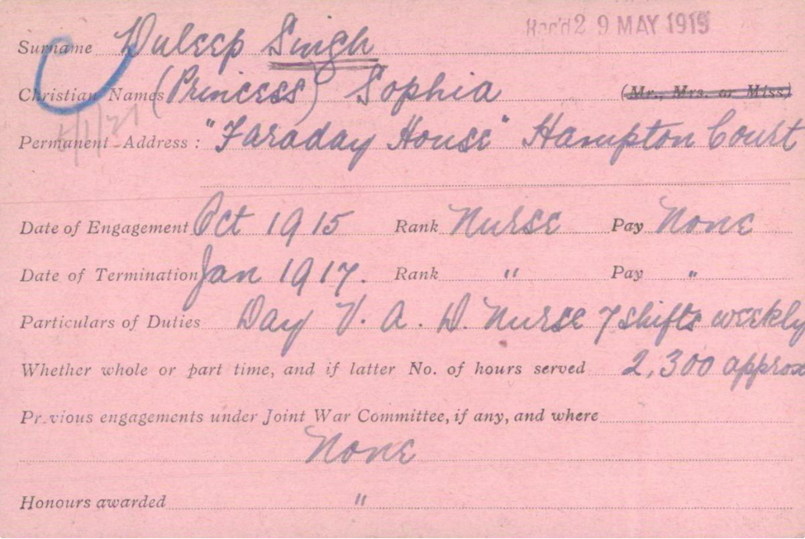
Other sources
Other
sources
about
Sophia
Notes:
Teacher notes:
During the first world war, the Suffragettes stopped their campaign. Many women volunteered to do jobs that men had done before the war began.
Sophia joined the British Red Cross and was in a Voluntary Aid Detachment. She worked as a nurse and helped to treat sick and wounded soldiers at Isleworth Auxiliary Hospital in Middlesex. While volunteering there, she would take photos with her patients and even gave some of them gifts.
This source shows how many hours Sophia spent volunteering as a nurse.
Learn more about this source with the British Red Cross
VAD service card of Princess Sophia Duleep Singh | British Red Cross
Image credit:
British Red Cross Museum and Archives

