Slide 1
The Tower Remembers

Slide 2
THE TOWER REMEMBERS: AN EXPLORATION

Slide 3
TODAY WE WILL:
Find out more about life at the Tower of London during the Second World War
–
Reflect on the impact of the Second World War on your community
–
Explore why and how we commemorate and remember significant moments from the past today
Notes:
The Tower of London served many roles during the Second World War. As a historic military fortress, it guarded prisoners of war, supported anti-aircraft defences and gave tours for visiting soldiers.
Today we are exploring what life at the Tower of London was like during the Second World War and how it acts as a place of remembrance and reflection today.

Slide 4
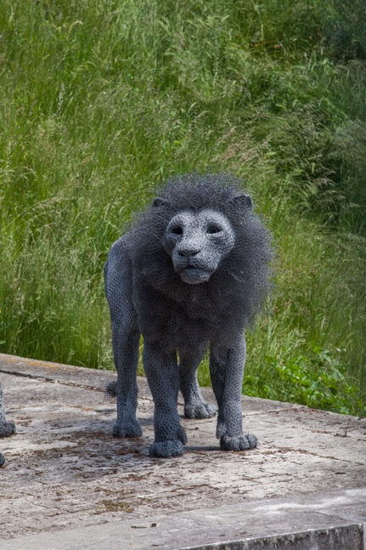
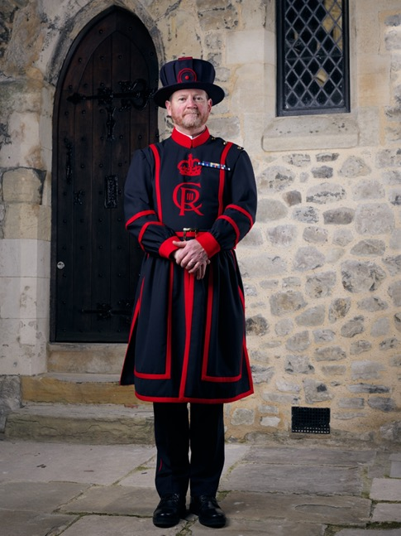
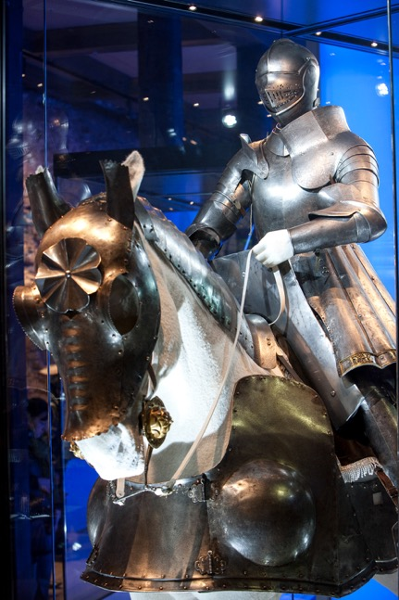
What is the Tower of London?
© Historic Royal Palaces
© Historic Royal Palaces
© Historic Royal Palaces
Notes:
- What is the Tower of London?
The Tower of London has been:
A Home: Yeoman Warders and their families (and pets) live here today. People in the past lived here too, as they did their jobs in the mint, menagerie, prison, armoury, records office, etc
A Menagerie/zoo: The royal menagerie had its roots in gift-giving between monarchs. The animals were later relocated to Regents Park with the formation of London Zoo.
Prison: Many different rooms and areas within the Tower have been used as prison accommodation.
Palace: The Tower of London was built with nice accommodation in the White Tower, and medieval palace area for medieval kings and their courts
Mint: The majority of the coins of the realm were made here at the Tower of London for over 500 years. The Tower was a suitable mint because it was a secure area for gold and silver.
Armoury: The Tower was a factory for making armour and ordnance (weapons such as cannon- many of which can be seen around the Tower). They were made here because the Tower was a secure location. The Royal Armouries are still based here (and in Leeds) today. The roots of the Tower as a military garrison are reflected in it still being the home of the Royal Fusiliers Regiment.
Record office: The Tower once functioned as the storehouse of all the main administrative records in the country. From legal and financial documents and legal documents which formed the basis of English law.
Tourist site: The Tower gets over 2.5 million visitors a year.

Slide 5
LIFE AT THE TOWER
Notes:
After the end of the First World War, the Tower of London continued its role as a tourist attraction. Maintaining its military traditions and royal ceremonies, diplomatic visits from around the world took centre stage. But in autumn 1939, tensions loomed, and the prospect of another war became inevitable.
By 3 September 1939, Britain declared war against Germany, marking the beginning of the nation’s involvement in the Second World War. At the outbreak, the Tower of London closed to the public.

Slide 6
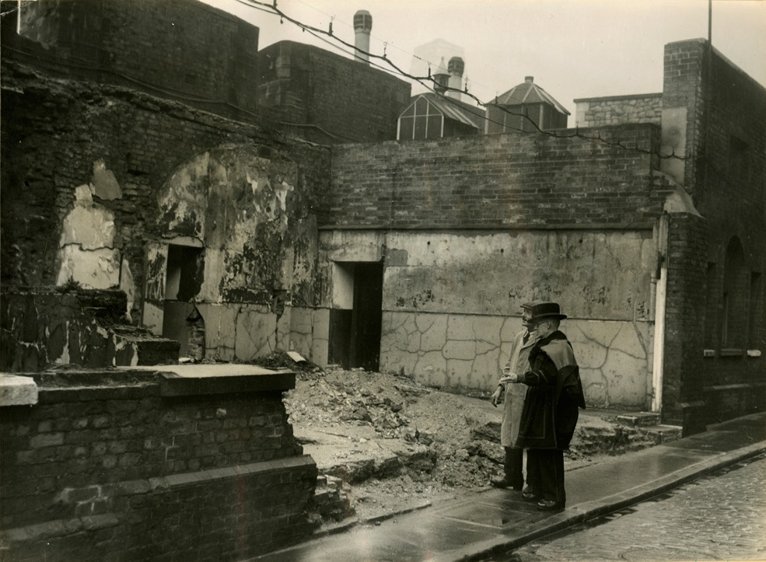
Tower residents
© Historic Royal Palaces/Yeoman Warder Archive
Notes:
The Yeoman Warders have been guarding the Tower of London since the time of King Henry VIII. During the Second World War the Yeoman Warders and their families were living at the Tower of London. Tower residents were issued with gas masks and steel helmets and prepared themselves for regular blackout drills. No shelters were dug at the Tower, though some basements were reinforced and used as refuge during air raids. On 10 October, the Yeoman Warders were advised to evacuate their families to the countryside. The Tower continued to face aerial bombardment until the end of the Blitz in May 1941.
During the Second World War, London was heavily bombed, especially the East End, where the Tower of London is. The East End was home to the docks, which were important for delivering supplies to the rest of the country. If the docks were destroyed, it would hurt both the economy and Britain’s ability to fight the war.
The East End was also a very crowded place, with lots of people living in small, packed buildings near their jobs. Many worked in factories, warehouses, or on the docks. When bombs hit factories, they didn’t just stop production—they also destroyed homes and small businesses, making life even harder for people. Between October 7, 1940, and June 6, 1941, a total of 1,259 bombs were dropped on Tower Hamlets.
This image shows Yeoman Warder Iliffe and Mr Stanton from the Ministry of works surveying bomb damage to 3 and 4 casemates inside the tower. The casemates are where the Yeoman warders live. The Tower community lost several members to the London Blitz, including Yeoman Warder Samuel Reeves and resident Lily Frances Lunn. They died during an air raid on 5 October 1940.
What do you think it would have been like to live inside the Tower of London during the Second World War?
What was it like for people living in your local community during the Second World War?

Slide 7
Savings group
© Historic Royal Palaces/Yeoman Warder Archive
Notes:
The Yeoman Warders' Savings Group was a wartime savings initiative started in April 1940 to encourage the Yeoman Warders and their families living at the Tower of London to contribute to the war effort by saving money. This was part of a broader national campaign in Britain to promote financial responsibility and raise funds to support the war.
During World War II, the British government encouraged people to save money through War Savings Certificates and National Savings schemes. These schemes helped fund the war effort by providing the government with money to produce weapons, equipment, and supplies. Many workplaces, schools, and communities formed their own savings groups, and the Yeoman Warders at the Tower of London were no exception.
By participating in the savings group, the Warders and their families not only secured their own finances during uncertain times but also contributed directly to Britain's ability to continue fighting in the war. It was a way for civilians, even those living within the historic walls of the Tower, to play an active role in the national effort.
- Can you think of a time your school or community has worked together to help others, like the Yeoman Warders’ Savings Group did during the war?

Slide 8
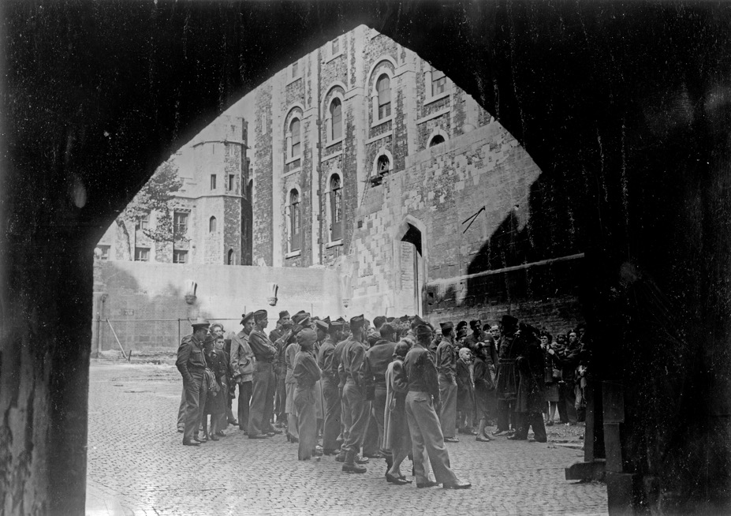
Soldiers in the
White Tower
© Historic Royal Palaces
Notes:
At the outbreak, the Tower of London closed to the public and remained as a military base and home to the Yeoman Warders.
Troops created a sports room and concert hall in the White Tower with a canteen and library on the ground floor and an air raid shelter in the basement. The famous execution block and axe were put on display for soldiers, while the Tower Armouries gave lectures and tours.
Tours of the Tower were later offered to Dominion troops, as well as British forces and their allies.
- If you had to turn a historic building into a safe and fun place for people during a difficult time, what things would you include?

Slide 9
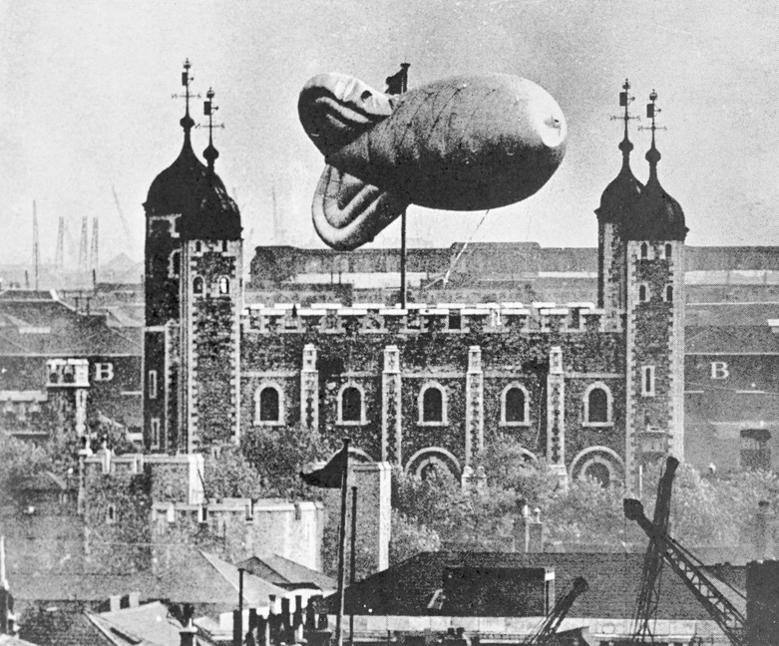
Women’s auxiliary Air Force
Heritage Image Partnership Ltd/Alamy Stock Photo
Notes:
During the Second World War, the Tower of London played a significant role in London's air defence strategy by hosting barrage balloons in its moat. These large balloons were tethered to the ground with steel cables and were designed to deter and obstruct enemy aircraft, particularly low-flying dive bombers, by forcing them to fly at higher altitudes, reducing their bombing accuracy. In 1940, a barrage balloon was prominently positioned in the Tower's western moat as part of this defensive measure. ​
In 1942-43 the operation and maintenance of these barrage balloons were entrusted to the Women's Auxiliary Air Force (WAAF), established in 1939. The WAAF was integral to the Royal Air Force's efforts, with members taking on various roles, including managing barrage balloons. These women were responsible for the deployment, maintenance, and operation of the balloons, tasks that demanded significant physical effort and technical skill.
- The women of the WAAF had to be strong and skilled to manage the barrage balloons. What other roles do you think women took on during the war, and why were they needed?

Slide 10
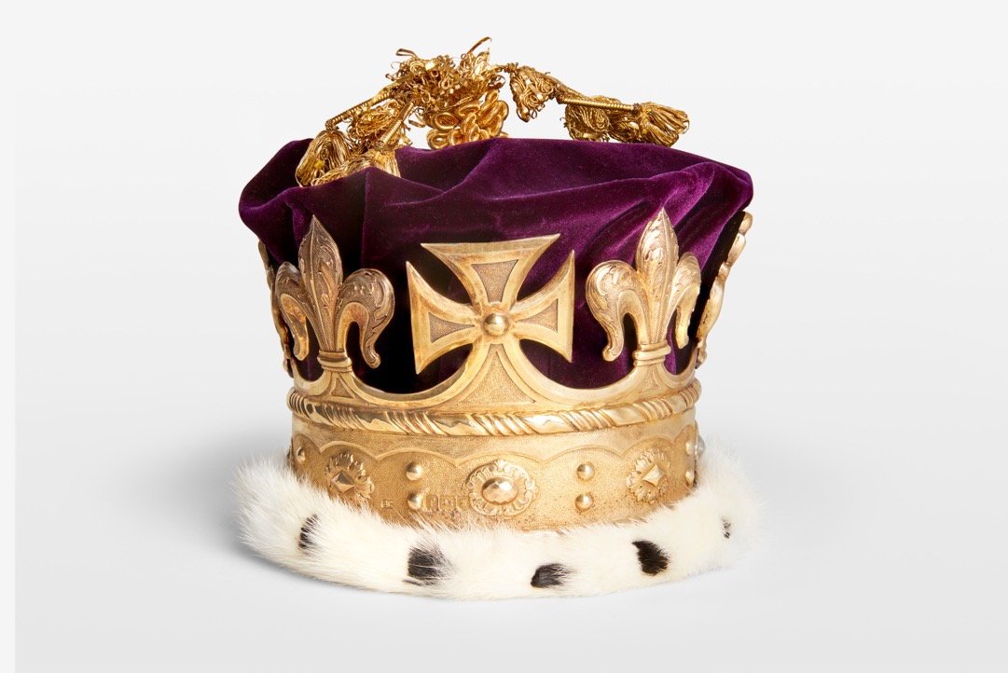
The Crown Jewels
© Historic Royal Palaces
Notes:
This images shows a coronet associated with the Princess Louise for the Coronation of Edward VII in 1902. The Crown Jewels have been stored and displayed at the Tower of London since 1661, continuing a long tradition of storing precious objects here. This collection of 23,578 gemstones is part of the Royal Collection and boasts items that are still used in royal ceremonies today.
The Crown Jewels are guarded by armed guards in the Jewel House at the Tower of London.
During the Second World War, the Crown Jewels were removed from the Tower. At the time, their location remained a mystery to the public, but it has since been revealed the Regalia was secretly hidden away at Windsor Castle.
Other important objects, such as Henry VIII’s armour were also removed from the Tower of London during the Second World War.
- During the war, people had to find safe places to protect important objects. What objects would you protect?

Slide 11
The Ravens
Notes:
It is said that the kingdom and the Tower of London will fall if the six resident ravens ever leave the fortress. Charles II is thought to be the first to insist that
the ravens be protected. His order was allegedly given against the wishes of his astronomer John Flamsteed, who complained the ravens impeded the business of his observatory in the White Tower.
The Blitz was a difficult time for the Tower's ravens. All but three died from either bombing or stress and two more died shortly after the war. The last two ravens Mabel and Gripp disappeared in 1946. However, two new ravens named Cora and Corax were quickly instated inside the fortress a few days later - ready to protect the fortress from harm.
Here you can see a film about the ravens made in 1952, highlighting their importance

Slide 12
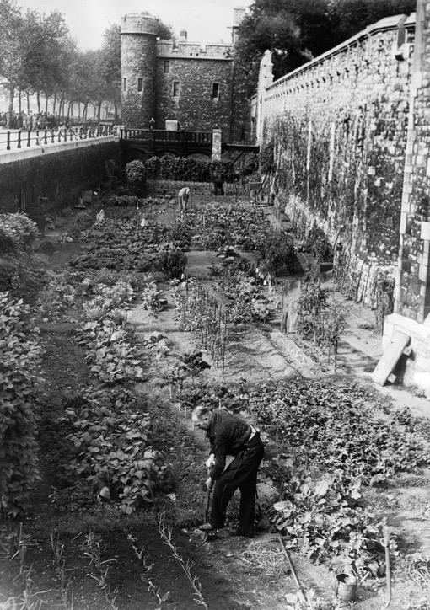
Digging for Victory
© Historic Royal Palaces/Yeoman Warder Archive
Notes:
The government introduced a campaign calling for the public to turn green spaces into allotments. Lawns, flower beds, sports pitches, gardens, and parks were transformed into vegetable patches, as The Ministry of Agriculture urged the British people to ‘Dig for Victory!’
Everyone was expected to 'do his or her bit' to help the war effort, as food and other essentials were limited. The Tower of London was no exception. The Tower joined the East End in following the government’s advice to grow vegetables. The Tower Moat became an allotment where residents, including Yeoman Warders, planted crops.
The Moat had been used to grow vegetables and graze livestock before, as early as the 1890s.
If you had to turn a space in your local community into a vegetable garden, where would you choose and why?
Teachers Note:
What was the impact of the Second World War on your local community? You might like to add some slides in that show:
The physical impact of the war on your local area
Community actions during the war such as Digging for Victory or the Savings Group
Different roles that members of your community took on because of the Second World War

Slide 13
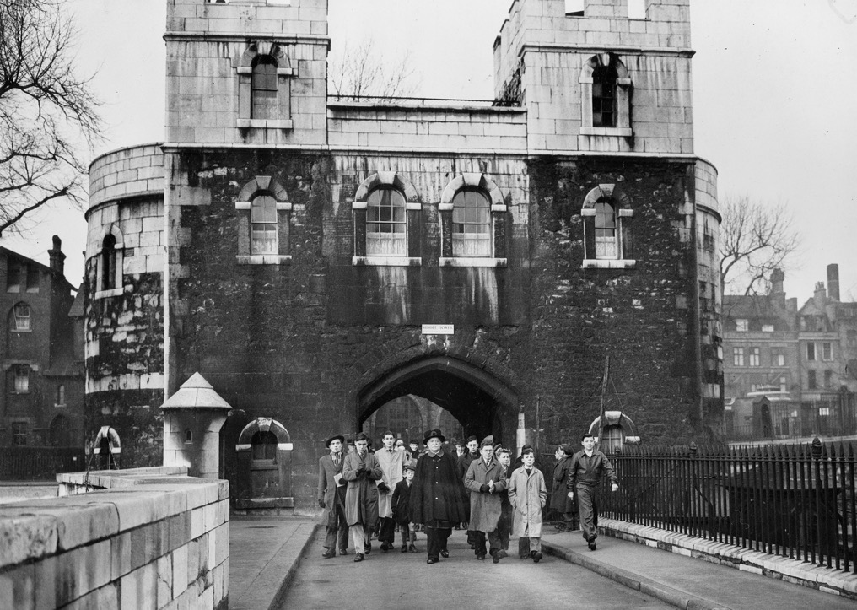
The Tower re-opens
© Historic Royal Palaces/Yeoman Warder Archive
Notes:
The Tower re-opened to tourists in 1946, although the bomb damage from the Blitz was highly visible and yet to be cleared.
The Tower had carried on supporting the war effort throughout the Second World War.
Today, the legacy of war and its effect on the Tower and its communities is remembered in a pair of Commonwealth War Graves Commission memorials on Tower Hill.
The memorials commemorate the First World War (built in 1928) and the Second World War (created in 1955), honouring civilian and merchant seafarers who were killed during the war and have no known grave. The memorials were devised by Edwin Lutyens, the architect responsible for designing The Cenotaph in Whitehall.
- What is the lasting legacy of the Second World War on your community?

Slide 14
A PALACE FOR REMEMBRANCE
Notes:
At The Tower of London we share and remember our past through:​
Exhibitions​
Warders Tours​
Events and ceremonies such as the Ceremony of the Keys which has been happening for 100’s of years​
Through our restoration and preservation work which helps us understand how the tower looked at different times​
Through commemorative moments that invite us to pause and remember​

Slide 15
WHAT IS REMEMBRANCE?
Notes:
- What is Remembrance?
Remembrance is about thinking back on important events or people, even if they're no longer around. It helps us honour those moments and understand how they shaped the world. For example, people might remember events like the end of a war, taking time to think about their importance and what we can learn from them.
Today the Tower of London is a place you can visit today where history has happened. ​By highlighting stories from the past at The Tower of London we:​
keep history alive​
ensure that we can remember and learn from the past ​
help people understand their roots​
can honour people from the past and recognise the impact they’ve had on our lives today​
Build connections - Learning about history helps us connect with others, whether it's understanding how different countries shaped the world or sharing stories from our own families. It brings us together to appreciate the diversity and shared experiences of humanity.​
The Tower is visited by thousands of people every year and has created moments for people to collectively remember and reflect.

Slide 16
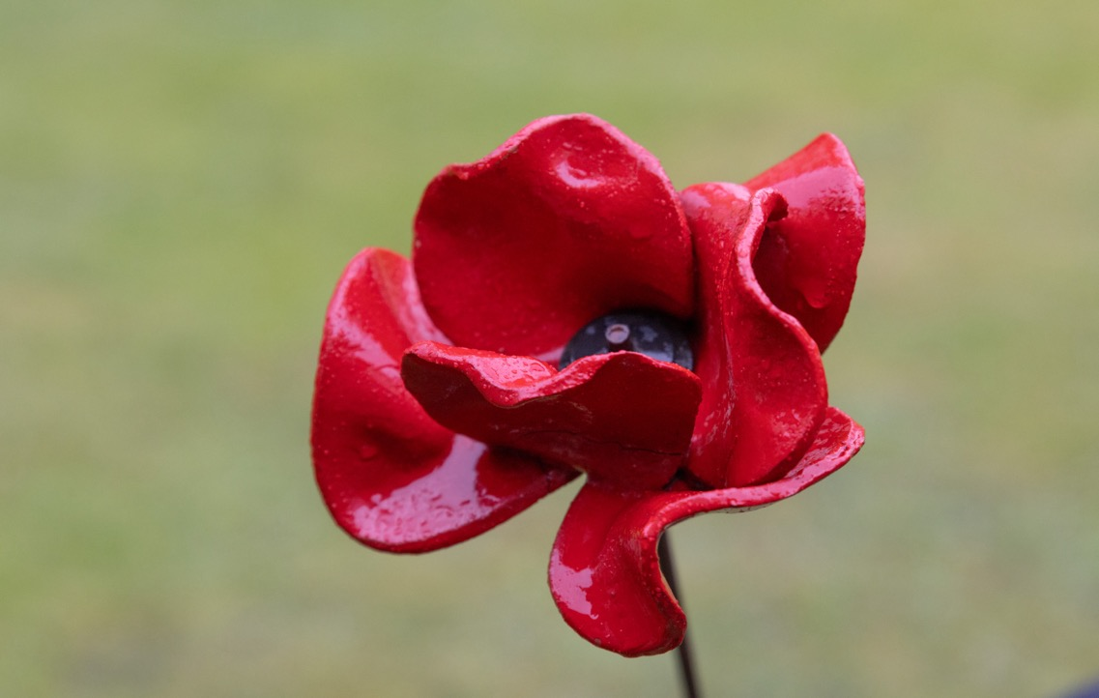
The Poppy
© Historic Royal Palaces/Imperial War Museums
Notes:
Poppies became a symbol of remembrance after the First World War. The idea came from a poem called "In Flanders Fields," written by Lieutenant Colonel John McCrae, a Canadian doctor. He wrote about how red poppies grew among the graves of soldiers in Flanders, a region in Belgium where many battles took place. In 1921, an organisation called the Royal British Legion started selling poppies to raise money for war veterans, and it soon became a symbol of remembering those who died in the war.​
Some people choose to wear white poppies to remember all victims of war from all nationalities. White poppies symbolise a commitment to peace and to finding non-violent solutions to conflicts.

Slide 17
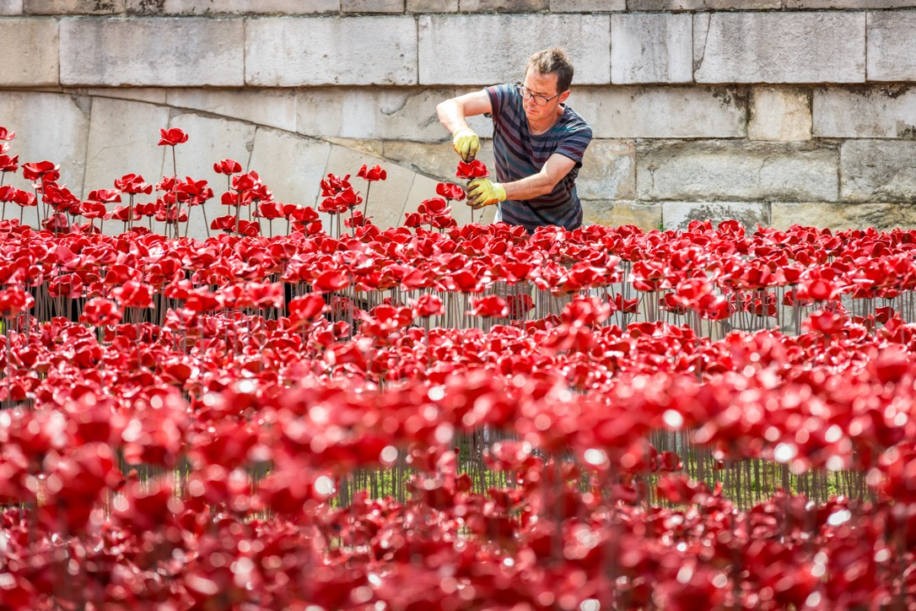
Tom Piper
© Historic Royal Palaces
Notes:
Tom Piper was Associate Designer for the Royal Shakespeare Company from 2004 to 2014, for whom he has designed over 50 productions, including the award-winning Histories Cycle with director Michael Boyd. He has had an extensive national and international freelance career in theatre, exhibition and installation design.
Tom Piper has worked with artist Paul Cummings to create several large scale installations an displays that provide opportunities for visitors to the Tower of London to collectively reflect and remember.

Slide 18
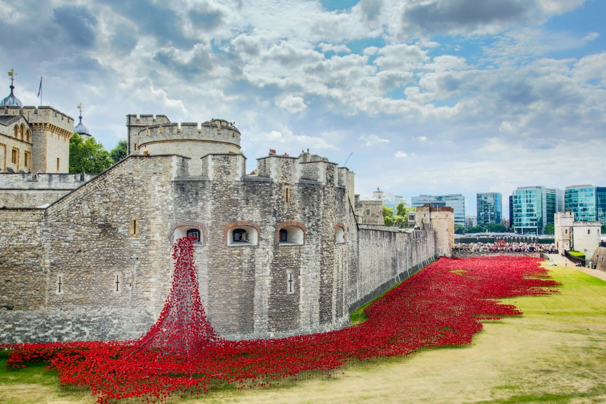
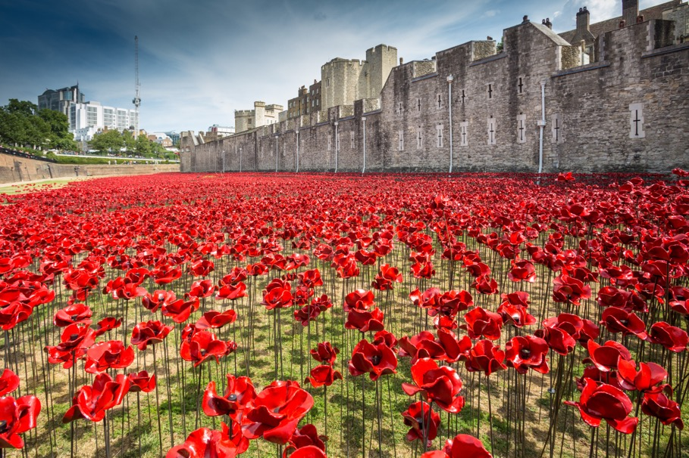
Blood swept lands and seas of red
© Historic Royal Palaces
© Historic Royal Palaces
Notes:
In 2014 ‘Blood Swept Lands and Seas of Red’ marked one hundred years since the first full day of Britain's involvement in the First World War. Created by artists Paul Cummins and Tom Piper, 888,246 ceramic poppies progressively filled the Tower's famous moat between July and November 2014. Each poppy represented a British military fatality.
The scale of the installation was intended to reflect the magnitude of both the centenary and the military lives lost.
21,688 people volunteered to install the poppies. The act of installing the poppies, as well as visiting the installation, provided moments of reflection.
- How does this art work make you feel?

Slide 19
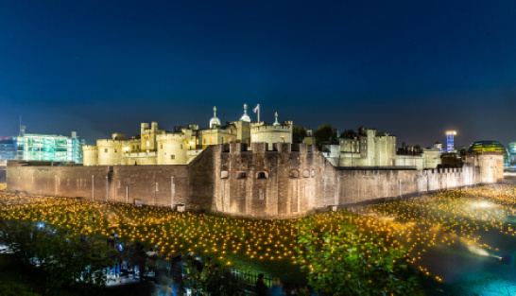
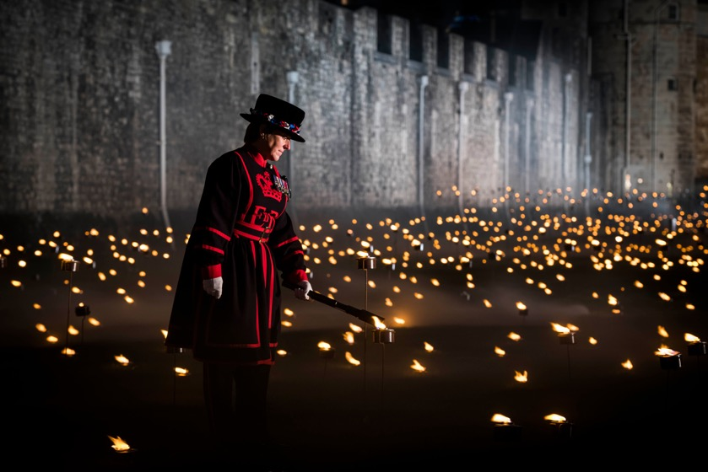
Beyond the Deepening Shadow
© Historic Royal Palaces
© Historic Royal Palaces
Notes:
In November 2018, thousands of flames were lit in the moat of the Tower of London to mark the centenary of the end of the First World War. This new installation, created by Designer Tom Piper and Sound Artist Mira Calix, saw the moat lit with thousands of individual flames.
Each night a Yeoman Warder, all ex-service people, lit the first flame and over the course of several hours volunteers lit the rest of the installation, gradually creating a circle of light, radiating from the Tower as a powerful symbol of remembrance.
Members of the public were invited to the Tower of London to see the installation evolve each night, and to join in a public act of commemoration.
How do you think lighting a candle or watching a fire helps us remember special people or events?
Where else do we use fire or candles to help us remember things?

Slide 20
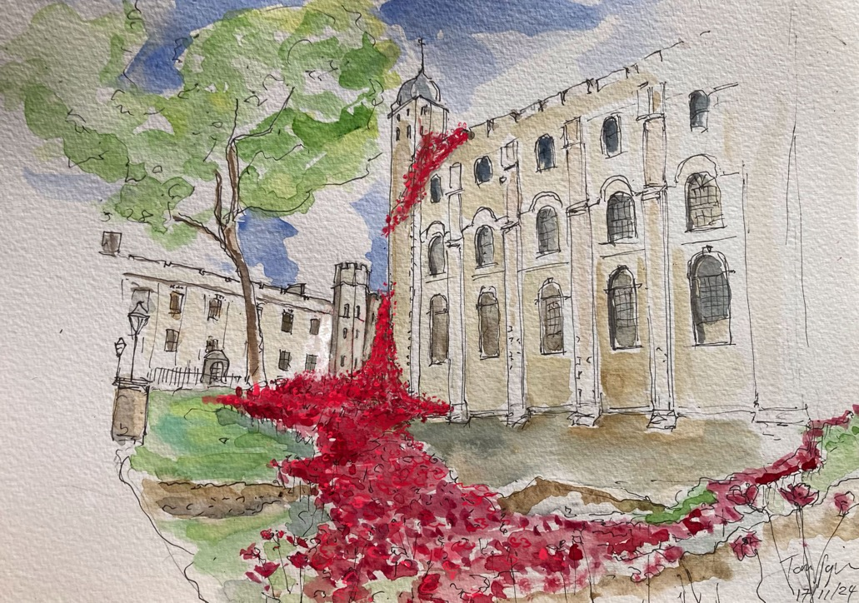
The Tower Remembers
© Tom Piper Design
Notes:
In 2025 30,000 of the original poppies, made for the 2014 installation, ‘Blood Swept Lands and Seas of Red’, returned to the Tower for the 80th anniversary of the Second World War, marking the sacrifices made by so many in our communities.
The poppies flow from the White Tower and pour across the lawn.
The poppies are on loan from Imperial War Museums and were designed and made by the artist, Paul Cummins. The new display has been created by the designer, Tom Piper.
What is significant about the 80th anniversary of the end of the Second World War?
It is the last significant anniversary where veterans and community members who were alive during the Second World War will be present
Teachers Note:
Here you might like to insert a slide with a picture of an event, monument, installation, memorial, road name or plaque near your school

Slide 21
HOW ELSE CAN WE REMEMBER SIGNIFICANT EVENTS?
Notes:
Reflection and remembrance can be personal and private or collective as you’ve seen the large scale displays at the Tower of London.
How else can we remember significant events?
Teachers Note:
Here you might like to insert a slide with other examples of creative remembrance such as poetry, art works and memorials

Slide 22
HOW DO YOU LIKE TO REMEMBER IMPORTANT MOMENTS?
Notes:
Reflection and remembrance can be personal and private or collective as you’ve seen with the large-scale displays at the Tower of London.
How else can we remember important moments?
Teachers Note:
Here you might like to insert a slide with other examples of creative remembrance such as poetry, art works and memorials

