Slide 1
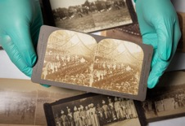
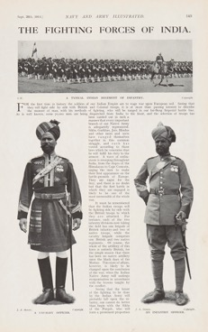
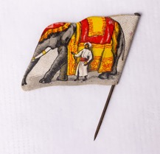
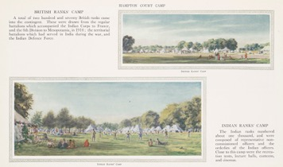
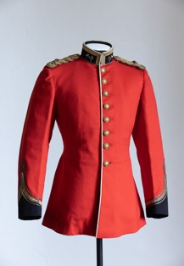
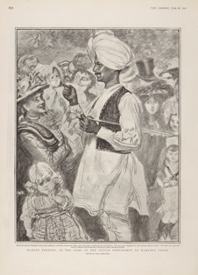
INDIAN SOLDIERS SOURCE BANK
WHAT
STORIES
CAN THESE OBJECTS TELL?
Notes:
This source bank shares objects and stories from the exhibition Indian Soldiers at Hampton Court Palace.
You do not need to visit the exhibition to use this resource.
Read more about this exhibition here: https://www.hrp.org.uk/hampton-court-palace/whats-on/the-indian-army-at-the-palace
Images (from left to right)
Stereoscope slides, 1902, © Historic Royal Palaces
Newspaper – The Fighting Forces of India, 1914 © Historic Royal Palaces
Elephant pin, © Historic Royal Palaces
Souvenir book, 1919, © Historic Royal Palaces
Indian Army officer’s tunic, 1903-22, © Historic Royal Palaces
Magazine – The Graphic, June 1902, © Historic Royal Palaces

Slide 2
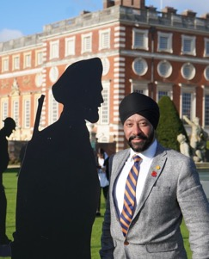
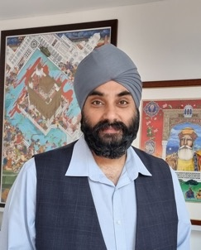
MEET THE TEAM
Hear from some of the team behind the Indian Soldiers at Hampton Court Palace exhibition.
A transcript is available in the notes section below the slide.
Jatinder
Tej
Rav
Notes:
Audio transcript
Speaker: Jatinder
My name is Jatinder, and I am a Community Partnerships Producer. My role on this project was to collect family histories, objects and create events for community groups alongside the exhibition. This is a collection of objects linked to Indian soldiers who visited the UK and Hampton Court Palace during the early 1900s. The story of the Indian Army is often overlooked. Despite the soldier's contribution to the former British Empire and two World Wars they are not often commemorated or taught in schools in the UK. At Historic Royal Palaces we made a public appeal to descendants of Indian soldiers who took part in these historic events. Lots of people contacted us to share their family stories and generously loan personal objects.
Speaker: Tej
Hi, my name is Tej, I am a GP during the day, but I also have a passion for history. My great-grandfather was a Subedar major, which is like equivalent to a major in the British Army. Men in his regiment were part of many regiments that visited Hampton Court Palace. And subsequently, I started collecting items, some of which are at the exhibition.
Speaker: Rav
Hello, I'm Rav Singh. I'm the founder of A Little History of the Sikhs. A Little history of the Sikhs is a community initiative and what we do is we bring history alive in spaces. So we run walking tours, day trips and study visits to all those places in England, London and across Europe that bring Sikh history alive. So, we got an email from the palace in 2021, and it dropped in my inbox and they were looking for some support on an art installation called Standing with Giants. And we were invited to the palace to design a silhouette of a Sikh soldier which would stand in the grounds of Hampton Court Palace and that story evolved and evolved and there was so much to talk about that an exhibition was decided upon and we became community curators for this exhibition.

Slide 3
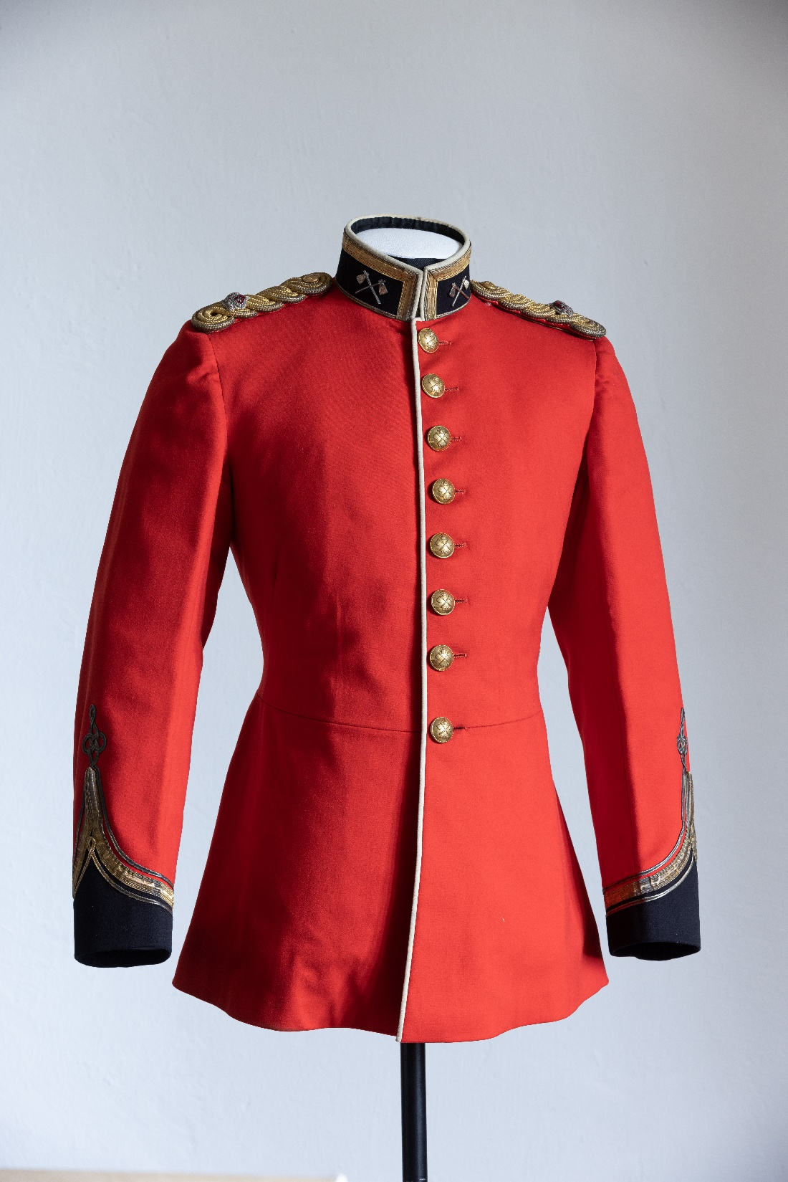
IMAGE SLIDE 1 – INDIAN ARMY OFFICER’S TUNIC
Notes:
Object info
Image: 32nd Sikh Pioneers Indian Army Officer’s tunic, © Historic Royal Palaces
Object owner: Dr Tejpal Singh Ralmill

Slide 4
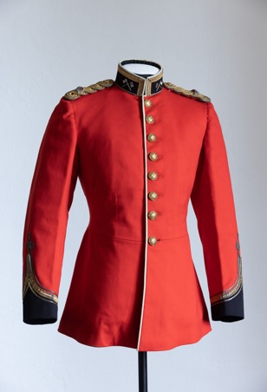
OFFICER’S TUNIC
32nd Sikh Pioneers Indian Army Officer’s tunic, 1903-22
ENQUIRY
BACKGROUND NOTES
WHAT CAN WE LEARN FROM THIS OBJECT?
Q | Describe this jacket. Would it be worn in battle or for parades? Why?
In 1858, the British passed the "Government of India Act”. This meant the British government took control of India. This is known as the British Raj.
The British wanted to protect India’s borders and stop any resistance from Indian people. To do this, they created an Indian Army and hired Indian soldiers.
When World War I began, at first the British didn’t want Indian soldiers to fight alongside British soldiers. But this changed as the British Army and its allies needed more help to fight the large German forces.
As a result, millions of Indian soldiers fought in both World Wars.
This tunic has different symbols which show what type of soldier wore it.
On the collar and buttons, there’s a picture of two crossed axes. This is the symbol of a special group of soldiers called Pioneers.
Pioneers did important work like building roads and fixing railways to help the army. There were several groups of Sikh Pioneer soldiers in the Indian Army.
On the shoulders, there are crown symbols. The crown shows that this soldier was a Major. Majors were in charge of groups of around 800 soldiers.
Q | How useful is this object to understand how the British viewed the Indian Army?
Listen to audio from community curator Tej to find out more.
Object owner: Dr Tejpal Singh Ralmill
Notes:
Answers
Describe this jacket. Would this uniform be worn in battle or for parades? Why?
The jacket is bright red and has bold black and gold designs on the collar, shoulders, and cuffs. It looks very high quality. There is a symbol on each side of the collar. A neat white trim runs along the front, and there are 8 shiny gold buttons. The jacket looks impressive. This jacket was only worn for special events like parades. We can tell this as it is too fancy and decorated to be used in battle.
How useful is this object to understand how the British viewed the Indian Army?
This jacket only helps a little in understanding how the British viewed the Indian Army. Since it is high quality, it shows that some Indian soldiers received nice uniforms, which suggests they were seen as an important and respected group. But only special regiments received jackets like this. Also, it was made for special events like parades, so it was intended to look impressive. It doesn’t tell us much about what soldiers wore in battle or in their daily lives. To really understand how the British saw the Indian Army, we would need to study other sources from the time.
Audio transcript
Speaker: Tej
So, this is a fine scarlet tunic. So, it's like a blazer for an Indian army officer and a British officer. He would have been a major, as you could tell from the single crown on the epaulette on the shoulder. And it would have been worn by somebody from the 32nd Sikh Pioneers Regiment. And we know this because of the crossed axes on the collar. And there's buttons on the front side which have also the crossed axes. So, the axes on the collar represent Pioneer's Regiment, in this case the Sikh Pioneer Regiment. But all Pioneer regiments had an element of engineering, so there would have been constructing roads or bridges, and hence this axe came to symbolise any Pioneer regiment, whether British or Indian Army regiments.
Object info
Image: 32nd Sikh Pioneers Indian Army Officer’s tunic, © Historic Royal Palaces
Object owner: Dr Tejpal Singh Ralmill

Slide 5
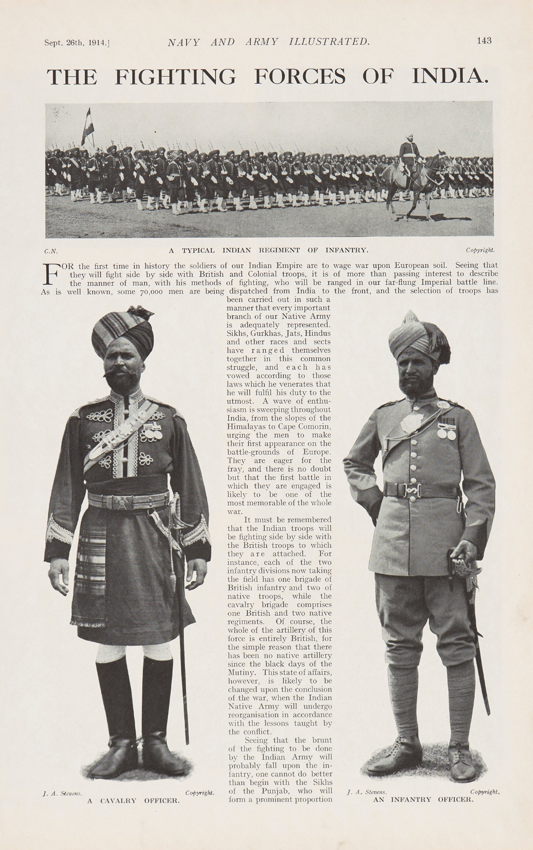
IMAGE SLIDE 3 – THE FIGHTING FORCES OF INDIA
Notes:
Object info
Image: Newspaper – The Fighting Forces of India, 1914, © Historic Royal Palaces
Object owner: Dr Tejpal Singh Ralmill

Slide 6
NEWSPAPER ARTICLE
The Fighting Forces of India, Navy and Army Illustrated, 1914
ENQUIRY
BACKGROUND NOTES
WHAT CAN WE LEARN FROM THIS OBJECT?
Q | Do you think this article was written by a British reporter? Why/why not?
Before World War I, there were about 215,000 Indian soldiers in the army. By the end of World War II, this number grew to more than 2.5 million. Many Indian soldiers lost their lives while serving. Some were given medals like the Indian Order of Merit (equivalent to a Victoria Cross) and the Allied Victory Medal for their bravery.
After World War II, India was still controlled by the British. Many Indians thought India should be given independence because of the sacrifices they made during the war. The British had promised to give India independence, but it didn’t happen until 1947 when they announced the Partition of India.
This ended the British Raj in India and also ended the British Indian Army.
Throughout this time, the British conducted lots of unethical research to study things like race, religion and caste in India. This research was based on the wrong idea that some races and groups were better than others.
This article was published in a magazine called Navy and Army Illustrated. The magazine showed pictures of military life and events like parades. It was partly made to encourage people to join the Navy and Army.
The article talks about the different religions of the Indian soldiers. It also describes them as ‘eager’ to fight in the war. The article says that the Indian soldiers would be fighting alongside British soldiers. It also mentions:
One British and two Indian divisions of infantry
One British and two Indian regiments of cavalry
British-only artillery
The Indian Army had soldiers from different religions, including Sikh, Hindu and Muslim soldiers.
Q | How useful is this article in showing how Indian soldiers felt about fighting in Europe?
Listen to audio from community curator Rav to find out more.
Object owner: Dr Tejpal Singh Ralmill
Notes:
Answers
Do you think this article was written by an Indian or a British reporter? How can you tell?
Some students might think that the article tries to make the British look good. It also uses judgemental language about the Indian soldiers, like saying they still have a lot to learn. It also suggests that the Indian soldiers can’t be trusted with artillery because of the 1857 War of Independence (also known as the Indian Mutiny). All of these aspects suggest it was written by a British reporter.
How useful is this article in showing how Indian soldiers felt about fighting in Europe?
This article isn’t very useful for understanding how Indian soldiers felt about fighting in Europe. Since it’s a British magazine, it might try to show the British in a good light and make the relationship between Britain and India look positive. Also, since the magazine wanted to recruit new soldiers, it might only be showing one side of the story. To really understand how Indian soldiers felt, we would need to look at evidence from the soldiers themselves.
Audio transcript
Speaker: Rav
So, here we see an article from the early 20th century, and it shows two standing soldiers from the Indian army. And when I look closely at the detail, you see they're highly decorated because they have nice uniforms. Obviously, the gentleman on the left has a more higher rank. But interestingly, they both have beards and they both have turbans. But the turbans can give you an indication of their faith and the religion they belong to. So, on the left-hand side, I would 95% guarantee that he's from a Sikh regiment in the Indian army. He's more colourful, and he's covering his hair with his turban. So, he would have long hair because Sikhs don't cut their hair. We protect our hair with a turban, but the gentleman on the right, even though he has a turban, my feeling is he is a non-Sikh regiment. He would be from a Punjabi-Musliman regiment. Muslims do cut their hair. But to tie a turban, they need a structure around which to tie it. So, if you look closely, you'll see a conical on his head. And then around the conical, which is that little peak, you see the turban tied around. So, we have a Muslim soldier and a Sikh soldier. And these decorated officers would then have been invited to events like the coronations here in the UK.
Object info
Image: Newspaper – The Fighting Forces of India, 1914, © Historic Royal Palaces
Object owner: Dr Tejpal Singh Ralmill

Slide 7
IMAGE SLIDE 7 – SOUVENIR BOOK
Notes:
Object info
Image: Souvenir book, 1919, © Historic Royal Palaces
Object owner: Dr Tejpal Singh Ralmill

Slide 8
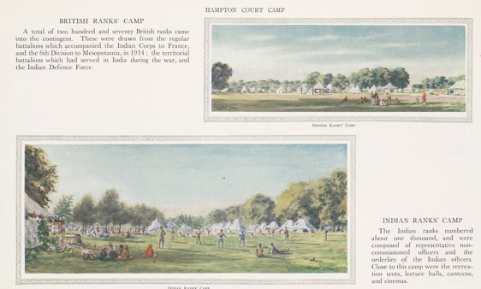
SOUVENIR BOOK
Our Indian Army Souvenir Book, 1919
BACKGROUND NOTES
ENQUIRY
In 1919, Indian soldiers were invited to attend the First World War Peace Parade. They travelled to England and camped in the same place where other Indian soldiers had stayed during similar visits in 1902. The campsite had many tents, enough for 1,800 Indian soldiers and civilian workers. At the time, this was one of the largest gatherings of people from India and South Asia ever in Britain.
The camp was set up along the River Thames. British and Indian officers had separate tents. The Young Men’s Christian Association provided entertainment for the Indian soldiers. There were also organised sports, and the soldiers were allowed to leave the camp with a pass.
Q | How would you compare the British and Indian camps shown in this image?
Q | What other types of evidence would help us build a complete picture of what the Indian soldier’s experience was like?
WHAT CAN WE LEARN FROM THIS OBJECT?
This is a page from a special souvenir book called Our Indian Army, which was published by the Indian Office. The book was made to remember and record the Indian Army’s visit to England in 1919.
The souvenir book was given to 1,500 people who were involved in the peace parade. It included many images and a record of the King’s speech in both English and Urdu.
This image from the book compares the British and Indian camps. The booklet says that 1,000 Indian soldiers and 270 British soldiers stayed in these camps.
Object owner: Dr Tejpal Singh Ralmill
Listen to audio from community curator Tej to find out more.
Notes:
Answers
How would you compare the British and Indian camps shown in this image?
The British and Indian camps in this image seem quite similar. Both show a series of white tents and soldiers enjoying the green space nearby. The Indian camp appears to have more colourful decoration (flags). The soldiers in the Indian camp appear to be playing sports with many onlookers. The soldiers in the British camp appear to be relaxing and chatting.
What other types of evidence would help us build a complete picture of what the Indian soldier’s experience was like?
To get a fuller picture of what the Indian soldier’s experience was like, it would be useful to look at:
Diary entries
Letters
Articles from Indian papers/magazine
Interviews with Indian soldiers
Oral testimony passed down to relatives and friends (like Rav and Tej, the community curators)
Audio transcript
Speaker: Tej
The 1919 victory parade was supposed to be a joint parade with the British Army, so the Indian and the British army were supposed to jointly do a victory parade in London. Unfortunately, because of Spanish flu, the Indian army had to quarantine en-route because there was an outbreak of Spanish Flu en-route, and therefore they were delayed and they missed the first victory parade, so they had a separate victory parade. So, this is an image from a souvenir book, and it captured that... that visit in 1919. So here you see these white camps as part of the encampment. This was the third time the Indian Army had used Hampton Court Palace and you see the British and the Indian Army camps in Home Park and other pages of this souvenir book will show the diversity of the Indian Army with different uniforms for different ethnic groups and different styles of turbans.
Object info
Image: Souvenir book, 1919, © Historic Royal Palaces
Object owner: Dr Tejpal Singh Ralmill

Slide 9
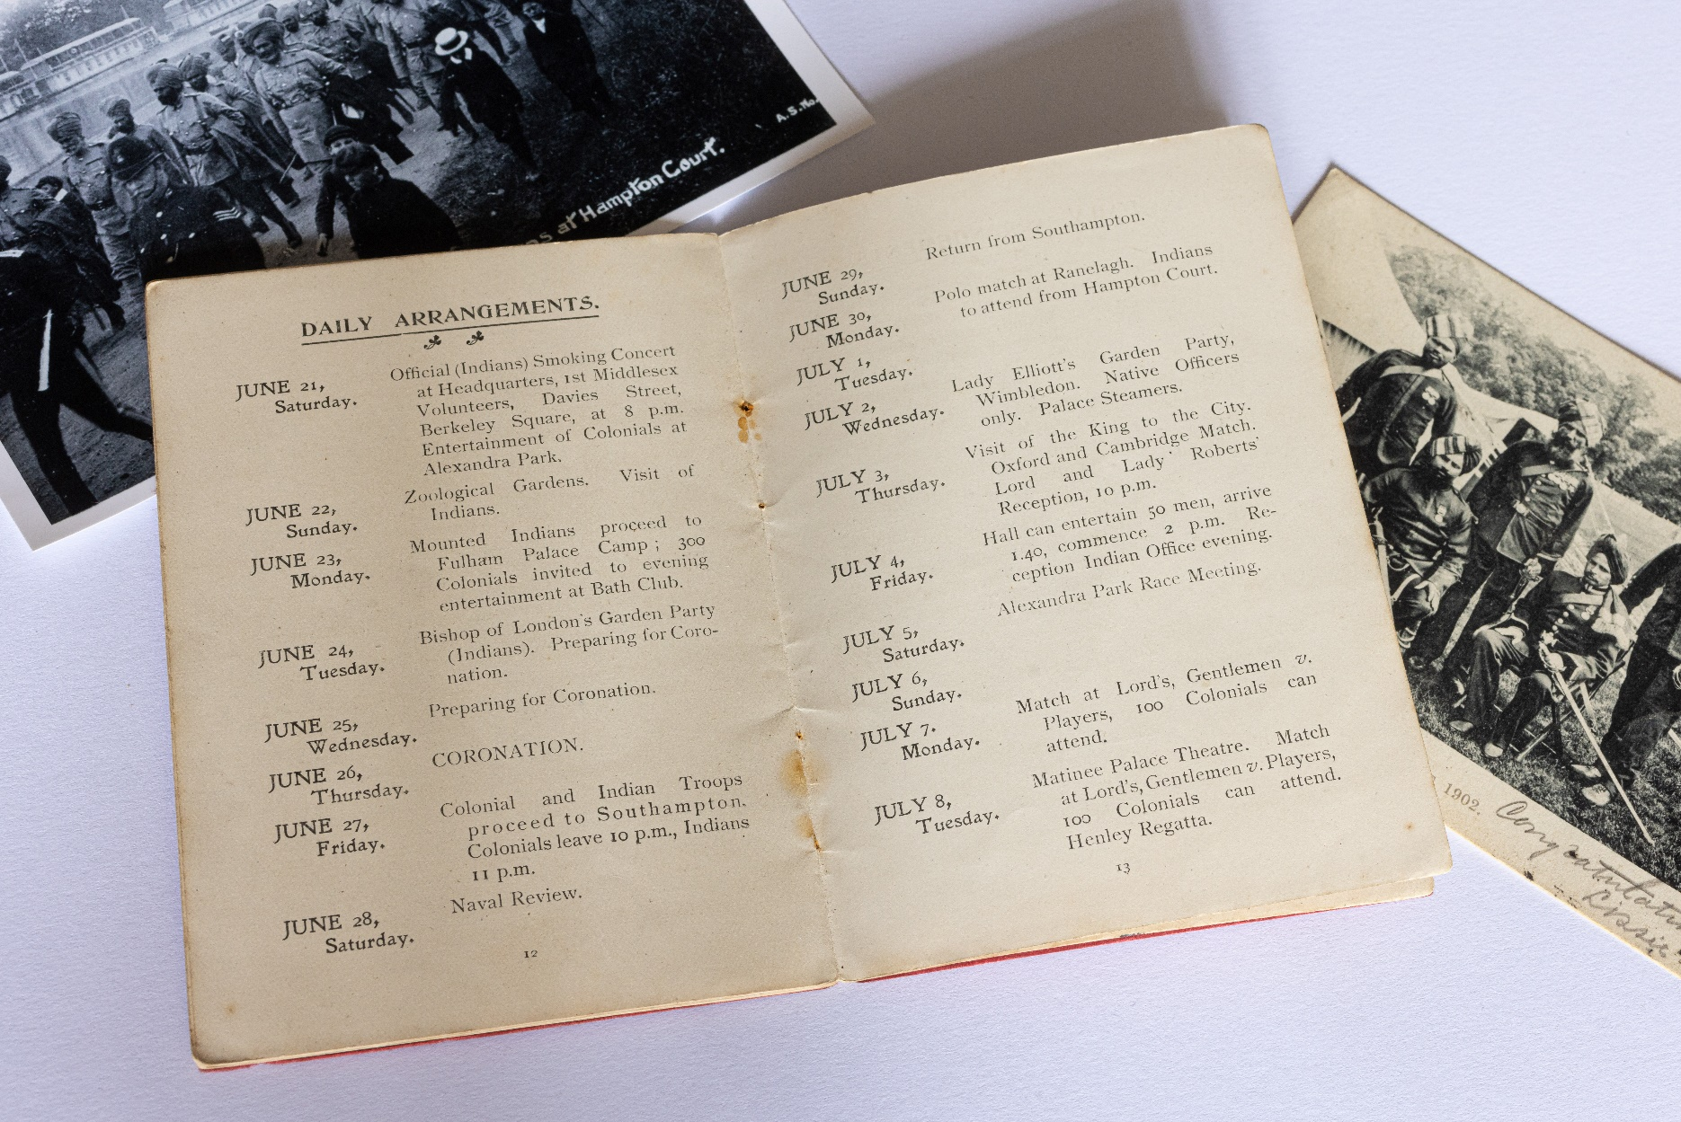
IMAGE SLIDE 4 – ENTERTAINMENT PROGRAMME
Notes:
Object info
Image: Entertainment programme, early 1900s, © Historic Royal Palaces
Object owner: Dr Tejpal Singh Ralmill

Slide 10
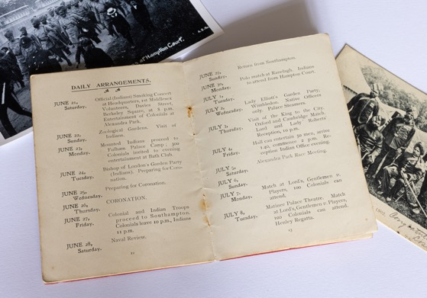
ENTERTAINMENT PROGRAMME
Entertainment of Colonial and Indian Troops Booklet, early 1900’s
ENQUIRY
BACKGROUND NOTES
Q | What do you
think of the activity schedule for the Indian soldiers?
In the early 1900s, the British government invited Indian Army soldiers to Britain to celebrate their sacrifices during the wars. In 1902, about 1,200 Indian soldiers stayed in campsites near Hampton Court Palace for two months.
During this visit, activities and day trips were planned for some of the visiting soldiers.
The Indian Army also visited Britain on three other occasions in 1911, 1919 and 1937.
Q | Why do you think the British government organised so many activities?
WHAT CAN WE LEARN FROM THIS OBJECT?
This document shows the different activities Indian soldiers were invited to take part in. The British government and charities organised these events.
The soldiers went on trips to places in London like the Tower of London, the zoo and St Paul’s Cathedral. They usually travelled by bus and were always escorted by a British officer. There were also trips to cities in the north of Britain.
These visits gave more British people a chance to meet the Indian soldiers.
Object owner: Dr Tejpal Singh Ralmill
Listen to audio from community curator Tej to find out more.
Notes:
Answers
What do you think of the activity schedule for the Indian soldiers?
Students might notice that the activity schedule looks very busy. There are events planned every day for over two weeks.
Why do you think the British government organised so many activities?
There are several reasons why the British organised trips for the Indian soldiers. These include:
Helping the soldiers feel part of the celebrations.
Thanking the soldiers for their sacrifices and making them feel appreciated.
Gaining more attention for the Indian soldiers' visit, possibly to show off the power and ‘kindness’ of the British Empire.
Giving the soldiers something to do while they waited during delays (such as the king being ill).
To help recruit new soldiers.
Audio transcript
Speaker: Tej
This is an entertainment programme that was put together in 1902. And the reason this programme was put together for the troops is because Edward VII had appendicitis. So, the coronation had to be delayed. So, you had 1,200 Indian troops at Home Park, Hampton Court Palace. And what do you do with them? So, they had many excursions in and around London, and indeed around the UK. This is one of the many items in my collection and I find it interesting because as well as having excursions to different parts of the UK, it was also a form of propaganda because the Indian troops would have been shown a good time and they would go back to their villages and this would enhance and improve recruiting because they would tell their fellow villagers, “it's great to join the British Indian Army because you get to see the world and to get to see England”, and so this was also used as an exercise for propaganda.
Object info
Image: Entertainment programme, early 1900s, © Historic Royal Palaces
Object owner: Dr Tejpal Singh Ralmill

Slide 11
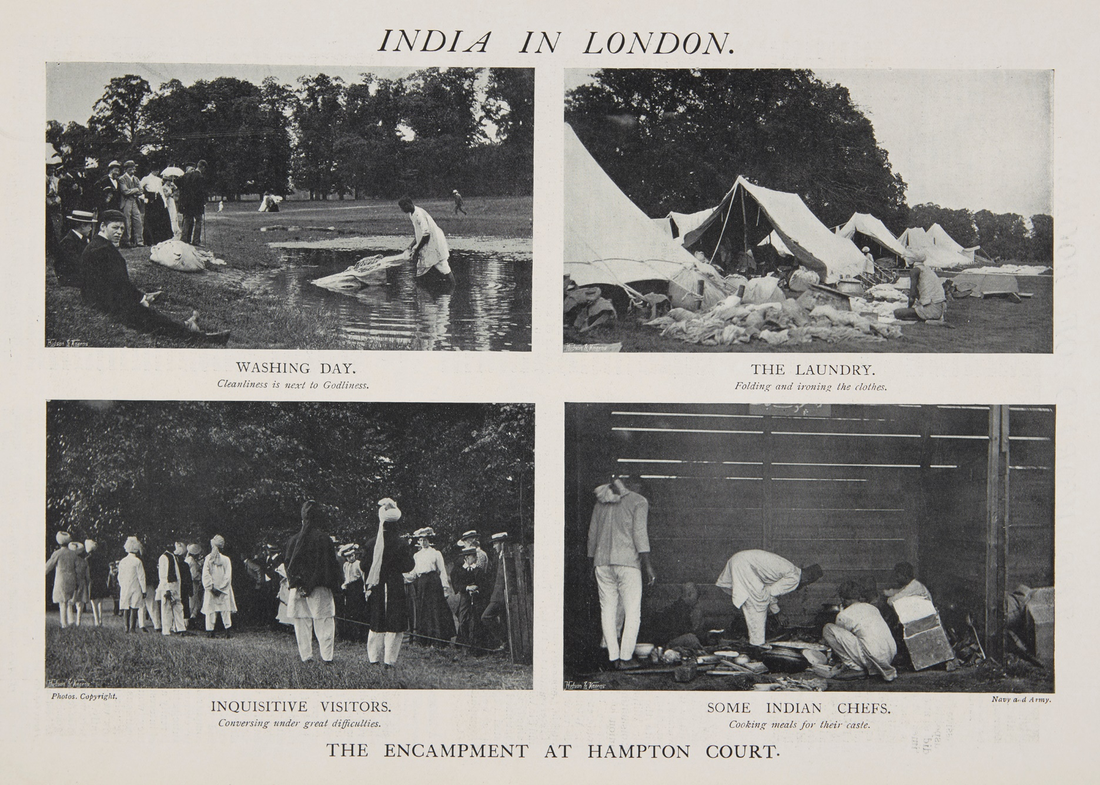
IMAGE SLIDE 5 – INDIA IN LONDON NEWSPAPER ARTICLE
Notes:
Object info
Image: Newspaper – India in London, 1902, © Historic Royal Palaces
Object owner: Dr Tejpal Singh Ralmill

Slide 12
NEWSPAPER IMAGES
India in London, Navy and Army Illustrated, 1902
ENQUIRY
BACKGROUND NOTES
During their visits to England, the Indian soldiers camped in the grounds of Hampton Court Palace. For most of the men, even those who had fought on the Western Front, this was their first time in England.
The camps were well-equipped and even had sporting events and silent movies. The British made an effort to meet the soldiers’ religious needs. Since Hinduism, Islam and Sikhism have different dietary rules, food had to be prepared in different ways for each faith. Because of this, the camps had separate kitchens and slaughterhouses for each group. However, soldiers from different backgrounds often ate together.
Q | How would you describe the behaviour of the British public in these images?
Q | How useful do you think these images are to understand what the Indian soldier’s experience was like?
WHAT CAN WE LEARN FROM THIS OBJECT?
This image was published in a glossy magazine called Navy and Army Illustrated. This magazine showed pictures of military life and events such as parades. It gives an interesting insight to the Indian soldier’s experience camping at Hampton Court Palace.
One image shows a soldier washing linen in a pond with British public looking on. The second image shows piles of laundry and what the campgrounds looked like. The third image shows British public looking upon Indian soldiers in the camps. The fourth image shows an example of the kitchens within the camps.
Object owner: Dr Tejpal Singh Ralmill
Listen to audio from community curator Rav to find out more.
Notes:
Answers
How would you describe the behaviour of the British public in these images?
In these images, the British public seem very curious about the Indian soldiers. They clearly want to get a closer look. However, some students might think that the British aren't being very respectful. It could be seen as the soldiers being "watched" or "observed". Also, in the bottom left image, it’s clear that the public is being kept separate from the Indian soldiers (this is because, during previous visits, the British public had acted inappropriately towards the soldiers).
How useful do you think these images are to understand what the Indian soldier’s experience was like?
These images are somewhat useful to understand the Indian soldier’s experience. Since they are photographs (rather than drawings) they give a realistic idea of what actually happened. However, they might not show everything that was going on. Also, since the pictures were published in a magazine, the photographer or editor might have picked only the images that showed a certain side of the events.
Audio transcript
Speaker: Rav
Here we have in the top left, we have washing day. And you've got to remember these uniforms are rich in colour, they're nicely embroidered, so they have to be washed carefully. So, these washer people, they were called dhobis. They were brought over from India with the army. So here we can see on a washing day, people are viewing how these Indian professional washermen would wash this. And it might be different to the way people do things here. It's a- very responsible job to do this, because if your uniforms aren't correct in a military parade, especially at a coronation, it reflects on the whole army. Now look at these bottom ones. We have some visitors. And we had some stories in 1902 where visitors were very welcome in the camp and they could walk around and meet the soldiers. But what they started to do was do things that the soldiers felt were not quite right, i.e. pulling their beards. And so, to see a tall gentleman with a turban akin to a crown and having a full beard or a tied-up beard, people were inquisitive. So, they would go and they would pull on their moustache and their beard. So here on the bottom left, you'll see a line and that line is probably a rope and that's a marking to say visitors, please do not cross into this area. And on the right-hand side, the bottom right, we have some Indian chefs. A well-fed soldier is a good soldier. You know, a hungry soldier is not a good soldier. So, they brought their own cooks with them from India. And on the ship that came, they had their own spices and their own ingredients and they were all mapped and they all listed and they're all bought over.
Object info
Image: Newspaper – India in London, 1902, © Historic Royal Palaces
Object owner: Dr Tejpal Singh Ralmill

Slide 13
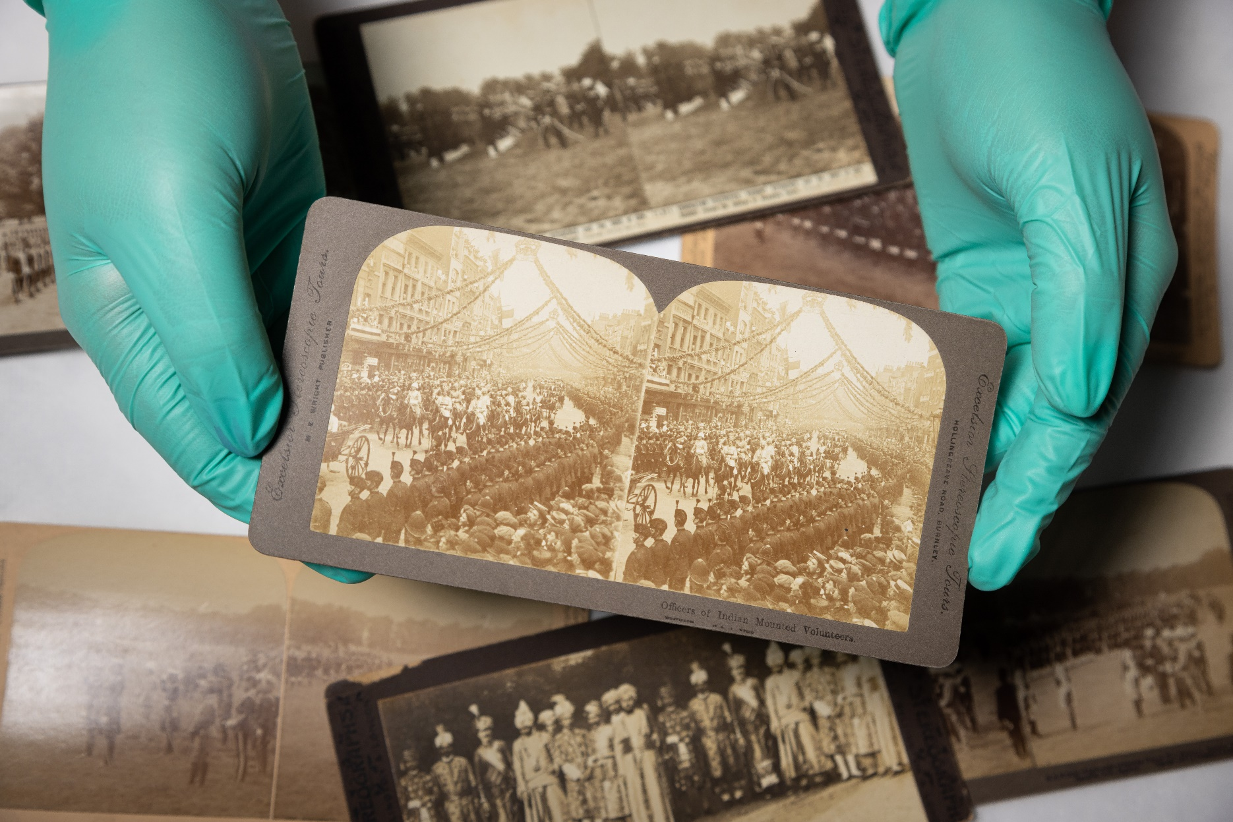
IMAGE SLIDE 6 – STEREOSCOPE SLIDES
Notes:
Object info
Image: Stereoscope slides, © Historic Royal Palaces

Slide 14
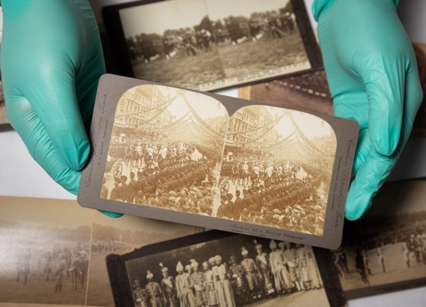
STEREOGRAPH SLIDES
Edward VII’s coronation parade, 1902
ENQUIRY
BACKGROUND NOTES
In 1902, there was a parade in London to celebrate the coronation of King Edward VII. More than 30,000 British and imperial soldiers took part, with over 1,000 Indian soldiers from 40 different regiments of the Indian Army. Large crowds came to watch and gave the Indian soldiers a warm welcome.
The celebrations were meant to show off the power and greatness of the British Empire. They were designed to make people feel proud and impressed. It marked the beginning of a new century and a new era after Queen Victoria’s death.
A potential underlying message of the parade was to show that Britain was in control of its empire (including India) and that the Indian people supported the British as rulers.
Q | What do you think of the event shown in the stereograph?
Q | What motivations do you think the British had for inviting the Indian Army to England?
WHAT CAN WE LEARN FROM THIS OBJECT?
This object is a stereograph. Stereographs were the first 3D images and were very popular from the 1850s to the 1900s. They feature two pictures from slightly different angles. When you look at them through a special viewer, the pictures appear 3D.
Many stereographs were made to show the Indian Army’s visits to Britain. This one shows the royal parade in London. The streets were decorated, and huge crowds gathered. In the centre, you can see Indian soldiers on horseback.
Listen to audio from community producer Jatinder to find out more.
Notes:
Answers
What do you think of the event shown in the stereograph?
Students may think the procession looks very impressive with garlands, huge crowds, and soldiers in impressive clothing.
What motivations do you think the British had for inviting the Indian Army to England?
There are several reasons the British invited the Indian Army to England. First, they might have wanted to show off their power by having such a large army and celebrate the diversity of the empire. They may have also wanted to make the public feel that Britain still had good control of its empire. Another reason could be that the British wanted the Indian soldiers to enjoy the event, which might encourage other Indian people to join the army.
Audio transcript
Speaker: Jatinder
This object is a stereoscope slide. A stereoscope was a device for viewing a pair of separate images through the left eye and the right eye. It depicted the same scene as a 3D object. The slide depicts a royal procession through London on the occasion of King Edward VII's coronation in 1902. At the centre of the stereoscope, we can see Indian mounted volunteer officers. The celebrations were a visual display of the power and magnificence of the British Empire. This is the first time I came across a stereoscope. I find them fun to use as they offer a unique way of viewing flat images.
Object info
Image: Stereograph slides, © Historic Royal Palaces

Slide 15
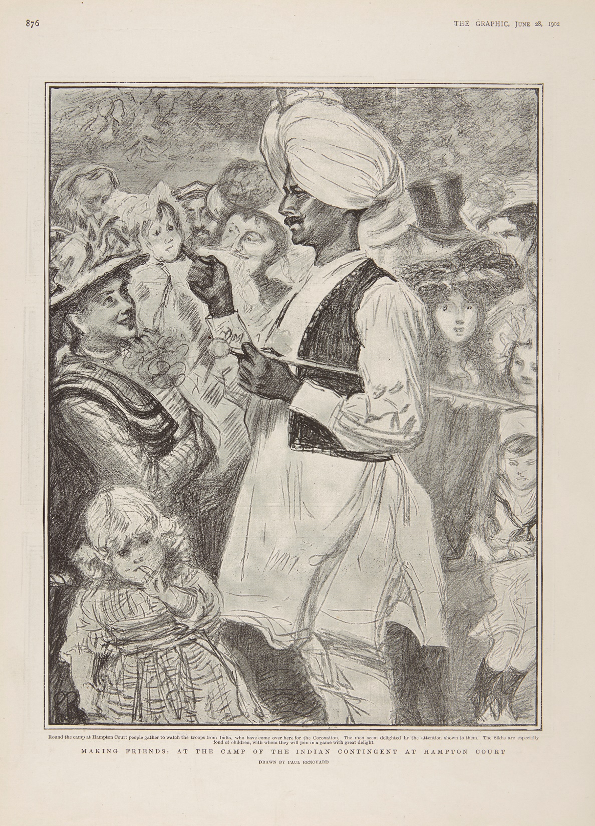
IMAGE SLIDE 4 – THE GRAPHIC MAGAZINE
Notes:
Object info
Image: Magazine – The Graphic, June, 1902, © Historic Royal Palaces

Slide 16
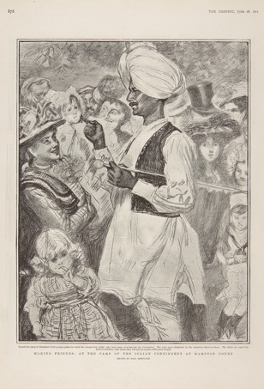
MAGAZINE ILLUSTRATION
Making Friends at Hampton Court, The Graphic, June 1902
ENQUIRY
BACKGROUND NOTES
WHAT CAN WE LEARN FROM THIS OBJECT?
Q | Do you think the soldier is being treated like a friend, celebrity or curiosity?
The soldiers’ visits got a lot of attention in newspapers and magazines. Many pictures show the British public being very curious and excited to see the Indian soldiers. Some images show people cheering as the soldiers marched through the streets.
The media coverage of these visits also worked as propaganda for the British Empire. It was a chance for Britain to show off the power of its imperial forces. This coverage also helped reassure the British public that the empire was strong.
The language and attitudes in British media from that time show bias and racism.
The illustration comes from a weekly magazine called The Graphic, which reported on the Indian Army’s visits several times. The picture shows an Indian soldier surrounded by a crowd of people. Most of the people look curious and fascinated. They seem friendly and eager to get a closer look at the soldier.
The soldier is wearing typical Indian civilian clothes, called a kurta pyjama with a koti (a short waistcoat). He is also wearing a large white turban. The soldier is touching the cheek of a small child with one finger of his right hand, while the child’s mother and the others around them smile.
The caption reads: Making Friends: At the camp of the Indian contingent at Hampton Court. Round the camp at Hampton Court people gather to watch the troops from India, who have come over here for the Coronation. The men seem delighted by the attention shown to them. The Sikhs are especially fond of children, with whom they will join in a game with great delight.
Q | Using this image as evidence, do you think the British made the Indian soldiers feel comfortable during their visit?
Listen to audio from community curator Rav to find out more.
Notes:
Answers
Do you think the soldier is being treated like a friend, celebrity or curiosity?
Some students might think the soldier is being treated like a celebrity because so many people are eager to see him. Others might think he is being treated like a curiosity since they are staring at him and getting very close. Some might feel the soldier is being treated like a friend because everyone looks happy to see him, and the article talks about "making friends." Students might think the solider is being treated like all three (a curiosity, celebrity and friend).
Using this image as evidence, do you think the British made the Indian soldiers feel comfortable during their visit?
Some students might think that the British public made the Indian soldiers feel uncomfortable by watching them so closely, even when they were off-duty. They might feel that the British public didn’t show respect and saw the soldiers as curiosities, not celebrities. On the other hand, some students might think the British public made the soldiers feel important and special because so many people were interested in them and gave them a warm welcome.
Audio transcript
Speaker: Rav
So, in this newspaper article what we see is a gentleman from the Indian Army camp meeting visitors and what you first see is how happy everyone is and smiling, you know, the lady there is smiling, she's carrying a baby who's inquisitively looking at the gentleman and everyone's eyes are staring at the gentlemen. And this is because they were very different in terms of people had never met people like this before. They were tall. They were athletically built because they were soldiers, but they also wore turbans, and turbans made them even taller. And these people have come here for a coronation, so they're important. They're staying at a palace, and the soldiers would love to meet people. I mean, modern-day England, we see turbans on Sikh peoples, but here my view would be this isn't a Sikh gentleman because his beard has been shaved. So, he's probably a Rajput Hindu or a Hindu from the style of his moustache I can tell. Probably a follower into the camp and that follower, he doesn't look like a washerman to me, he does not look like cook to me. What he looks like to me is probably one of the doctors because their own doctors came from India as well and he would be learned enough to probably speak English as well so he's communicating with the audience.
Object info
Image: Magazine – The Graphic, June, 1902, © Historic Royal Palaces

Slide 17
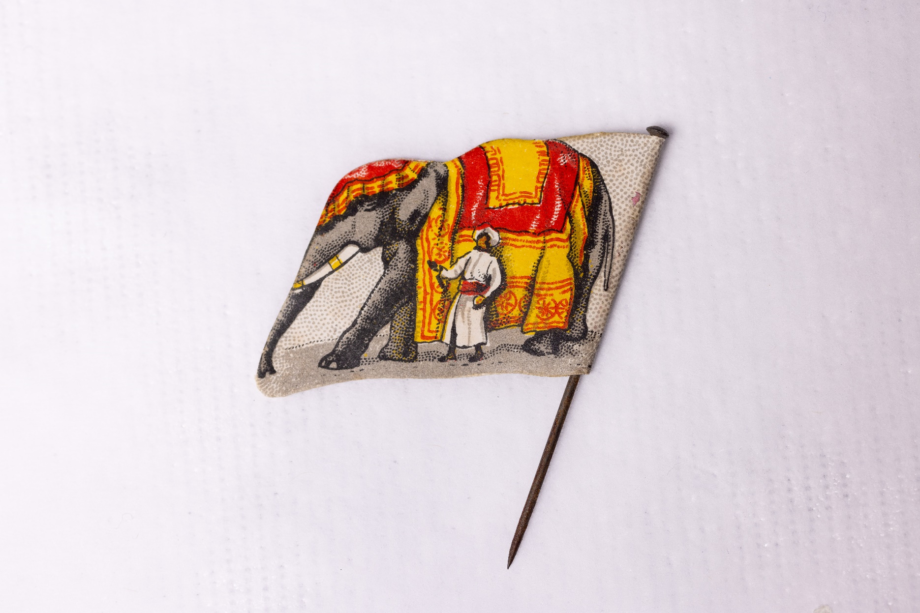
IMAGE SLIDE 2 – ELEPHANT PIN
Notes:
Object info
Image: Elephant pin, © Historic Royal Palaces

Slide 18
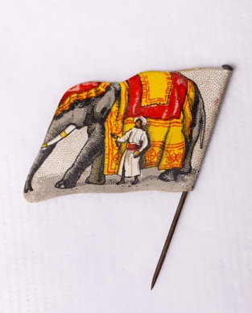
CLOTHING PIN
India Day Pin
ENQUIRY
BACKGROUND NOTES
WHAT CAN WE LEARN FROM THIS OBJECT?
Q | Why do you think this design was chosen to celebrate the Indian soldiers?
During the First and Second World Wars, tens of thousands of Indian soldiers died in battle. Many more were wounded or went missing.
A military hospital was set up at Brighton Pavilion to care for the Indian soldiers. The hospital had separate kitchens and facilities to meet the needs of the different religions.
British nurses were not permitted to take care of the wounded Indian soldiers.
Princess Sophia Duleep Singh was the daughter of the last Maharaja of Punjab and goddaughter to Queen Victoria. She became well-known for campaigning for women's rights and Indian independence. During the First World War, she helped raise money for soldiers. She also worked as a nurse at the Indian Army hospital in Brighton.
This pin is very small, measuring only 2.5cm tall. It is bright and colourful and shows an Indian elephant. It is a very rare object.
Volunteers, including Princess Sophia Duleep Singh, sold pins like this during ‘India Day’.
The goal was to raise money for Indian soldiers around the world. The event raised over a million pounds.
Q | Why do you think British people might have bought this pin? (Hint: why do people buy charity badges today?)
Listen to audio from community producer Jatinder to find out more.
Notes:
Answers
Why do you think this design was chosen to celebrate the Indian soldiers?
The design is colourful and would stand out. It shows an elephant, which is native to Asia. The elephant would have seemed “exotic” and unusual for British people to have on a pin. It also shows a man wearing traditional clothing from Asia, which would remind people of the Indian soldiers. However, it reminds us of stereotypes people had of Indian culture at the time (and today).
Why do you think British people might have bought this pin? (Hint - why do people buy charity badges today?)
Reasons people might have bought this pin include:
Wanting to show pride in the British empire
Wanting a souvenir to remember the Indian army
Wanting to help raise money to support the Indian soldiers
Wanting to show support and stand with the Indian soldiers
Audio transcript
Speaker: Jatinder
This object is one of the smallest in our collection. It is a pin badge that was sold by volunteers such as Princess Sophia Duleep Singh to raise money for Indian soldiers worldwide during World War I. This is an important pin badge as it shows the role women had when contributing to the war effort. It is one our star objects in the exhibition and you can often find lots of people crowded around it when they come to visit. I think Sophia Duleep Singh is an inspirational woman as she used her platform to champion social and political causes, particularly women's rights and suffrage in the UK.
Object info
Image: Elephant pin, © Historic Royal Palaces

Slide 19
VOCABULARY LIST
artillery | part of an army that uses large guns
British Raj | the period when Britain controlled India. The term ‘raj’ comes from the Hindi word ‘raj’, which means ‘rule’.
cavalry | soldiers who fight on horseback
caste | a system of social classes in India
East India Company | a British trading companying that controlled parts of India
followers | people who supported daily life for the Indian soldiers, such as washerman (dhobi) or cooks
imperial | relating to the British Empire
infantry | soldiers who fight on foot
koti | a short sleeveless waist coat worn throughout India
kurta pyjama | a lightweight long, loose shirt and drawstring pyjamas, usually made from cotton
Partition of India | the division of India into India and Pakistan in 1947, when the British Raj ended
propaganda | information spread to influence opinions, often in a biased way
regiments | large groups of soldiers in an army
resistance | the act of fighting against control or oppression
sepoys | lowest rank in the Indian Army, equivalent to Private in British Army. The term ‘sepoy’ comes from the Persian word ‘sipahi’, which means soldier.
unethical | actions that are morally wrong or unfair

