Slide 1
Ina Sarah Forbes Bonetta – source task
Ina Sarah Forbes Bonetta
– Source Task –
Notes:
Image Credit:
© National Portrait Gallery, London

Slide 2
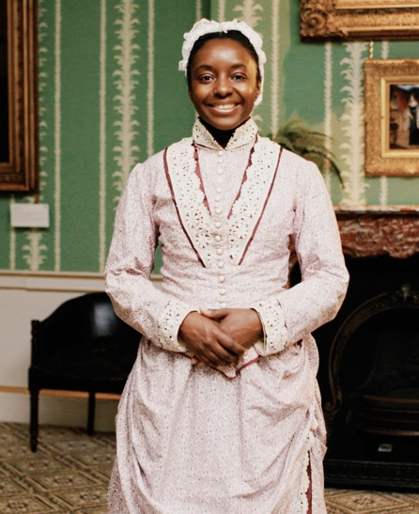
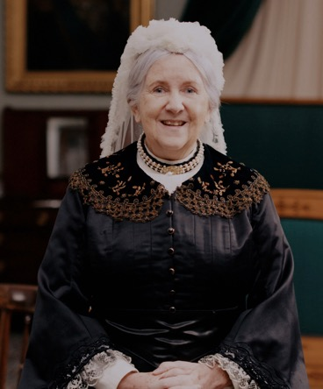
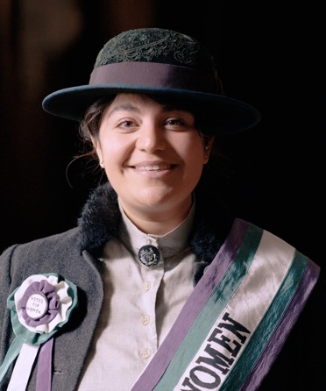
Have you watched me tell my story?
Have you watched me tell my story?
Queen Victoria
Princess Sophia
Duleep Singh
Ina Sarah Forbes Bonetta
Notes:
Watch the videos: https://youtube.com/playlist?list=PLmQztN3936tL1ZgIHlfwlsKaRAqEDNQf1&feature=shared

Slide 3
Vocabulary
history | Learning about people, places and events from a long time ago to understand what life was like in the past.
source | Items from the past that help us learn about what happened. These might be portraits or documents.
evidence | Clues that help us understand and explain what life was like in the past.
portrait | A picture or artwork of a person. It can be a painting, a photograph or even a sculpture.
monarch | A king or queen who leads a country and makes important decisions.
empire | A group of countries that were ruled over by one monarch or another country.
god-daughter | A child who has godparents. A godparent is a special adult chosen to guide and support a child as they grow up, especially in their faith.
Notes:
Teacher notes:
These terms are useful in the context of the video of this source task and the original video. It would be useful for children to be aware of them however you do not need to memorise or discuss all of them on this slide.

Slide 4
When did Ina (Sarah) live?
When did
Ina Sarah
live?
Ina was born
over 150 years ago!
VICTORIAN PERIOD
Queen Victoria’s life
Sarah’s life
Further into the past
Now
Notes:
Teacher notes:
The purpose of this slide is for children to understand that this period of history is a long time in the past which is why life is so different to what they know.
Ask children to find 'now'. Explain this is where we are today.
Move finger back to the end of the bright blue section. This is how far the oldest people alive today can remember. The Victorians are further in the past than that.
Say the word Victorian and explain this was a time of great change in Great Britain.

Slide 5
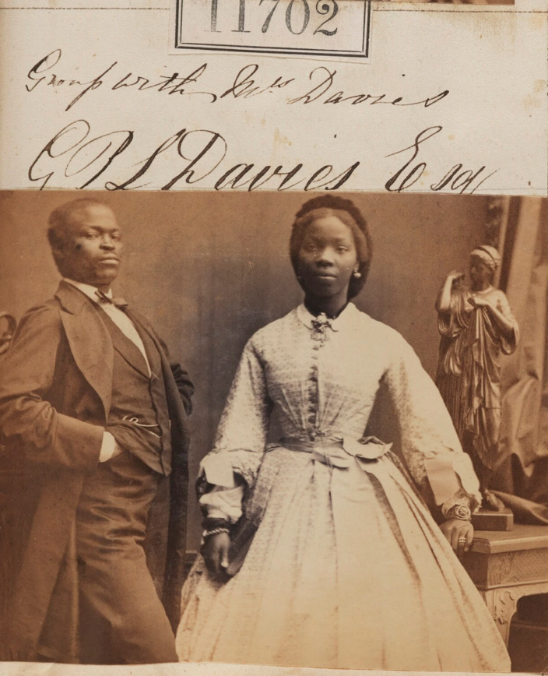
Do you remember this source?
Do you
remember
this source?
Notes:
About this source:
Photography was invented during the 19th century and has become more common since then. This photograph was taken shortly after Ina’s marriage to her husband. The text above the photograph states: "J P L Davies Esq". This is Ina's husband’s name (James Pinson Labulo Davies). The couple did not know each other well at the time of the marriage. There is evidence to suggest she did not want to marry him, but was unable to decline the marriage.
These photographs were taken by a famous Victorian photographer called Camille Silvy, which may have been a request from Queen Victoria.
The wedding took place in Sierra Leone, was very large and attracted a large crowd. Newspapers reported that there were 10 horse-drawn carriages and 16 bridesmaids, and the wedding party included ‘white ladies with African gentlemen and African ladies with white gentlemen’.
Learn more about this source with the National Portrait Gallery:
NPG Ax61385; James Pinson Labulo Davies; Aina (Sarah Forbes Bonetta (later Davies)) - Portrait - National Portrait Gallery

Slide 6
How does this source help tell Ina (Sarah)’s story?
How does this
source help tell Ina Sarah’s story?
Notes:
Task:
Ask the students to look closely at this source.
Questions to ask:
Does this photograph look similar to photographs taken today?
The photograph is in black and white, and the people are wearing very different clothes. They are also posing in quite a serious way.
How long does it take to take a photograph today?
Taking a photo today is very quick but when cameras were very different in the Victorian period. When you pressed the button, a photograph took a very long time to develop. This meant that the people in the picture would need to stand still for several minutes, otherwise it would be blurry.
Do you think everyone had their own camera in Victorian times?
No, cameras were a lot less common than today. Photography was expensive, and rich people would organise photography to celebrate special events.
Themes to explore:
Sadly, lots of events in Ina's life suggest she had little control over some of the things that happened to her. She was born in an area of West Africa that is now called Nigeria, but sadly her parents died and she was taken away from her home. She spent a long voyage on a ship to England. She married James, and there is evidence to suggest she did not want to. Ina became a bit of a 'celebrity' with many people interested in her life. However, it is very possible that she did not want to be the centre of attention.​
​In Victorian times, some people had the wrong idea that African people were not equal to others. Unfortunately, as part of this, Black people were sometimes seen as 'scientific objects' or 'curiosities'. Often, the people photographed were either not given a choice or not able to refuse. Therefore, photography of Black people from this time is potentially problematic.
We have decided to use photographs of Ina in these resources because they are valuable historic sources and especially important to help young children visualise her life. However, we believe it is important for teachers to be aware of the context surrounding photography from this time.

Slide 7
Look closer
Look closer at this source…
Who is the man?
Do you think she was
happy in this photo?
Her husband, James Davies, who was an African merchant. Ina did not want to marry him but Queen Victoria approved the marriage, so it went ahead in 1862. ​
Her expression is quite serious. Victorian portraits often look like this as it took several minutes to take a photo. But we do know she didn’t want to get married.
Notes:
Teacher notes:
Ask the students to look closely at this source.
Use the source as evidence to answer the questions on the slide.
Source:
https://www.npg.org.uk/collections/search/portrait/mw86363/James-Pinson-Labulo-Davies-Aina-Sarah-Forbes-Bonetta-later-Davies

Slide 8
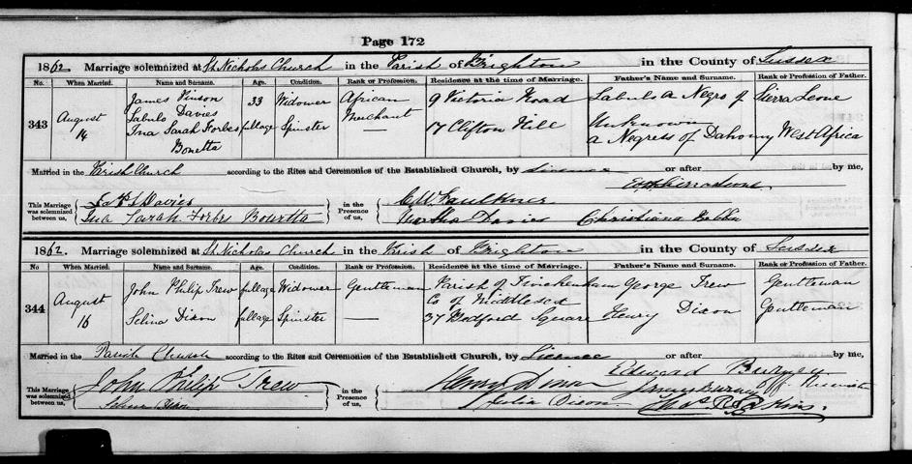
Other sources
Other sources about Ina Sarah
Notes:
Teacher notes:
This source is Ina and James' marriage certificate. She chose to use her birth name ‘Ina’ on this document. It is a lovely source that suggests she did not lose her childhood identity. Ina’s story is full of challenges and decisions made for her, but this source is a small glimpse into a time when she was perhaps able to take a bit more control.​
Task:
Find where she signed her name, and see if you can spot what name she used (Ina or Sarah)?
It says 'Ina' - what is this?
Ina was her birth name. She was probably given this name by her parents, in (a West African village that is now in) Nigeria. But when she was young, her parents died and she was taken on a ship and brought to England. Her name she was given a new name by the people who had taken charge of her. She became known as Sarah Forbes Bonetta.​​
Why do you think she used her birth name on this document?
She may have wanted to remember her original identity and heritage. She may have also wanted to take a little bit of control back in a situation where she didn’t have much power. ​
How should we remember this person? As Sarah or as Ina?
Many students might think ‘Ina’ is a better way to remember this person. Ideally, we would be able to ask a person what they would like to be known as, but sadly Ina/Sarah died a long time ago so we can't ask her what we should call her. ​
​Many of the historic sources and recent articles about this individual are likely to use the name 'Sarah'. On one hand, using this name might make it easier to find information about her. On the other, this document reveals that she chose to use her birth name on an important document. Because of this we have chosen to use ‘Ina’ as her first name in these resources.
Image credit:
PAR255/1/3/35, East Sussex and Brighton and Hove Record Office at The Keep

