Slide 1
HOW TO USE - NOTES FOR TEACHERS
These resources from Historic Royal Palaces are multi-purpose. They are ready for you to tweak and use in your lessons.
For the best experience, download and open the file in the PowerPoint desktop app.
Answers are found under the slide. Click on the notes symbol at the bottom of the screen.
Delete text and images to make your own worksheets.
Disclaimer and Use Terms
We are the owner or the licensee of all intellectual property rights in these resources which are protected by copyright laws and treaties around the world. All such rights are reserved. These resources, and the content included within them, may be used by you for educational purposes only. This means that you may download the resources and use or share them solely in educational environments (including for home school lessons) or as part of homework. You may not share the resources other than for the above purposes and you must not use the resources, or any part of them, for any commercial purpose.

Slide 2
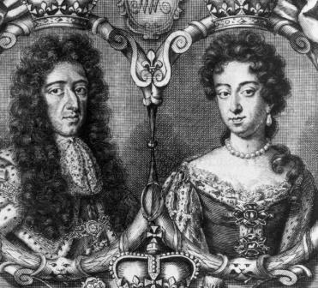
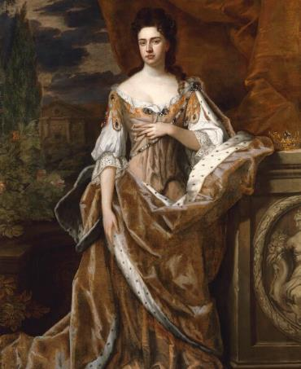
WILLIAM AND MARY AND QUEEN ANNE
WILLIAM III
QUEEN
AND MARY II
ANNE
The only British monarchs to have ruled together
A hard-working queen and the last Stuart monarch
Mary was the daughter of James II. William was the grandson of Charles I.
They were both Protestants and got married in 1677.
As part of the Glorious Revolution
1688-1689:
Catholic King James II was unpopular.
William and Mary were invited to become rulers instead.
They became joint monarchs.
It was called the Glorious Revolution because it did not involve violence in England, however it did lead to violence in Ireland.
As monarchs, they hired the architect Sir Christopher Wren to transform Nottingham House into Kensington Palace. This included new State Apartments, accommodation for courtiers and kitchens and stables.
Mary died of smallpox and a few years later William died after a riding accident.
Anne was the younger sister of Mary II. Anne became queen after Mary’s husband William III died.
She was a dedicated, hard-working monarch and met her ministers every day.
Shy but able to speak up when needed.
Married Prince George of Denmark and had 18 pregnancies.
Sadly, only one child, William, lived more than two years but he also died young, aged 11.
Anne improved the gardens at Kensington Palace including building the Orangery.
Anne started to suffer from poor health and died at Kensington Palace in 1714.
© Historic Royal Palaces
Royal Collection Trust
© His Majesty King Charles III 2024
William: 1689-1702, Netherlands
Mary: 1689-1694, London
Lived: 1665 - 1714
Birthplace: London
Reigned: 1689 – 1694 & 1702
Reigned: 1702 -1714
William was devastated when Mary died and did not remarry.
She used the King’s State Apartments at Kensington Palace, not the Queen’s.
Q:
What evidence is there that Anne was a hardworking monarch?
Notes:
Queen Anne notes:
The fact that Anne met her ministers every day is evidence that she was a conscientious monarch. The quote by Bishop Gilbert Burnet is evidence that she was a confident and authoritative public speaker.

Slide 3
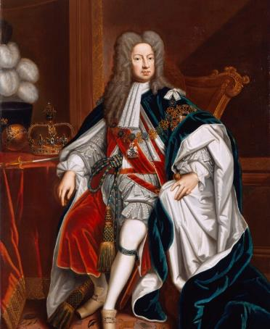
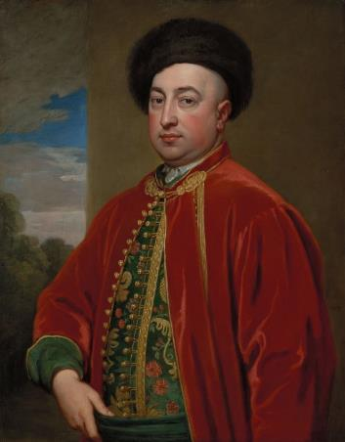
GEORGE I AND MEHEMET
GEORGE I
MEHEMET
The first Georgian King
Turkish valet to George I who rose to an important position
George was from Hanover in Germany. He became king when Queen Anne died without an heir. He was next in line to be king partly because he was Protestant.
He visited Kensington Palace for the first time when he came to England in 1714.
Spoke German and French but only a few words of English.
Spent little time in England and made regular visits back to Hanover.
Left the running of the country to his trusted ministers.
George I made improvements at Kensington Palace including creating new State Apartments.
Mehemet was possibly born in the area of modern-day Greece. He and another man (Mustafa) were taken as prisoners during wars between Hapsburg and the Ottoman Empire.
In 1714, George I brought Mehemet and Mustafa to England as his valets. They are both are pictured in the murals on the King’s staircase at Kensington Palace.
Was Muslim but was baptised as a Christian in Hanover.
Became George I’s closest personal servant for over 40 years.
In 1706, married Marie Hedwig Wedekind. Their mixed-race marriage was uncommon for the time, but successful.
Owned a house in Hanover.
Died at Kensington Palace.
© National Portrait Gallery, London
Royal Collection Trust
© His Majesty King Charles III 2024
Lived: 1660 - 1727
Lived: ? - 1726
Birthplace: Hanover, Germany
Birthplace: Unknown
Reigned: 1714 - 1727
George I gave him the title: ‘Mehmet von Koenigstreu’ (True to the King).
Brought 18 cooks with him to England.
What objects in the portrait tell us that George I is a king?
Q:
What can you tell about Mehemet from his portrait?
Q:
Notes:
George I notes:
George I’s portrait shows a crown, an orb and a sceptre on a side table. These are ancient symbols of monarchy.
Mehemet notes:
In his portrait, Mehemet’s looks proud and confident. He wears velvets and furs which suggest he is wealthy.

Slide 4
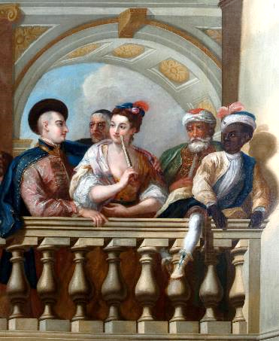
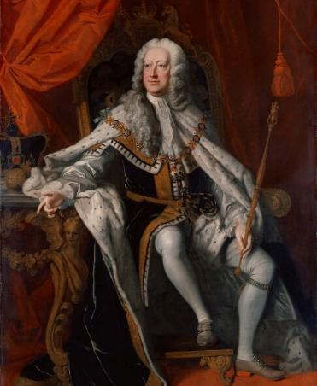
MUSTAFA AND GEORGE II
MUSTAPHA
GEORGE II
Turkish valet to George I
The last British monarch to lead his troops into battle
Mustapha was born in modern-day Greece but was captured by Hanoverians during a wars between Hapsburg and the Ottoman Empire.
He eventually went on to serve the army and converted to Christianity.
In 1714, Mustapha was one of two men brought to England by George I to be valets.
They are both are pictured in the murals on the King’s staircase at Kensington Palace.
Some historians believe that Mustapha is the person on the right of the image.
Mustafa was baptised as a Christian and was given the name Ernst August. He became one of the King’s closest attendants.
He was obsessed with facts and figures.
© Historic Royal Palaces
© National Portrait Gallery, London
Lived: unknown
Lived: 1683 - 1760
Birthplace: Morea
Birthplace: Hanover, Germany
Reigned: 1727 - 1760
George II moved into Kensington Palace when he became king. He and his wife, Queen Caroline, made it their main home in London.
Was dull and self-important.
Often lost his temper.
Sometimes threw off his wig and kicked it round the room.
Loved order and routine.
Reportedly had his underwear numbered according to the day of the week.
He married Magdalena Catharina Homeyer in Hanover in 1708.
Q:
Why do you think we know so few details about Mustapha’s life?
Q:
The Earl of Chesterfield wrote about George II “little things…afflicted him more than great ones”. Can you explain the quote in your own words?
Notes:
Mustafa notes:
The lives of ordinary people were not recorded in the past in the same way as famous or important people’s lives were. There were no national records of births, marriages and deaths but some details can be found in church registers.
George II notes:
The quote suggests that George II was more upset by petty, unimportant things than by important matters.

Slide 5
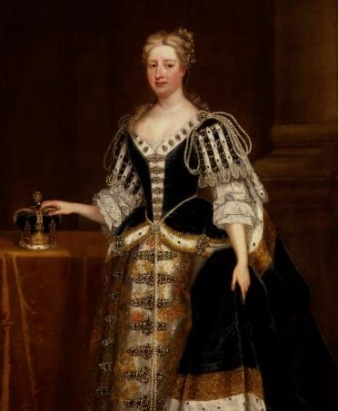
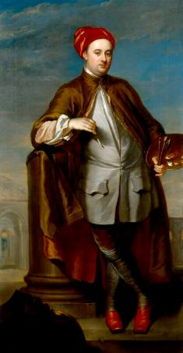
QUEEN CAROLINE AND WILLIAM KENT
QUEEN
WILLIAM
CAROLINE
KENT
An intelligent, sophisticated and forward-thinking queen
Architect, painter, interior designer and landscape gardener
Caroline was born at the Palace of Ansbach in Germany.
Married the future George II in 1705.
Moved with him to England in 1714.
Became Queen Consort in 1727.
Caroline brought glamour, intelligence and liveliness to court and made Kensington Palace a glittering centre of court life.
She invited theologians, philosophers, scientists, artists, writers and gardeners to her receptions.
She also hired William Kent to transform the gardens at Kensington Palace. The old gardens were replaced with more fashionable ‘natural’ ones.
He was charming and good at making powerful friends.
© National Portrait Gallery, London
© National Portrait Gallery, London
CC BY NC ND 3.0
Lived: 1683 - 1737
Lived: 1685 - 1748
Birthplace: Ansbach, Germany
Birthplace: Yorkshire
Reigned: 1727 - 1737
William started his working life painting signs and coaches. He studied art in Italy.
Hired by George I to decorate new State Apartments at Kensington Palace.
Employed by George II and Queen Caroline to improve the royal accommodation at Hampton Court Palace.
He was the first British designer to control all parts of interior decoration, from furniture to fireplaces.
His style was dazzling. He used illusions that tricked the eye. He famously created wall and ceiling paintings plus gold statues.
Had all her children vaccinated against smallpox.
Q:
What impression do you have of William Kent?
Q:
Can you give one example of Caroline being ‘forward-thinking’?
Notes:
Queen Caroline notes:
There are lots of examples that Queen Caroline was ‘forward thinking’. She had her children vaccinated against smallpox and she spent time with scientists, artists, writers. She also modernised the gardens at Kensington Palace.
William Kent notes:
One opinion is that William Kent was multi-talented and successful. He was good at networking. Quite showy and flamboyant. Judging by his double chins, he liked good food.

Slide 6
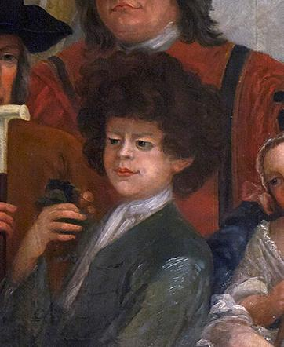
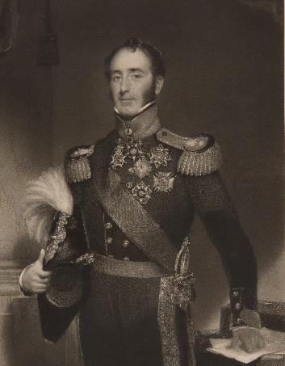
PETER ‘THE WILD BOY’ AND JOHN CONROY
PETER FROM
JOHN
HANOVER
CONROY
The boy who survived living alone in the woods
Ambitious man at Kensington Palace during Queen Victoria’s childhood
In 1725, Peter was found as a young boy living alone in the woods near Hanover, Germany. A description of him stated that he was ‘walking on his hands and feet, climbing trees like a squirrel, and feeding on grass and moss.’ He did not speak. Local villagers named him Peter.
Caused great public interest due to his unusual behaviour.
George I sent for Peter and he was displayed at court in England.
Taught to bow and kiss the hands of ladies for their amusement.
Featured in a painting on the King’s Stairs at Kensington Palace.
He was sent to live on a farm in Hertfordshire. He wore a collar with his name and address on it, after he went missing one day.
John was an officer in the Royal Household Artillery. He became assistant to Edward Duke of Kent, Queen Victoria’s father.
Edward died not long after Victoria’s birth. John Became comptroller of the royal household at Kensington Palace.
He had increasing power over the Victoria’s mother. He devised set of rules known as the ‘Kensington System’. They were designed to isolate Victoria and keep her under his control.
If Victoria inherited the throne before she was 18 her mother would be appointed regent. John Conroy planned to be ‘the power behind the throne’.
His plan failed as Victoria became queen two months after her 18th birthday.
© Historic Royal Palaces
© Historic Royal Palaces
Lived: ? - 1785
Lived 1786 - 1854
Birthplace: Germany
Birthplace Caernarvonshire, Wales
Today it’s thought that Peter probably had a genetic disorder called Pitt-Hopkins Syndrome.
He claimed to be descended from an ancient line of Irish Kings.
Q:
What does the phrase ‘the power behind the throne’ mean?
How would you describe Conroy’s character?
Q:
What do you think of the way Peter was treated?
What does the fact that Peter was included in the painting on the King’s Staircase tell you about him?
Notes:
Peter From Hanover notes:
Many people are likely to be upset/angry at Peter’s treatment. It shows a lack of understanding about disabilities at the time, and a lack of respect for those that had them.
The fact that Peter was included in a high profile painting suggests he had become something of a celebrity. There was a lot of public interest in him.
John Conroy notes:
‘Power behind the throne’ means someone who gains or uses power by controlling the person who is officially in charge.
Conroy could be described as cunning, scheming, manipulative, controlling and ambitious.

Slide 7
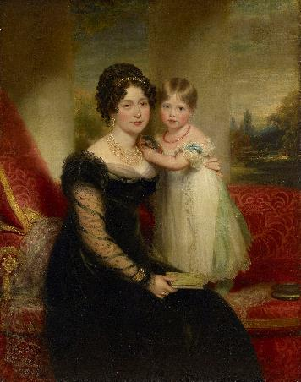
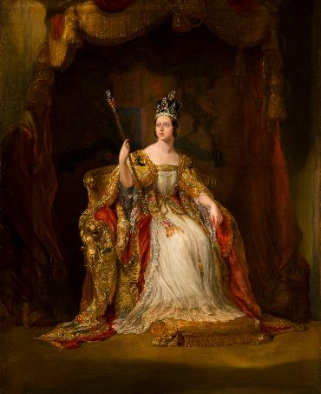
PRINCESS VICTOIRE AND QUEEN VICTORIA
PRINCESS
QUEEN
VICTOIRE
VICTORIA
German princess and Queen Victoria’s mother
The second longest reigning monarch in British history
Born ‘Marie Luise Victoire’.
Had two children by her first marriage to a German Prince.
Second marriage was to Edward, Duke of Kent, in 1818.
Gave birth to Victoria at Kensington Palace in 1819.
Edward died a few months after Victoria was born and Victoire became responsible for his huge debt. She was lonely and isolated, but she adored her daughter.
However, Victoire started to be controlled by John Conroy. This led to her daughter resenting her. When Victoria became queen, she moved to Buckingham Palace without her mother.
Victoire reconnected with Victoria after Victoria had her first baby. Victoria was heart-broken when Victoire died.
Victoria was born in Kensington Palace, but her father died suddenly eight months later. Her mother started to rely on John Conroy who had been her father’s assistant.
John Conroy kept Victoria isolated at Kensington Palace under close watch.
She became queen aged 18 when her uncle William IV died.
Married her cousin, Prince Albert, in 1840.
They had a very successful partnership and had nine children.
She was crowned Empress of India in 1876.
Albert suddenly died in 1861 and she withdrew from public life for many years. She celebrated her Golden Jubilee in 1887 and Diamond Jubilee in 1897.
Royal Collection Trust
© His Majesty King Charles III 2024
Royal Collection Trust
© His Majesty King Charles III 2024
Lived 1786 - 1861
Lived: 1819 - 1901
Born Saxe-Coburg-Saalfield, Germany
Birthplace: London
Reigned: 1837 - 1901
Queen Victoria later blamed Conroy for ‘wickedly’ distancing her from her mother.
She kept a diary from age 13 to a few days before she died, aged 81.
Q:
Describe how Victoria is portrayed in her Coronation portrait.
What impression of her do you think this creates?
Q:
The portrait is of Victoire with baby Victoria. What evidence is there in it that she is a widow?
Notes:
Princess Victoire notes:
Victoire is dressed in black mourning clothes, which suggests she is a widow. Baby Victoria holds a miniature portrait of her late father.
Queen Victoria notes:
In her portrait, Victoria is seated on a throne, wearing her coronation robes over a simple white dress. She wears a crown (the Impe
rial State Crown) and holds a sceptre (The Sceptre with Cross). She is gazing upwards with the light shining on her face.
The portrait creates an impression of a calm, regal, confident, poised, innocent young woman.

Slide 8
TEMPLATE WORKSHEET
________________
________________
________________
________________
Image credit:
Image credit:
Lived: _______
Lived: _______
Birthplace: _______
Birthplace: _______
Q:
Q:

Slide 9
VOCABULARY LIST
afflicted | caused pain or trouble by
architect | person who designs buildings and plans and supervises them being built
Catholic | member of the Roman Catholic Church. A type of Christianity that follows the teachings of the Pope
courtiers | nobleman or noblewoman who spends a lot of time at the royal court
comptroller | royal household official in charge of finances
Diamond Jubilee | celebrations marking the 60th anniversary of an event, such as someone becoming king or queen
empire | large group of countries or regions that are controlled by one ruler or government
empress | woman who rules over an empire
genetic disorder | health problem or condition sometimes passed from parents to children
Georgian | the time from 1714 to 1830 when Britain and Ireland were ruled by George I-George IV
Glorious Revolution | events of 1688-89 when the Catholic King James II was replaced by the Protestant William III and Mary II
Golden Jubilee | celebrations marking the 50th anniversary of an event, such as someone becoming king or queen
government | group of people that have the authority to rule a country
heir | person who will become the next king or queen
interior decoration | decoration inside a building
Kensington System | set of rules devised to keep Victoria under strict control at Kensington Palace as a child

Slide 10
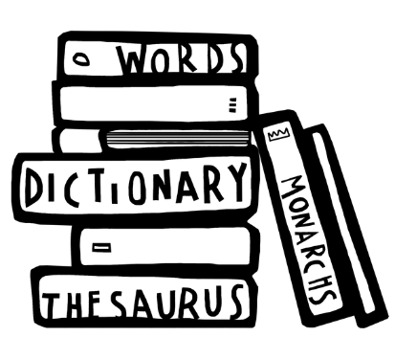
VOCABULARY LIST 2
VOCABULARY LIST
minister | someone with a lot of power and responsibility in government
monarch | ruler of a kingdom or empire, such as a king or queen
monarchy | system of government with a king or queen as its head
mourning | a sign of the deep sadness and loss felt when someone dies (such as wearing black clothes)
nobleman/woman | someone of high rank in society
orangery | brick building with large windows used for growing exotic fruits and plants
Ottoman Empire | powerful state created by Turkish tribes
philosopher | someone who studies human life and the world, for example how we think and what we value
Protestant | a type of Christianity that believes people do not need officials (such as the Pope or Bishops) to communicate with God
Queen Consort | wife of the reigning king
regent | person who rules when the king or queen is unable to
smallpox | serious and often deadly infectious disease in the past
State Apartments | grand public rooms where official visitors are hosted
theologian | someone who studies religious belief
valet | personal assistant responsible for a man’s clothes and appearance
wealthy | having a large amount of money, property, land and valuable possessions

