Slide 1
HOW TO USE - NOTES FOR TEACHERS
These resources from Historic Royal Palaces are multi-purpose. They are ready for you to tweak and use in your lessons.
For the best experience, download and open the file in the PowerPoint desktop app.
Answers are found under the slide. Click on the notes symbol at the bottom of the screen.
Delete text and images to make your own worksheets.
Disclaimer and Use Terms
We are the owner or the licensee of all intellectual property rights in these resources which are protected by copyright laws and treaties around the world. All such rights are reserved. These resources, and the content included within them, may be used by you for educational purposes only. This means that you may download the resources and use or share them solely in educational environments (including for home school lessons) or as part of homework. You may not share the resources other than for the above purposes and you must not use the resources, or any part of them, for any commercial purpose.

Slide 2
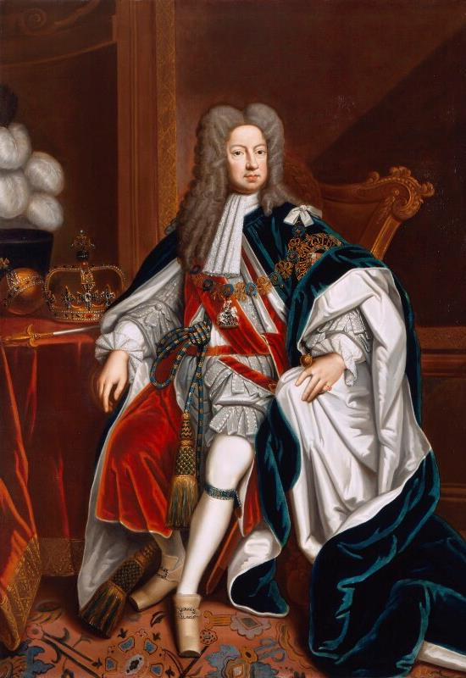
GEORGE I
The first Georgian King
In 1701, Parliament ordered that British monarchs could not be Catholic. Not long after, Queen Anne died without an heir. Over 50 of Anne’s relatives could have had a claim to the throne, but they were Catholic.
George I was a distant relative of Anne, and he was Protestant. He became King in 1714. In 1715, Anne’s half-brother, James Stuart, attempted a rebellion to become king, but this failed.
George visited Kensington Palace for the first time when he came to England in 1714.
He brought 18 cooks to England with him.
Spoke German and French but only a few words of English.
Spent little time in England and made regular visits back to Hanover. Left the running of the country to his trusted ministers, including Britain’s first Prime Minister.
Divorced his wife so had no Queen Consort.
Reportedly died of a stroke brought on by eating too many strawberries while travelling to Hanover.
When in England, George I stayed at Hampton Court Palace and at Kensington Palace. He made improvements including:
a new kitchen and laundry at Hampton Court
new apartments for the Prince and Princess of Wales
rebuilding part of the old palace at Kensington to create new State Apartments.
“In private life he would have been called an honest blockhead”
Lady Mary Wortley Montagu writing about George I.
He was uncomfortable in social situations.
Q:
What objects in the portrait tell us that George I is a king?
© National Portrait Gallery, London
Reigned: 1714 - 1727
Q:
What evidence is there to suggest why George I was not a popular king?
Lived: 1660 - 1727 |Birthplace: Hanover, Germany
Notes:
George I notes:
George I’s portrait includes a crown, an orb and a sceptre. These are ancient symbols of monarchy.
George I may not have been popular because he spoke little English and frequently returned to Hanover. He was a reluctant king, shy and socially awkward.

Slide 3
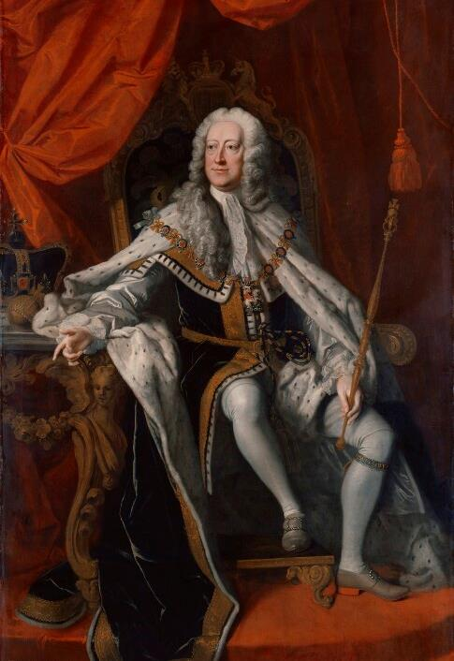
GEORGE II
The last British monarch to lead his troops into battle
George II moved into Kensington Palace when he became king. He spoke more English than his father but still spent a lot of time in Hanover. He relied on the Prime Minister to run the country.
In 1743, at the Battle of Dettingen in Germany, he was the last British monarch to fight alongside his soldiers. His claim to the throne was challenged by Prince Charles Edward Stuart, but the prince’s army was defeated at the Battle of Culloden in 1746.
Dull and self-important.
Often lost his temper.
Sometimes threw off his wig and kicked it round the room.
Loved order and routine.
Reportedly had his underwear numbered according to the day of the week.
He and his wife, Queen Caroline, made Kensington Palace their main home in London. They also used Hampton Court Palace, particularly during the summer.
He often argued with his eldest son, Frederick, Prince of Wales. In 1737, he banished Frederick and Frederick’s wife from court.
“Little things…afflicted him more than great ones.”
The Earl of Chesterfield, writing about George II
Died while on the toilet at Kensington Palace.
Q:
Can you explain the quote by Earl Chesterfield in your own words?
Obsessed with facts and figures.
© National Portrait Gallery, London
Q:
How would you describe how George II is portrayed in his portrait?
Reigned: 1727 - 1760
Q:
What evidence is there that might disagree with the idea of George II as a ‘kind king’?
Lived: 1683 - 1760 | Birthplace: Hanover, Germany
Notes:
George II notes:
The quote suggests that George II was more upset by petty, unimportant things than by important matters.
In his portrait, George II is portrayed as regal but also kindly.
There is evidence in that George was bad tempered and petty. He fell out with his eldest son. This is different to how he is portrayed in the portrait.

Slide 4
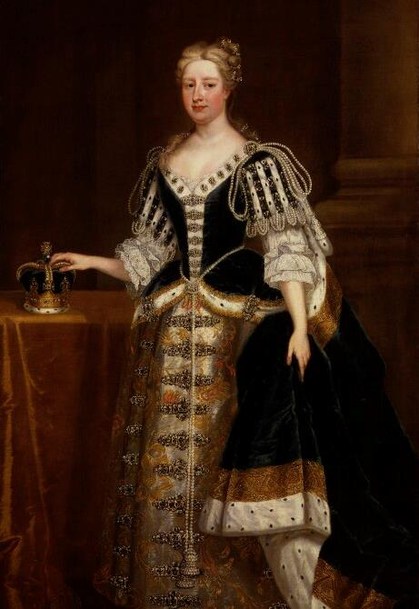
QUEEN CAROLINE OF ANSBACH
An intelligent, sophisticated and forward-thinking queen
Brought up at courts of Berlin and Dresden.
Surrounded by artists, writers and intellectuals.
Developed keen interest in art, history and science.
Caroline married the future George II in 1705. She moved with him to England in 1714. At this time, her title was Princess of Wales. As George’s father had divorced his own wife, Caroline became the most senior woman at court. She became Queen Consort in 1727.
She brought glamour, intelligence and liveliness to court. Her husband discussed politics with her and trusted her judgement. He appointed her as regent on several occasions when he was away in Hanover.
She made Kensington Palace a glittering centre of court life. She invited philosophers, scientists, artists, writers and gardeners to her receptions.
She also hired William Kent to transform the gardens at Kensington Palace. The old gardens were replaced with more fashionable, ‘natural’ ones.
Caroline and George II were very different but had a successful marriage. They had nine children and Caroline made sure they were well-educated and cared for. However, she had a poor relationship with eldest son, Frederick.
"Born to encourage the arts and the well-being of mankind."
Voltaire (a French philosopher) speaking of Queen Caroline
She collected miniature portraits.
Q:
How is Caroline’s clothing decorated in her portrait?
Had all her children vaccinated against smallpox.
© National Portrait Gallery, London
Q:
What impression do these decorations create?
Reigned: 1727 - 1737
Q:
Can you give one example of Caroline being ‘forward-thinking’?
Lived: 1683 – 1737 | Birthplace: Ansbach, Germany
Notes:
Queen Caroline notes:
The decorations in Queen Caroline’s portrait include lace, jewels and fur. The jewels are diamonds and pearls. The fur is ermine: a stoat whose fur turns white in winter and has a black tip to its tail.
The decorations on Queen Caroline’s clothing create an impression of glamour and wealth.
There are lots of examples that Queen Caroline was ‘forward thinking’. She had her children vaccinated against smallpox and she spent time with scientists, artists, writers. She also modernised the gardens at Kensington Palace.

Slide 5
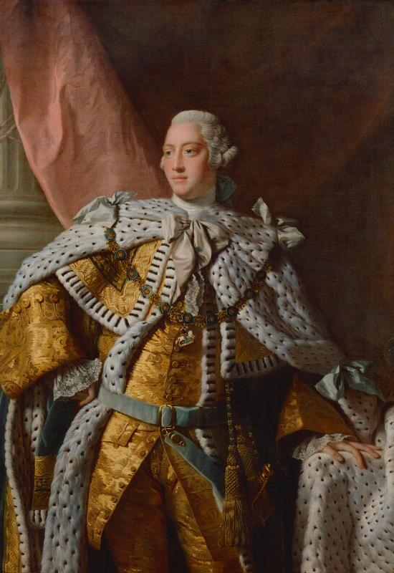
GEORGE III
The third longest reigning monarch in British history
Unlike George I and George II, George III was born in England and spoke English as his first language. He was the first British monarch to celebrate a Golden Jubilee.
Nicknamed ‘Farmer George’ because of he liked farming and had simple tastes.
Became heir to the throne aged 12 when his father, Prince Frederick, died suddenly.
Became king aged 22 when his grandfather, George II, died.
He was cultured and well-educated and a hard-working king who took an interest in government. His interests included botany, the arts and sciences, music and manufacturing.
He ruled over 13 North American colonies, and he was not keen for them to become independent.
As a result, during his reign, the American War of Independence took place between 1776 -1783. As part of this George Washington’s armies defeated the British and Great Britain recognised the independence of the United States.
Devoted to his wife, Queen Charlotte.
Loved their children but he strictly controlled them.
This led to poor relationships with his children when they became adults.
He disliked Kensington Palace. Instead, he made Windsor Palace and Buckingham House his main homes.
He suffered periods of mental illness which became worse during stressful times. Eventually in 1811, he was declared unfit to rule. His eldest son, George IV was appointed regent.
Q:
Can you describe the clothing George III is wearing in his portrait?
Q:
What do you think George III’s best qualities as king were?
He collected over 65,000 books.
© National Portrait Gallery, London
Reigned: 1760 - 1820
Q:
Can you give one example of George III being over-controlling? What was the result of this?
Lived: 1738 - 1820 | Birthplace: Ansbach, Germany
Notes:
George III notes:
In his portrait, George III is wearing coronation robes. He has a fashionable knee length coat, breeches and cloak made from gold silk brocade and lined with ermine.
Some of George III’s better qualities were that took his responsibilities as king seriously. He was conscientious and hard-working.
There are a few examples of George III being over-controlling:
George was over-controlling with his children. This led to poor relationships with them when they grew-up.
He was also over-controlling with the American colonies. Some historians think this contributed to the American War of Independence and the ‘loss’ of the colonies.

Slide 6
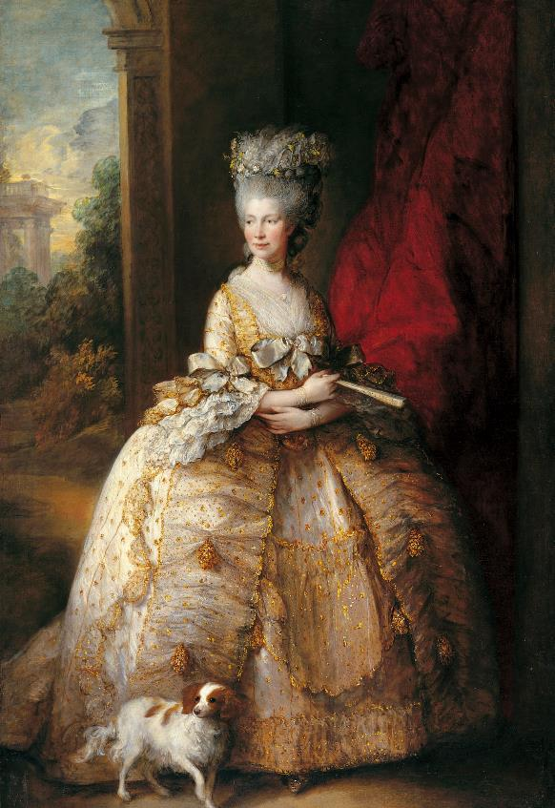
QUEEN CHARLOTTE
An intelligent queen with a wide range of interests
Charlotte was born and brought up in the Palace of Mirow, now part of Germany. She spoke German, French and English and was sweet and good humoured.
Married George III in 1761. She was 17 and he was 23.
Both crowned later the same year.
Gave birth to her first child, the future George IV, less than a year later.
In 1761, George III bought a new house for her called Buckingham House. It was renamed the Queen’s House. 14 of their 15 children were born there. They enjoyed happy, relaxed family summers at Kew Palace before George became too unwell with mental illness.
Played the harpsichord and very interested in music.
Wolfgang Amadeus Mozart performed for her.
Keen amateur botanist.
Took a great interest in the gardens at Kew Palace.
Interested in books - her large library included books on botany, the theatre and literature.
Scientifically minded, she surrounded herself with serious thinkers, including female writers.
Charlotte founded many orphanages. In 1809, she became the patron of The Queen’s Hospital in London. She became her husband’s guardian in 1811, when he was too ill to rule.
“I am of the opinion that if women had the same advantages as men in their education they might do as well.” Queen Charlotte
Collected luxury objects including French porcelain and jewelled boxes.
Q:
What image of Queen Charlotte has the artist created in the portrait?
Royal Collection Trust / © His Majesty King Charles III 2024
Reigned: 1761 - 1818
Q:
What evidence is there in this biography that she was an intelligent woman?
Lived: 1744 - 1818 |Birthplace: Mirow, Germany
Notes:
Queen Charlotte notes:
In her portrait, Queen Charlotte seems kind and gentle, cheerful and lively. Her fancy dress and tall wig, make her appear regal, graceful and fashionable.
Charlotte had a wide range of interests including science, botany and literature. The quote suggests that she recognised that women were as intelligent as men but that they were at a disadvantage because they didn’t have the same education.

Slide 7
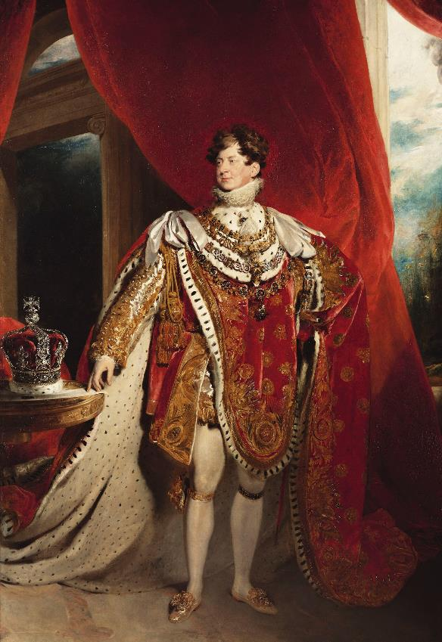
GEORGE IV
An extravagant monarch and the last Georgian King
George IV ruled as Prince Regent from 1811 while his father was unwell. He became king when his father died.
Given his own house in London at the age of 18.
Friends included artists, politicians and actresses.
Secretly married a Roman Catholic widow, Mrs. Maria Fitzherbert.
This marriage was considered invalid because George III had not given them permission.
George IV later officially married his cousin, Princess Caroline of Brunswick. However, they separated not long after their daughter, Princess Charlotte, was born.
Spent large amounts of money.
Collected furniture, textiles, books and paintings.
Remodelled his home in Brighton into the Royal Pavilion.
Ordered Buckingham House to be rebuilt
as a palace.
His daughter, Princess Charlotte, died in childbirth aged 21. He became very overweight due to eating and drinking too much. He suffered from health problems including gout and tried to disguise his large waist with tight fitting jackets and tight belts. Died at Windsor Castle without an heir.
“He is rather too fond of wine and women”
George IV, aged 17, writing about himself.
In later life, he wore a wig designed to look like dark, thick, curly hair.
Had a new crown made for his coronation. It had over 12,000 diamonds.
Q:
What image do you think George IV wanted to create in his portrait?
Royal Collection Trust / © His Majesty King Charles III 2024
Reigned: 1820 - 1830
Q:
What evidence is there in this biography that George was a ‘vain and extravagant’ king?
Lived: 1762 - 1830 |Birthplace: London
Notes:
George IV notes:
In his portrait, George IV might have wanted to create an image of wealth, power and of majesty. He is wearing flamboyant Coronation robes that he designed himself.
George IV was vain of his appearance, wearing tight clothes and a wig in later life. He was also extravagant, he spent vast sums of money on collecting, building projects and his coronation.

Slide 8
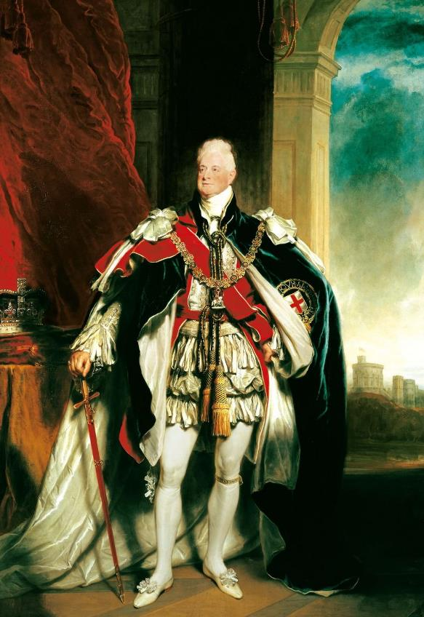
WILLIAM IV
Britain’s ‘Sailor King’
William IV was the third son of King George III. He became king when his eldest brother, George IV, died without an heir. His other brother had also died without an heir.
Joined the Royal Navy aged 13.
Became Duke of Clarence in 1789.
Lived with the famous actress Dorthea Jordan.
They had 10 children known as the ‘Fitzclarences’.
Since they weren’t married, their children would not be able to become monarchs themselves.
After Princess Charlotte died, William became next in line to the throne. He married Princess Adelaide of Saxe-Meningen, hoping they would have children and he would have an heir. They had two daughters who both died in childhood.
Whilst he was king, the Great Reform Act was passed in 1832.
This gave more men the right to vote in elections. In 1833, Britain abolished slavery in most of their overseas colonies.
Had plain tastes.
Interested in naval and military affairs.
Liked Windsor Castle and completed building work there.
“I have my view of things, and I tell them to my ministers. If they do not adopt them, I cannot help it. I have done my duty.”
William IV
Hated pomp and ceremony and didn’t want to have a Coronation.
Q:
How far do you think William’s Coronation Portrait reflects his personality and tastes?
Royal Collection Trust / © His Majesty King Charles III 2024
Reigned: 1830 - 1837
Q:
What does the quote tell you about William’s understanding of the role of the monarch?
Lived: 1765 - 1837 |Birthplace: London
Notes:
William IV notes:
In his portrait, William IV appears to be a regal king, dressed in showy coronation robes. This does not reflect William’s personality as a man with plain and simple tastes and a naval background.
William understood that the role of the monarch in the 19th century was limited. He considered it his duty to express an opinion to his ministers but knew that they were the ones that govern the country.

Slide 9
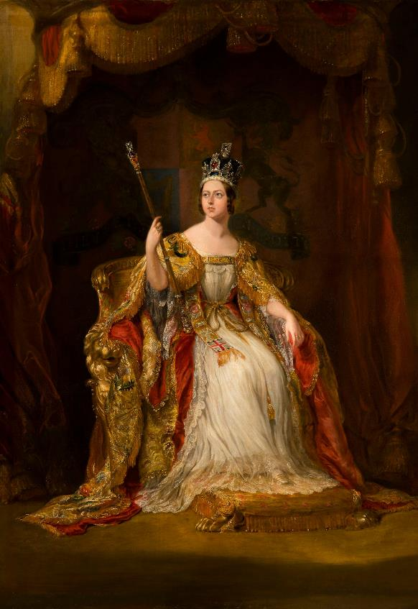
VICTORIA
A queen who reigned for 63 years
Victoria’s father died suddenly 8 months after she was born. Her mother relied on John Conroy who had been her husband’s assistant. Conroy devised the ‘Kensington System’ which kept Victoria alone and under close watch.
5th in line to the throne when she was born in Kensington Palace.
Due to deaths in the family, she became queen when she was 18 years old.
She moved into Buckingham Palace.
People were delighted to have a new young queen.
Married her German cousin, Prince Albert, in 1840.
Had nine children.
Spent holidays at Osborne House on the Isle of Wight.
Albert died suddenly in 1861 and Victoria was grief stricken.
She wore black mourning clothes for the rest of her life and withdrew from public for many years.
Victoria became Empress of India in 1876 but never visited. Many changes took place during Victoria’s time as queen:
the invention of postage stamps
the development of a railway network
the industrialisation of Britain
the invention of the telephone.
She celebrated her Golden Jubilee in 1887 and Diamond Jubilee in 1897.
As a princess, she was not allowed to walk downstairs without holding someone’s hand.
Q:
Describe how Victoria is portrayed in her Coronation portrait.
Q:
What impression of her do you think this creates?
Kept a diary from age 13 to a few days before she died at 81.
Royal Collection Trust / © His Majesty King Charles III 2024
Reigned: 1837 - 1901
Q:
What do you think Queen Victoria is most remembered for today?
Lived: 1819 - 1901 | Birthplace: London
Notes:
Victoria notes:
In her portrait, Victoria is seated on a throne, wearing her coronation robes over a simple white dress. She wears a crown (the Imperial State Crown) and holds a sceptre (The Sceptre with Cross). She is gazing upwards with the light shining on her face.
The portrait creates an impression of a calm, regal, confident, poised, innocent young woman.
Victoria is remembered for lots of things today:
Her marriage to Prince Albert
That she always wore black after he died
Being Empress of India
The length of her reign
The changes that took place during her reign.

Slide 10
TEMPLATE WORKSHEET
________________
________________
________________
________________
Image credit:
Image credit:
Lived: _______
Lived: _______
Birthplace: _______
Birthplace: _______
Q:
Q:

Slide 11
VOCABULARY LIST
abolish | officially end something
afflicted | caused pain or trouble by
American War of Independence | military campaign by the American colonies to win their independence from Great Britain
apartment | set of rooms for living in
botany | the scientific study of plants
botanist | someone who studies plants
Catholic | member of the Roman Catholic Church. A type of Christianity that follows the teachings of the Pope
colony | a group of people from one country who build a settlement in another land; or a country or area under the control of another country
crowned | when a crown is placed on the head of someone during a ceremony to recognise them officially as monarch
Diamond Jubilee | celebrations marking the 60th anniversary of an event, such as someone becoming king or queen
Elector | German prince who had the right to vote in elections to choose the Emperor
empire | large group of countries or regions that are controlled by one ruler or government
empress | woman who rules over an empire
Georgian | the time from 1714 to 1830 when Britain and Ireland were ruled by George I-George IV
Golden Jubilee | celebrations marking the 50th anniversary of an event, such as someone becoming king or queen
gout | disease that causes severe pain and swelling, usually of the big toe

Slide 12
VOCABULARY LIST 2
VOCABULARY LIST
government | group of people that have the authority to rule a country
Great Reform Act| law passed by Parliament in 1832: middle class men could now vote, but not women or other men
harpsichord | musical instrument similar to a piano
heir | person who will become the next king or queen
industrialisation | when manufacturing and other industries are introduced on a large scale
intellectual | someone who is well educated and interested in studying
invalid | not legal
Kensington System | set of rules devised to keep Victoria under strict control at Kensington Palace as a child
military | word used in connection with an armed force such as soldiers
minister | someone with a lot of power and responsibility in government
monarch | ruler of a kingdom or empire, such as a king or queen
monarchy | system of government with a king or queen as its head
mourning | a sign of the deep sadness and loss felt when someone dies (such as wearing black clothes)
navy | ships built and maintained to defend a country
Queen Consort | the wife of a reigning king

Slide 13
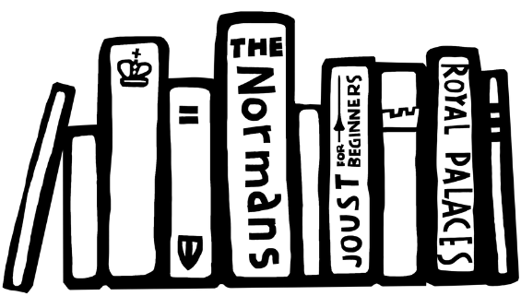
VOCABULARY LIST 3
VOCABULARY LIST
Parliament | the group of people elected to make and change laws in a country; in the past only very rich and powerful people were Members of Parliament
patron | someone who gives financial or other support to a person or organisation
philosopher | someone who studies human life and the world, for example how we think and what we value
Prime Minister | the leader of the government
Protestant | a type of Christianity that believes people do not need officials (such as the Pope or Bishops) to communicate with God
rebellion | a fight by a large group of people against the government or ruler; or an action against rules and accepted ways of behaving
regent | person who rules when the king or queen is unable to
smallpox | serious and often deadly infectious disease in the past
State Apartments | grand public rooms where official visitors are hosted
widow | woman whose husband has died

