Slide 1
HOW TO USE - NOTES FOR TEACHERS
These resources from Historic Royal Palaces are multi-purpose. They are ready for you to tweak and use in your lessons.
For the best experience, download and open the file in the PowerPoint desktop app.
Answers are found under the slide. Click on the notes symbol at the bottom of the screen.
Delete text and images to make your own worksheets.
Disclaimer and Use Terms
We are the owner or the licensee of all intellectual property rights in these resources which are protected by copyright laws and treaties around the world. All such rights are reserved. These resources, and the content included within them, may be used by you for educational purposes only. This means that you may download the resources and use or share them solely in educational environments (including for home school lessons) or as part of homework. You may not share the resources other than for the above purposes and you must not use the resources, or any part of them, for any commercial purpose.

Slide 2
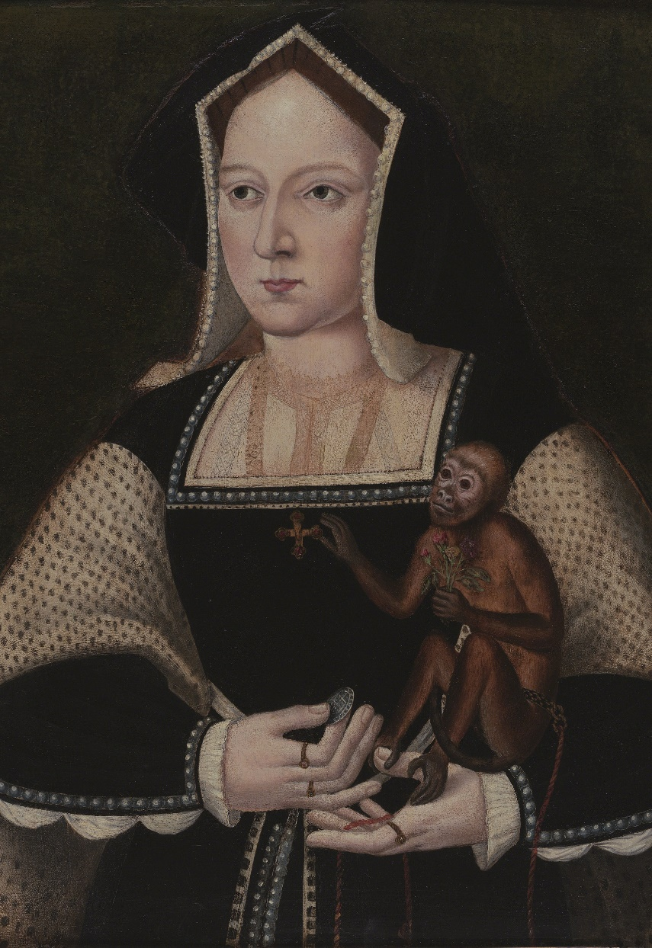
KATHERINE OF ARAGON
A Catholic Spanish princess who became a brave queen
Katherine’s mother was a very powerful, intelligent Queen of Spain, and an important influence in her life.
Brought to England aged 15 to marry Arthur, the eldest son of Henry VII.
Arthur died few months later.
Arthur’s brother Henry became King Henry VIII.
Katherine and Henry got married in 1509
The first 10 years of their marriage were happy.
Henry often dressed up as Robin Hood to surprise her.
They both were religious, enjoyed riding, hunting, dancing and fine clothes.
In 1513, Katherine became regent while Henry was fighting in France. The Scottish army took this as an opportunity to invade England. Katherine rode north in full armour to address the English troops.
She had one son who sadly only lived for two months, and she suffered other losses too. In 1516, she had a daughter, Mary.
Henry was obsessed with having a son and wanted to remarry.
He thought that God was punishing him because he had married his brother’s widow.
Katherine was now unable to have more children.
Henry wanted Katherine to accept that their marriage was invalid and go quietly into a convent. She refused to leave, and the Pope supported her. Finally, Henry went against the Pope. He banished Katherine from court, and she was banned from seeing her daughter. However, she remained popular with the public.
‘Mine eyes desire you above all things.’
Katherine’s words in her final letter to Henry before she died.
Q:
Give one example that shows Katherine was a very capable woman?
Why do you think Katherine refused to ‘go quietly’ when Henry wanted to remarry?
The first female ambassador in European history.
Photo © Philip Mould Ltd, London / Bridgeman Images
Q:
Reigned: 1509 - 1533
Q:
What influence might Katherine’s mother have had on her?
Lived: 1485 - 1536 | Birthplace: Madrid, Spain
Notes:
Notes:
There are a few examples that Katherine was capable woman. Henry made her regent when he was away fighting. Her father also made her the Spanish ambassador. Also, she got the Pope’s support and stood up for herself when Henry tried to send her away.
Katherine may not have wanted to ‘go quietly’ when Henry wanted to remarry for a few reasons. Having been brought up as a Spanish princess, Katherine had a strong sense of her high status and position in the world. She was a devout Catholic so her marriage was sacred and could not be ended except by one partner dying. If she accepted the marriage was invalid, that would make her daughter illegitimate.
Katherine’s mother was a strong, powerful ruler and a queen in her own right. This possibly influenced Katherine to also be strong willed and brave.

Slide 3
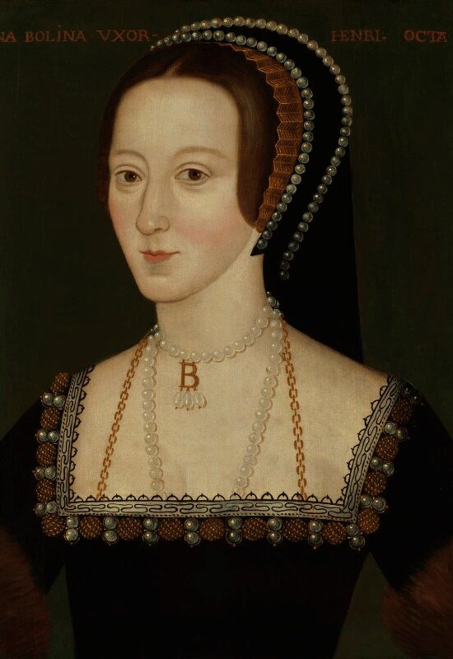
ANNE BOLEYN
A captivating queen who got involved with politics
Anne’s father was a respected courtier, and her grandfather was the Duke of Norfolk – a very powerful man. She spent her childhood at Hever Castle. Her father wanted her to have the same education as her brothers. She was sent to French Court in 1514 where she learnt skills and manners to be a lady at court. She was stylish and sophisticated and had a captivating personality. She returned to England by 1522 and became a lady-in-waiting to Henry’s first wife.
By 1526, Henry was obsessed with Anne, however she refused him at first. After Henry broke from the Church, they got married in 1533.
Stayed in Royal Apartments at Tower of London before her Coronation.
Had a large procession through the streets of London to Westminster.
Gave birth to a daughter, Elizabeth.
Supported Henry’s religious changes.
Outspoken and reportedly had fierce temper.
At the time, it was unusual for women to get involved with politics, but Anne was intelligent and determined to be involved. As a result, she made enemies at court including Thomas Cromwell. She also suffered the loss of pregnancies. Her relationship with Henry began to break down. She was eventually accused of seeing other men and plotting to kill the King.
Even though there was not much evidence, she was found guilty of treason and imprisoned in the Tower of London. She was beheaded by a swordsman on Tower Green and buried in the Chapel. After she died, Henry tried to remove all traces of Anne, including destroying her portraits.
Q:
Anne’s portrait was painted in the late 1500s, but art historians think it may be a copy of a lost original. How is she portrayed in it?
When Elizabeth became queen, she had new portraits made of Anne.
© National Portrait Gallery, London
Reigned: 1533 - 1536
Q:
Do you think Anne was responsible for her downfall and execution?
Lived: c.1501 - 1536 | Birthplace: Norfolk
Notes:
Notes:
In the portrait, Anne is portrayed as very elegant and fashionable. She is pale with dark hair and eyes, with a long, oval face and a slender neck. Her black dress and hood are trimmed with pearls and gold decorations. She wears simple but expensive gold and pearl necklaces, with a pendant in the shape of the letter ‘B’ for Boleyn.
Since there is no evidence that Anne was guilty of the charges against her, many people might think that she wasn’t responsible for her own downfall. She was not responsible for the fact that her baby was a girl, or that she suffered losses whilst pregnant. However, others might say that she had been unwise to make enemies at the Tudor court.

Slide 4
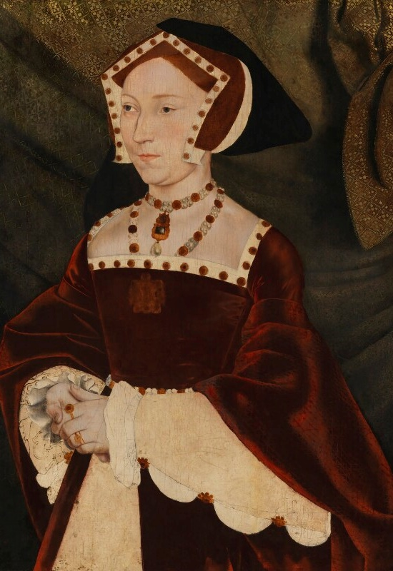
JANE SEYMOUR
A peacemaker queen, who supported Catholic monasteries
Jane was born around 1508 at Wolf Hall. She came from a wealthy family, but they had little power at court. She was a devout Catholic and was taught needlework.
She was sent to court by her family in 1529 and was a lady-in-wating to Katherine of Aragon, who she respected. She later also served Anne Boleyn. Jane was reported to be gentle and a peacemaker.
Henry sent her letters and gifts, and she politely refused him at first. However, they got engaged the day after Anne’s execution and got married a few days later.
Stopped fashions that Anne had introduced.
Formed a close relationship with her stepdaughter Mary.
Helped Mary and Henry to repair their relationship.
At one point, she begged Henry not to close the Catholic monasteries. This made Henry very angry, and he told her he did not want his wife to get involved in politics. As a warning, he reminded Jane what had happened to his previous wife.
In 1537 she gave birth to a boy, Edward, at Hampton Court Palace. This finally gave Henry a male heir. But it was a difficult birth and Jane became ill. She died two weeks later.
Her labour lasted three days and three nights.
Q:
Jane’s portrait was painted when she was queen. How has the painter conveyed her status and personality?
Her motto was ‘Bound to obey and serve’.
© National Portrait Gallery, London
Reigned: 1536 - 1537
Q:
Why do you think Henry remembered Jane as his favourite wife?
Lived: c.1508 - 1537 | Birthplace: Wiltshire
Notes:
Notes:
In the portrait, Jane is wearing very expensive clothes made of rich fabrics, decorated with jewels. The style of the clothes, and her expression, make her appear formal, modest and demure. There is also the Christian symbol, IHS, on her pendant, which shows her to be religious. (IHS is an abbreviation of the Greek word for Jesus.)
Henry might have remembered Jane as her favourite wife because she was the only one of his wives to have a surviving son. She was also reported to be gentle, so it might be suggested that she was submissive to Henry. Also, since she died now long after having his longed-for heir, she might have been idealised in his memory.

Slide 5
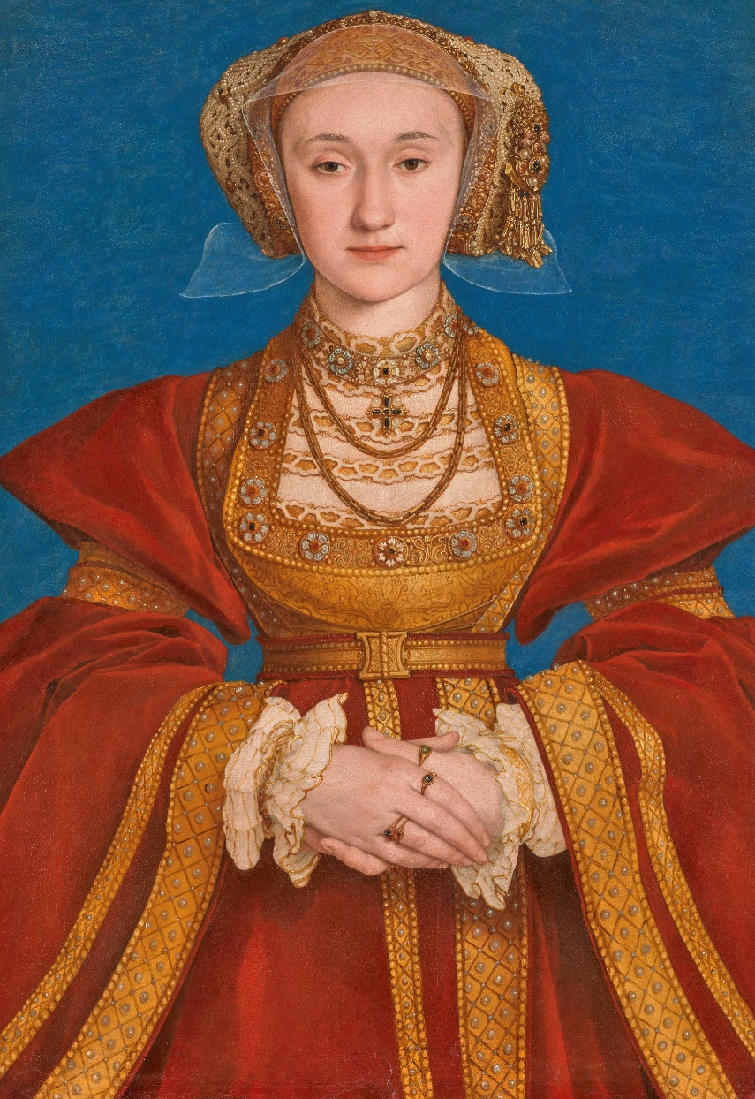
ANNE OF CLEVES
A generous and kind queen who made the most of a bad situation
Anne was born in Germany and her father was a duke. Her mother was a Catholic, but Anne was probably Protestant. She liked card games and gambling.
Henry VIII’s chief minister was Thomas Cromwell. Together, they were planning a new marriage for Henry, but they also wanted to set up an alliance in Europe. A painter was sent to Germany to paint portraits of Anne and her younger sister. Henry saw these images and thought Anne was very beautiful, he decided to marry her.
She arrived in England in 1539.
Henry was anxious to meet her.
He greeted her in disguise which was a tradition of a romantic courtly lover.
He attempted to kiss her, but Anne did not recognise him.
Henry was disappointed by her appearance and behaviour.
Henry wanted to get out of the marriage, but he could not do this without risking his alliance. The marriage went ahead, and their wedding was extravagant. However, they did not have a close relationship and they did not have much in common.
Tried to learn English to make the relationship work.
Became friends with Henry’s daughter Elizabeth and they developed a close relationship.
Generous and kind towards her servants.
After six months she agreed to end the marriage. She stayed in England and was given a generous allowance and properties. She seemed to enjoy her life without the responsibility of being queen. Later, when Edward became king, she lost many of her properties. However, after he died, she was part of Mary I’s coronation procession and remained close to her stepdaughters.
Q:
Why do you think Henry rejected Anne shortly after meeting her?
After she separated from Henry, Anne had a strong position at court.
(C) RMN-Grand Palais (musée du Louvre) Adrien Didierjean
Reigned: 1540
Q:
Do you think Anne was sensible in agreeing to their separation? If so, why?
Lived: 1515-1557 Birthplace: Rhineland, Germany
Notes:
Notes:
Henry might have rejected Anne because he had fallen in love with her based on her portrait and in person and he was disappointed with her appearance. Also, their first meeting was a disaster and Henry may have felt embarrassed or offended by her behaviour.
Many people will think Anne was sensible in agreeing to a separation as she avoided being banished from court like Katherine of Aragon was. Instead, she was rewarded with money and properties, and seems to have formed a good relationship with Henry and his daughters.

Slide 6
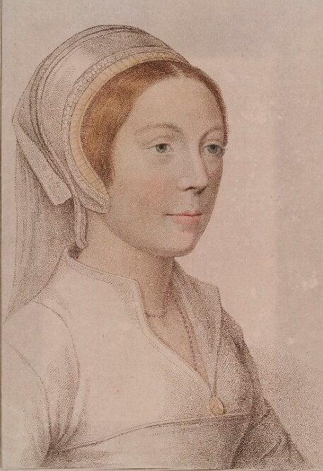
CATHERINE HOWARD
A gracious, young queen who had a sad ending
Catherine’s father, Edmund Howard was a son of the Duke of Norfolk. Her mother, Joyce, died in 1528 and Catherine was sent to live with her step-grandmother, Agnes Tilney. She had a stable life there and as she got older had a few romantic relationships.
In 1539, her uncle helped to get Catherine a position at court.
She became a lady-in-waiting to Anne of Cleves.
Henry was attracted to Catherine.
They got married in 1540.
Henry was almost 50 years old, and he adored his new, young wife. Catherine was a gracious and traditional queen. However, in 1541, she began a relationship with Thomas Culpepper. They wrote each other love letters and eventually these were discovered.
Catherine was at Hampton Court Palace when Henry found out. He ordered an immediate investigation. She was put under house arrest. Eventually, she confessed that she had had affairs. Henry was devastated by her betrayal, and she was sentenced to death. There is evidence that the men around her, including her uncle and Thomas, used Katherine and her position to help themselves.
In 1542, she was taken by boat to the Tower of London and was executed three days later. She was buried in the chapel nearby.
Had a good relationship with her stepdaughter Elizabeth and gave her gifts of jewellery.
Q:
Roughly how old was Catherine when she started attending court, got married, started her affair with Thomas and was executed?
Was so terrified about her execution that she had to be helped to walk.
© National Portrait Gallery, London
Reigned: 1540 - 1541
Q:
Experts are unsure if this image is of Catherine. There are few images of her surviving today. Why might this be?
Lived: c.1523 - 1542 | Birthplace: London
Notes:
Notes:
Catherine was roughly 16 when she started attending court, 17 when she married Henry, 18 when she started her relationship with Thomas and 19 when she was executed.
There are a few reasons that might explain why there are so few portraits of Catherine around today. Firstly, she was only queen for a short time so this might not have been enough to have a portrait made. Also, Henry often destroyed all documents and portraits related to his former wives, so he may have ordered any portraits of her to be demolished.

Slide 7
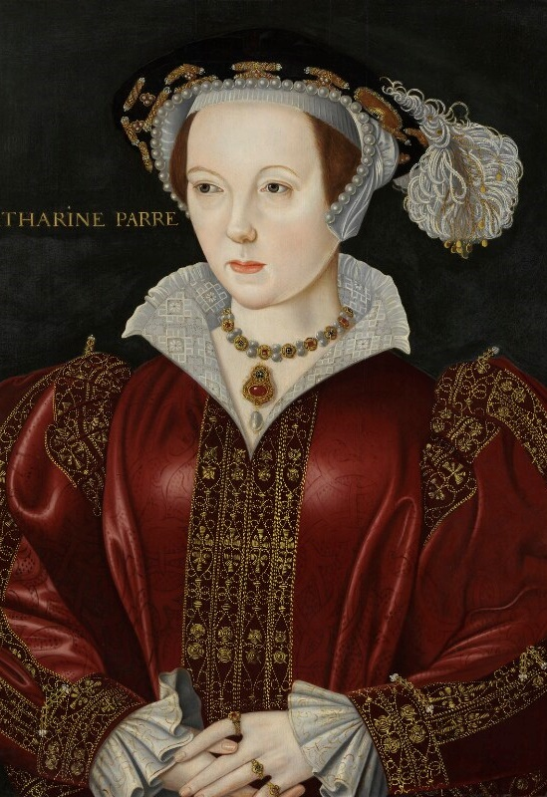
KATHERINE PARR
An intelligent, mature queen who had impressive achievements
Katherine’s father was a courtier, Sir Thomas Parr, and her mother was Maud, a lady-in-waiting to Katherine of Aragon. She was very clever, fluent in French, Latin and Italian and liked music and dancing.
First marriage to Sir Edward Burgh.
He died and she became a widow.
Second marriage to Lord Latimer.
He was about twenty years older than her and in poor health.
Katherine took care of him until he died.
She was a strong supporter of the English Reformation. She met and fell in love with Thomas Seymour, Jane Seymour’s brother. But Henry VIII proposed to her, and they got married at Hampton Court Palace in 1543.
Loving stepmother to Henry’s three children.
Had a strong influence on his daughter Elizabeth.
Became regent while Henry fought in France in 1544.
She did very well in this role.
She had disagreements with Henry about religion. His ministers tried to turn him against her. This could have ended badly for Katherine, but she told Henry she had only argued with him to learn from him, and he forgave her.
Katherine was loyal to Henry until he died in 1547. Then, she married Thomas Seymour and gave birth to their daughter, Mary, in 1548. Katherine died a few days after.
Q:
Why do you think Katherine accepted Henry’s marriage proposal, even though there is evidence she was already in love with Thomas Seymour?
The first English queen to write and publish her own books.
© National Portrait Gallery, London
Reigned: 1543 - 1547
Q:
What evidence is there that Katherine was good at connecting with people?
Lived: 1512 - 1548 | Birthplace: London
Notes:
Notes:
Katherine may have agreed to marry Henry because she felt it was her duty to accept him, or God’s will. Perhaps she was concerned what he would do if she refused. There is no evidence that Katherine was an ambitious woman who wanted the power and status of being queen.
There is lots of evidence Katherine was good at connecting with people. She cared for her second husband when he was ill. She also managed to connect with all three of Henry’s children, despite them having different religions and a troubled past with each other and Henry himself. She was also able to convince Henry to trust her again after his ministers tried to turn him against her.

Slide 8
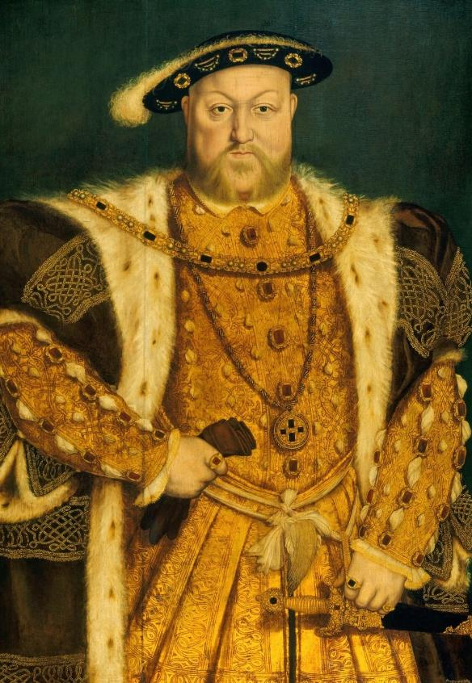
HENRY VIII
The King who married six times and created the Church of England
Henry VIII was the second son of Henry VII. His elder brother, Arthur, died in 1502. Henry VIII became king aged 17 after his father died.
Wrote music and poetry.
Graceful dancer and excellent sportsman.
Married his brother’s widow, Katherine of Aragon.
In 1516, their daughter Mary was born.
During his time as king, he had two big challenges: having a male heir and getting the Pope’s permission for a divorce.
Henry and Katherine did not have a son to become heir. Henry thought God was punishing him for marrying his brother’s widow. He asked the Pope to declare that their marriage had been invalid, but the Pope refused. So, Henry broke away from the Roman Catholic Church.
Married his second wife Anne Boleyn in 1533.
Created a separate Church of England.
Made himself the Supreme Head of the Church of England.
In 1534, got Parliament’s support to make changes to the way the Church was run, and this started the English Reformation.
Henry and his chief minister, Thomas Cromwell, closed hundreds of monasteries, and took land and treasure. Henry used this wealth for developing England’s navy and building projects at Hampton Court Palace.
He and Anne had one child, Elizabeth, but not long after he accused Anne of treason, and she was executed. Around this time, he had an accident whilst jousting where he was knocked unconscious for a few hours.
His third wife, Jane Seymour, gave birth to his only son Edward at Hampton Court Palace. After she died, he married three more times, and executed another of his wives, Catherine Howard. When Henry died, he was buried with Jane Seymour in the Chapel at Windsor Castle.
Q:
Henry was very popular when he first became king. Why do you think that was?
Royal Collection Trust / © His Majesty King Charles III 2024
Q:
Why was Henry determined to end his marriage to Katherine of Aragon?
Reigned: 1507 – 1547
Q:
How does the artist convey Henry’s power in the portrait?
Lived: 1491 - 1547 | Birthplace: London
Notes:
Notes:
Henry might have been a popular because he was tall, young, sporty and cultured. Some people thought this would be a new era, with a new young king and his wife.
Henry wanted to end his marriage because he wanted a son to inherit the throne. The Wars of the Roses was still in living memory. Henry might have feared that leaving the throne to a woman might result in a civil war and the end of the Tudor dynasty.
In his portrait, Henry stands in a dominant pose. His expensive, fashionable clothes, encrusted with jewels, emphasise both his immense wealth and his physical size. One hand rests on his sword, which adds to the impression of a powerful, masculine, ruler.

Slide 9
TEMPLATE BIOGRAPHY
____________
____________
____________
____________
Image credit:
Image credit:
Lived: _______
Lived: _______
Birthplace: _______
Birthplace: _______
Q:
Q:

Slide 10
VOCABULARY LIST
affair | romantic relationship between two people, one or both of whom are married to someone else
alliance | agreement between people or countries to help each other
allowance | set amount of money to spend
ambassador | the official representative of a foreign ruler at the royal court
Catholic | member of the Roman Catholic Church - a type of Christianity that follows the teachings of the Pope
chief minister | the king or queen’s main advisor who has a lot of power
Church of England | the Christian church in England based on the Protestant faith, established by King Henry VIII, with the king or queen as its head
convent | buildings where religious communities of women called nuns live and worship
courtier | nobleman or noblewoman who spends a lot of time at the royal court
divorce | the legal ending of a marriage
courtly lover | knight who performed noble deeds for the woman he loved
dowry | money or property given by the bride’s family to her husband
English Reformation | name given to ending the Pope's control of the English Church and the religious changes that followed
government | group of people that have the authority to rule a country
heir | person who will become the next king or queen
house arrest | kept as a prisoner in a house, castle or palace rather than a prison

Slide 11
VOCABULARY LIST 2
VOCABULARY LIST
illegitimate | child whose parents were not legally married to each other when they were born
invalid | not legal
jousting | sport developed in the Middle Ages as training for soldiers who fought on horseback
lady-in-waiting | one of the queen’s companions who is there to do as the queen wishes
monasteries | buildings where religious communities of men called monks live and worship
minister | someone with a lot of power and responsibility in government
navy | ships built and maintained to defend a country
nobleman/woman | person of high rank in society
Parliament | the group of people elected to make and change laws in a country; in the past only very rich and powerful people were Members of Parliament
peacemaker | someone who tries to stop people from arguing or fighting
plot/plotting | secretly plan to harm someone, especially a government or ruler
Pope | the head of the Roman Catholic Church
Protestant | A type of Christianity that believes people do not need officials (such as the Pope or Bishops) to communicate with God
regent | person who rules when the king or queen is unable to
Roman Catholic Church | Christian religion with the Pope as its head

Slide 12
VOCABULARY LIST 3
VOCABULARY LIST
Royal Apartments | the king or queen’s private rooms
Supreme Head | the highest in rank
treason | the crime of acting against your own country, especially by trying to kill the king or queen, or overthrow the government
wealthy | having a large amount of money, property, land and valuable possessions
widow | woman whose husband has died

