Slide 1
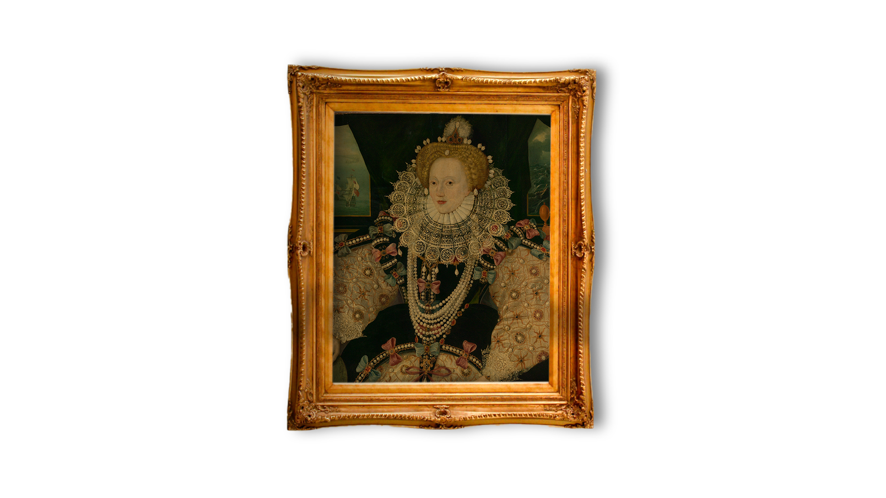
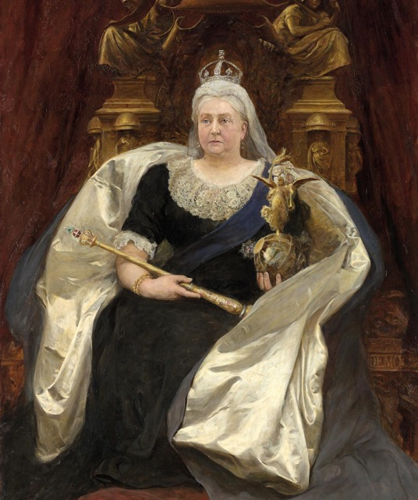
Comparing
Queens
– Source Task –
Queen Victoria
Elizabeth I
Notes:
Image Credits:
National Gallery of Victoria, Melbourne, Purchased, 1892, This digital record has been made available on NGV Collection Online through the generous support of Digitisation Champion Ms Carol Grigor through Metal Manufactures Limited
Elizabeth I Elizabeth 1, 1533 – 1603 (the Armada Portrait) © National Maritime Museum, Greenwich, London

Slide 2
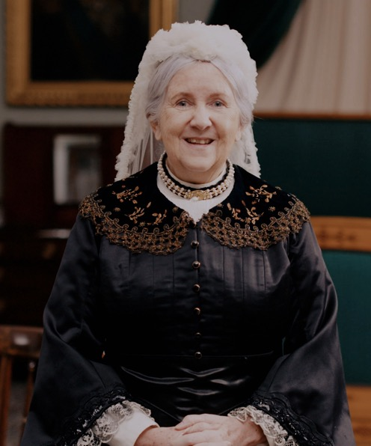
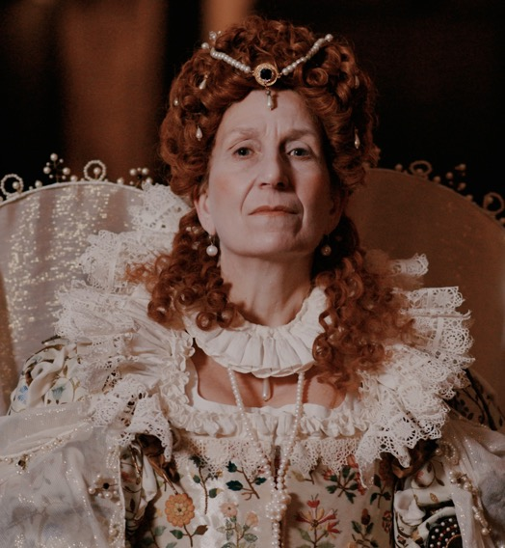
Have you watched us tell our stories?
Elizabeth I
Queen Victoria
Notes:
Watch the videos: https://youtube.com/playlist?list=PLmQztN3936tL1ZgIHlfwlsKaRAqEDNQf1&feature=shared

Slide 3
Vocabulary
history | Learning about people, places and events from a long time ago to understand what life was like in the past.
source | Items from the past that help us learn about what happened. These might be portraits or documents.
evidence | Clues that help us understand and explain what life was like in the past.
portrait | A picture or artwork of a person. It can be a painting, a photograph or even a sculpture.
monarch | A king or queen who leads a country and makes important decisions.
empire | A group of countries that were ruled over by one monarch or another country.
empress | A woman who reigns over an empire.
Parliament | The people who discuss and pass laws in the UK.
reign | The duration of time a ruler is monarch for.
crown | Something a king or queen wears on their head to show they have power.
Notes:
Teacher notes:
These terms are useful in the context of the video of this source task and the original video. It would be useful for children to be aware of them however you do not need to memorise or discuss all of them on this slide.

Slide 4
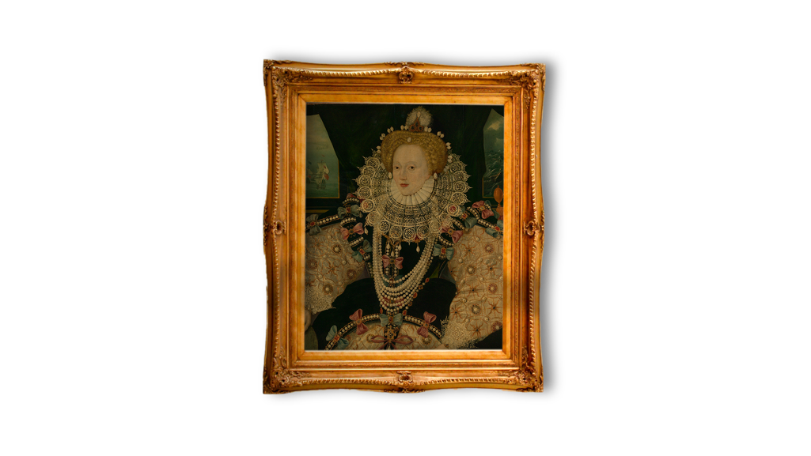
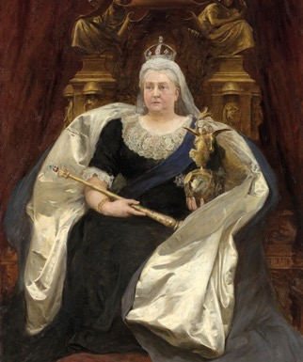
Which reign happened first?
Which reign
happened
first?
TUDOR PERIOD
VICTORIAN PERIOD
Elizabeth was born almost 500 years ago!
Victoria was born
over 200 years ago!
Elizabeth I
Queen Victoria
Further into the past
Now
Notes:
Teacher notes:
The purpose of this slide is for students to understand that this period of history is a long time in the past which is why life is so different to what they know.
Task:
To find out which of the Queens reigned further in the past.
Explain that if they were further in the past, their reign comes earlier in history.
Ask children to find now – explain this is where we are today.
Move finger back to the first Queen’s reign. Explain this is Queen Victoria. Continue to move back along the timelines to Elizabeth I and explain she is further in the past.
Ask the children to finish the sentence:
Queen Elizabeth reigned ______ Queen Victoria. (before)
Queen Victoria reigned ______ Queen Elizabeth I. (after)

Slide 5
What can we remember about Elizabeth’s reign?
What challenges did she face?
What power did she have?
Did she have a large family?
Where did she reign over?
Notes:
Teacher notes:
Answers are on the final slide. Some information can be found on the portrait, but others are not directly visible.

Slide 6
What can we remember about Victoria’s reign?
What can we remember about Victoria’s reign?
What challenges did she face?
What power did she have?
Did she have a large family?
Where did she reign over?
Notes:
Teacher notes:
Answers are on the final slide. Some information can be found on the portrait, but others are not directly visible.

Slide 7
Who reigned longer?
Who reigned longer?
44 years
63 years
✓

Slide 8
Who ruled over more places?
Who ruled over more places?
England
Wales
Ireland
England
Scotland
Wales
Ireland
Canada
Egypt
India
Australia
New Zealand
…and even more across the British Empire!
✓

Slide 9
Who had more power over Parliament?
Who had more power over Parliament?
✓
The Queen’s power reduced and more decisions were made by the Houses of Parliament.
Made decisions about how the country would be run at home and abroad.
Set up the Church of England.
Decided what Parliament
could discuss.
Ruled over other countries in the Empire too.

Slide 10
Who had to deal with people thinking that a woman could be a strong ruler?
Who had to deal with people thinking that a woman could be a strong ruler?
✓
✓

Slide 11
Comparing Queens – comparison chart
Comparing Queens
 | Queen Elizabeth I | Queen Victoria
When did they reign? | 1558 – 1603 (44 years) | 1837 – 1901 (63 years)
Where did they reign | England, Wales and Ireland | England, Scotland, Wales, Ireland, Canada, Egypt, India, Australia, New Zealand and more across the British Empire.
What power did they have? | Made decisions about how the country would run at home and abroad. Set up the Church of England. Decided what Parliament could discuss. | The Queen’s power reduced and more decisions were made by the Houses of Parliament. Ruled over other countries in the Empire too.
Did they have a large family? | She had a sister and a brother but never married and had no children. | She married Prince Albert and had nine children and lots of godchildren.
What difficulties did they face? | People thought a woman could not rule without a husband. People had been fighting about different religious beliefs in England. There was bad weather during her reign and not enough food. | She became queen very young and people were not sure if she could do it. Prince Albert died at age 42 and she found that very difficult. There were not equal rights for women and across the Empire many people were not treated fairly by the British. People protested and rebelled during her time as queen.
Notes:
Teacher notes:
Print this slide out to help your discussions.

