Slide 1
HOW TO USE - NOTES FOR TEACHERS
These resources from Historic Royal Palaces are multi-purpose. They are ready for you to tweak and use in your lessons.
For the best experience, download and open the file in the PowerPoint desktop app.
Answers are found under the slide. Click on the notes symbol at the bottom of the screen.
Delete text and images to make your own worksheets.
Disclaimer and Use Terms
We are the owner or the licensee of all intellectual property rights in these resources which are protected by copyright laws and treaties around the world. All such rights are reserved. These resources, and the content included within them, may be used by you for educational purposes only. This means that you may download the resources and use or share them solely in educational environments (including for home school lessons) or as part of homework. You may not share the resources other than for the above purposes and you must not use the resources, or any part of them, for any commercial purpose.

Slide 2
HAMPTON COURT PALACE TIMELINE
1514
1760
Thomas Wolsey rents Hampton Court. Rebuilding works begins
Grace and favour apartments
1529
1689
1838
Henry VIII starts building project
Parts of Tudor palace destroyed. New palace building begins
Queen Victoria opens the palace to the public free of charge

Slide 3
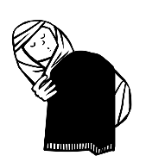
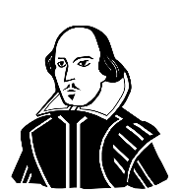
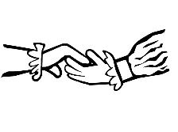
HAMPTON COURT PALACE TIMELINE
1514
1537
1543
1603
1760
Thomas Wolsey rents Hampton Court. Rebuilding works begins
Jane Seymour gives birth and dies soon after
Chapel Royal – Henry VIII marries Katherine Parr
The Great Hall – Shakespeare’s company performs
Grace and favour apartments
1529
1541
1689
1838
Henry VIII starts building project
Katherine Howard under house arrest
Parts of Tudor palace destroyed. New palace building begins
Queen Victoria opens the palace to the public free of charge

Slide 4
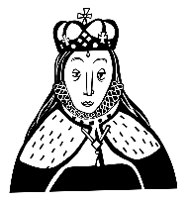
HAMPTON COURT PALACE TIMELINE
1514
1537
1543
1603
1646
1737
1913
Thomas Wolsey rents Hampton Court. Rebuilding works begins
Jane Seymour gives birth and dies soon after
Chapel Royal – Henry VIII marries Katherine Parr
The Great Hall – Shakespeare’s company performs
Charles I imprisoned and escapes
Grace and favour apartments
Sophia Duleep Singh sells suffragette newspaper
1529
1541
1562
1604
1689
1838
Henry VIII starts building project
Catherine Howard under house arrest
Elizabeth I sick with smallpox
James I religious meeting King James Bible
Parts of Tudor palace destroyed. New palace building begins
Queen Victoria opens the palace to the public free of charge

Slide 5
CLASSROOM TASKS
Q1
In which year did Henry VIII begin his spectacular building project at Hampton Court Palace?
Q2
How many years after the death of his third wife (Jane Seymour) at Hampton Court, did Henry VIII marry his sixth wife (Katherine Parr) there?
Q3
Which monarch was sick with smallpox at Hampton Court Palace?
Q4
Which Queen opened Hampton Court gardens and State Apartments to the public?
Notes:
Classroom task answers
Henry VIII began his building programme in 1529.
Henry VIII married Katherine Parr, his sixth wife, six years after the death of his third wife, Jane Seymour.
Queen Elizabeth had smallpox.
Queen Victoria opened the gardens and State Apartments to the public.

Slide 6
VOCABULARY LIST
grace and favour | property owned by the King or Queen but given to someone to live in, rent free
house arrest | kept as a prisoner in a house, castle or palace rather than a prison
smallpox | serious and often deadly infectious disease in the past
Suffragette | member of the Women’s Social and Political Union who fought for the right of women to vote in elections

