Slide 1
HOW TO USE - NOTES FOR TEACHERS
These resources from Historic Royal Palaces are multi-purpose. They are ready for you to tweak and use in your lessons.
For the best experience, download and open the file in the PowerPoint desktop app.
Answers are found under the slide. Click on the notes symbol at the bottom of the screen.
Delete text and images to make your own worksheets.
Disclaimer and Use Terms
We are the owner or the licensee of all intellectual property rights in these resources which are protected by copyright laws and treaties around the world. All such rights are reserved. These resources, and the content included within them, may be used by you for educational purposes only. This means that you may download the resources and use or share them solely in educational environments (including for home school lessons) or as part of homework. You may not share the resources other than for the above purposes and you must not use the resources, or any part of them, for any commercial purpose.

Slide 2
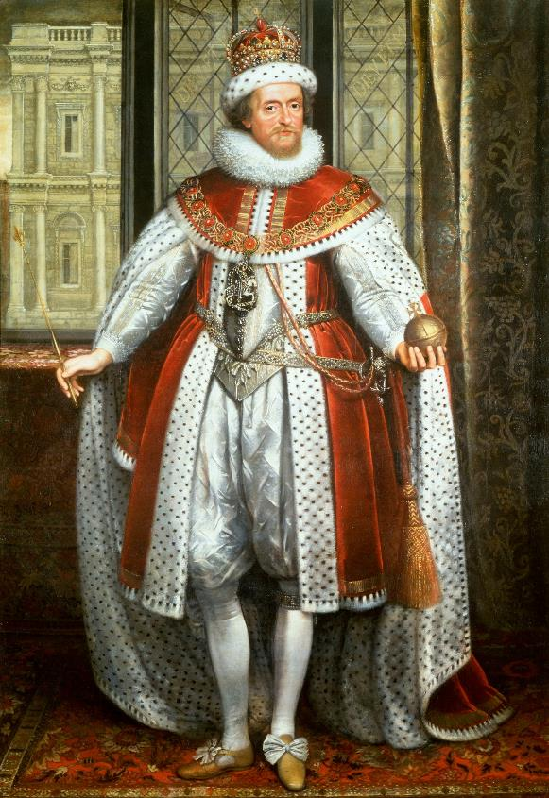
JAMES I
The king who united the thrones of Scotland and England
James was born in Edinburgh Castle. He was the son of Mary Queen of Scots and Henry Stuart. He was also the great-grandson of Margaret, Henry VIII’s eldest sister.
Brought up Protestant.
Became King James VI of Scotland after his mother’s abdication in 1567.
Became King of England after Elizabeth I’s death in 1603.
James married Anne of Denmark in 1589. Together, they had several children however only three of them survived beyond infancy.
Was intelligent and academic and studied modern and ancient theology.
Organised a religious conference at Hampton Court Palace in 1604.
Supported the English translation of the Christian Bible called the King James Bible.
William Shakespeare’s acting company performed for James at Hampton Court Palace.
Loved masques.
Asked an artist to design the Banqueting House as a performance space.
In 1605, he survived the Gunpowder Plot. This was a plot organised by a group of Catholic conspirators who planned to blow up the Houses of Parliament while James was giving speech.
He was superstitious and obsessed with witches.
He wrote one of the first anti-smoking pamphlets.
Q:
How do you think James asked to be portrayed in his portrait?
Royal Collection Trust / © His Majesty King Charles III 2024
Reigned: 1566 - 1625
Q:
What are some things James might be well remembered for?
Lived: 1603 - 1625 |Birthplace: Edinburgh, Scotland
Notes:
James I notes:
In his portrait, James might have asked to be painted as imposing and majestic. He is wearing a crown and holding an orb and sceptre. They are all ancient symbols of monarchy.
James has several important legacies. He united the thrones of England and Scotland, he encouraged the publication of the King James Bible, he was a supporter of the arts and he commissioned the Banqueting House.

Slide 3
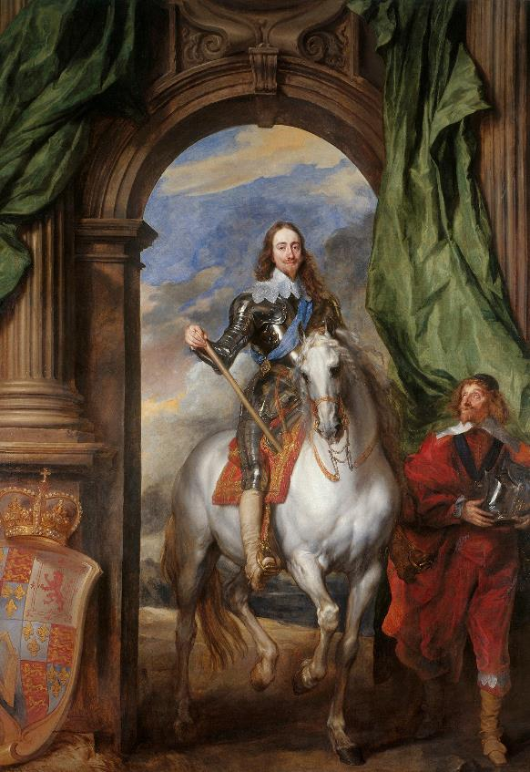
CHARLES I
The only English monarch executed for treason
Charles was born in Dunfermline Palace. He was the youngest child of James I and Anne of Denmark. He moved to England when he was aged two, when his father inherited the throne.
Shy and insecure.
In 1612, his eldest brother Henry died, and Charles became heir.
In 1625 he married the Catholic princess Henrietta Maria of France.
Together, they had 9 children.
He became king in 1625, aged 25. In private, he was a gentle man and loving father. In public, his shyness made him appear rude. He believed in the Divine Right of Kings – that kings were chosen by God to rule and only they had the power to make laws. This led to clashes with Parliament and outbreak of English Civil War in 1642.
The Kings’ supporters were called Royalists or Cavaliers.
Parliament’s supporters were nicknamed Roundheads.
Parliament’s army was led by Oliver Cromwell.
In 1645, the Royalist army was defeated at the Battle of Naseby. Charles was captured and put under house arrest at Hampton Court Palace. He escaped through the gardens but was recaptured and imprisoned at Carisbrooke Castle on the Isle of Wight.
He refused to negotiate peace or accept Parliament’s power and was put on trial for treason. He was found guilty and beheaded outside Banqueting House in Whitehall. He wore a thick shirt for his execution. He did not want people to think he was shivering with fear.
‘Sweetheart, you will forget this.’
Charles’s last words to his young daughter Elizabeth, recorded in her diary.
Q:
Charles chose to be painted on horseback. Why do you think that was?
As a child, he was small for his age and often unwell.
Royal Collection Trust / © His Majesty King Charles III 2024
Q:
This portrait measures almost 4 metres by 3 metres. How is Charles portrayed in it?
Reigned 1625 - 1649
Q:
Why do you think Charles refused to negotiate peace with Parliament?
Lived 1600-1649 Birthplace Dunfermline, Scotland
Notes:
Charles I notes:
Charles may have wanted to be painted on horseback because he was worried about his height. Being painted on horseback gave him greater height and authority.
In his portrait, Charles is portrayed as a ruler and as a warrior. He holds a staff in one hand (an ancient symbol of authority) and is wearing armour. The size of the portrait and the angle the painter has chosen means that Charles towers above the viewer.
Charles did not want to negotiate with Parliament because he believed in the Divine Right of Kings. He believed that he was chosen by God to rule. To accept other authority would be a sin against God.

Slide 4
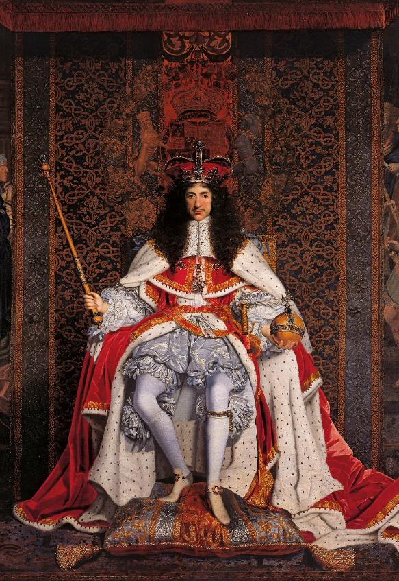
CHARLES II
The king who restored the monarchy
Charles was born in St. James’s Palace. He was the eldest surviving child of Charles I and Henrietta Maria. He fought in the Civil War as a teenager.
Tried to become king after his father’s execution.
Supported by Scottish forces.
They were defeated at Battle of Worcester in 1651.
Hid in oak tree to avoid being caught.
Escaped to Europe in disguise.
After Charles I’s execution, Oliver Cromwell ruled the country instead of a king, but he was very strict and not very popular. His plans eventually failed leading to the end of the English Commonwealth.
Charles II was invited to become king in 1660. New Coronation Regalia was made as the old set had been destroyed. He was the last monarch to parade from the Tower of London before his Coronation. Crowds cheered and fountains flowed with wine
He married a Portuguese princess, Catherine of Braganza. However, he had 14 children with other women. These children were not able to become monarchs themselves.
Spent time with artists, poets and playwrights.
Interested in physics, chemistry, mathematics and medicine.
Created a pleasure garden at Hampton Court Palace.
Wanted religious understanding for Catholics and Nonconformists.
This led to tension with Parliament.
His reign is known for two disasters in London, the Great Plague in 1665 and the Great Fire of London in 1666. When he died, he had no heir.
Q:
Why do you think Oliver Cromwell ordered the Coronation Regalia to be destroyed?
He made wigs fashionable in London.
Royal Collection Trust / © His Majesty King Charles III 2024
Reigned: 1660 - 1685
Q:
What image of Charles do you think the artist wanted to create?
Lived: 1630 - 1685 |Birthplace: London
Notes:
Charles II notes:
The Coronation Regalia are symbols of monarchy. Oliver Cromwell wanted to destroy them to signify the end of the monarchy, and the creation of a republic. (The jewels could also be sold and the precious metals used to create coins.)
The artist may have wanted to create an image of power and majesty, of a monarch restored to his rightful place. In his portrait, Charles wears a crown and holds the orb and sceptre. He’s seated on a throne-like chair, with his feet resting on luxurious cushions and rich tapestries in the background.

Slide 5
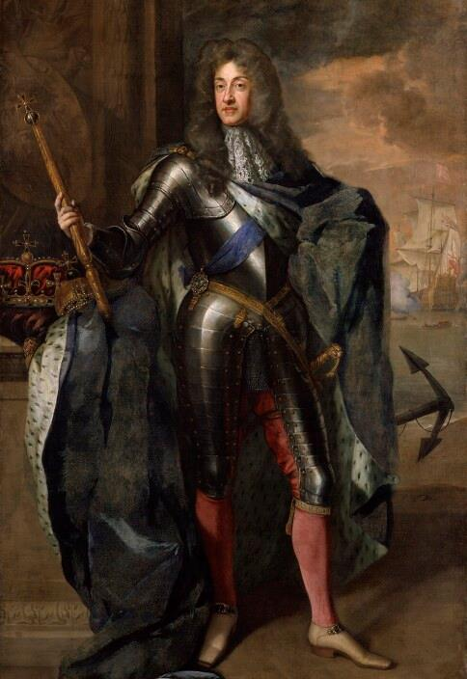
JAMES II
An unpopular king who lost his throne
James was the second son of King Charles I. He was sent to France as child when the Civil War broke out. He grew up in exile after his father was executed. He served in both French and Spanish armies.
His brother, Charles II, became king in 1660. He made James the Lord High Admiral. James was also in charge of putting out the fire during the Great Fire of London.
Married Anne Hyde.
They had two daughters, Mary and Anne.
They were brought up as Protestants.
James later became Catholic.
Had a second marriage to the Italian princess Mary of Modena.
His brother, King Charles II had many children, but they were illegitimate.
So, in 1685 when Charles II died, James II became king. James fought against an uprising that was led by Charles II’s illegitimate son.
James II was an unpopular king. His Catholic policies led to tension with Parliament. He had a son, also called James, in 1688. People were worried this would lead to a Catholic dynasty.
As a result, James’s Protestant daughter, Mary, and her Dutch husband, William of Orange were invited to become king and queen. James fled to France. This period is known as The Glorious Revolution.
He attempted to fight back with the help of a French army but was defeated at the Battle of the Boyne in Ireland in 1690 and was exiled.
Q:
What two leadership roles was James II given by his brother?
During his time in the French army, he was known for his bravery.
© National Portrait Gallery, London
Q:
Why do you think James II chose to wear armour in his portrait?
Reigned: 1685 - 1688
Q:
What objects has the painter included that show his different roles, past and present?
Lived: 1633 - 1701 Birthplace: London
Notes:
James II notes:
Charles II made James II Lord High Admiral of the Royal Navy and put him in charge of fire-fighting operations during the Great Fire of London in 1666.
James II had been a soldier in the French and Spanish armies. In his portrait, he has chosen to be portrayed as a warrior king.
In his portrait, James II is holding a sceptre. The crown and orb are on a pedestal to the side. These symbolise that he is now king. The anchor behind him (and a scene of a battle at sea) represent his previous role as Lord High Admiral.

Slide 6
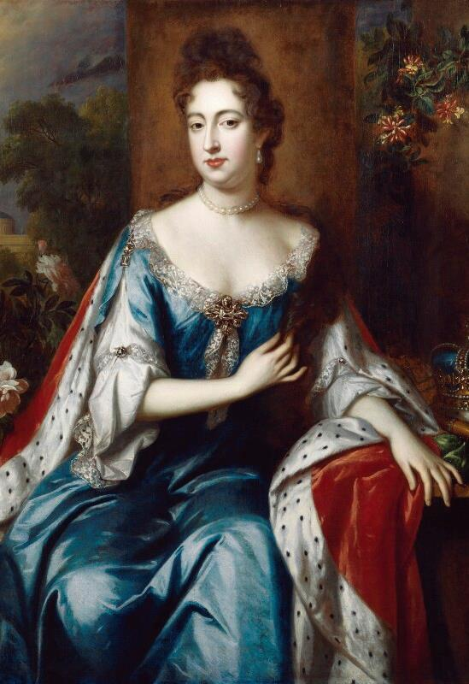
MARY II
The only queen in British history who ruled jointly with her husband
Mary’s father was James II, and her mother was Anne Hyde. Her uncle, King Charles II ordered that she should be brought up a Protestant. She learned Dutch and French.
She married her cousin William, Prince of the Netherlands. She was 15 and he was 27. She cried throughout their wedding and left England to live in the Netherlands. She became popular with the Dutch people and was described as gentle and cheerful.
In England, her father King James II was unpopular, and people were worried about a new Catholic dynasty. As a result, in 1688, Mary was invited to become queen instead. She refused to unless William also ruled as king alongside her. She thought of him as a more experienced ruler. However, as part of this arrangement their power as king and queen would be limited by Parliament.
As queen, she preferred to leave politics to William, but she was a firm and capable ruler when he was away fighting in Ireland.
Mary and William bought Nottingham House in 1689 and transformed it into Kensington Palace. They also hired Sir Christopher Wren to build a new palace at Hampton Court.
She died suddenly of smallpox at Kensington Palace in 1694. Huge crowds lined up to see her coffin when it was placed in Banqueting Hall before her funeral.
Had a large collection of ceramics that she displayed at Kensington Palace.
Q:
What evidence is there in the biography that Mary was popular with the English public?
As a girl, took leading roles in ballet performances at court.
© National Portrait Gallery, London
Q:
Why do you think she was popular?
Reigned: 1689 - 1694
Q:
How is Mary portrayed in her portrait?
Lived: 1662 - 1694 Birthplace: London
Notes:
Mary II notes:
The fact that huge crowds mourned Mary when she lay in state in the Banqueting House suggests she was very popular with the public.
Mary may have been popular because she was said to be gentle and cheerful. She was also a capable ruler while William was away.
In her portrait, Mary’s pose and cloak (lined with ermine) are dignified and regal. The artist has included a crown to make it clear she’s a monarch. He has painted sweet-smelling flowers (roses and honeysuckle) in the background, perhaps intended to reflect her personality.

Slide 7
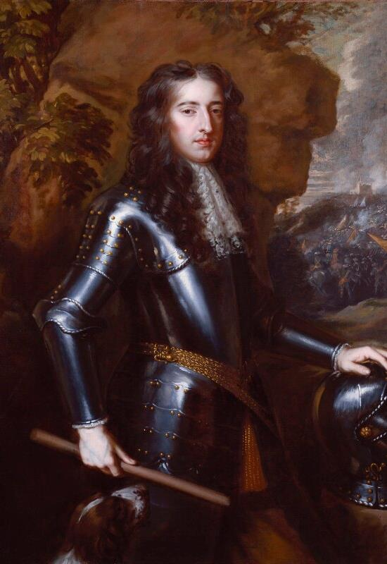
WILLIAM III
The only king in British history who ruled jointly with his wife
William was a Prince. His mother was Mary, the eldest daughter of Charles I and his father was a ruler of the Netherlands. He married his Protestant cousin Mary in 1677. She was the daughter of King James II.
He fought in wars in Europe against the French King, Louis XIV. Louis wanted to expand Catholic territories and William was seen as a protector of the Protestant faith.
In England, King James II was unpopular, and people were worried about a new Catholic dynasty. As a result, in 1688, William and Mary were invited to become rulers instead. As part of this arrangement, their power as king and queen would be limited by Parliament.
To do this, William sailed his ships to England and landed his army in Devon. They marched towards London and were joined by other supporters.
King James II fled to France and Parliament declared William and Mary as joint rulers. This is known as The Glorious Revolution because it avoided violence in England. However, it did lead to violence in Ireland.
William and Mary bought Nottingham House in 1689 and transformed it into Kensington Palace. At the time Kensington was surrounded by countryside. They also hired Sir Christopher Wren to build a new palace at Hampton Court. William was very sad when Mary died in 1694 and did not remarry. He died in Kensington Palace in 1702 after a riding accident at Hampton Court Palace.
He suffered from asthma so disliked the dust and dirt of central London.
Q:
The portrait is of William at the time of his marriage. How do you think he wanted to be portrayed?
He was happier on the battlefield than at court.
Royal Collection Trust / © His Majesty King Charles III 2024
Reigned: 1689 - 1702
Q:
Why do you think he made Kensington Palace one of the main royal residences?
Lived: 1650 - 1702 |Birthplace: The Netherlands
Notes:
William III notes:
In his portrait, William might have wanted to be portrayed as a soldier and man of action. He’s wearing a suit of armour. One hand rests on a helmet and the other holds a ceremonial baton – the sign of a high-ranking military officer.
William liked Kensington Palace because the clean air was better for his health. As a military man he also had no interest in the social life of central London.

Slide 8
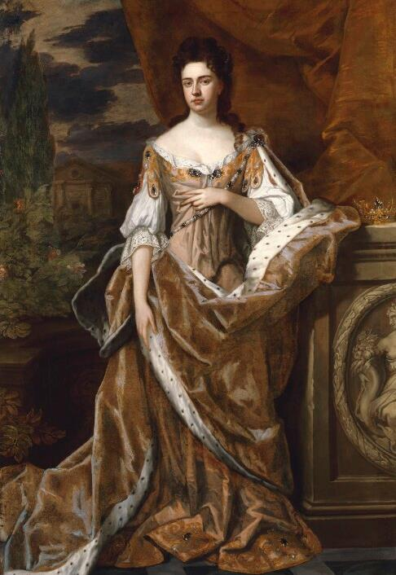
ANNE
A hard-working queen and the last Stuart monarch
Anne was the younger daughter of James II, and she was sister to Mary II. Her uncle, King Charles II ordered that she should be brought up a Protestant.
She married Prince George of Denmark in 1683. He was said to be a dull man, but they were both devoted to each other. Anne had at least 17 pregnancies but suffered many losses. Only one of her children, William, lived more than two years, but he died of smallpox in 1700 aged 11.
Became queen when her brother-in-law William III died.
Dedicated and hard-working monarch.
Met her ministers every day.
Shy but able to be confident when needed.
A good public speaker.
She was a popular queen and supported the Acts of Union in 1707.
The Acts of Union united the kingdoms of Scotland and England (which included Wales at the time).
Her female friends were very important to her. One of her friends, Sarah Churchill, became extremely wealthy and powerful through Anne. Sarah’s husband was given title Duke of Marlborough. They built a magnificent country home called Blenheim Palace.
Anne improved the gardens at Kensington Palace including constructing the Orangery. She also completed the building of the new palace at Hampton Court. She enjoyed hunting in the Palace grounds.
Her beloved husband George died from severe asthma in 1708. She died at Kensington Palace eight years later.
“She pronounced this, as she did all her other speeches, with great weight and authority.”
Q:
What evidence is there that Anne was a hard-working monarch and a good public speaker?
She used the King’s State Apartments at Kensington Palace, not the Queen’s.
Bishop Gilbert Burnet writing about Anne’s first speech to Parliament.
© National Portrait Gallery, London
Q:
What legacy did Anne leave to the country?
Reigned: 1702 - 1714
Q:
Compare Anne to her sister, Mary II. Were they similar as queens?
Lived: 1665 - 1714 Birthplace: London
Notes:
Anne notes:
There is lots of evidence Anne was a hard-working monarch and good speaker. The fact that she met her ministers every day is evidence that she was hard-working. The quote from the bishop is evidence that she was a confident and authoritative public speaker.
Anne’s legacy was the Acts of Union, which created a united kingdom of Great Britain: Scotland, England and Wales. (Ireland joined the Union in 1801, creating the United Kingdom.)
When comparing Anne to her sister Mary, it is clear both were capable queens able to rule without their husbands. However, Mary seemed to prefer leaving most of the politics to her husband whereas Anne decided to meet with her ministers every day and was a confident speaker. The fact that she used the King’s apartments and not the Queen’s suggest that she was serious about being seen as a capable ruler.

Slide 9
TEMPLATE WORKSHEET
________________
________________
________________
________________
Image credit:
Image credit:
Lived: _______
Lived: _______
Birthplace: _______
Birthplace: _______
Q:
Q:

Slide 10
VOCABULARY LIST
abdication | the act of formally giving up power as a king or queen
Catholic | member of the Roman Catholic Church. A type of Christianity that follows the teachings of the Pope.
Church of England | the Christian church in England based on the Protestant faith, established by King Henry VIII, with the king or queen as its head.
civil war | a war between groups of people of the same country
conspirator | person who takes part in a secret plan to do something illegal
Coronation Regalia | objects used during the coronation ceremony, including the crown, orb and sceptre
dynasty | series of leaders from the same family
English Commonwealth | period from 1649-1660 when Britain and Ireland had no king or queen
exiled | sent away from your own country
government | group of people that have the authority to rule a country
heir | the person who will become the next king or queen
house arrest | kept as a prisoner in a house, castle or palace rather than a prison
illegitimate | child whose parents were not legally married to each other when they were born
inherit | given something such as money or a title after the death of the person who owned or held them before
Lord High Admiral | head of the Royal Navy; the title is awarded as an honour and the person has little real power
masque | show with music, poetry and dancing, and fantastic sets and costumes

Slide 11
VOCABULARY LIST 2
VOCABULARY LIST
military | word used in connection with an armed force such as soldiers
minister | someone with a lot of power and responsibility in government
monarch | ruler of a kingdom or Empire, such as a king or queen
monarchy | system of government with a king or queen as its head
navy | ships built and maintained to defend a country
Nonconformist | member of a Protestant church that holds different beliefs to the Church of England
orangery | brick building with large windows used for growing exotic fruits and plants
Parliament | the group of people elected to make and change laws in a country; in the past only very rich and powerful people were Members of Parliament
playwright | someone who writes (‘makes’) plays
pleasure garden | in the past, a private garden with plants and neat paths for walking
Protestant | a type of Christianity that believes people do not need officials (such as the Pope or Bishops) to communicate with God
Puritan | member of a group of English Protestants with strict moral and religious beliefs
Roman Catholic Church | Christian religion with the Pope as its head
Royalist | someone who believes that a king or queen should rule their country
smallpox | serious and often deadly infectious disease in the past
State Apartments | grand public rooms where official visitors are hosted

Slide 12
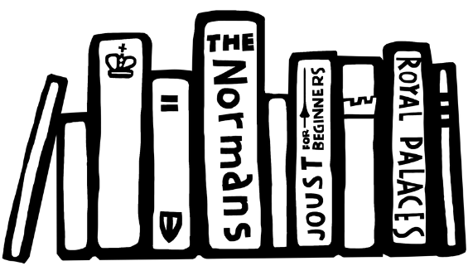
VOCABULARY LIST 3
VOCABULARY LIST
statesman | skilled, experienced and respected political leader
The Glorious Revolution | events of 1688-89 when the Catholic King James II was replaced by the Protestant William III and Mary II
theology | the study of religious belief
treason | the crime of acting against your own country, especially by trying to kill the king or queen, or overthrow the government
uprising | protests against the government or ruler by people who are angry and want change; usually in one part of the country and often violent

