Slide 1
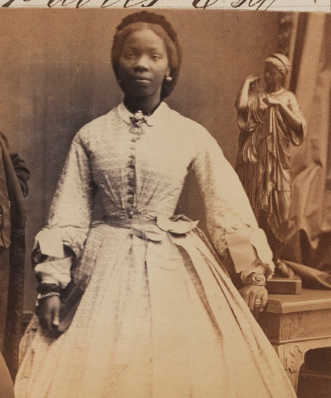
WATCH-ALONG GUIDE
BEFORE WATCHING
KEY THEMES
WIDER HISTORICAL THEMES
Ina Sarah Forbes Bonetta is a significant individual because of her extraordinary life story. She was born in West Africa, an are that is now Nigeria, but was taken to England as a child where she became Queen Victoria’s goddaughter. She faced many challenges and had little control over many aspects of her life. However, she was a very talented and intelligent woman. She is most commonly known as Sarah Forbes Bonetta but when she got married, she chose to sign her marriage certificate with her birth name, Ina. Because of that, we have chosen to use the name ‘Ina’ in these resources.
This video can be used to explore how African people were viewed and treated during the Victorian period. Ina’s intelligence and talent helped challenge some people’s negative opinions about African people at the time.
Society | In Victorian times, some people had the wrong idea that African people were not equal to others. As part of this, Black people were sometimes seen as ‘scientific objects’ or ‘curiosities’. Ina’s life shows how these beliefs affected people, even those who lived in comfort.
Her story also shows the big gap between the rich and the poor. While Ina received a good education and lived comfortably, most people in Britain worked long hours in tough jobs.
In the video, Ina says “But a lot of children did not have these opportunities and were not able to have lessons like I did.”
Photography | Photography of Black people from this time is potentially problematic.
Black people were sometimes photographed as ‘curiosities’. Often, they were not given a choice or able to refuse being photographed.
Celebrity
A famous person.
(British) Empire
A group of countries ruled by one king, queen, or government. During Queen Victoria’s time, Britain ruled many countries around the world.
Goddaughter
A child who has godparents. A godparent is a special adult chosen to guide and support a child as they grow up, especially in their faith.
INA SARAH
FORBES BONETTA
SOURCES USED IN THE VIDEO
Portraits | The video features several photographs of Ina, taken when photography was a new technology during the Victorian period.
Documents | The video includes Ina’s marriage certificate, which reveals that she used her original birth name for this important document.

Slide 2
WHILE WATCHING
00:36
1:20
1:44
3:00
3:25
END
LEAVING WEST AFRICA
LACK OF CONTROL
SOCIETY
RECLAIMING HER NAME
THE PIANO
REMEMBERING INA
Discuss that Ina did not choose to leave her home in West Africa, nor did she choose to be renamed Sarah Forbes Bonetta.
NB The area Ina was born in was not called Nigeria at the time, but we know it as that today.
Do you like it when people take photographs of you, even if they don’t ask first?
Ina did not have control over many parts of her life. Being photographed was not always a choice for Ina.
Did children in the Victorian period have the same opportunities as children today?
Many children did not have access to education. Some had to work in difficult jobs. There was a large gap between the lives of the wealthy and the poor.
Discuss why she may have chosen to sign her name as ‘Ina’ when most people probably knew her as Sarah.
How does this object help tell Ina’s story?
Ina received a good education and was known as a talented pianist. Playing music may have given her a sense of control over her life. Her skills also helped challenge the wrong idea some people had that African people were not equal to others.
How should we remember Ina today?
We should remember Ina today because despite facing many challenges and having little control over her life, she showed intelligence and resilience.
Her life is also an important glimpse into how some African people were treated during the Victorian period.
AFTER WATCHING
HOW DO WE KNOW?
KNOWLEDGE SUMMARY
Introduce the idea of a historical source—something historians use to study the past. Explain that evidence is the information we get from these sources to understand and explain history.
A supporting PowerPoint presentation is available to help students study the sources shown in the video, including photographs and a marriage certificate.
These activities help students explore how sources shape what we know about historical figures.
Ina Sarah is a significant individual.
She was born in (what is now) Nigeria but was brought to Britain as a child and became Queen Victoria’s goddaughter.
She was highly intelligent and a talented musician.
However, she had little control over some aspects of her life.
During the Victorian period, African people were wrongly viewed as inferior. Ina’s intelligence and talents challenged these false beliefs.
By signing her marriage certificate with her birth name, Ina, she showed pride in her identity and heritage.
Image credit: James Pinson Labulo Davies; Aina (Sarah Forbes Bonetta (later Davies) by Camille Silvy albumen print, 15 September 1862 © National Portrait Gallery, London

