Slide 1
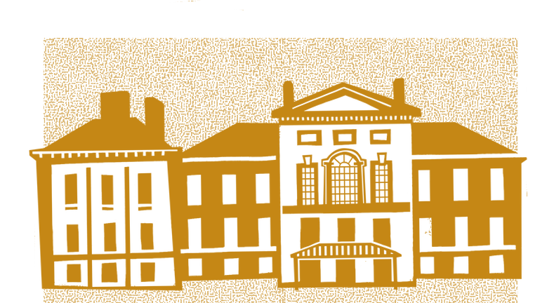
THE
DAILY LIFE IN
VICTORIAN BRITAIN
VICTORIANS
Life in Victorian Britain varied greatly depending on class and wealth. The wealthy lived in large houses with servants. The middle classes benefited from better jobs in business and industry. However, for the working classes, life was tough. Many lived in crowded, unsanitary conditions and worked long hours. Children often had to work to support their families, though new laws gradually improved working conditions. As the century progressed, better transport, entertainment, and public parks became more accessible, especially in towns and cities.
A KNOWLEDGE BOOSTER FOR TEACHERS
THE BRITISH EMPIRE
IN A NUTSHELL
VICTORIAN SOCIETY
During the Victorian era, Britain controlled vast territories across every continent except Antarctica. The empire brought wealth and power to Britain, providing raw materials that fuelled industry and creating markets for British goods. Many British people moved to the colonies, taking up influential roles.
However, British expansion was often justified by the belief that non-European cultures were ‘uncivilised.’ Indigenous languages, religions, and traditions were suppressed, and British systems of government were imposed. Local resources and wealth were taken away for financial gain. People like Ina Sarah Forbes Bonetta, a West African girl brought to England, highlight the empire’s problematic legacy.
Resistance to British rule existed across the empire, with uprisings met with extreme force, including public executions and mass shootings.
The stories of figures like Sophia Duleep Singh and Ina Sarah Forbes Bonetta highlight both the opportunities and injustices faced by people across the empire, even those
connected to Queen Victoria herself.
The Victorian period was a time of enormous change. Britain remained an economic powerhouse, driven by its industrial towns, growing cities, and vast empire. Science, technology, and the arts developed rapidly alongside major social and political reforms. While Queen Victoria ruled as Queen of the United Kingdom of Great Britain and Ireland, the power of the monarchy declined, with Parliament taking greater control.
Industrialists gained power alongside traditional landowners, and by the late 19th century, two-thirds of men could vote. However, women were excluded from voting until the 20th century. The suffrage
movement campaigned for change, with figures like Sophia Duleep Singh protesting for women’s rights. After Victoria’s reign ended, some suffragettes used militant tactics such as arson to push for change.
Living and working conditions also began to improve. New laws restricted child labour, made workplaces safer, and in 1880, education was made compulsory for children up to the age of 10.
NEW TECHNOLOGY IN
THE VICTORIAN PERIOD
The Victorian era was marked by rapid technological advancements that transformed everyday life. The industrial revolution introduced innovations such as the steam engine, which powered factories, trains, and ships, drastically improving transportation and trade. The invention of the telegraph and later the telephone allowed people to send messages over long distances in an instant. Additionally, developments in medicine, like the introduction of anaesthesia and anti-septics, improved healthcare and surgery.
These technological breakthroughs not only boosted Britain’s economy but also changed how people worked, travelled, and interacted with each other.
POWER OF
THE MONARCH
Victoria held many titles, including Empress of India (from 1876), but her political power declined as Parliament took on more decision-making. She still influenced politics by mediating between the House of Commons and Lords. She also attempted–unsuccessfully—to prevent William Gladstone from becoming Prime Minister.

