Slide 1
HOW TO USE - NOTES FOR TEACHERS
These resources from Historic Royal Palaces are multi-purpose. They are ready for you to tweak and use in your lessons.
For the best experience, download and open the file in the PowerPoint desktop app.
Answers are found under the slide. Click on the notes symbol at the bottom of the screen.
Delete text and images to make your own worksheets.
Disclaimer and Use Terms
We are the owner or the licensee of all intellectual property rights in these resources which are protected by copyright laws and treaties around the world. All such rights are reserved. These resources, and the content included within them, may be used by you for educational purposes only. This means that you may download the resources and use or share them solely in educational environments (including for home school lessons) or as part of homework. You may not share the resources other than for the above purposes and you must not use the resources, or any part of them, for any commercial purpose.

Slide 2
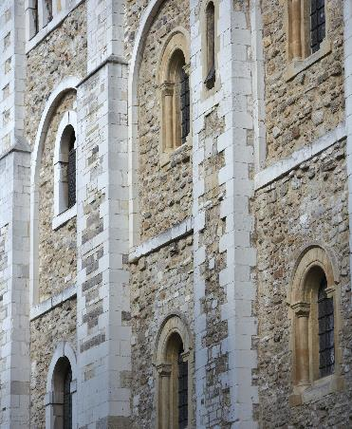
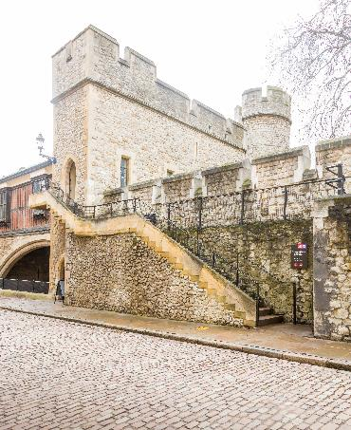
RANULF FLAMBARD AND ISAAC OF NORWICH
RANULF
ISAAC
FLAMBARD
OF NORWICH
One of the first prisoners in the Tower of London and the first to escape
Jewish financier imprisoned in the Norman Tower of London
Ranulf served King William II and became very unpopular. People blamed Ranulf for new taxes and for trying to make more money for the king.
In 1099, Ranulf became Bishop of Durham. In 1100, William II died, and his brother became King Henry I. Ranulf was soon arrested. He was imprisoned in the White Tower at the Tower of London.
Ranulf’s escape from the Tower is legendary. One story suggests he escaped by:
having a rope smuggled into the Tower in a barrel of wine
giving the wine to his guards, who drank too much and fell asleep
climbing down the rope to where his friends waited with horses.
sailing to Normandy.
Isaac was a wealthy man and an important member of the Jewish community in Norwich. He was a moneylender and supported studies into the Jewish religion.
At the time, Jewish people were only allowed to stay in England with the king’s permission. The king could tax them whenever he wanted.
In 1210, King John wanted to increase taxes. As a result, Isaac of Norwich and many other Jewish people were imprisoned in Bristol. In 1213, Isaac was transferred to the Tower of London.
The Constable of the Tower was the official who had control of London’s Jewish community. The Constable would help protect Jewish people for the king, but was also involved in taking money from them.
Issac of Norwich was released after agreeing to pay the king 10,000 marks – a huge sum of money.
© Historic Royal Palaces
© Historic Royal Palaces
Lived: c.1060 - 1128
Lived: c. 1170 - c. 1235
Birthplace: unknown
Birthplace: unknown
This image shows windows at the White Tower where Ranulf may have been held.
Between 1189 - 1290 much of the building work at the Tower of London was funded by Jewish tax money. This image shows St Thomas Tower which was built using Jewish tax money.
It is said, he paid the king £1000 for his position as Bishop.
Why do you think one of the Constable’s roles was to protect Jewish people?
How were Jewish people exploited by Norman kings?
Q:
Q:
Can you think of reasons why Henry I might have wanted to imprison Ranulf?
Notes:
Ranulf Flambard notes:
Henry wanted to increase his popularity as a new king. Since Ranulf was unpopular, putting him in imprison may have made the public support Henry. However, Ranulf was blamed for Willliam II’s unpopular tax policies.
Issac of Norwich notes:
Jewish people were the property of the King and were seen as an extremely valuable source of income. Therefore, the Norman Kings wanted to protect them.
Norman Kings needed Jewish financiers’ skills and networks. However, they were taxed at extremely high rates. Some of their taxes were used to pay for building projects, including the Tower of London.

Slide 3
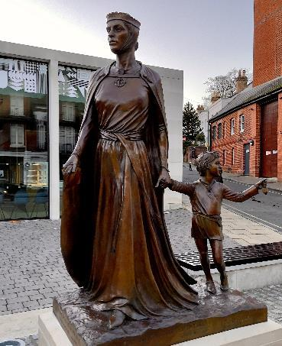
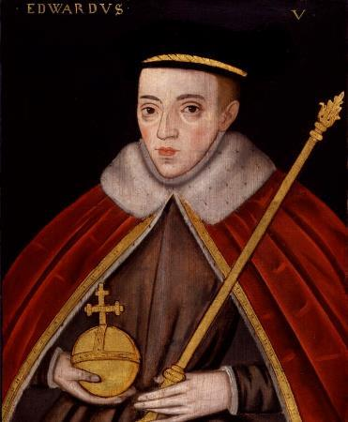
LICORICIA OF WINCHESTER AND EDWARD V
LICORICIA OF
EDWARD V
WINCHESTER
The older of the two boys known as the Princes in the Tower
Successful Jewish businesswoman and prisoner in the Tower
Edward V was the elder son of Edward IV and Elizabeth Woodville. He became Prince of Wales in 1471 and grew up with his uncle Antony Woodville, Earl Rivers, at Ludlow Castle.
Edward became king when he was 12, when his father died. His other uncle, Richard of Gloucester, was named Lord Protector. Edward and his younger brother, also called Richard, were taken to the Royal Apartments at the Tower of London, to prepare for Edward’s coronation.
However, not long before his coronation, his parents’ marriage was declared invalid. This meant he and his brother were illegitimate and he could not become king. Days later, Richard of Gloucester became king.
Edward and Richard were last seen in autumn 1483, playing in the gardens at the Tower of London. They both disappeared soon after.
Licoricia was the most important female Jewish financier in medieval England. She was married to one of the richest Jewish men.
At the time, when Jewish people died, one third of all their money had to be paid to the king. In 1244, when her husband died, she was imprisoned in the Tower of London because she now owed a huge amount of money. She was held there until she paid it.
Once released, she returned to Winchester and continued to grow her business. She leant money to very important people including the Royal Family and the Christian Church. In 1277, she was found murdered in her home alongside her maid. We do not know who killed them, or why.
Lategatsby23 CC BY-SA 4.0
© National Portrait Gallery, London
Lived: ? – 1277
Lived: 1470 - ?
Birthplace: unknown
Birthplace: London
Reigned: 1483
Today, there is a statue of Licoricia on Jewry Street in Winchester.
In 1674 skeletons of two children were found at the Tower of London. Many people believe these are the remains of the princes.
Q:
Why was Licoricia imprisoned in the Tower?
What does Licoricia’s story tell you about the position of some women in medieval England?
Q:
Why do you think the story of the two princes still fascinates people?
Notes:
Licoricia of Winchester notes:
Licoricia was imprisoned because Henry III wanted to make sure he received all the money he expected after the death of her husband.
Licoricia’s story reminds us that Jewish women were successful businesswomen, but were also exploited by the king in medieval England.
Edward V notes:
There are many reasons the story of the two princes still fascinates people today. Some people will be particularly interested since what happened to the princes is still a mystery, unlikely ever to be solved.

Slide 4
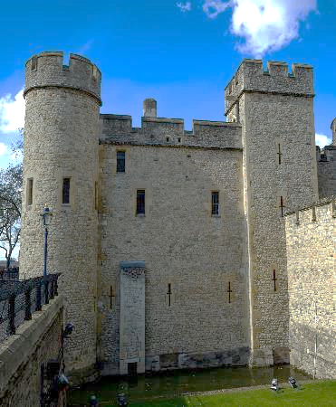
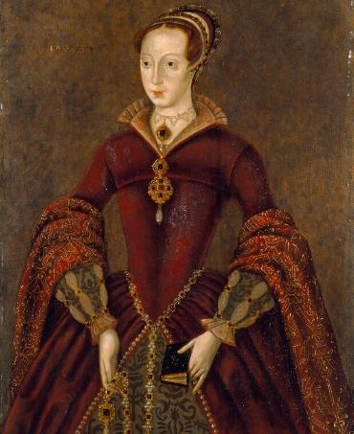
ALICE TANKERVILLE AND LADY JANE GREY
ALICE
LADY JANE
TANKERVILLE
GREY
The only woman known to have escaped from the Tower of London
The ‘Nine Day Queen’
In 1534, Alice and her husband John Wolfe were arrested for the murder and robbery of two merchants. The crime took place on a boat in the River Thames.
Alice was charged with piracy and imprisoned inside the Tower of London. She tried to escape with the help of friends that worked inside the Tower. One of them smuggled her ropes and a key. Alice unlocked her prison door, possibly disguised in men’s clothes. She met her friend on the Tower walls, probably near St Thomas's Tower.
Alice slid down the wall into a small boat where they escaped along the river.
However, Alice was quickly re-captured and returned to her cell. She was executed in March 1534.
Jane was the great-granddaughter of Henry VII and grandniece of Henry VIII. She married Lord Guildford Dudley in 1553.
Dudley’s father was King Edward VI’s chief minister and may have suggested that Jane should be the next queen, as she was Protestant just like him.
Edward died and Jane was proclaimed Queen of England.
She was reportedly surprised and upset by this.
However, support was growing for Mary to become queen. Mary was Edward VI’s half-sister and Jane’s cousin. Mary was also Catholic. Jane was queen for only nine days before Mary was proclaimed queen. Jane and her husband became high-status prisoners and were held separately in the Tower of London.
In 1554, Jane and her husband were sentenced to death for treason. Guildford was beheaded on Tower Hill. Jane saw his body brought back to the Tower of London before her own execution.
© Historic Royal Palaces
© National Portrait Gallery, London
Lived: ? – 1534
Lived: 1537 - 1554
Birthplace: unknown
Birthplace: Leicestershire
This is an image of St Thomas Tower where Alice may have escaped from, using rope to climb down the walls.
Reigned: 1553
Her hands and feet were fastened to the wall with iron manacles.
She was given a comfortable place to stay whilst imprisoned.
Q:
Why do you think was Alice was charged with piracy?
What does this tell you about how some low-status prisoners in the Tower were treated?
Notes:
Alice Tankerville notes:
Alice’s alleged crime had taken place on a boat on the river Thames. This means she was technically a pirate, so she was charged with piracy.
Some low-status prisoners in the Tower were treated extremely harshly.
Tip: Contrast Alice’s story to the death of Walter Raleigh.

Slide 5
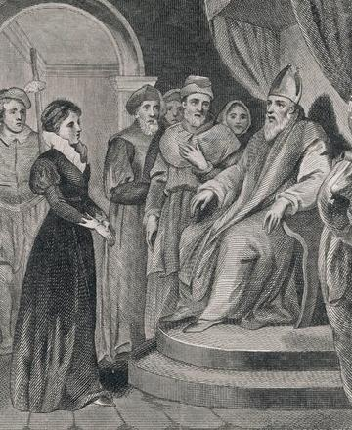
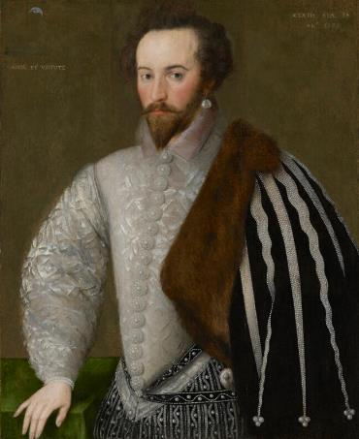
ANNE ASKEW AND SIR WALTER RALEIGH
ANNE
SIR WALTER
ASKEW
RALEIGH
A Protestant who refused to give up her beliefs even under torture
Famous explorer and one of Queen Elizabeth I’s favourites
Anne was born around 1521. Her father was a wealthy landowner. She was well-educated and Protestant and was forced to marry at a young age.
King Henry VIII passed laws that stopped lower class women from reading the Christian Bible (which was a Protestant activity). Women from higher status families were only allowed to read the Bible in private.
As a devout Protestant, Anne caused controversy. One of her first acts of rebellion was reading the Bible in public in Lincoln Cathedral. She was challenged by Bishops and Priests. Her husband was very angry at her and did not welcome her back home.
In 1544, she travelled to London and continued Protestant activities. She was arrested several more times and released. In 1546 she was arrested again for heresy and imprisoned in the Tower of London. She was tortured and was eventually burnt at the stake.
Walter was a soldier as a young man. In the 1580s he led voyages to North America, helped suppress rebellions in Ireland and defend England against the Spanish Armada.
He was one of Elizabeth I’s favourite people at court and became a Knight in 1584. He secretly married Bess Throckmorton and they had had a baby but in 1592, Elizabeth found out. Walter, Bess and the baby were imprisoned in the Tower of London. Sadly, their baby did not survive an outbreak of the plague. Bess was released shortly after. Walter was released a few months later and was banned from court for five years.
In 1603, he was accused of plotting against James I. He was imprisoned in the Tower of London again. He was held for 13 years. During this time, he created a garden and used plants to make herbal remedies.
In 1616, he led an expedition to South America which went badly. Because of this, he was executed in 1618.
Chronicle / Alamy Stock Photo
© National Portrait Gallery, London
CC BY NC ND 3.0
Lived: c.1521 - 1546
Lived: 1554 - 1618
Birthplace: Lincolnshire
Birthplace: Devon
‘Strike, man, strike.’ reportedly Walter’s final words to his executioner.
She travelled to London to demand a divorce from her husband. She was refused.
During his imprisonment he wrote a book called ‘The History of the World.’

Slide 6
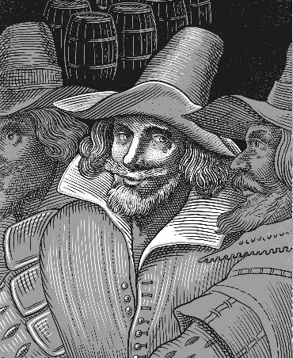
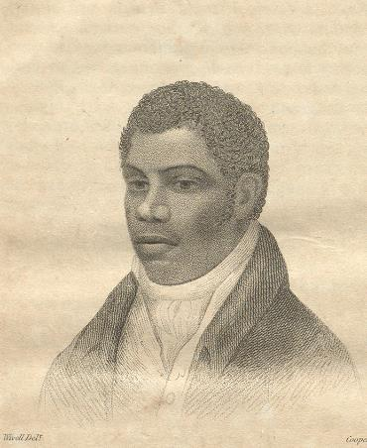
GUY FAWKES AND WILLIAM DAVIDSON
GUY
WILLIAM
FAWKES
DAVIDSON
The most well-known of the Gunpowder Plot conspirators
Part of a secret plot to kill the Prime Minister
Guy was Catholic and fought for Spain as a young man. At some point Guy moved back to England. At the time England was a Protestant country and dangerous for Catholic people. There were laws that limited their freedom and rights. Guy joined a group of other Catholic men to plan how to bring the Catholic faith back to England.
The plan was to assassinate King James I and his ministers at the opening of Parliament on 5th November 1605.
The plotters hid 36 barrels of gunpowder in a cellar beneath the Houses of Parliament. This would be enough to destroy everything nearby.
Guy was a gunpowder expert, so he waited in the vault to light the fuse. However, he was captured by the King’s men and taken to the Tower of London. Guy was tortured and sentenced to death for treason.
William was born in Jamaica. He was the son of a British government official and Black woman whose name we do not know. At 14, he was sent to England to study. He left his studies to go into the Navy. He returned to England and became an apprentice to a lawyer.
William became involved in a group that wanted to make changes to Parliament. In 1820, he was part of Cato Street Conspiracy, which planned to start a revolution by murdering the Prime Minister and his cabinet ministers.
However, one of the conspirators was a spy and reported them. William and others were arrested and imprisoned in the Tower of London. He was executed for treason. Afterwards there was a public campaign to investigate the spy George Edwards for treason. There were claims he had created the plot so he could report it and claim reward money.
© Historic Royal Palaces
Courtesy of the British Library 6495.aaa.42
Died: 1570 - 1606
Died: 1786 - 1820
Birthplace: York
Birthplace: Jamaica
At first Guy refused to tell the King who the other plotters were.
He was also a skilled furniture maker.
From what you know so far how would you describe William?
Q:
Guy Fawkes was described as a ‘great devil’ by someone who witnessed his execution. What is your opinion of him and his actions?
Q:
Notes:
Guy Fawkes notes:
Some might say that he was wicked because he plotted to murder the King and all his ministers in an act of terrorism. In spite of this, some might argue he was brave because he was fighting for the right to practise his faith and held out for several days under torture.
William Davidson notes:
Words that might be used to describe William are intelligent, brave, reckless, revolutionary, unlucky, traitorous.

Slide 7
TEMPLATE BIOGRAPHY
____________
____________
____________
____________
Image credit:
Image credit:
Lived: _______
Lived: _______
Birthplace: _______
Birthplace: _______
Q:
Q:

Slide 8
VOCABULARY LIST
assassinate | murder an important person for political or religious reasons
bishop | important and powerful member of the Christian church
Catholic | member of the Roman Catholic Church, a type of Christianity that follows the teachings of the Pope
conspiracy | a secret plan to do something illegal
Constable of the Tower | person in charge of the Tower of London when the king or queen is away
counterfeit | exact copy of something else used for a dishonest purpose
financier | a person or company that controls a large amount of money
government | group of people that have the authority to rule a country
heresy | an opinion or belief opposite to accepted Christian teaching at the time
imprisoned | kept in a prison
Knight | title awarded to a man for services to the king or queen; he can then use the title ‘Sir’ before his name
manacles | two metal rings joined by a chain
merchant | person who buys and sells things in large amounts
minister | someone with a lot of power and responsibility in government
navy | ships built and maintained to defend a country
Parliament | the group of people elected to make and change laws in a country

Slide 9
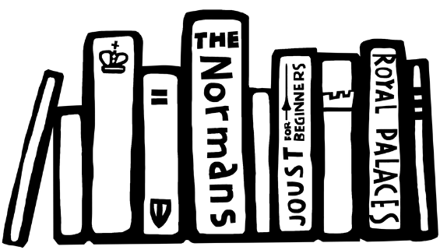
VOCABULARY LIST 2
VOCABULARY LIST
piracy | crimes committed at sea
plot/ plotting | secretly plan to harm someone, especially a government or ruler
policies | plans for how to do things, usually used by the government or big organisations
Prime Minister | the leader of the government
Protestant | a type of Christianity that believes people do not need officials (such as the Pope or Bishops) to communicate with God
rebellion | a fight by a large group of people against the government or ruler; or an action against rules and accepted ways of behaving
revolution | an attempt by a large group of people to change the government or ruler of a country
Spanish Armada | the large fleet of ships sent to invade England by Philip II of Spain in 1588
taxes | money that you have to pay to the government or ruler; in the past taxes were used to pay for things such as building projects and wars
treason | the crime of acting against your own country, especially by trying to kill the king or queen, or overthrow the government

