Slide 1
TOWER OF LONDON

Slide 2
Visual Story
Tower of London

Slide 3
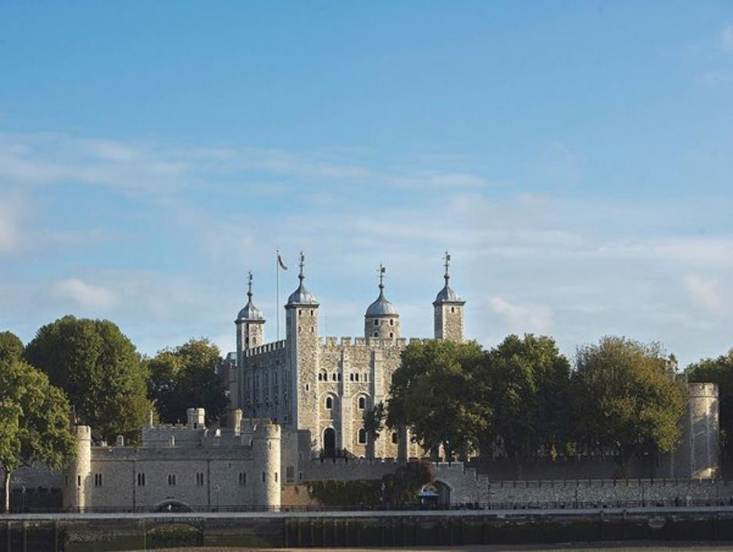
This is the Tower of London. Come and look around.

Slide 4
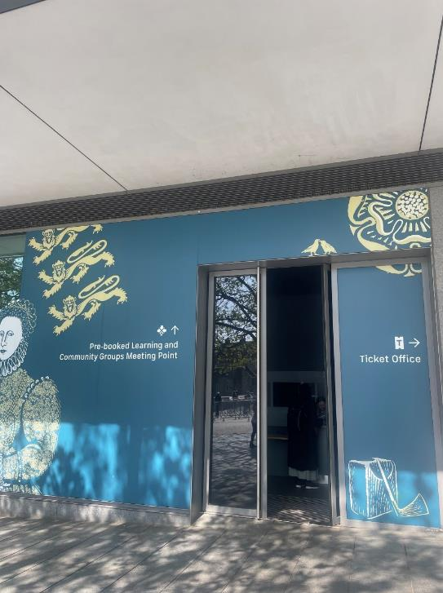
You will arrive at the Schools Desk.
There will be someone to meet you.

Slide 5
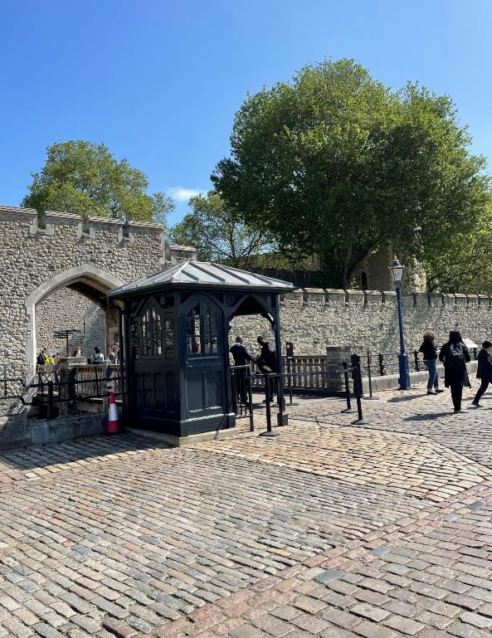
You will walk to the Group Entrance, which looks like this.

Slide 6
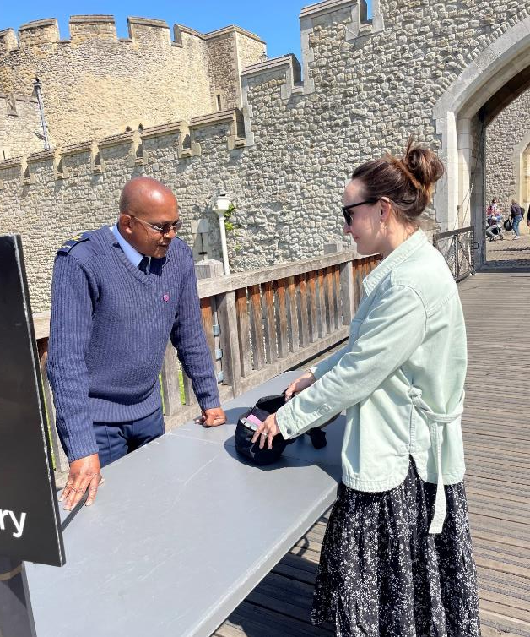
Your bag may be searched for security reasons.

Slide 7
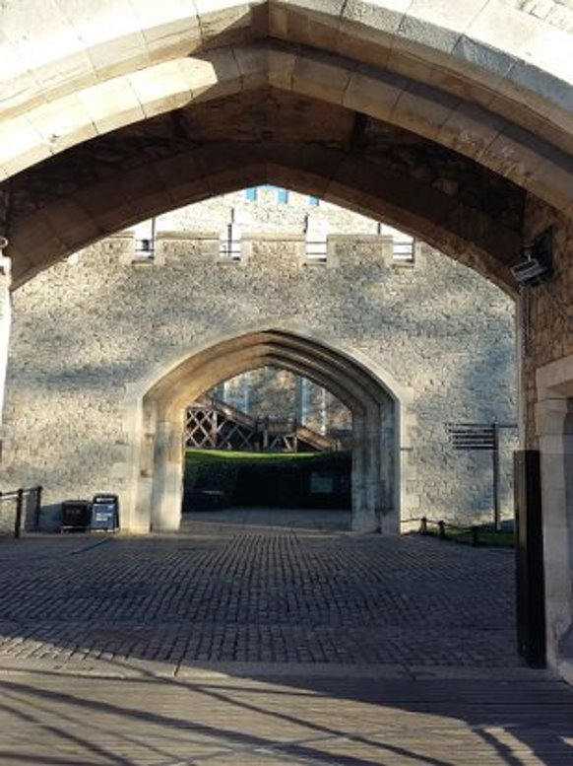
You will then enter through this archway.

Slide 8
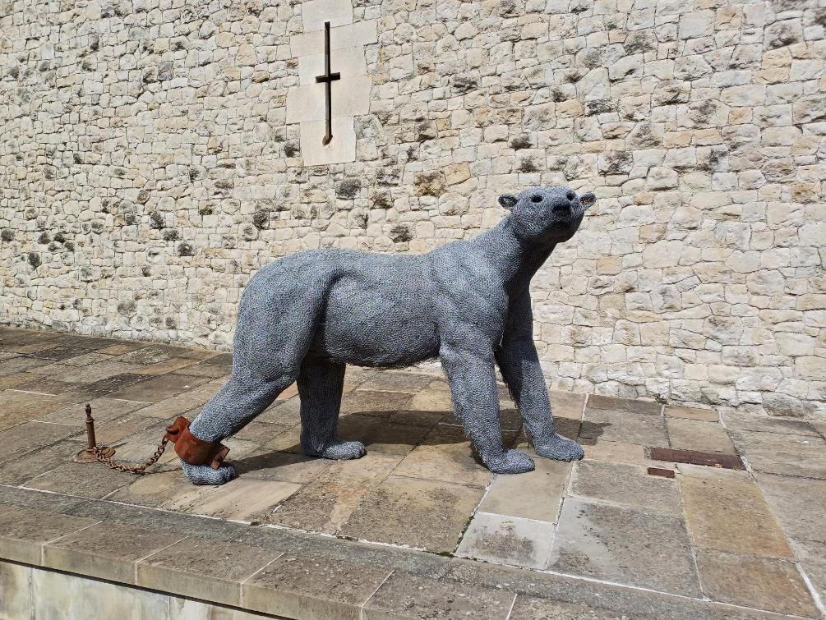
Look out for this sculpture of a polar bear.

Slide 9
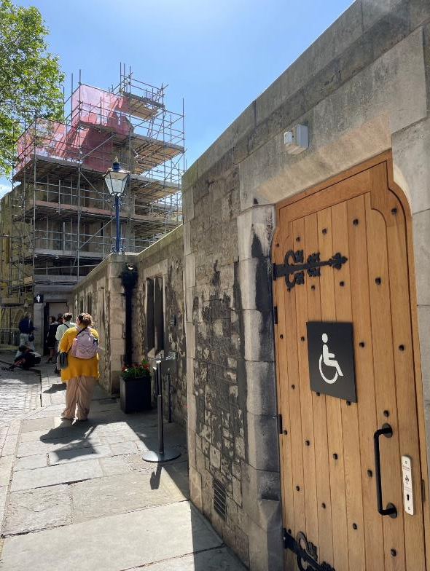
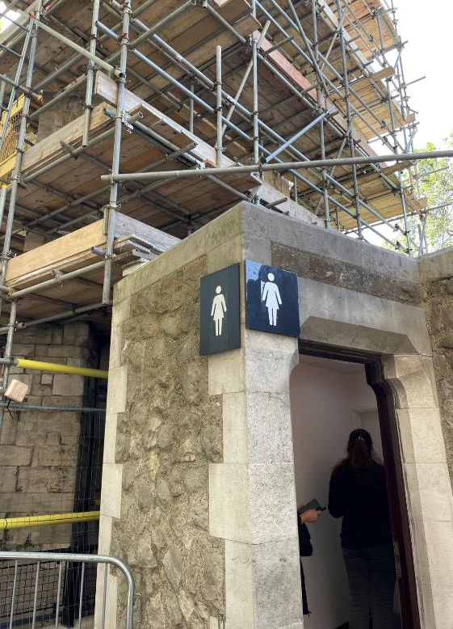
There are toilets near here.

Slide 10
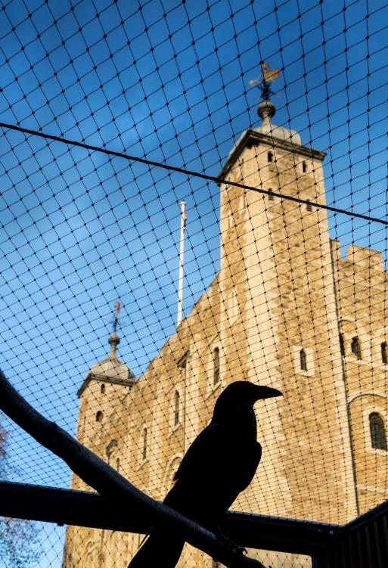
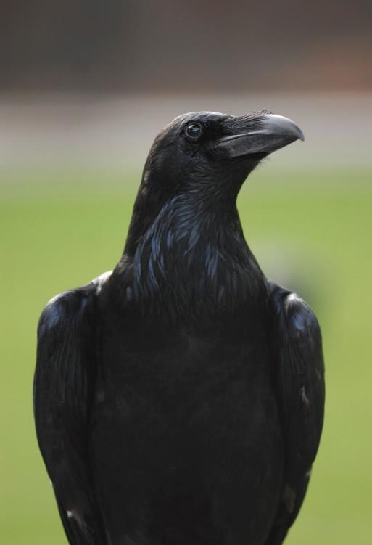
You can look for and listen to the ravens.

Slide 11
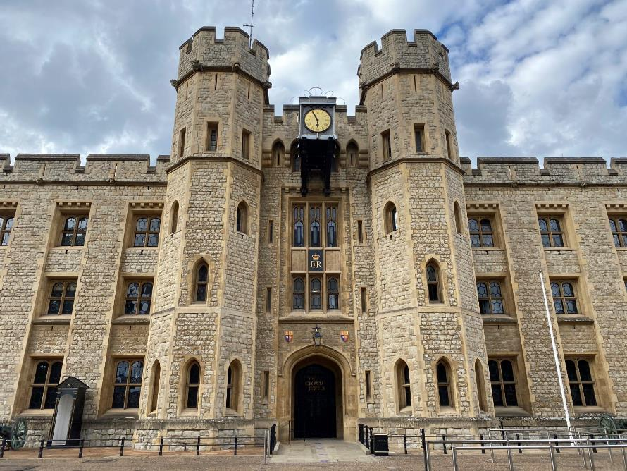
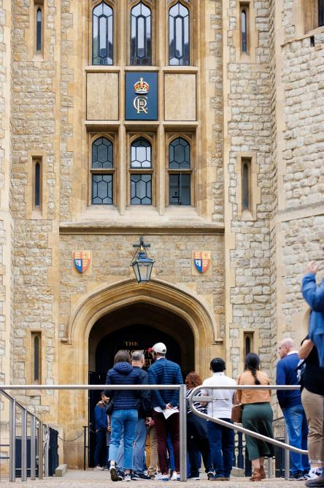
The Crown Jewels are kept inside the Jewel House. It can get very busy and you may have to queue to go inside.

Slide 12
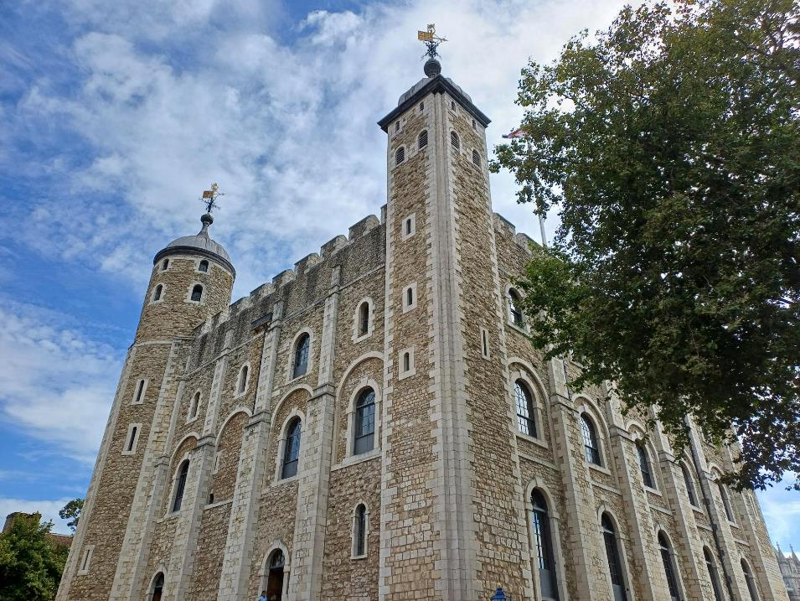
There are lots of other things to see at the Tower of London.

Slide 13
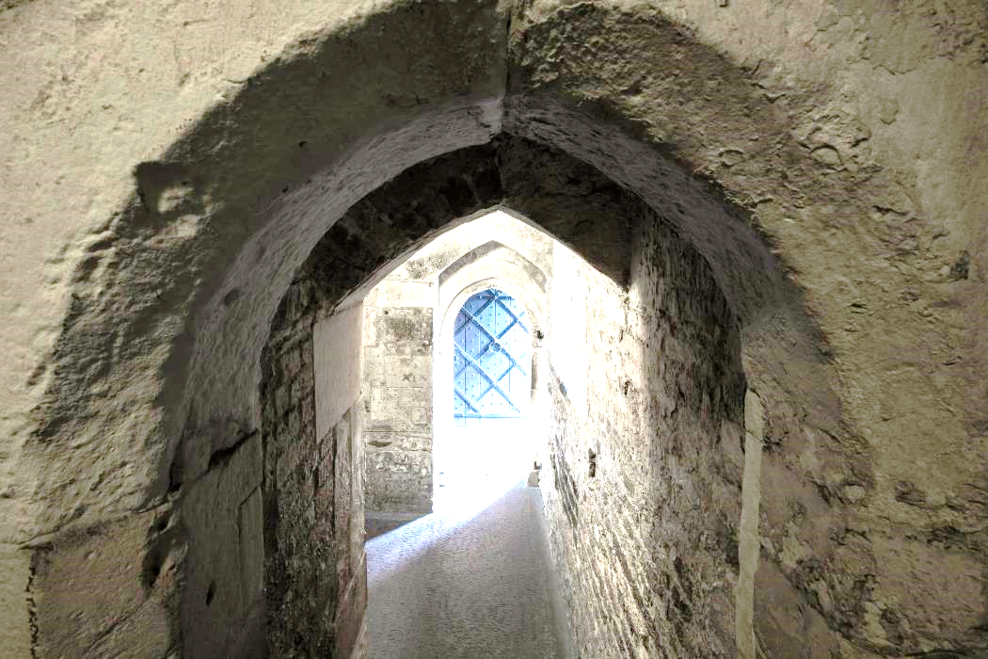
You may go inside this tower

Slide 14
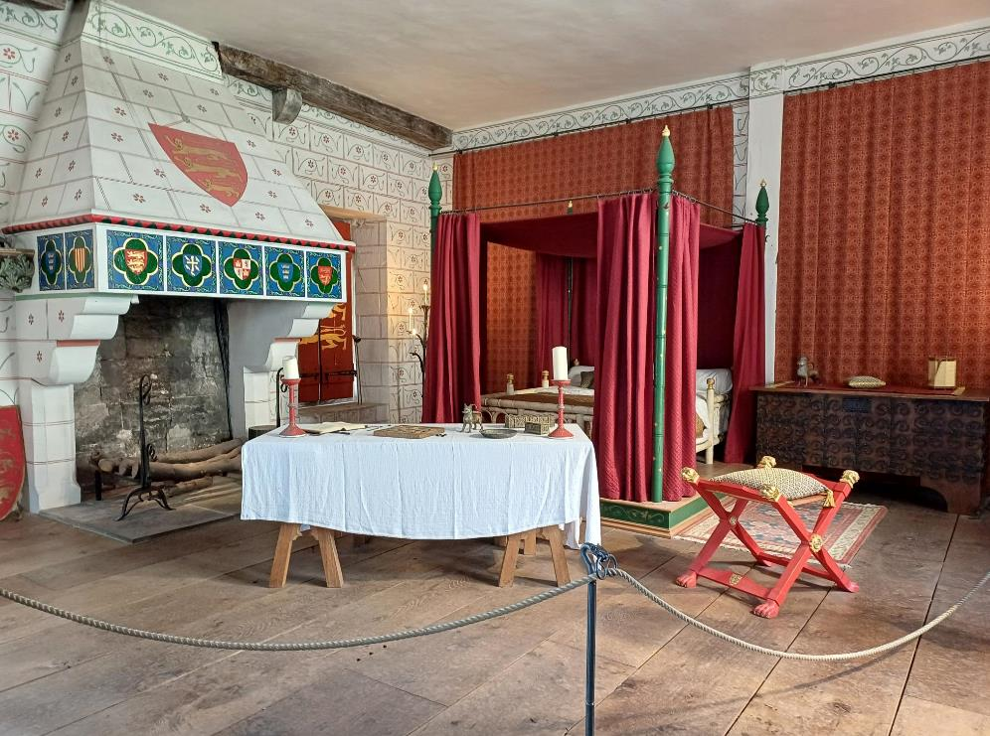
or this room.

Slide 15
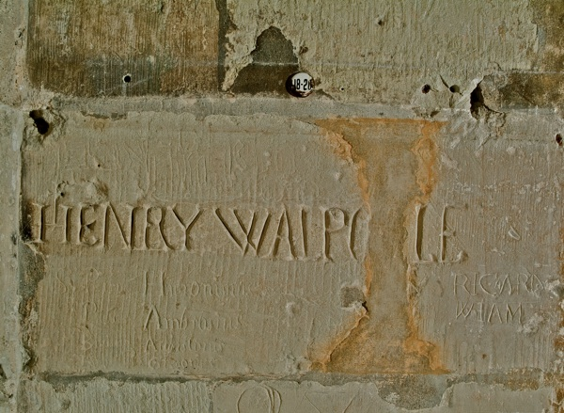
You might see writing on walls.

Slide 16
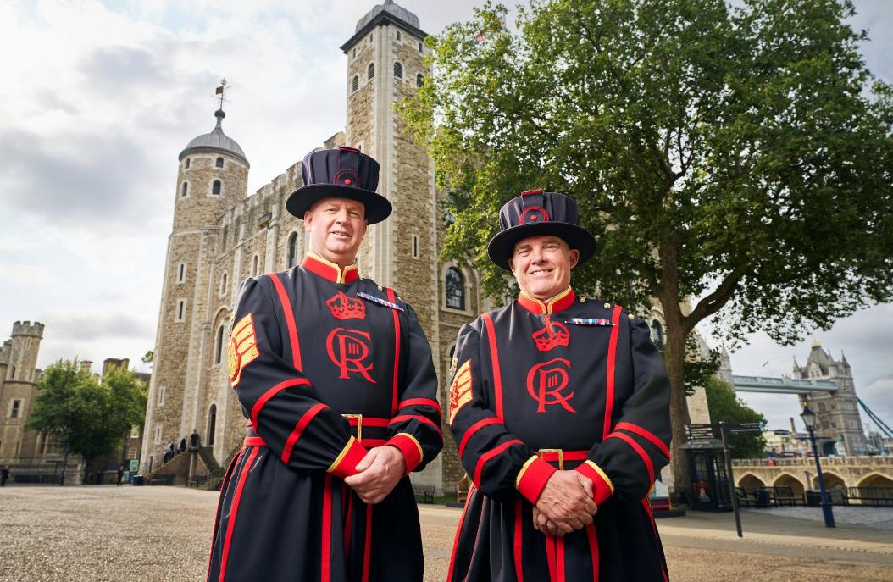
If you need help or have any questions, you can ask someone in uniform.

Slide 17
We hope you enjoy your visit.

