Slide 1
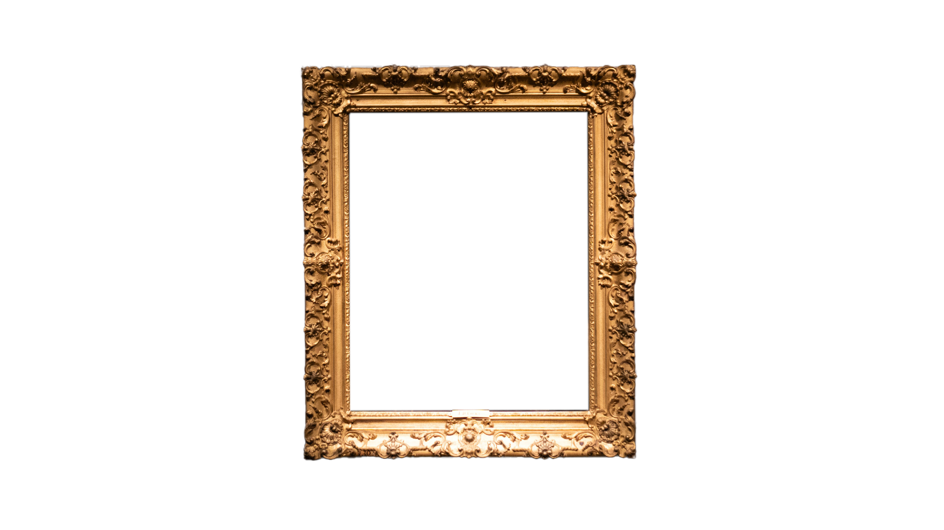
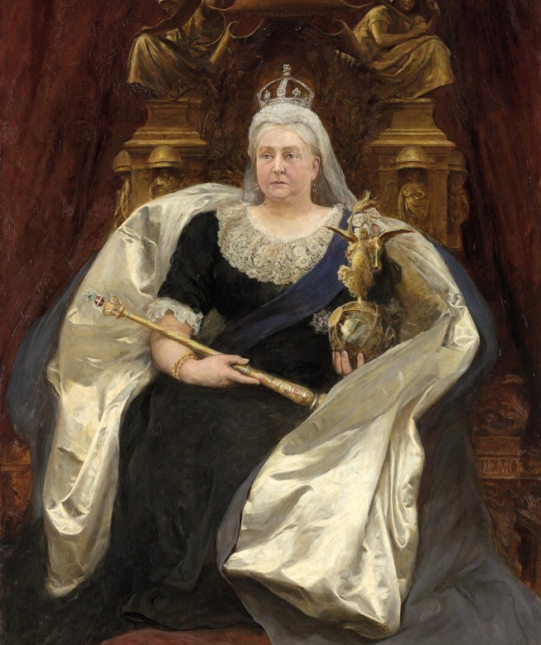
Queen Victoria source task
Queen Victoria
– Source Task –
Notes:
Image Credit:
National Gallery of Victoria, Melbourne Purchased, 1892 This digital record has been made available on NGV Collection Online through the generous support of Digitisation Champion Ms Carol Grigor through Metal Manufactures Limited

Slide 2
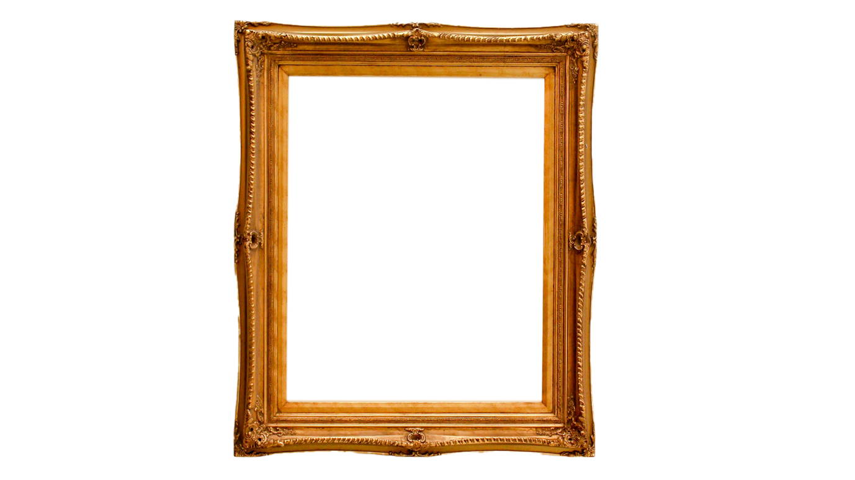
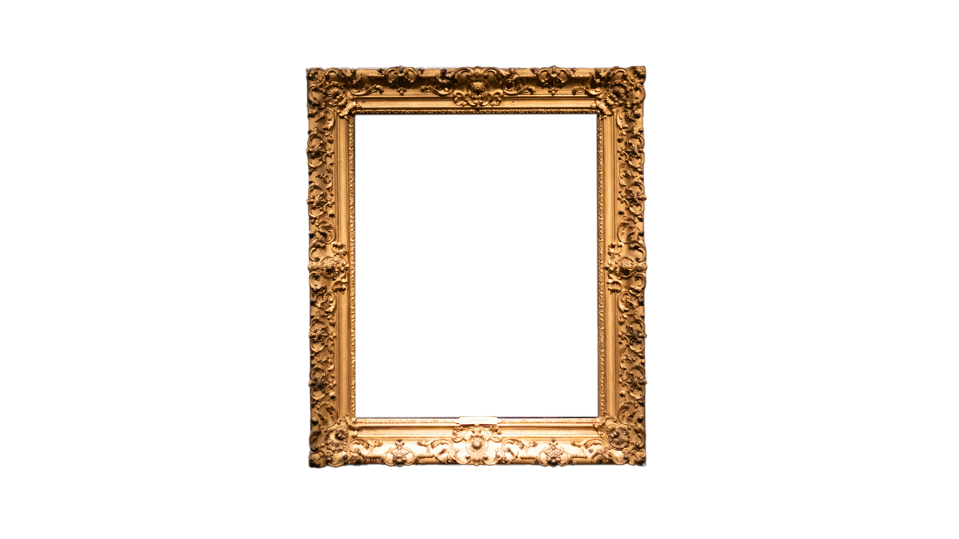
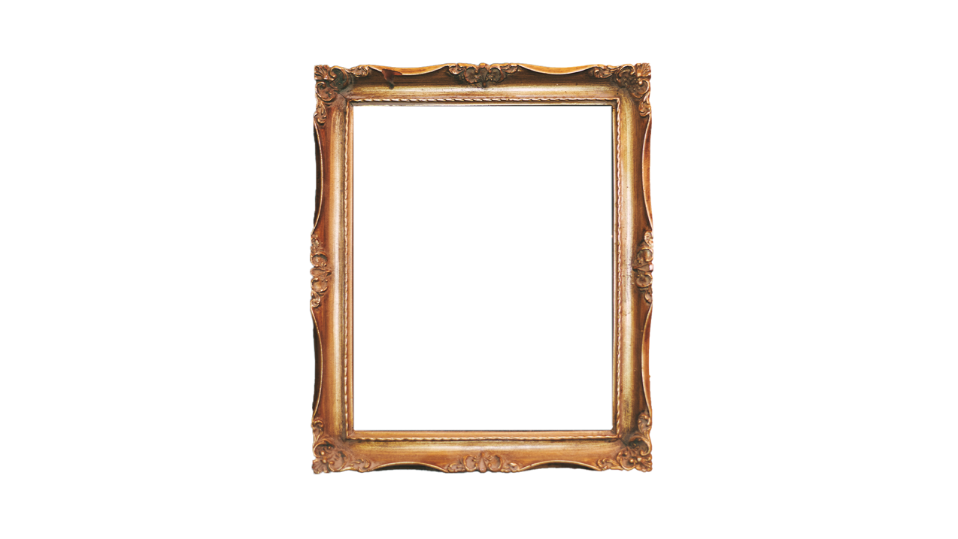
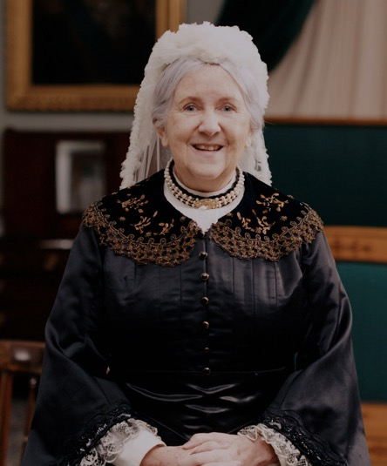
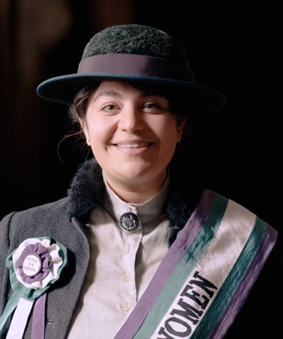
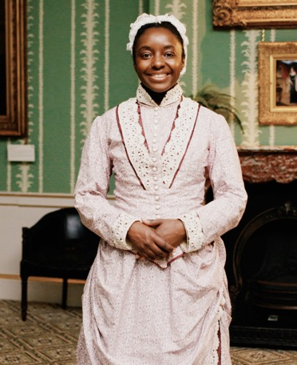
Have you watched me tell my story?
Have you watched me tell my story?
Princess Sophia
Duleep Singh
Sarah Forbes Bonetta
Queen Victoria
Notes:
Watch the videos: https://youtube.com/playlist?list=PLmQztN3936tL1ZgIHlfwlsKaRAqEDNQf1&feature=shared

Slide 3
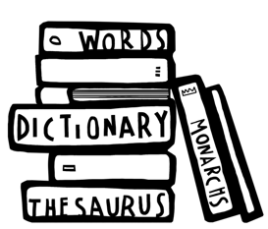
Vocabulary
history | Learning about people, places and events from a long time ago to understand what life was like in the past.
source | Items from the past that help us learn about what happened. These might be portraits or documents.
evidence | Clues that help us understand and explain what life was like in the past.
portrait | A picture or artwork of a person. It can be a painting, a photograph or even a sculpture.
monarch | A king or queen who leads a country and makes important decisions.
empire | A group of countries that were ruled over by one monarch or another country.
empress | A woman who reigns over an empire.
crown | Something that a king or queen wears on their head to show they have power.
sceptre | A rod carried by monarchs as a symbol of their power.
Notes:
Teacher notes:
These terms are useful in the context of the video of this source task and the original video. It would be useful for children to be aware of them however you do not need to memorise or discuss all of them on this slide.

Slide 4
When did Queen Victoria live?
When did
Queen Victoria
live?
Victoria was born
over 200 years ago!
VICTORIAN PERIOD
Queen Victoria
Further into the past
Now
Notes:
Teacher notes:
The purpose of this slide is for children to understand that this period of history is a long time in the past which is why life is so different to what they know.
Ask children to find 'now'. Explain this is where we are today.
Move finger back to the end of the bright blue section. This is how far the oldest people alive today can remember. The Victorians are further in the past than that.
Say the word Victorian and explain this was a time of great change in Great Britain.

Slide 5
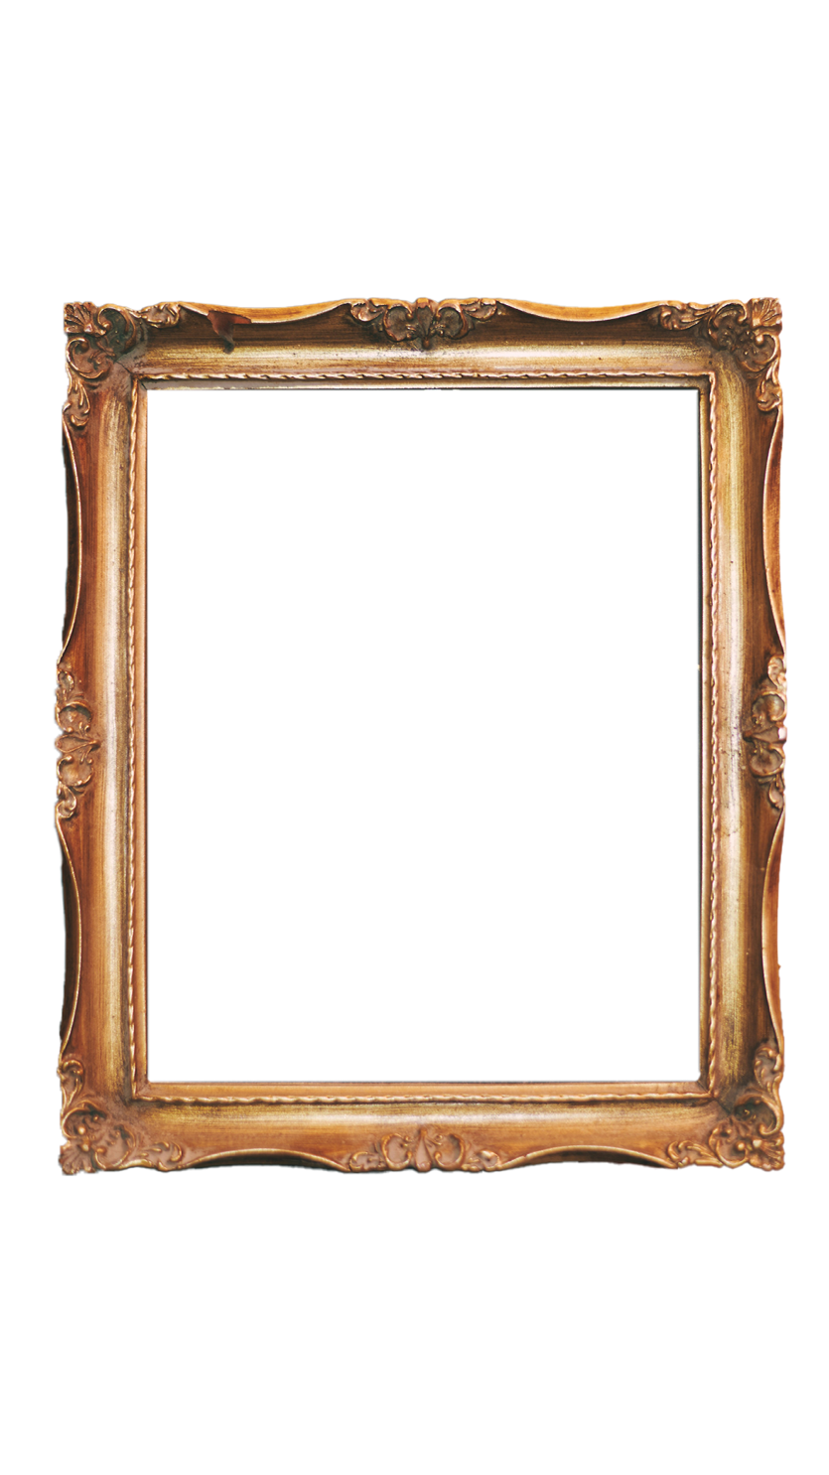
Do you remember these sources?
Do you remember these sources?
Notes:
About these sources:
Left: This is a photograph of Queen Victoria taken after the death of Prince Albert in 1888. She appears to be wearing black clothing in mourning to the death of her husband. She found his loss incredibly difficult and grieved for the rest of her life. Cameras were a new invention and Queen Victoria was the first British Queen to be photographed. We have both photographs and paintings of her which shows how important she was.
Right: This painting of Queen Victoria was created by Hubert Herkomer. The Queen had actually declined being painted by him. Instead, he used a statue and photographs of Victoria as references. The portrait is from the Australian province of Victoria which was named after the queen. In the painting we see Victoria's lavish clothing. She wears the Koh-i-Noor diamond in her crown, highlighting her role as the Empress of India. She sits on a impressive throne. Portraits such as this would have taken a long time to complete. They include lots of ‘messages’ for people to pick up on. This portrait is a symbol that she was head of the British Empire which ruled over many countries around the world.
Learn more about this portrait with the National Gallery of Victoria,
Queen Victoria | NGV
Questions to ask:
What is similar about the different sources?
In both images, her clothes include both fabric and fur, they look expensive. She seems to be wearing similar colours (although it is tricky to know for sure from the black and white photograph).
What is different about the different sources?
In the painting, Victoria holds an orb and sceptre and has a crown. She also sits on a throne. These are important messages of power.
Do you think the painting looks like her?
Some people at the time thought that this painting did not look very much like Victoria. This might be because the painter created the image from other sources, rather than meeting Victoria herself. It also reminds us why it is important for us to look at different sources today, to help get a fuller idea of the past.
Image Credit:
Historic Royal Palaces
National Gallery of Victoria, Melbourne, Purchased, 1892, This digital record has been made available on NGV Collection Online through the generous support of Digitisation Champion Ms Carol Grigor through Metal Manufactures Limited

Slide 6
How does this source help tell Victoria’s story?
How does this
source help tell
Victoria’s story?
Notes:
Task:​
Ask the students to look closely at this source. ​
​
Questions to ask:​
Can you find something that shows Victoria was the monarch?​
She is wearing a crown (children may refer to her being sat on a throne too).​ ​
Can you find something that shows how wealthy the British monarch was in the Victorian period? ​
She is wearing a crown, carrying a sceptre and holding a globe; they are made of gold and include valuable jewels.​
​
Themes to explore:​
Whilst Queen Victoria enjoyed many luxuries in life, it is important to remember that life was not fair or easy for many other people at that time. In Great Britain, many people were forced into workhouses, where they had very strict rules. Many children were also forced to work. Overseas, in many parts of the British Empire, the British gave local people very strict rules and imposed lots of changes to culture, religion and trade. ​
​
Queen Victoria was the ruler of the British Empire. This included lots of different countries around the world including India. The Koh-i-Noor diamond seen in the portrait is one of the most famous diamonds in the world. This diamond had been taken from a deposed ten-year-old Maharaja (King) in present India in 1849. He was Sophia Duleep Singh's father. The jewel was surrendered to Queen Victoria and is still part of the Crown Jewels today.​
​
​

Slide 7
Source close-up
How does this
source help tell
Victoria’s story?
Notes:
Task:
Look at the three sections of the portrait. Ask the students to describe what they can see in that part of the painting. Ask how each part helps to tell Queen Victoria's story?
(answers on the next slide)

Slide 8
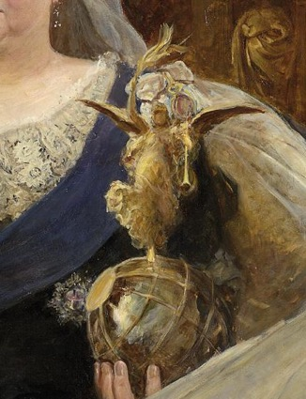
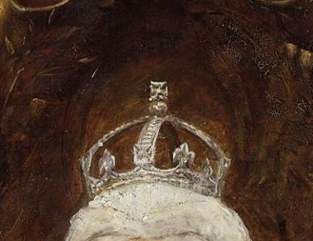
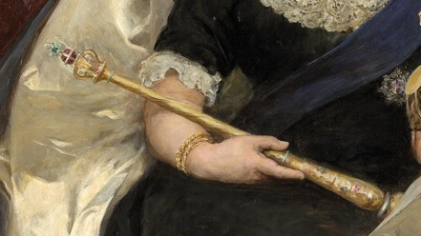
Look closer
Look closer at this source…
The crown is a symbol
of Victoria’s royal power.
The scepter is another symbol
of Victoria’s power.
The globe shows
Victoria’s power in other
parts of the world.
Notes:
Each section of the painting helps tell us about Elizabeth I's story and remind us why she is a significant individual.
The Crown
Victoria was queen for 63 years, the second longest in British history (Queen Elizabeth II reigned for 70 years). During this time Victoria saw lots of new inventions and changes, such as trains, cameras and the telephone. This crown includes the Koh-i-Noor diamond, a symbol of her position as Empress of India too.
The Sceptre
‘Ordinary’ people looked to the Queen as being powerful and someone to be inspired by. The sceptre is still used as a symbol of royalty today and was held by King Charles III when he was coronated.
The Globe
Queen Victoria was the ruler of many countries that were part of the British Empire. She also had two goddaughters with global connections: Ina Sarah Forbes Bonetta was from (what is now) Nigeria and Sophia Duleep Singh was born in England but had Indian, Ethiopian and German heritage.​
​It is important students understand the British Empire brought lots of benefits to Britain. This included wealth and access to raw materials. It helped Britain grow more powerful during the Victorian period. However, students should be introduced to the idea that people of colonised areas did not experience these benefits and were often exploited by the British.
The British Empire no longer exists but some countries have chosen to stay close to Britain as part of the Commonwealth.
Today, we know it is important to respect and consider other people’s beliefs and cultures.​

Slide 9
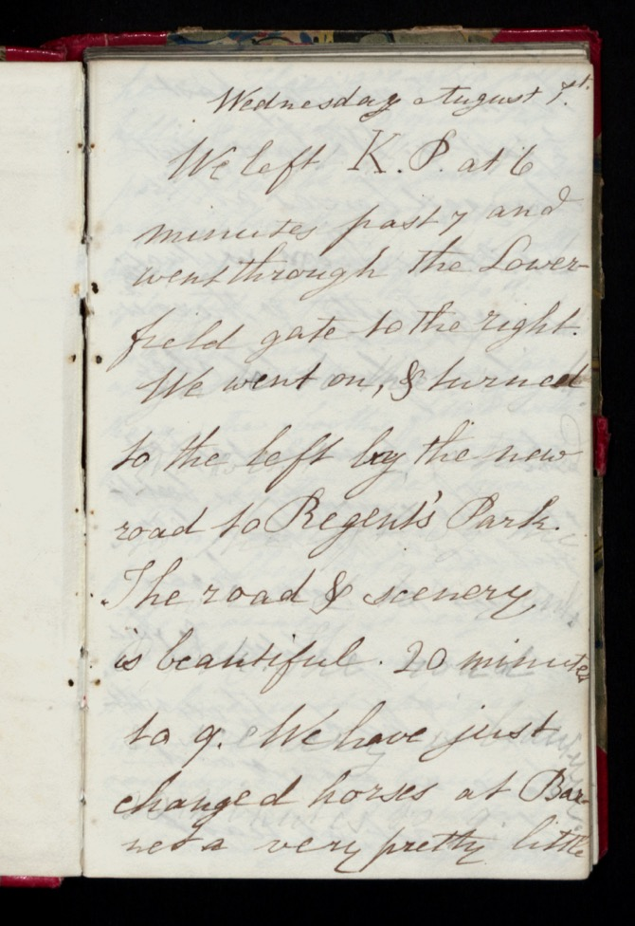
Other sources
Other sources
about Queen Victoria
Notes:
Teacher notes:
Queen Victoria kept a diary across her life. They are important to historians studying her reign as they show what she saw, thought and felt as she travelled around the United Kingdom and beyond. They are a wonderful example of a primary source and how historians know about people and events in the past. In this diary entry, Victoria writes about leaving Kensington Palace, seeing beautiful scenery and also having to change horses.
Learn more about Victoria's Journal with the Bodleian Library:
https://qvj.bodleian.ox.ac.uk/search/
See more images from Victoria's journal with Royal Collection Trust:
Queen Victoria's Journal
Image credit:
© Royal Collection Enterprises Limited 2025 | Royal Collection Trust

