Slide 1
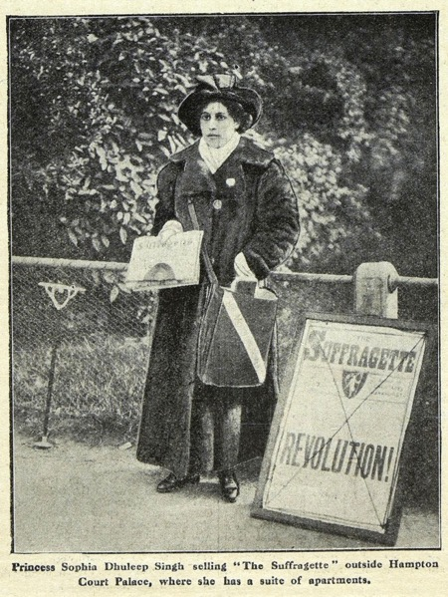
WATCH-ALONG GUIDE
BEFORE WATCHING
KEY THEMES
WIDER HISTORICAL THEMES
Sophia Duleep Singh is a significant individual because she used her position as a princess to speak out against injustice and fight for social change.
This video explores how groups like the suffragettes fought for equality, often facing punishment and mistreatment for their actions. During this time, the bicycle became a symbol of women’s freedom and independence.
The video also highlights the British Empire’s rule in India, where many Indian people faced harsh treatment and strict rules.
Society | During the Victorian period, women did not have the same rights as men. They were not allowed to vote and were often paid less for their work.
Suffragettes were a group of women who protested to change these unfair laws and fought for women’s rights.
Power and protest | Sophia used her position as a princess to support the suffragette movement. Despite facing criticism and danger, she kept fighting for women’s right to vote.
Empire | Sophia’s life was shaped by the British Empire’s rule in India. Her family lost their kingdom when the British took control of Punjab. In India, life was very unfair for lots of Indian people.
The British had very harsh rules and there was lots of violence and suffering.
Sophia was deeply affected by her visit to India, which inspired her to speak up for people who needed a voice.
Celebrity
A famous person.
(British) Empire
A group of countries ruled by one king, queen, or government. During Queen Victoria’s time, Britain ruled many countries around the world.
Goddaughter
A child who has godparents. A godparent is a special adult chosen to guide and support a child as they grow up, especially in their faith.
SOURCES USED IN THE VIDEO
SOPHIA
DULEEP SINGH
Portraits | Several photographs of Sophia and her family are featured in the video, giving an insight into their lives in England.
Documents | The video includes a newspaper article and a volunteer record card, which help us understand Sophia’s involvement in the suffragette movement and her time volunteering during World War I.

Slide 2
WHILE WATCHING
00:52
2:24
2:28
3:26
3:38
END
USING YOUR VOICE
SUFFRAGETTES
BEING A PRINCESS
VISITING INDIA
THE BICYCLE
REMEMBERING SOPHIA
Do you think it is brave to speak up for others?
Discuss that Sophia stood up for what she thought was fair and right, even when it was difficult. Encourage them to look for examples of her bravery in the video.
Do you think Sophia stopped fighting because some people disagreed with her views?
No, Sophia used her voice and position as a princess to campaign for justice. Some people disagreed with her actions, but she continued to support the suffragettes.
What words would you use to describe a princess?
Now listen to Sophia’s answer. Does your class agree with her description of a princess? Emphasise that Sophia wanted to use her privilege to help others and make a positive difference.
Why do you think Sophia found visiting India difficult?
Sophia’s father was Maharaja Duleep Singh. He was the last Sikh Maharaja of the Punjab.
When he was 10 years old, he was forced by the British to surrender his lands and the Koh-i-Noor diamond. The British treated the Indian
people very badly. It must have been hard for Sophia to witness this treatment of other people, particularly because as she had strong connections to both countries.
Is it common for women to ride bicycles today?
Yes. Many people use bicycles today.
Was it common for women to ride bicycles when Sophia was alive?
No. Some believed it was inappropriate for women to ride bicycles. Bicycles became a symbol of women’s freedom and independence. Sophia seems to have adored riding her bicycle and was sometimes featured in newspapers because she rode her bike in public.
How should we remember Sophia today?
We should remember Sophia today because she campaigned for causes that she believed in. This including women’s right to vote but also supporting Indian soldiers. She used her voice and actions to help others and challenge unfairness.
AFTER WATCHING
HOW DO WE KNOW?
KNOWLEDGE SUMMARY
Introduce the idea of a historical source—something historians use to study the past. Explain that evidence is the information we get from these sources to understand and explain history.
A supporting PowerPoint presentation is available to help students study the sources shown in the video, including photographs of Sophia, a newspaper article, and a volunteer record card.
These activities help students explore how sources shape what we know about historical figures.
Princess Sophia Duleep Singh is a significant individual.
Sophia was the daughter of a Maharaja (king) of a region in India. She was born in Britain during the Victorian period. She was also goddaughter of Queen Victoria.
Throughout her life, she worked to help others and improve society.
She campaigned for women’s rights as a suffragette and used her public profile to raise awareness.
Sophia rode a bicycle, which became a symbol of women’s freedom and independence. Her actions contributed to the fight for equal rights and continue to inspire people today.
Image credit: Princess Sophia Duleep Singh. Image printed in the Suffragette Newspaper © The National Archives

