Slide 1
HOW TO USE - NOTES FOR TEACHERS
These resources from Historic Royal Palaces are multi-purpose. They are ready for you to tweak and use in your lessons.
For the best experience, download and open the file in the PowerPoint desktop app.
Answers are found under the slide. Click on the notes symbol at the bottom of the screen.
Delete text and images to make your own worksheets.
Disclaimer and Use Terms
We are the owner or the licensee of all intellectual property rights in these resources which are protected by copyright laws and treaties around the world. All such rights are reserved. These resources, and the content included within them, may be used by you for educational purposes only. This means that you may download the resources and use or share them solely in educational environments (including for home school lessons) or as part of homework. You may not share the resources other than for the above purposes and you must not use the resources, or any part of them, for any commercial purpose.

Slide 2
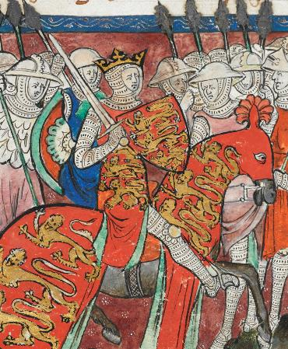
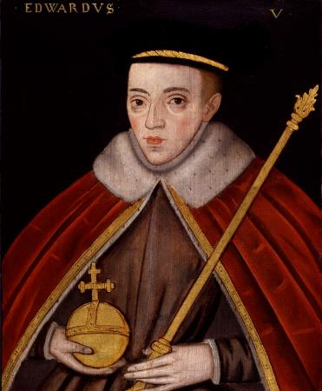
WILLIAM I AND EDWARD V
WILLIAM THE
EDWARD V
CONQUEROR
The older of the two boys known as the Princes in the Tower
The first Norman King of England
Edward V was the elder son of Edward IV and Elizabeth Woodville. He became Prince of Wales in 1471 and grew up with his uncle Antony Woodville, Earl Rivers, at Ludlow Castle.
Edward became king when he was 12, when his father died. His other uncle, Richard of Gloucester, was named Lord Protector. Edward and his younger brother, also called Richard, were taken to the Royal Apartments at the Tower of London, to prepare for Edward’s coronation.
However, not long before his coronation, his parents’ marriage was declared invalid. This meant he and his brother were illegitimate and he could not become king. Days later, Richard of Gloucester became King.
Edward and Richard were last seen in autumn 1483, playing in the gardens at the Tower of London. They both disappeared soon after.
William was the son of Robert, Duke of Normandy. William was 8 years old when his father died. At this point William became Duke of Normandy. He grew up to become an experienced and ruthless military commander.
In 1066, he became the king of England after defeating the Saxon King Harold at the Battle of Hastings. After this, he was also known as William the Conqueror.
He knew that the key to controlling England was to control London. He ordered the building of a great stone fortress in London. It took 25 years to complete.
An extremely strong warrior.
Liked to hunt and created many new royal forests in England.
Some through he was greedy and cruel.
Others thought he was generous and fair.
Courtesy of the British Library
Cotton Claudius D.II
© National Portrait Gallery, London
Died: c.1027 - 1087
Lived: 1470 - ?
Birthplace: Normandy
Birthplace: London
Reigned: 1066 - 1087
Reigned: 1483
He was the first king to
be crowned at Westminster Abbey.
In 1674 skeletons of two children were found at the Tower of London. Many people believe these are the remains of the princes.
Q:
Why do you think the story of the two princes still fascinates people?
Q:
Why do you think William built a huge fortress in London?
Notes:
William I notes:
William’s main purpose in building the Tower was as a symbol of power, to control the population of London. The largest of three stone castles he built in the city, it would have dwarfed the small wooden buildings that surrounded it and made a clear statement about who was now in control of the country. It also served as a royal palace and as a garrison for troops.
Edward V notes:
There are many reasons the story of the two princes still fascinates people today. Some people will be particularly interested since what happened to the princes is still a mystery, unlikely ever to be solved.

Slide 3
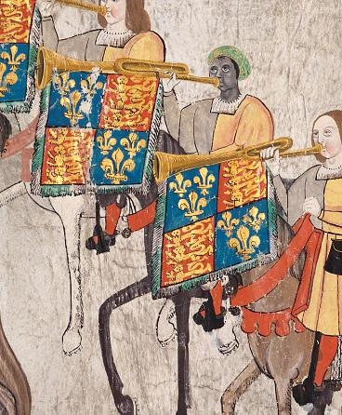
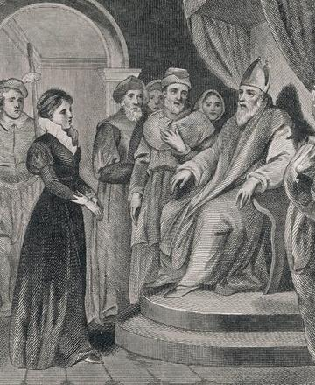
JOHN BLANKE AND ANNE ASKEW
JOHN
ANNE
BLANKE
ASKEW
A Black trumpeter at the courts of Henry VII and Henry VIII
A Protestant who refused to give up her beliefs even under torture
John had African heritage. It is possible he travelled to England from Spain with Katherine of Aragon in 1501. He was a successful, royal trumpeter and was part of a long tradition of Black musicians performing at European royal courts.
Played at Henry VII’s funeral, May 1509
Played at Henry VIII’s marriage and Coronation, June 1509.
John was well paid and received 8d. (pence) per day, the same as a skilled craftsperson. He asked the king for promotion. His request was successful, and his wage was doubled.
In 1511, John was painted on the Westminster Tournament Roll. He is shown on horseback, playing his trumpet. In 1512, John got married and the king gave him a new wedding outfit including a gown of violet velvet and a hat.
Anne was born around 1521. Her father was a wealthy landowner. She was well-educated and Protestant and was forced to marry at a young age.
King Henry VIII passed laws that stopped lower class women from reading the Christian Bible (which was a Protestant activity). Women from higher status families were only allowed to read the Bible in private.
As a devout Protestant Anne caused much controversy. One of her first acts of rebellion was reading the Bible in public in Lincoln Cathedral. She was challenged by Bishops and Priests. Her husband was very angry at her and did not welcome her back home.
In 1544, she travelled to London and continued Protestant activities. She was arrested several more times and released. In 1546 she was arrested again for heresy and imprisoned in the Tower of London. She was tortured and was eventually burnt at the stake.
College of Arms MS Westminster Tournament Roll, 1511, membrane 28. Reproduced by permission of the Kings, Heralds and Pursuivants of Arms.
Chronicle / Alamy Stock Photo
Lived: unknown
Lived: c.1521 - 1546
Birthplace: unknown
Birthplace: Lincolnshire
The only Black Tudor who has an identifiable image surviving today.
She travelled to London to demand a divorce from her husband. She was refused.
Q:
Why do you think the image of John on the Westminster Tournament Roll is important as historical evidence?
What evidence is there that Henry VIII respected John Blanke?
Notes:
John Blanke notes:
The image is important because it is evidence of John’s life as a black person at Tudor court. There are no other images of named black people from this time in England so it is an important historical document.
There are a few things that suggest Henry respected John. Henry gave him a gift of clothing when he got married (clothes were very expensive.) John also successfully negotiated a promotion and a pay rise.

Slide 4
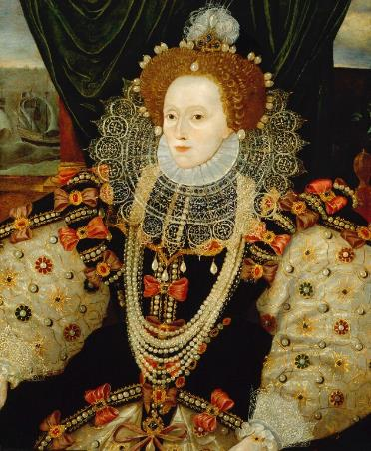
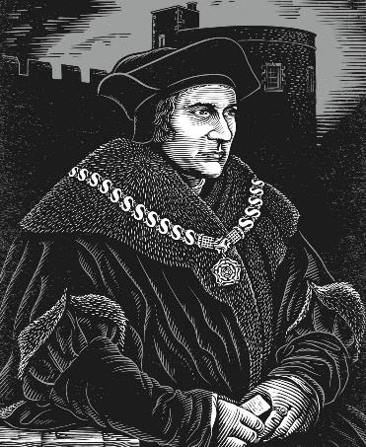
ELIZABETH I AND THOMAS MORE
ELIZABETH I
THOMAS
MORE
Last Tudor monarch – a queen who ruled alone
Lord Chancellor who was imprisoned in the Tower for his beliefs
Elizabeth was the daughter of Henry VIII and his second wife, Anne Boleyn.
She was Protestant and was accused of plotting against her half-sister, the Catholic Queen Mary I.
In 1554, Mary imprisoned Elizabeth briefly in the Tower of London.
Mary thought Elizabeth was involved in a Protestant Rebellion.
Elizabeth became queen in 1558, aged 25. In 1588, Philip of Spain planned an invasion of England and launched the Spanish Armada. The Armada was defeated by Elizabeth’s much smaller English navy.
She was worried there might be more Catholic rebellions against her as well as other threats. Elizabeth used the Tower of London as a prison and imprisoned many people over several decades.
Thomas studied at Oxford University before becoming a lawyer.
He was elected to Parliament in 1504 and became a trusted advisor to Henry VIII.
Henry made Thomas Lord Chancellor in 1529.
Thomas was a Roman Catholic. This meant he could not support Henry when Henry wanted to marry Anne Boleyn, or when Henry claimed to be Supreme Head of the Church in England. Because of this, he was imprisoned in the Tower of London in 1534.
He was executed for treason in 1535.
© National Portrait Gallery, London
© Historic Royal Palaces
Lived: 1533 - 1603
Lived: 1478 - 1535
Birthplace: London
Birthplace: London
Reigned: 1558 - 1603
“I know I have the body of a weak and feeble woman; but I have the heart and stomach of a king, and of a king of England too.”
Elizabeth’s speech at the time of the Spanish Armada.
‘I die the king’s faithful servant, but God’s first.’
Words spoken by Thomas before his execution.
Q:
What impression of Thomas do you have from his image?
Do you think Thomas should have supported Henry?
Q:
What clues are there that this portrait was painted to celebrate the defeat of the Spanish Armada?
Notes:
Elizabeth I notes:
In the portrait, we can see scenes from the defeat of the Spanish Armada on the wall behind the Queen. This suggests it was painted to celebrate the defeat of the Spanish Armada. (English fireships setting out on the left, and Spanish ships being wrecked in storms on the right.) Also, Elizabeth’s hand rests on a globe, perhaps representing England’s command of the seas.
Thomas More notes:
Thomas More’s image gives the impression of a wealthy and powerful man. He is wearing layers of expensive clothes that make him appear large and dominant. He also wears a heavy gold chain, with the Tudor rose badge. Note: This is the ‘chain of office’ that shows his position as Lord Chancellor.
Some might think Thomas should have supported Henry, as Henry was his king and Thomas knew what might happen if he defied him. Others might argue that Thomas could not support something he believed to be wrong and that he was a martyr, prepared to die for his beliefs.

Slide 5
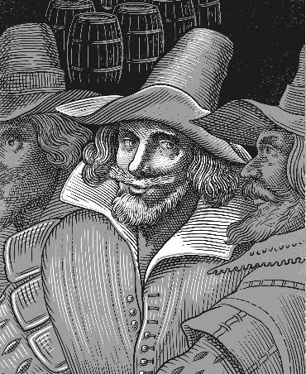
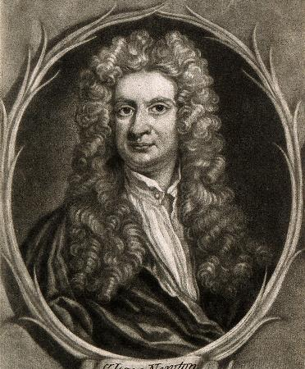
GUY FAWKES AND ISAAC NEWTON
GUY
ISAAC
FAWKES
NEWTON
The most well-known of the Gunpowder Plot conspirators
The scientist in charge of the Royal Mint at the Tower of London
Guy was Catholic and fought for Spain as a young man. At some point Guy moved back to England. At the time England was a Protestant country and dangerous for Catholic people. There were laws that limited their freedom and rights. Guy joined a group of other Catholic men to plan how to bring the Catholic faith back to England.
The plan was to assassinate King James I and his ministers at the opening of Parliament on 5th November 1605.
The plotters hid 36 barrels of gunpowder in a cellar beneath the Houses of Parliament. This would be enough to destroy everything nearby.
Guy was a gunpowder expert, so he waited in the vault to light the fuse. However, he was captured by the King’s men and taken to the Tower of London. Guy was tortured and sentenced to death for treason.
He invented the reflecting telescope, which is still used by astronomers today.
© Historic Royal Palaces
Wellcome Collection 546490i
Died: 1570 - 1606
Lived: 1642 - 1727
Birthplace: York
Location: Lincolnshire
Sir Isaac Newton was a mathematician, physicist and astronomer.
He is well known for developing the theory of gravity. He studied at Cambridge University, and later became a Professor of Mathematics there. In 1696 Isaac moved to London and was in charge of the Royal Mint.
He was promoted to master in 1699.
Calculated the most efficient way to produce coins.
Helped the mint to re-coin £2.5 million of silver.
Tracked down counterfeiters who made fake coins.
At first Guy refused to tell the King who the other plotters were.
Q:
What do you think was Isaac Newton’s biggest achievement?
Q:
Guy Fawkes was described as a ‘great devil’ by someone who witnessed his execution. What is your opinion of him and his actions?
Notes:
Guy Fawkes notes:
Some might say that he was wicked because he plotted to murder the King and all his ministers in an act of terrorism. In spite of this, some might argue he was brave because he was fighting for the right to practise his faith and held out for several days under torture.
Isaac Newton notes:
Many people know Issac Newton for his work developing the theory of gravity. Some people may think his work on the reflecting telescope is his biggest achievement. It is clear he also made huge contributions to mathematics and physics and astronomy.

Slide 6
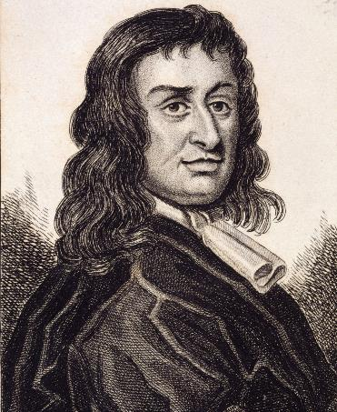
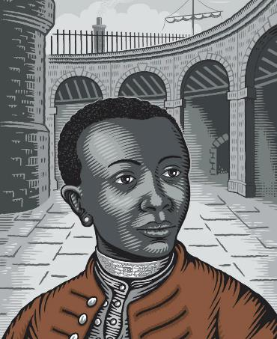
COLONEL BLOOD AND EDWARD FRANCIS
COLONEL
EDWARD
BLOOD
FRANCIS
The man who almost stole the Crown Jewels
An African man who lived at the Tower of London
Thomas was an Irish soldier, adventurer and spy.
During the English Civil War he fought on both sides, both for and against the king.
In 1671, he planned to steal the Crown Jewels from the Tower of London.
Thomas tricked the Jewel House Keeper into becoming friends. He then attacked him and stole the crown, orb and sceptre. However, he and his accomplices were arrested before they could escape.
Thomas asked if he could speak to King Charles II. We don’t know what he said, but the king pardoned him and gave him lands in Ireland.
It is thought that Edward might have tried to escape enslavement more than once.
Courtesy of the British Library C.152.b.9
© Historic Royal Palaces
Lived c1617 - 1680
Lived: unknown
Birthplace County Meath, Ireland
Birthplace: unknown
Edward was an enslaved African who lived in the home of Thomas Dymock. Thomas looked after the lions at the Tower of London, which were part of the Royal Menagerie.
In 1692, Thomas claimed that Edward had tried to poison him. Surprisingly, Edward confessed to the crime.
He also apparently admitted that he thought he could gain his freedom by killing Thomas.
Edward was fined and imprisoned. He somehow managed to pay the fine. It is not known what happened to him after he was released from prison.
He visited the Jewel Keeper and his family for several months to win their trust.
Q:
What is surprising about how Charles II treated Thomas after he was caught?
Q:
The image is an artist’s impression of Edward. Why do you think we know so little about what he looked like, or where he was born or died?
Notes:
Colonel Blood notes:
We might have expected the King Charles II to punish Thomas for trying to steal the Crown Jewels. However, instead the King even gave Thomas land in Ireland. This is made even more surprising by the fact that Thomas fought against the King during the civil war.
Extra information
Charles II’s actions have puzzled many people. Some think he had a liking for rogues and may have been amused by Thomas’s boldness. Some think the king feared an uprising and was trying to look more merciful. Others wonder whether Thomas had acted with the King’s knowledge, perhaps because Charles was short of money and intended to sell the jewels himself.
Edward Francis notes:
Edward Francis was one of thousands of people of African descent in Britain in the 1600s and 1700s. Sadly, historical evidence for their lives is often very scarce. We often do not know where they were born, died, or even their names. Enslaved people were often given new names by their enslavers.

Slide 7
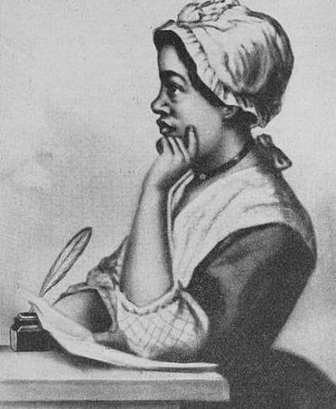
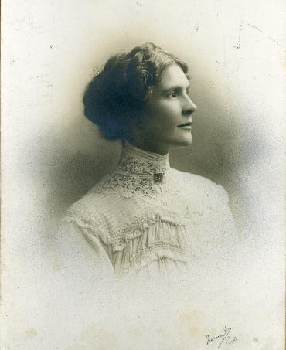
PHILLIS WHEATLEY AND LEONORA COHEN
PHILLIS
LEONORA
WHEATLEY
COHEN
The first published African American Woman
A campaigner for women’s rights known as the ‘Tower Suffragette’
Phillis was born in West Africa in around 1753. As a child, she was captured, enslaved and taken to Boston in America. She was bought by a man named John Wheatley and acted as a servant to his wife.
She was highly intelligent. She was also encouraged to study, which was very unusual for an enslaved person. She later became a well-known poet and was the first African American Woman to be published.
Phillis came to London in 1773. She visited several attractions including the Tower of London which she wrote about in a letter.
She described seeing the Crown Jewels, the Armoury, and the Royal Menagerie. She was shown round by a famous abolitionist called Granville Sharpe who worked at the Tower.
Leonora’s father died when she was five. Her mother struggled to support the family alone.
Leonora joined the suffragette movement in 1909 and took part in many protests.
In 1913 Leonora smuggled an iron bar into the Jewel House at the Tower of London and used it to smash a display case.
Leonora left a note attached to the iron bar at the Tower of London. It stated: ‘This is my protest against the Government’s treachery to the working women of Great Britain.’
She was charged with causing unlawful and malicious damage.
She defended herself in court and was found not guilty.
New York Public Library
© Leeds Museums and Galleries, UK
Bridgeman Images
Lived: unknown
Lived: 1873 - 1978
Birthplace: West Africa
Birthplace: Unknown
‘Since my return to America my Master has, at the desire of my friends in England, given me my freedom.’
Phillis Wheatley writing in a letter.
“Life was hard. My mother would say ‘Leonora, if only we women had a say in things’, but we hadn’t... I vowed I’d try to change things.”
Leonora Cohen talking about her experiences.
Do you think it was usual for enslaved people to be as well-educated as Phillis?
What clues are there which might explain why Phillis gained her freedom when she returned to America?
Q:
Is there any evidence from her childhood to suggest why Leonora became a suffragette?
Do you admire Leonora for smashing the case? Why or why not?
Q:
Notes:
Phillis Wheatley notes:
Most enslaved people were not encouraged in their education and were prevented from even learning how to read and write. Some educated themselves in secret.
The quote suggests that Phillis’s friends in England put pressure on her ‘Master’ to free her from enslavement. One of these may have been Granville Sharp, an abolitionist who worked at the Tower of London.
Leonora Cohen notes:
As a widow and single parent, Leonora’s mother struggled to support the family. (There were few job opportunities for women, and they were generally paid half as much as men. There were also no state benefits to help families.) Without the right to vote women had no say in changing their lives for the better.
Some might not admire Leonora as they might say smashing the case was an act of vandalism. Others might argue that she was admirable as she was prepared to fight (and perhaps go to jail) for the right of women to vote.

Slide 8
TEMPLATE WORKSHEET
________________
________________
________________
________________
Image credit:
Image credit:
Lived: _______
Lived: _______
Birthplace: _______
Birthplace: _______
Q:
Q:

Slide 9
VOCABULARY LIST
abolitionist | person who campaigned to end slavery
accomplice | someone who helps another to commit a crime
assassinate | murder an important person for political or religious reasons
astronomer | scientist who studies the stars, planets and other natural objects in space
Catholic | member of the Roman Catholic Church, a type of Christianity that follows the teachings of the Pope
Church of England | the Christian church in England based on the Protestant faith, established by King Henry VIII, with the king or queen as its head
civil war | a war between groups of people of the same country
counterfeiter | person who makes a copy of something to deceive someone else
English Civil War | battles that took place between 1642 and 1651 between the supporters of King Charles I and the supporters of Parliament (led by Oliver Cromwell)
enslaved | someone who is forced into slavery
fortress | strong building or place that can be defended from attack
garrison | group of soldiers defending a town or building, or the buildings that the soldiers live in
government | group of people that have the authority to rule a country
heresy | opinion or belief opposite to accepted Christian teaching at the time
heritage | something that is handed down from the past, including culture and traditions
imprisoned | kept in a prison

Slide 10
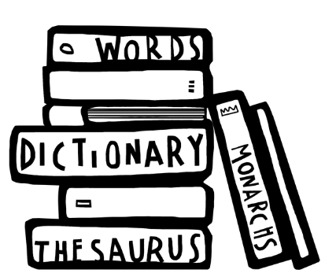
VOCABULARY LIST 2
VOCABULARY LIST
joust | sport developed in the Middle Ages as training for soldiers who fought on horseback
Lord Chancellor | in the past, the king or queen’s most important advisor
malicious | intended to harm someone or something
menagerie | collection of wild animals
military | word used in connection with an armed force such as soldiers
minister | someone with a lot of power and responsibility in government
navy | ships built and maintained to defend a country
Parliament | the group of people elected to make and change laws in a country; in the past only very rich and powerful people were Members of Parliament
patron | someone who gives financial or other support to a person or organisation
physicist | scientist who studies the relationship between matter (solids, liquids and gas) forces and energy
Pope | the head of the Roman Catholic church
procession | a number of people (sometimes on horseback) moving in an orderly fashion
Protestant | A type of Christianity that believes people do not need officials (such as the Pope or Bishops) to communicate with God
rebellion | a fight by a large group of people against the government or ruler; or an action against rules and accepted ways of behaving
recant | say that you no longer hold an opinion or belief
re-coin | make new coins by melting down old ones

Slide 11
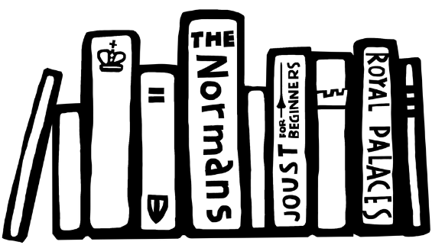
VOCABULARY LIST 3
VOCABULARY LIST
reflecting telescope | type of telescope that uses mirrors to reflect light and form an image
Roman Catholic Church | Christian religion with the Pope as its head
Royal Mint | factory that makes a country’s coins; in the past coins were made out of precious metals which were worth the value of the coins
Saxon | one of a group of people who lived in Britain from around 410 to 1066; the first Saxons came from what is now Germany
slavery | the practice of one person losing their freedom and being owned by another as property
Spanish Armada | the large fleet of ships sent to invade England by Philip II of Spain in 1588
state prison | in the past, a prison used for political or religious prisoners or people charged with very serious crimes
suffragette | member of the Women’s Social and Political Union (WSPU) who campaigned for the right of women to vote in the UK
Supreme Head | the highest in rank
theologian | someone who studies religious belief
treason | the crime of acting against your own country, especially by trying to kill the king or queen, or overthrow the government
Westminster Tournament Roll | long painting of a joust held in 1511 to celebrate the birth of Henry VIII and Katherine of Aragon’s son, who died a few weeks later

