Slide 1
The Tower Remembers

Slide 2
THE TOWER REMEMBERS: AN INTRODUCTION

Slide 3
TODAY WE WILL:
Find out more about key events such as VE Day, the Victory Parade, and the anniversary of the Battle of Britain, and how we observe significant moments from the Second World War.
–
Reflect on the role of the Tower of London as a backdrop to key moments in history and its role as a site for reflection.
–
Explore what remembrance means today and consider how and why it’s important that we remember significant moments in history.
Notes:
Todays session is about thinking about why it’s important that we commemorate and remember significant moments from the past today and looking at how significant moments from the Second World War have been remembered.

Slide 4
What do poppies represent?
Notes:
- Every year in November poppies appear in newsagents and train stations and outside supermarkets but what do they represent?
Poppies are seen in November to mark Armistice Day – a day of remembrance when we remember all those who have been impacted and continue to be impacted by war.

Slide 5
WHAT DOES REMEMBRANCE MEAN?
Notes:
- What is Remembrance?
Remembrance is the act of remembering important people, events, or moments from the past, like the soldiers who fought in Second World War and the communities that were impacted, and other significant events in history. It's about honouring individual sacrifices and achievements and remembering what happened so we can learn from history to help create a better future.
Reflection and remembrance can be personal and private or collective, such as the large scale displays at the Tower of London.
How else can we remember significant events?
What are some of the ways that your community remembers significant moments or people?
Monuments/memorials
Plaques
Road names
Events
A memorial is a special place, or an object, or piece of art created that helps us remember and honour someone or something important. It could be a statue, a plaque, a garden, or even a painting, poem or sculpture.
Teachers Note:
Here you might like to insert a slide with a picture of an event, monument, memorial, road name or plaque near your school

Slide 6
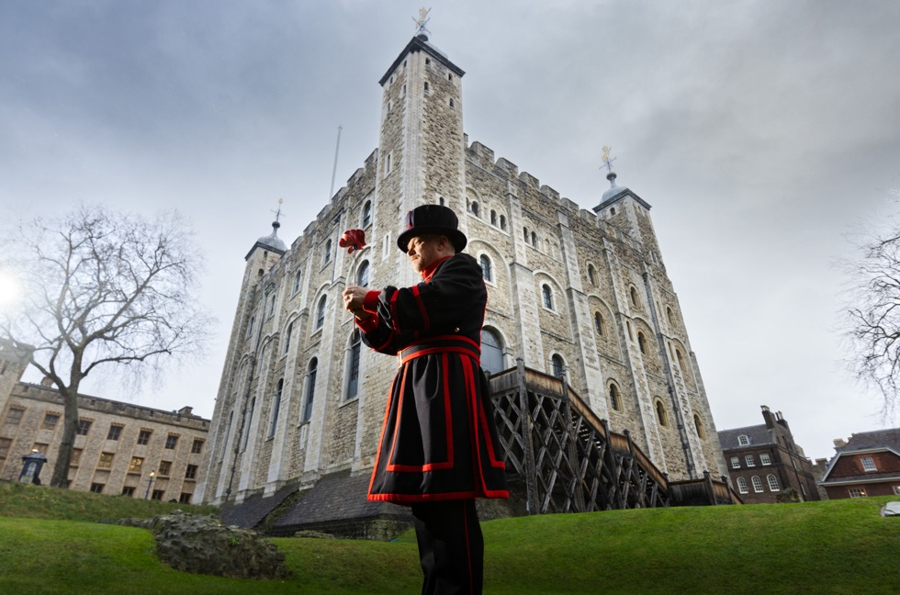
Why does the Tower remember?
© Historic Royal Palaces/Imperial War Museums
Notes:
The Tower of London has been guarded by the Yeoman Warders since Tudor Times. By tradition, only 422 people have ever held the role of Yeoman Warder at the Tower of London. Today’s Yeoman Warders need to have at least 22 years’ military service, they need to have reached a certain rank within their service and to have been awarded the long service and good conduct medal.
The tower is also the home of a Royal Fusilier TA Regiment and continues to be the Regimental Headquarters.
The Tower of London has almost three million visitors.
Why do you think we it’s important that we tell stories from the past?
So we don’t forget things that have happened
Because it’s fun to hear about people and events from the past
Because we can see how much things have changed
It reminds that people were brave and did important things
By highlighting stories from the past at The Tower of London we:
keep history alive
ensure that we can remember and learn from the past
help people understand their roots
can honour people from the past and recognise the impact they’ve had on our lives today
Build connections - Learning about history helps us connect with others, whether it's understanding how different countries shaped the world or sharing stories from our own families. It brings us together to appreciate the diversity and shared experiences of humanity.
As a site that has existed for over 1000 years the Tower of London has been part of many significant moments in history.

Slide 7
The second world war at the Tower of London
Notes:
During the Second World War the tower was home to the Yeoman Warders and their families, high profile prisoners and soldiers who were stationed at the Tower.
Tower Hamlets and East London were heavily bombed during the Second World War and the Tower of London was hit several times. This video shows some of the bomb damage at the Tower.
What was the impact of the Second World War on your community?
Who was living in your community at that time?
How did people stay safe?
Is there any lasting damage you can still see today?
Teachers Note:
This slide is an opportunity for you to include images and questions relating to the impact of World War II on your local area.
You might to add in your own images here that show the impact of the Second World War on your local area. You could:
Include images of VE Day celebrations in your local town or city
Highlight historical figures in your community who played an important role in the Second World War
Show some of the impact the war had on your local community

Slide 8
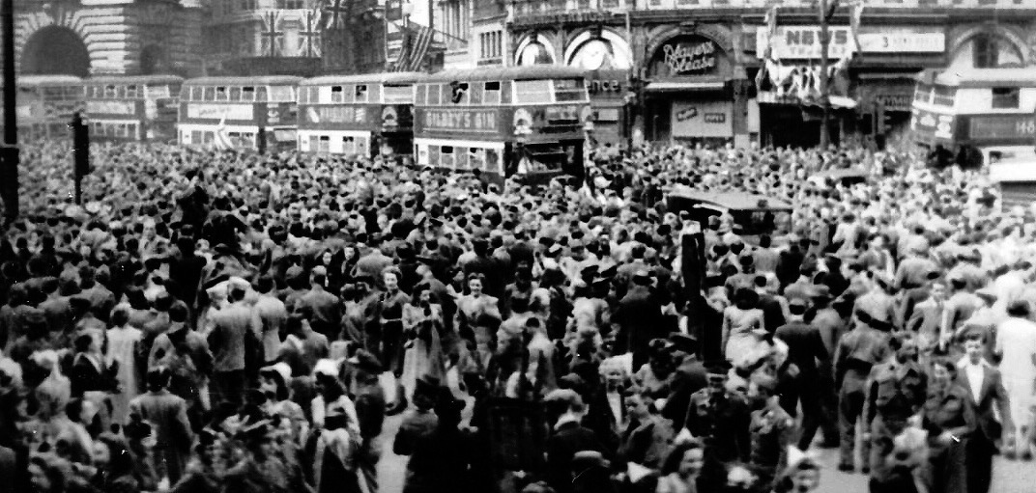
VE Day – Piccadilly Circus, London
Image taken by Sgt. James A. Spence during WWII service – Creative Commons
Notes:
This photograph shows people gathering in Piccadilly Circus in London to celebrate the end of the Second World War
How do you think it felt to be part of the crowd after almost 6 years of war?
VE Day stands for Victory in Europe Day. It happened on May 8, 1945 and it marked the end of the Second World War in Europe. The war had been going on for almost 6 years, and it had been a really difficult time for people as bombs were dropped on towns, families were separated, young men and women supported the war effort and food was rationed
There were lots of celebrations on VE Day and many people gathered in the streets. To mark the occasion, the Tower was illuminated with floodlights, and the East End of London celebrated with a week of street parties,
Can you think of an event in your community's history that marked the end of a significant period?
How did your community celebrate this moment?

Slide 9
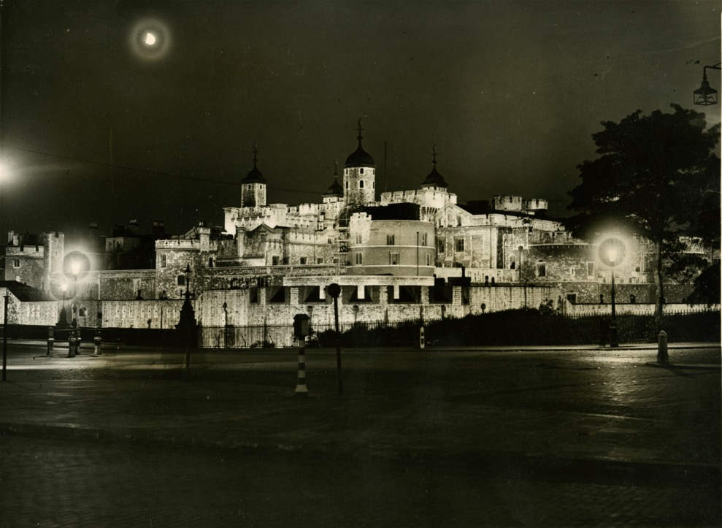
VE Day at the Tower
© Historic Royal Palaces/Yeoman Warder Archive
Notes:
To mark VE Day, the Tower was illuminated with floodlights, and the East End of London celebrated with a week of street parties, although the shadow of all the lives lost hung over the festivities.
The war against Japan continued and many soldiers were still serving overseas. The effects of the war would be felt for many years.
-Why do you think the light was an important part of this celebration?
Hope and freedom – during the blitz London was shrouded in darkness at night because of the threat of bombing. The floodlights showed London was safe again
Victory and a brighter future
Brought people together – the lights could be seen from some distance away
Honoured those who had been lost
Remembered those who were still fighting

Slide 10
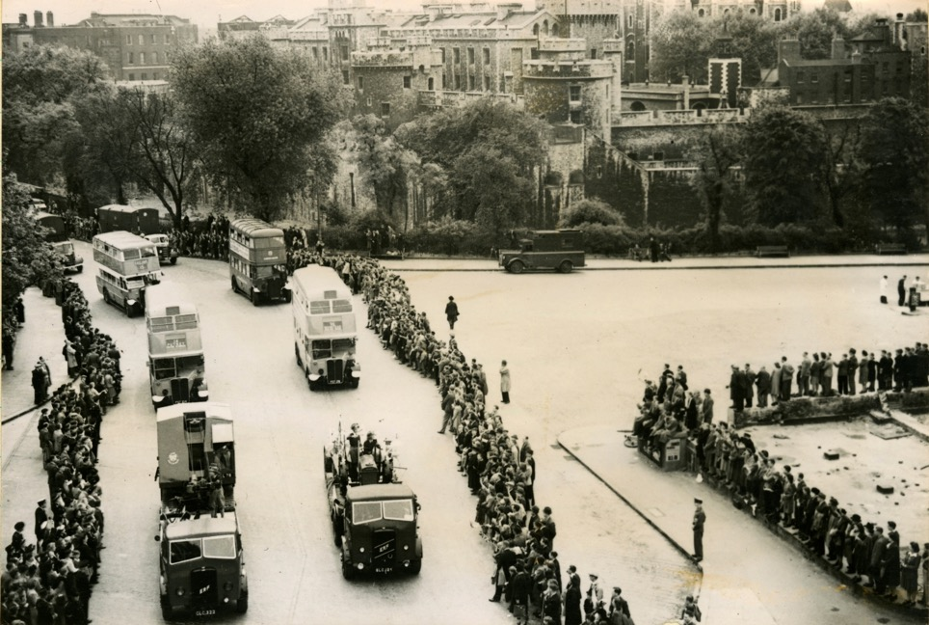
Victory day parade
Why do you think Victory Day was an important celebration?
© Historic Royal Palaces/Yeoman Warder Archive
Notes:
The following year on the 8th June 1946 London celebrated with the Victory Day Parade which included a military parade through the streets and fireworks that night.
Most of the allies were represented at the parade, including representatives from the US, France, Belgium, Brazil, Czechoslovakia, Denmark, Egypt, Ethiopia, Greece, Iran, Iraq, Luxembourg, Mexico, Nepal, Netherlands, Norway and Transjordan.
The only allied countries not represented at the parade were USSR, Yugoslavia, and Poland
Can you see the Tower of London in the background?
- Why do you think Victory Day was important?
It was a reminder that the allied forces had worked together to win the war
It was a way of remembering and honouring the soldiers who had died in battle
It helped build national pride and hope as countries started to rebuild after the war
It was a symbol of peace and hope after years of violence and conflict

Slide 11
Battle of Britain 6th anniversary
© Historic Royal Palaces/Yeoman Warder Archive
Notes:
As well as remembering and honouring big moments like the end of the war there have also been events to remember individual battles.
The Battle of Britain was a major air battle during the Second World War that took place in 1940. Germany wanted to invade Britain, so they launched a series of air attacks with hundreds of planes, hoping to destroy the British Royal Air Force (RAF) and break Britain’s defences. The RAF, using faster planes like the Spitfire, fought back fiercely, and after several months of intense fighting, Germany’s Luftwaffe (air force) was forced to retreat, making it a crucial victory for Britain and stopping a German invasion.
Here you see Lancasters of the 35 Bomber Squadron leading a fly past the Tower of London in commemoration of the Sixth Anniversary of the Battle of Britain in 1946.
Is there a significant moment, anniversary or event in your community's history that you recognise or celebrate every years?
How has this event changed over the years? Perhaps you could talk to older members of your wider school community to find out more.

Slide 12
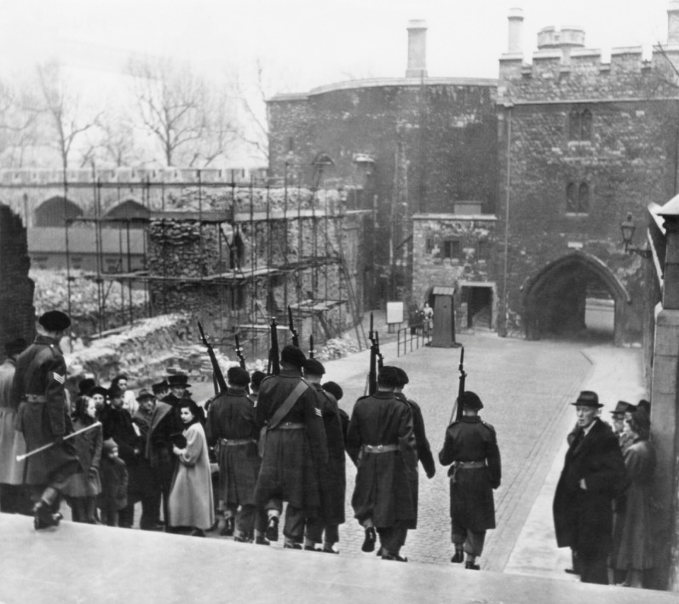
The Tower Re-Opens
© Historic Royal Palaces/Yeoman Warder Archive
© Crown copyright: Historic Royal Palaces
Notes:
The Tower re-opened to tourists in 1946, although the bomb damage from the Blitz was highly visible and yet to be cleared.
- What impact do you think seeing the bomb damage might have had on visitors?
Emotional impact – people might have felt relieved, sad, scared
Remind people of the risks they had faced
Remind people of what they might have lost

Slide 13
Symbols of remembrance
© Luxmuralis/Historic Royal Palaces
Notes:
Sometimes events develop their own symbols which helps us remember them. For example, the poppy is a symbol of both remembrance and hope and are worn in support of the armed forces community.
- What other symbols do we use to remember and honour people or express hope for the future?
During COVID 19 we used the rainbow to honour the workers in the NHS
We light candles to remember people we have lost
A white dove is often a symbol of peace

Slide 14
In Flanders Field – John McCrae
“In Flanders fields the poppies blow
Between the crosses, row on row,
That mark our place; and in the sky
The larks, still bravely singing, fly
Scarce heard amid the guns below.”
In Flanders Field by John McCrae
Notes:
Poppies became a symbol of remembrance after the First World War. The idea came from a poem called "In Flanders Fields," written by Lieutenant Colonel John McCrae, a Canadian doctor. He wrote about how red poppies grew among the graves of soldiers in Flanders, a region in Belgium where many battles took place. In 1921, an organisation called the Royal British Legion started selling poppies to raise money for war veterans, and it soon became a symbol of remembering those who died in the war.
Imagine you can step inside this poem – what can you hear? What can you see?

Slide 15
The 80th Anniversary
© Historic Royal Palaces
Notes:
2025 marks the 80th anniversary of the end of the Second World War.
In 2025 The Tower of London has a display of ceramic poppies, on loan from the Imperial War Museum, that were a small part of a big art installation in 2014. This display invites people to remember all of those who were, and still are, affected by the impact of war.
What is significant about the 80th anniversary of the end of the Second World War?
It’s the last significant anniversary marking the end of the Second World War where we have living veterans
It’s the last significant anniversary marking the end of the Second World War where we have people in our communities who were alive during the Second World War.
How do you like to remember?

