Slide 1
KENSINGTON PALACE

Slide 2
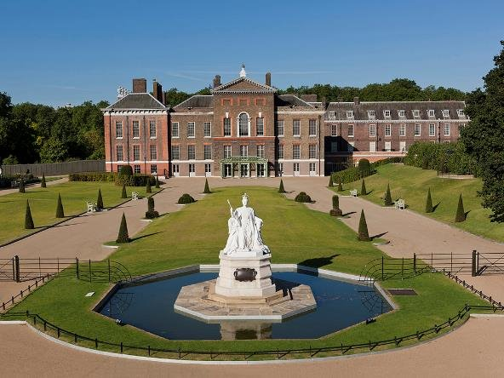
This is Kensington Palace.
Come and look inside.

Slide 3
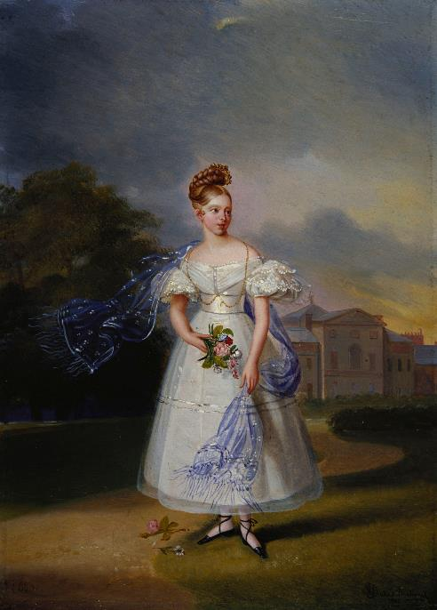
Queen Victoria was born in Kensington Palace over 200 years ago.
© Royal Collection Enterprises Limited 2025 | Royal Collection Trust

Slide 4
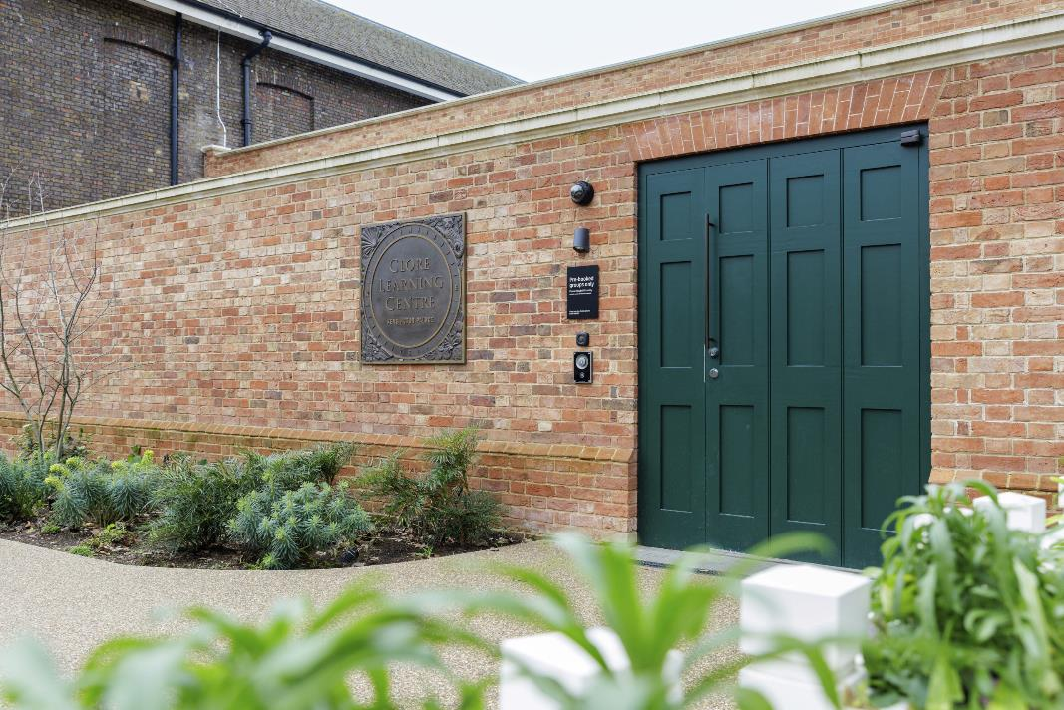
When you arrive, you will first come to this building: the Clore Learning Centre

Slide 5
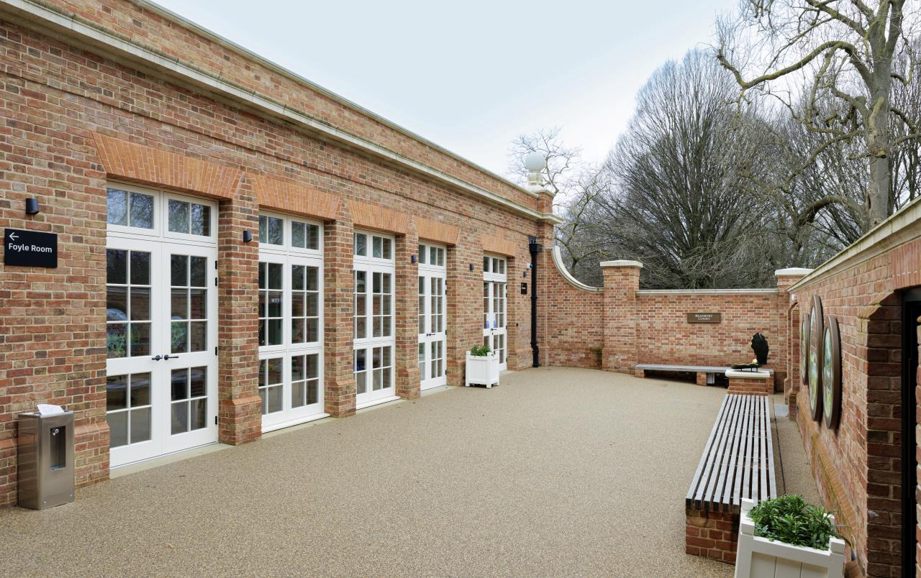
You will enter this courtyard.

Slide 6
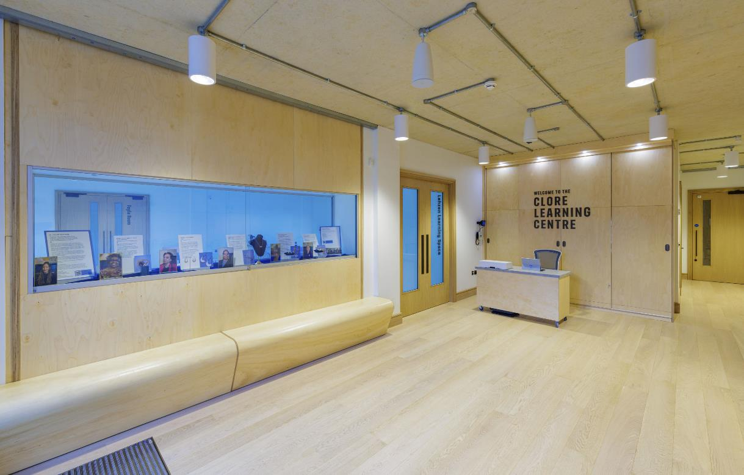
You can leave your coats and bags here. There is an accessible toilet nearby.

Slide 7
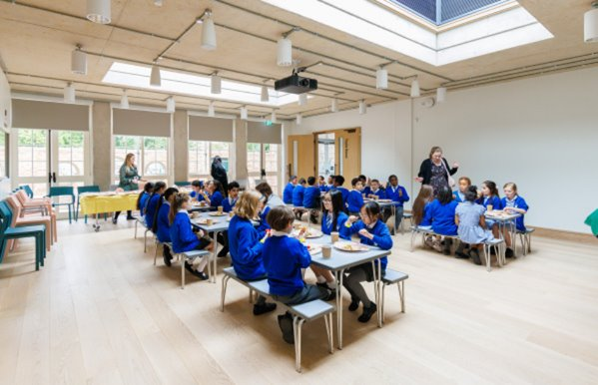
You will spend time in this room learning about Queen Victoria’s childhood.

Slide 8
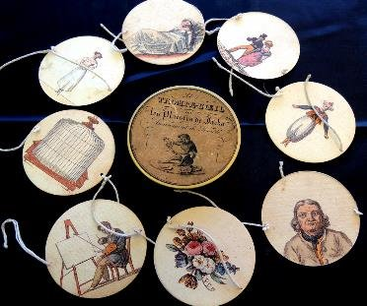
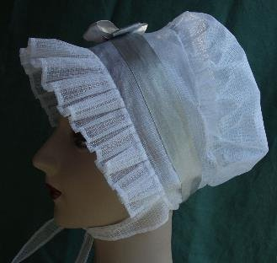
You will have the chance to handle toys and clothes like these.

Slide 9
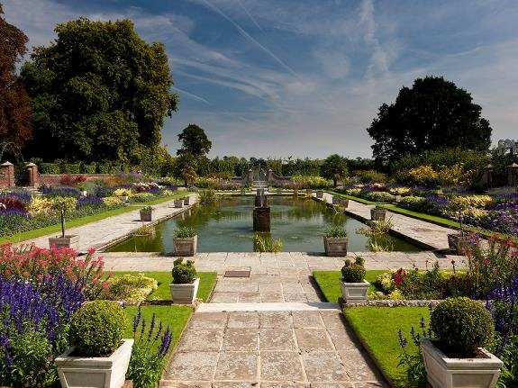
Afterwards, you will walk through the gardens to the palace.

Slide 10
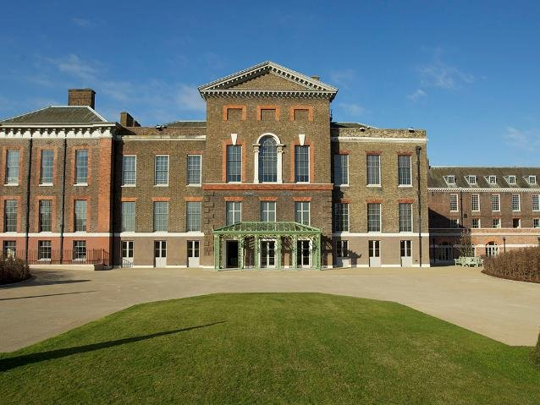
The entrance to the palace is behind the green canopy.

Slide 11
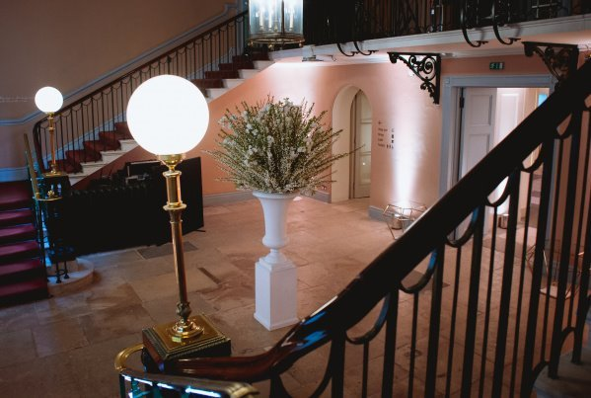
You will walk up these stairs

Slide 12
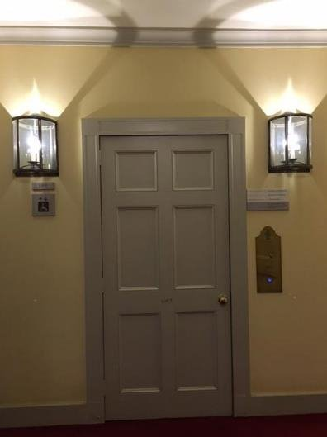
There is also a lift.

Slide 13
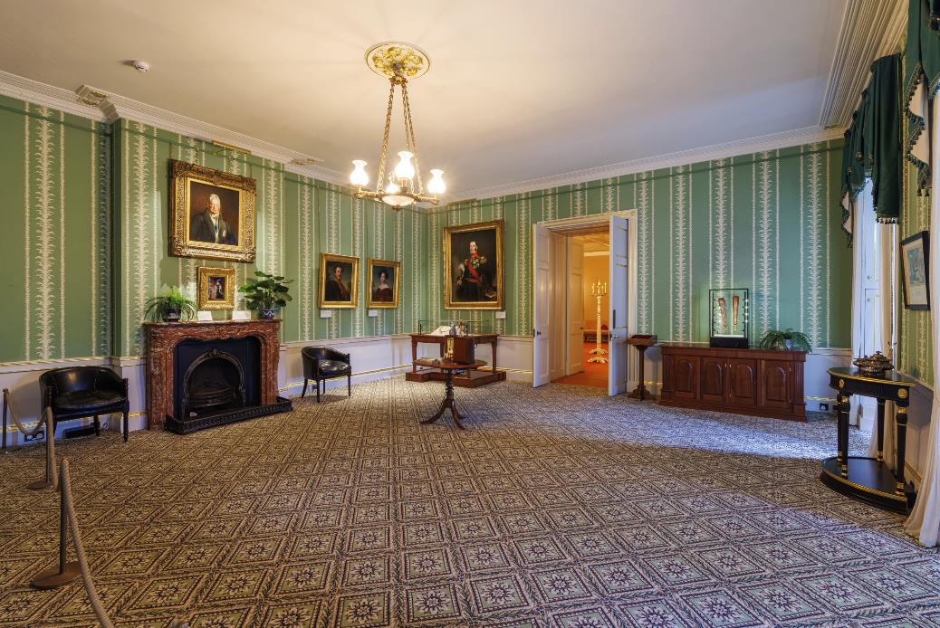
You will visit the rooms that Queen Victoria grew up in.

Slide 14
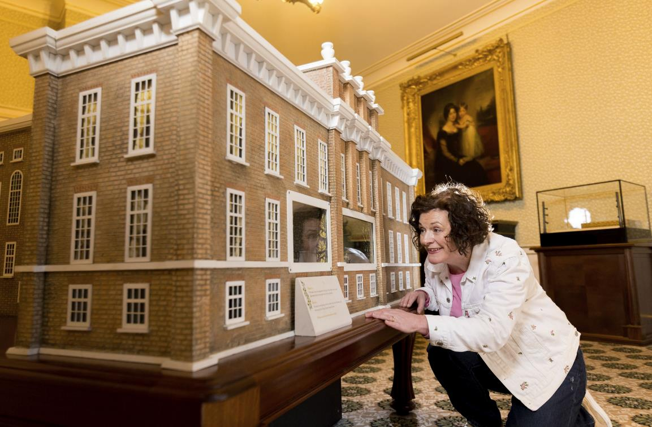
You will see a model of Kensington Palace.

Slide 15
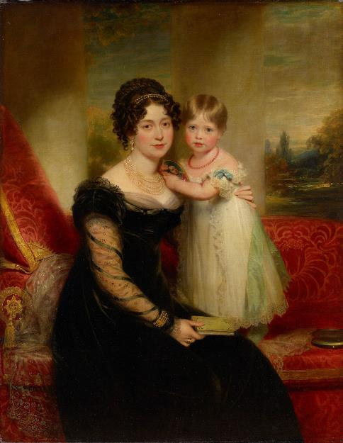
You will also see a painting of Queen Victoria when she was a baby, sitting with her mother.
© Royal Collection Enterprises Limited 2024 | Royal Collection Trust

Slide 16
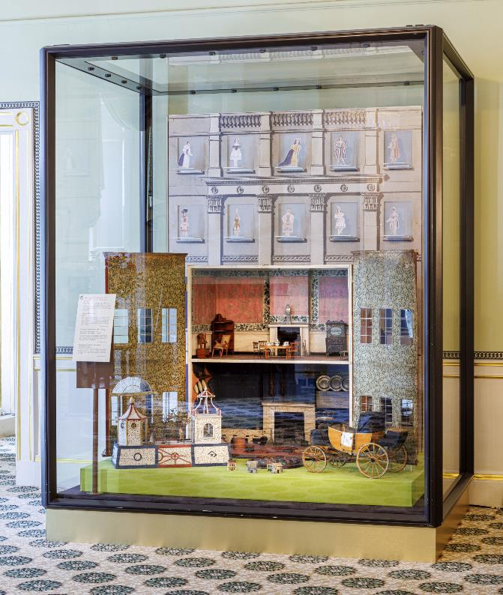
You might see toys that Queen Victoria played with.

Slide 17
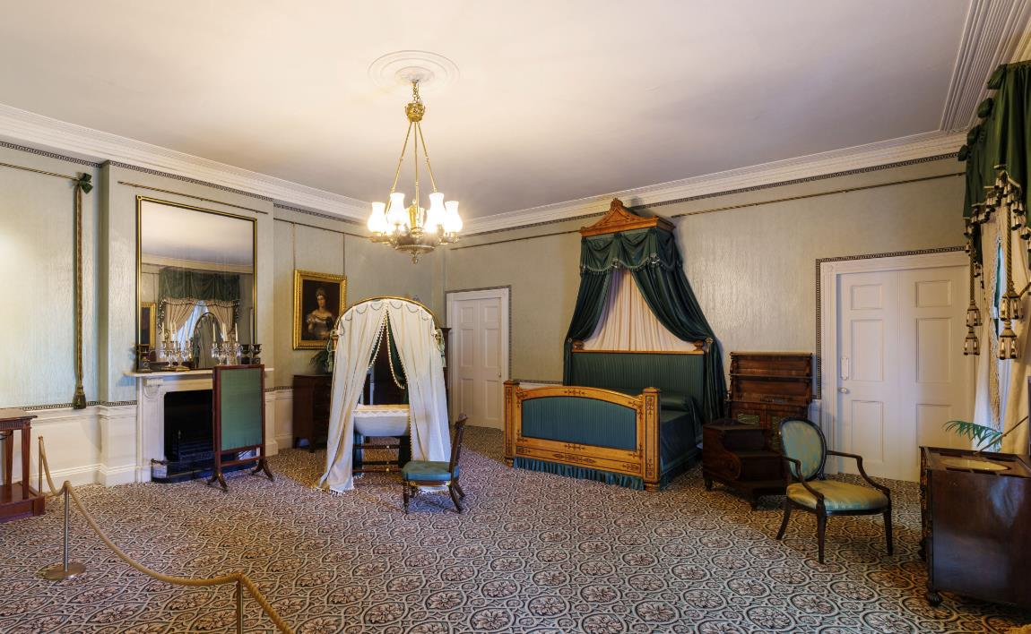
Look out for the room in which Queen Victoria was born.

Slide 18
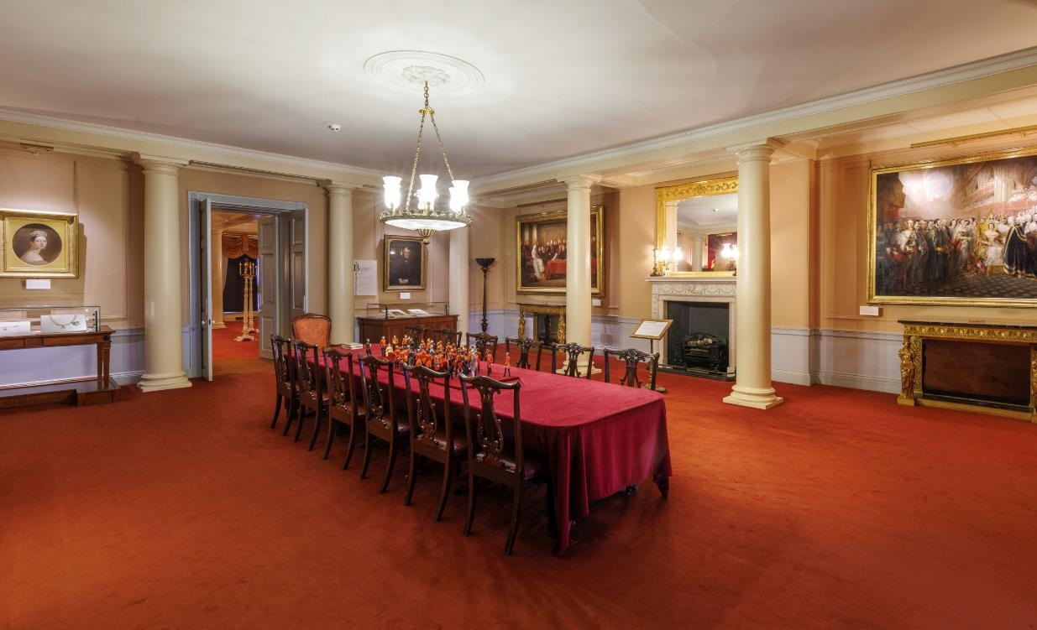
You will walk through this room

Slide 19
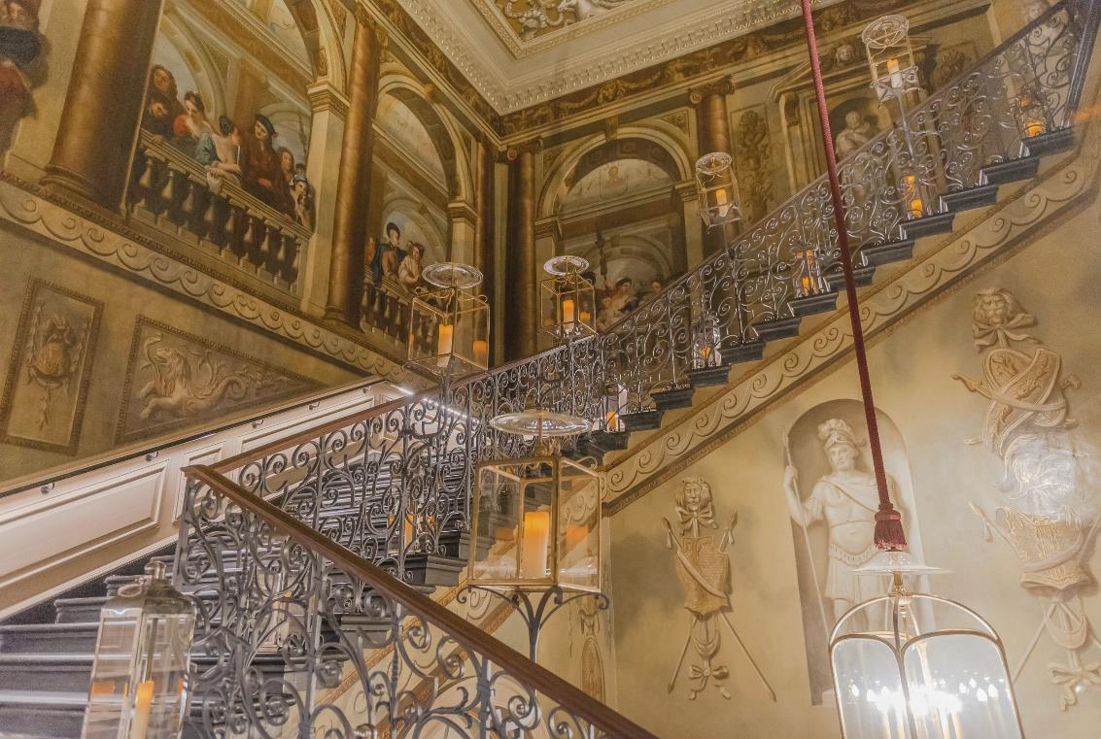
You might see this staircase in the palace.

Slide 20
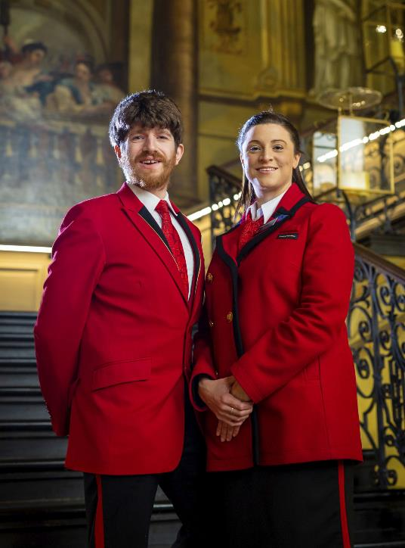
If you need help or have any questions, you can ask someone in a uniform.

Slide 21
We hope you enjoy your visit.

