Slide 1
WATCH-ALONG GUIDE
BEFORE WATCHING
KEY THEMES
WIDER HISTORICAL THEMES
Queen Elizabeth I was a significant individual because she was the longest-ruling queen of her time, leading England for 44 years.
She was a strong and independent leader who chose not to marry, focusing on ruling her country.
During her reign, explorers travelled to new places, and she inspired her army during a battle called the Spanish Armada.
This video can be used to explore the question:
Society | Elizabeth I faced challenges because she was a female ruler in a time where most people believed only men should be in charge. In the video, she says, “I have had to deal with people believing that only men can be strong leaders.”
Power of the Monarch | In Elizabeth’s time, monarchs had much more power than they do today. In the video, Elizabeth says, “I have made tough decisions to protect my country and make it stronger.” She had control over the government and the Church of England.
Monarch
A king or queen who leads a country and makes important decisions.
Explorer
Someone who travels to new places to learn about them.
Invade
When an army attacks and tries to take over a place.
Portrait
A picture of a person. It can be a painting, a photograph or a sculpture.
A GOLDEN AGE FOR WHOM?
SOURCES USED IN THE VIDEO
While England gained wealth and power during Elizabeth’s time, these benefits often came at the expense of other countries.
Explorers stole valuable resources from other lands, which affected the people who lived there.
Portraits | Many paintings of Elizabeth are featured in the video, which reveal how she wanted to be seen as a strong and powerful ruler.
Documents | A letter from Elizabeth to the King of Sweden shows that she was confident, independent, and did not feel she needed a husband to lead her country.
ELIZABETH I

Slide 2
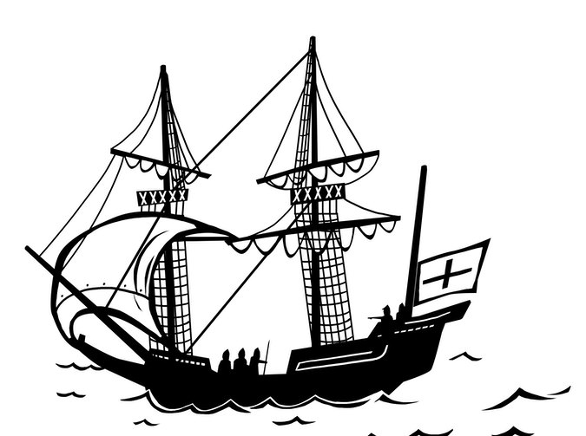
WHILE WATCHING
00:38
00:52
1:23
3:57
4:17
END
EXPLORATION &
ITS CONSEQUENCES
WHAT IS A GOLDEN AGE?
SOCIETY
POLITICAL POWER
THE GLOBE
REMEMBERING QUEEN ELIZABETH
Discuss how exploration benefited Elizabeth and England but often harmed others.
Was this a Golden Age?
Yes–there were new discoveries, and art and theatre became very popular.
Was it a Golden Age for everyone?
No—many people in England were poor and life was hard for them.
Are men and women treated equally today?
Talk with students about how women have more rights today than in Elizabeth’s time.
Why did Elizabeth
choose not to marry?
She wanted to focus on ruling England and did not want to share her power.
How does this object help tell Elizabeth’s story?
The globe represents the world. It shows how Elizabeth encouraged exploration and trade. It also reminds us of the Spanish Armada (a fleet of ships sent to invade England) when Elizabeth gave a brave speech to her army.
Why should we remember Queen Elizabeth I today?
Elizabeth was a powerful queen who showed that women can be strong leaders. She encouraged exploration and made England an important world power.
Her story also helps us understand that history can be complicated — not everyone benefited during her reign,
and many people’s lives
were difficult.
AFTER WATCHING
HOW DO WE KNOW?
KNOWLEDGE SUMMARY
Introduce the idea of a historical source—something historians use to study the past. Explain that evidence is the information we get from these sources to understand and explain history.
A supporting PowerPoint presentation is available to help students study the sources shown in the video, including Elizabeth’s portraits and her letter to the King of Sweden.
These activities help students explore how sources shape what we know about historical figures.
Queen Elizabeth I is a significant individual.
During her reign, English explorers travelled to new lands, bringing back goods like potatoes and sugar.
Many Indigenous people were treated unfairly by English explorers.
This time is called a ‘Golden Age’ because of advances in exploration, art and theatre.
However, not everyone benefited – many people in England still lived in poverty.
Image credit: Elizabeth I, 1533-1603 (the Armada Portrait) © National Maritime Museum, Greenwich, London

