Slide 1




HOW TO USE - NOTES FOR TEACHERS
These resources from Historic Royal Palaces are multi-purpose.
They are ready for you to tweak and use in your lessons.
For the best experience, download and open the
file in the PowerPoint
desktop app.
Answers are found
under the slide. Click
on the notes symbol at
the bottom of the screen.
Delete text and images to make your own worksheets.
Disclaimer and Use Terms
We are the owner or the licensee of all intellectual property rights in these resources which are protected by copyright laws and treaties around the world. All such rights are reserved. These resources, and the content included within them, may be used by you for educational purposes only. This means that you may download the resources and use or share them solely in educational environments (including for home school lessons) or as part of homework. You may not share the resources other than for the above purposes and you must not use the resources, or any part of them, for any commercial purpose.
Notes:
How to use:
This resource is editable. Teachers can adapt the content for their students. Some teachers may wish to use the sources and audio with their students and use the text-based slides for their own background reading. Other teachers may wish to print off the text-based slides for group activities.
Key vocabulary is highlighted in bold. Definitions are included on the final page.
To use this resource on interactive devices such as Chrome Books, teachers may wish to save this file as a pdf first.
Image credits (from left to right)
© Peter Bance Collection
© Historic Royal Palaces
© Toor Collection
© Toor Collection
© Peter Bance Collection
© Courtesy of the Kapany Collection, The Sikh Foundation

Slide 2



MEET THE HISTORIAN
Mishka is the Curator for Inclusive History at Historic Royal Palace.
Hear from Mishka about what historic sources are and how we can learn from them.
Mishka Sinha
Listen to audio from Mishka
Notes:
Audio transcript:
My name is Mishka Sinha, I'm the curator of Inclusive History at Historic Royal Palaces and it is my job to tell the histories and stories of everyone, not just people who are rich or powerful. I shed more light on the histories of people who often get left out of history and that could be women or people who choose different genders from their birth genders, it could be people who're disabled, it can be people that come from different parts of the world. My job is to try to include them in the histories that we tell.
Very often the histories we study in school are incomplete histories because we're learning the history from the point of view of a particular idea. What we want to do is to tell inclusive histories which are histories that aren't from just one perspective or one idea but try to bring together the stories of different people to see history from different perspectives.
So, one of my jobs is to make sure that the histories that we tell are accurate. One part is to makes sure that these histories are taken from what we call original sources and that means things like letters, diaries. Objects can tell us something about who owns that object and those are what we called original sources. And that's different from secondary sources or sources where people have written books that are really easy to read, and fun to read sometimes, but those books are only telling us part of the story because they're from the point of view of the person who's written the book.
But even when you get original sources, the second part of making sure that history is accurate is to read any source you read with some questions in mind. Who is writing this? Why are they writing this? Are they rich? Are they powerful? Are they men? Are they women? And when we ask ourselves these questions, then we have a way of reading sources in a critical way. And that is our job as historians.

Slide 3
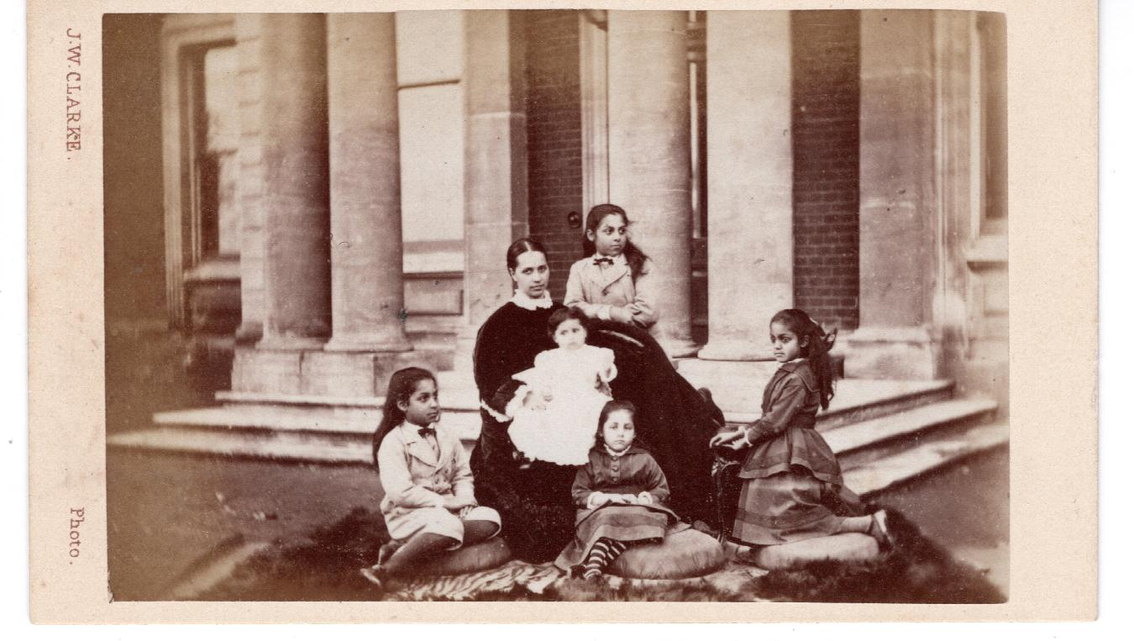
INTRODUCTION TO EMPIRE
Listen to audio from Mishka
Notes:
Transcript
Mishka: Our story today will follow a family whose lives were shaped by two different empires. The first empire in our story is the Sikh Empire. This was a powerful kingdom in an area called Punjab. Today, we know this area as parts of India, Pakistan, and Afghanistan. This empire was ruled by Sikhs. People of different religions lived and worked together as part of the Sikh Empire, and they had a powerful army called the Khalsa Army. The other empire we will hear about in our story is the British Empire. From the 1500s, the British started exploring and trading with other parts of the world. The British set up bases in these areas called colonies. They often fought the local or indigenous people to take land and they brought in changes to how people lived and life of the people who lived there was often very unfair. Over time, the British Empire ruled in many different places, including North America, large parts of Africa and Asia including India.
Photograph: The Duleep Singh family outside their home, Elveden Hall.

Slide 4
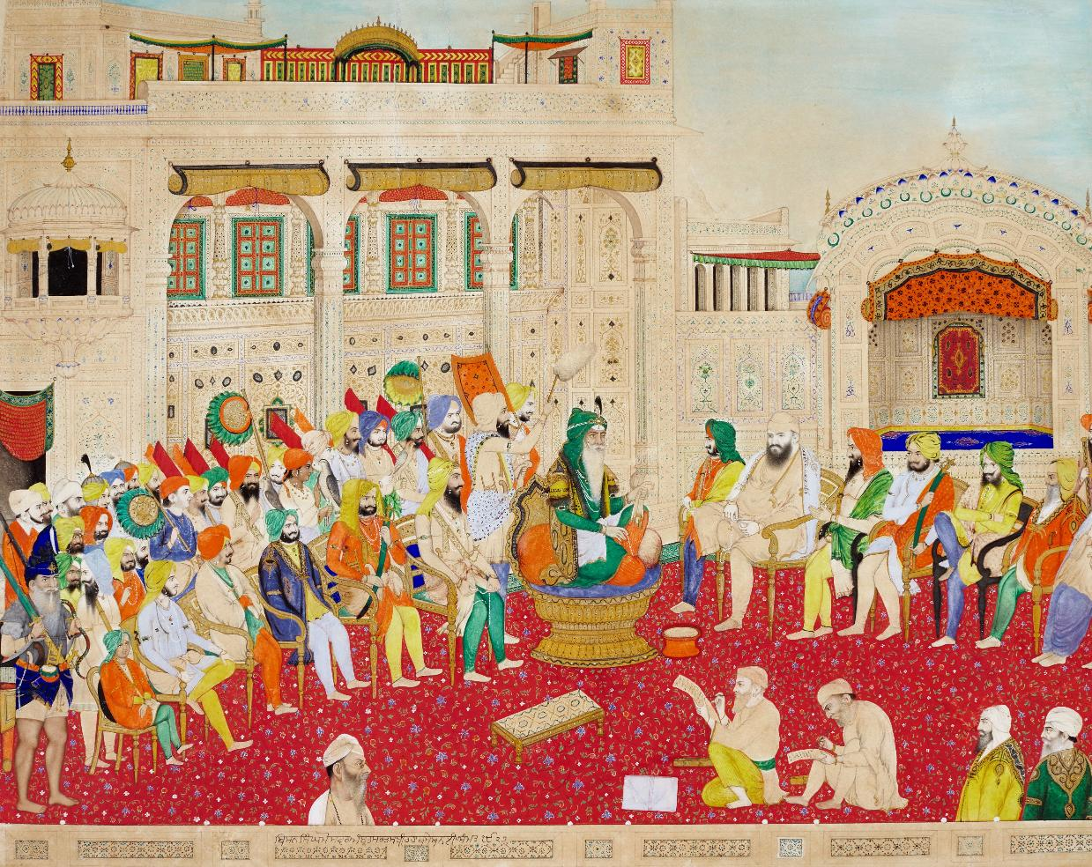
Court of Lahore image
© Toor Collection
Listen to audio from Mishka
Notes:
Transcript:
Mishka: This is is a painting of the court of Lahore. Today Lahore is a city in Pakistan, although at that time it was a part of an area called Punjab. The court of Lahore is where the Sikh Empire was ruled from and this painting shows how the court looked in the early 1800s. The court was a busy place with lots of people travelling there. In the middle of this painting, you can see the Maharaja, the king or the ruler of the Sikh empire. His name qas Maharaja Ranjit Singh. And if you look at him closely, you can see that he is blind in one eye and the painter, the artist has captured that. To the left, you can his sons and he has a lot of sons. I would like you to look closely for the youngest son. He's smaller than the rest and he is sitting right at the end wearing a red top and a green turban. His name was Duleep Singh. And he is very important in our story today.

Slide 5

COURT OF LAHORE
Painting of the Court of Lahore by Bishan Singh
Questions
BACKGROUND NOTES
Maharaja Ranjit Singh was the leader of the Sikh Empire. He ruled over an area called Punjab. The Court of Lahore was the main place where he ruled from.
The Court of Lahore was famous for being beautiful and full of activity. Many talented people from across South Asia travelled there to work together. This included poets, musicians, and artists.
When Ranjit Singh died in 1839, his sons fought over who would be the next ruler.
Q | What first impressions do you get about the Court of Lahore from this painting?
Q | What do the clothes, objects, or decorations tell you about life in the Sikh Empire?
WHAT CAN WE LEARN FROM THIS SOURCE?
This painting was made in 1870 by a Sikh artist called Bishan Singh. It shows Maharaja Ranjit Singh in the middle on his famous golden throne. He was blind in one eye and this detail is included in the painting.
It was painted after Ranjit Singh died but all the people in the painting are based on real people. On the left are his sons. The youngest, Duleep Singh, is on the end. One of the sons holds a khanda, a type of sword.
On the right are noblemen including Baba Ram Singh Basti, a spiritual advisor.
This painting shows the Court of Lahore to be a busy, colourful place. It suggests the Sikh Empire was strong
and powerful.
Q | Who is included in this painting and who do you think might be missing?
Q | Why do you think this painting was created after Ranjit Singh’s death?
© Toor Collection
Key dates: 1870
Notes:
Answers
What first impressions do you get about the Court of Lahore from this painting?
The court is really colourful and has a magnificent golden throne at the centre. The Maharaja is the most important person in the court and he is surrounded by lots of advisers, noblemen and people. It looks like there are lots of conversations happening and maybe ideas being shared.
What do the clothes, objects, or decorations tell you about life in the Sikh Empire?
The bright colours, rich fabrics, and detailed patterns on the clothing show that the court was a place of wealth and high status. The people closest to Maharaja Ranjit Singh are dressed in especially fine garments, which helps us understand how important they were in the empire.
The golden throne in the centre shows just how powerful and respected Ranjit Singh was. The decorated carpets, arches, and architecture suggest that art and craftsmanship were highly valued, and that the court was a space designed to impress visitors and show the empire’s strength.
All these details together make life in the Sikh Empire seem elegant, organised, and full of culture. They tell us that the court was not just a political place, but also a centre of creativity.
Who is included in this painting and who do you think might be missing?
The painting shows important men from Maharaja Ranjit Singh’s court including his sons, his ministers, his generals, and other advisers who helped run the empire. These figures were powerful and respected, so including them shows how strong and organised the Sikh Empire once was.
Women are completely missing, even though they were part of the royal family and played important roles behind the scenes. Ordinary people, like workers, guards, musicians, or anyone who wasn’t a high‑ranking man, are also not shown.
Why do you think this painting was created after Ranjit Singh’s death?
Bishan Singh may have painted this scene many years after Ranjit Singh died because he wanted to show people how grand and important the Sikh Empire once was. By the time he painted it, the empire had already fallen, so creating this picture helped keep the memory of Ranjit Singh and his court alive.
He may also have wanted to remind people of how different communities once worked together in a peaceful and talented court full of music, poetry, and art. Painting this scene was a way to celebrate that history and honour a time of unity, creativity, and strong leadership.

Slide 6
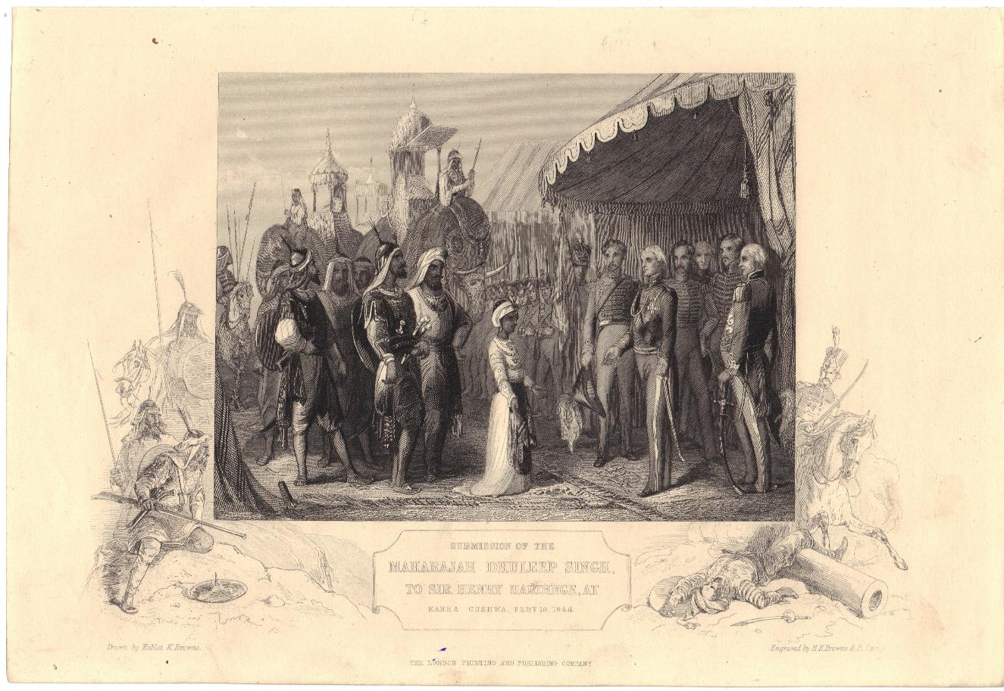
Duleep Singh engraving image
© Peter Bance Collection
Listen to audio from Mishka
Notes:
Transcript:
Mishka: When Maharaja Ranjit Singh died, that's the man we saw in the centre of the painting of the Court of Lahore, Ranjit Singh's sons began to fight about who should be the next Maharaja. There was lots of violence between them and eventually the youngest son, Duleep, became the next Maharaja. But he was only five years old. And his mother tried to help him rule the Sikh empire. We will hear more about her soon. The British saw this as an opportunity to expand their territories and take over the Sikh Empire. They fought wars against Duleep and his armies, and his mum. And when he was only about 10 years old, Duleep was forced to give up his land, his money and his jewels, including the famous Koh-i- Noor diamond to the British government. This image was made to remember the moment Duleep’s surrendered. A few years later, he went to England where he was given a pension, that is money to live on. He had to agree to remain obedient to the British government.

Slide 7
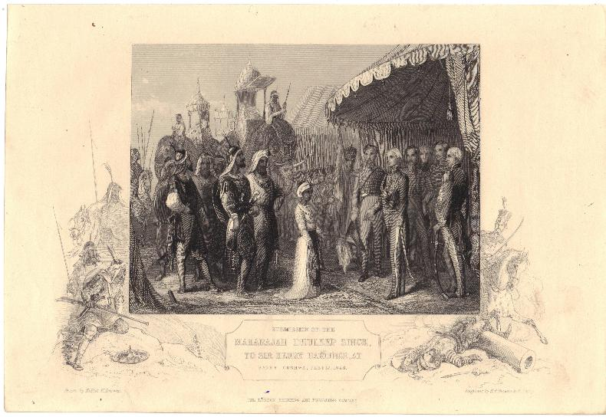
MAHARAJA DULEEP SINGH
BACKGROUND NOTES
An engraving showing the moment when Maharaja Duleep
Singh was forced to give up the Sikh Empire
After Maharaja Ranjit Singh died, there was a violent struggle for power. Several of his sons were killed. In the end the youngest, Duleep Singh, became the
new Maharaja but he was only five years old. So, his mother Jind Kaur became his regent, ruling on his behalf.
The British East India Company used this chaos as a chance to take more power. They started wars and even took Duleep away from his mother. In 1849, when he was around 10 years old, Duleep was forced to give up his lands and the famous Koh-i-Noor diamond.
The British officials offered him a pension; this meant they would give him money regularly. However, he had to agree to be “obedient to the British Government.”
Questions
Q | Describe what you can see in this image. Who seems powerful?
Q | Why was this image created as an engraving rather than a painting?
Q | This engraving was made and published in Britain. How might that effect how the event is shown?
WHAT CAN WE LEARN FROM THIS SOURCE?
This object is an engraving. These are made by carving a design onto a metal sheet, covering with ink, and pressing onto paper – a bit like a stamp. This means the image can be printed many times. The engraving was created and published in Britain.
The image shows the moment when power was handed over from the Sikh Empire to the British.
In this image, young Duleep Singh stands with the Khalsa Army. This includes soldiers and elephants. British officials stand opposite him. The scene highlights differences in power.
© Peter Bance Collection
Q | Why do you think the British wanted images of this moment to be widely shared?
Key dates: Duleep surrendered to the British in 1849
Notes:
Answers
Describe what you can see in this image. Who seems powerful?
There is a young boy standing in front of some British officials in uniform. Behind the boy are soldiers and elephants. The British officials are standing in a small tent. They have swords at their sides and have removed their hats. The boy seems to have his head slightly bowed. The boy is in the middle of the etching meaning that we look at him first and he holds our attention but then men are taller and even though they don’t have a whole army behind them they are relaxed and look down on the boy.
Why was this image created as an engraving rather than a painting?
Engravings are easier to create multiple copies to share widely. It could be printed many times and sent all over Britain and the wider British Empire. That meant more people could see the scene, learn about the event, and understand it in the way the publisher wanted.
Engravings were cheaper to produce and quick to distribute, especially through newspapers, magazines, and books. This made them a powerful tool for influencing public opinion. By choosing an engraving, the creators could make sure British audiences saw the event from a British point of view, reaching far more people than a single painting ever could.
This engraving was made and published in Britain. How might that effect how the event is shown?
The artist has focused on making the British look powerful. Sir Henry Hardinge and his men are much taller that the young Maharaja. There are only a few British men shown but there are many Kahlsa soldiers shown and elephants suggesting the British are more powerful that the armed soldiers and elephants. It looks like a friendly meeting and not a defeat.
It doesn’t show the impact of the Sikh war on the people of the Sikh Empire or how much they have lost. It doesn’t show the exchange of wealth and land ideas. It doesn’t show how the people in Punjab felt. It shows the story the British Empire wanted to tell.
Why do you think the British wanted images of this moment to be widely shared?
The British wanted images of this moment to be shared because it helped support the story they wanted people to believe about their empire. They could make their actions in India look peaceful, fair, and even generous.
Sharing these pictures also helped convince the British public that their empire was strong and doing the “right” thing. It made Britain look organised and in control, while making the takeover of the Sikh Empire seem normal or even positive.

Slide 8
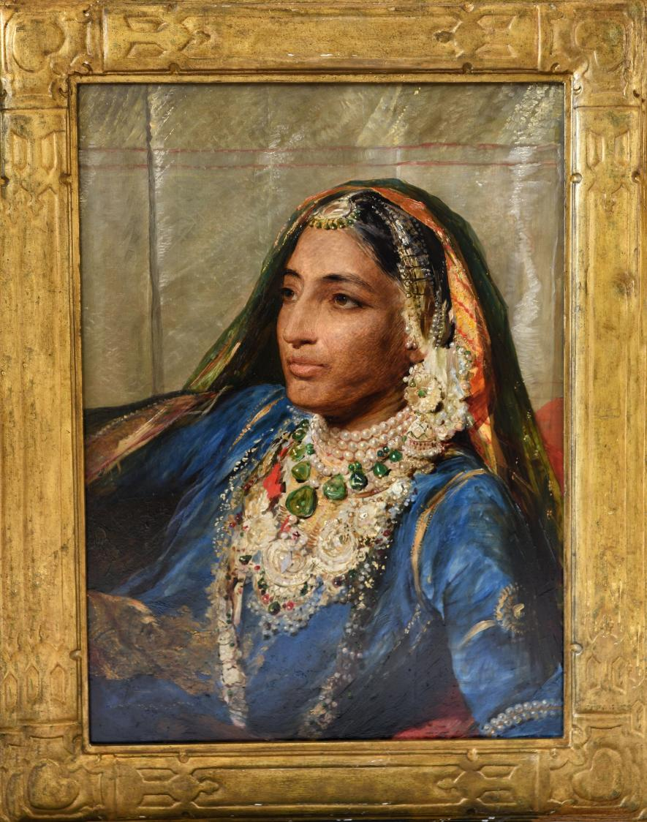
Portrait of Jind Kaur image
Listen to audio from Mishka
© Courtesy of the Kapany Collection, The Sikh Foundation
Notes:
Transcript
Mishka: The Sikh court and the Sikh empire had many strong and powerful women. Duleep’s mother was called Maharani Jind Kaur. Maharani means queen or great queen, and this is a painting of her. Remember, when Duleep became Maharaja, he was only about five years old. So, Jind became regent. This means she helped him to rule the Sikh Empire. However, British officials wanted to take control in Punjab and they spread rumours about Jind Kaur. They fought her armies and stopped her from being regent. They separated her from her son, Duleep, when he was only nine years old and they took away her jewellery. Jind Kaur fought back and so she took charge of the armies and herself led them and rallied them. But she was put in prison. She managed to escape from her prison, dressed as her seamstress, and trekked 800 miles across the Himalayas and went to Nepal. Jind
Kaur and her son, Duleep, were heartbroken to be taken away from each other. After 13 years of pleading, the British government finally allowed them to meet in Calcutta in eastern India. But they had to promise never to return to Punjab, their homeland. They agreed. And Duleep took his mother to England with him. This painting was made after Jind Kaur moved to England to be with her son.

Slide 9
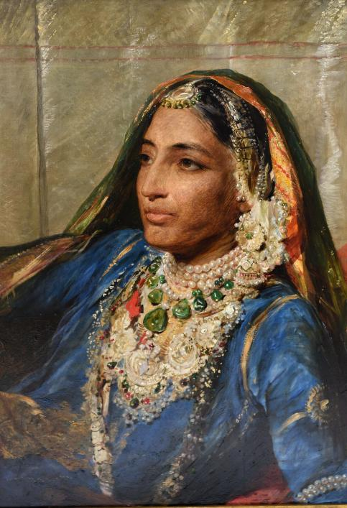
MAHARANI JIND KAUR
Portrait of Maharani Jind Kaur, Duleep Singh’s mother and regent
Questions
BACKGROUND NOTES
WHAT CAN WE LEARN FROM
THIS SOURCE?
Q | Describe Jind Kaur from this painting.
Maharani Jind Kaur was Duleep Singh’s mother. In 1843, Duleep became Maharaja. But he was only five years old. So, Jind Kaur became regent, ruling on his behalf.
When the British armies tried to take control, Jind Kaur tried to protect her son’s kingdom. She worked with the Khalsa army to
fight back.
British officials spread rumours about Jind Kaur. They stopped her being regent and they took Duleep away from her. They also took lots of her jewellery. She tried to resist, but she was taken to prison. She managed to escape to Nepal where she spent many years in exile.
After 13 years apart, the British government finally allowed Jind Kaur to see her son again.
But she had to promise never to return to
Punjab.
Around this time the British government also returned 525 pieces of her jewellery to her.
This is a portrait of Jind Kaur. It was created by the artist George Richmond after she came to England.
Her son, Duleep Singh ordered the painting to be made. It might have been to help bring back some of her honour after she had been treated unfairly.
In South Asian art, powerful rulers and gods are often shown reclining (laying back), resting on their side, with one arm on a special cushion. This is a symbol of their importance and status and is different to European art where important people are often painted standing up.
In this painting, Jind Kaur is dressed in beautiful royal clothes and jewellery, reclining in a powerful pose.
Jind Kaur died aged 46, before the painting was completed. After she died her portrait was shown in the Royal Academy. Many people went to see it as she was very famous and lots of people knew her story.
Q | What can’t you learn about Jind Kaur from this painting?
Q | Why do you think the British spread rumours about
Jind Kaur?
Q | Why do you think the British agreed to return her jewellery only if she never returned to Punjab? What does this tell us about control and power?
© Courtesy of the Kapany Collection, The Sikh Foundation
Key dates: Painted around 1863
Notes:
Answers
Describe Jind Kaur from this painting.
She looks very regal but relaxed. She’s wearing lots of jewellery made of precious stones and gold which shows us she was rich, powerful and had a high status. She looks quite young in this drawing so it is surprising to hear that she dies with two years of this painting.
What can’t you learn about Maharani Jind Kaur?
You can’t tell that she led an army, that she ruled an entire Kingdom for her young son. You can’t tell that she was stripped of her jewels and her status and imprisoned before escaping and finding safety in Nepal. You can’t tell that she was separated from her young son for 13 years. You can’t tell how strong she is.
Why did the British spread rumours about Jind Kaur?
The British spread rumours about Jind Kaur because it helped them weaken her power and make it easier to take control of the Sikh Empire.
Jind Kaur was ruling as regent for her five‑year‑old son, Duleep Singh, and she was trying to protect his kingdom from British takeover. By spreading rumours about her, British officials made her seem untrustworthy or dangerous. This made it harder for her to keep support from advisers, soldiers, and people in Punjab.
Once people doubted her, it became easier for the British to step in, defeat her armies, take her wealth, and separate her from her son.
Why do you think the British agreed to return her jewellery only if she came to England and never returned to Punjab? What does this tell us about control and power?
Maharani Jind Kaur’s jewellery was a symbol of her power and influence. They were worried if she returned to India she might use her power to cause a revolt or an uprising that would threaten the British control of the Sikh Empire.

Slide 10
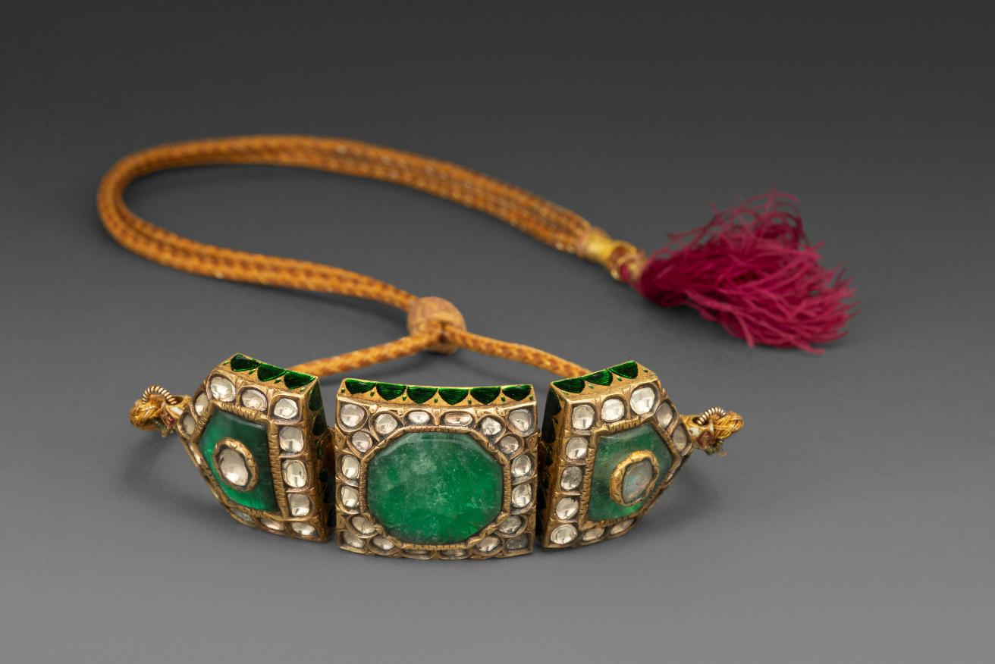
Bazuband image
© Toor Collection
Listen to audio from Mishka
Notes:
Transcript
Mishka: This object is a piece of jewellery that we think belonged to Jind Kaur. It is called a bazuband. Bazubands were usually worn around the arm by men and women in South Asia. Jewellery is very important in South Asian culture, particularly for women, and it is often passed down from mothers to daughters. Women in many cultures in the past often couldn't control their own money. Their fathers and husbands controlled it for them. Jewellery was a way for women to own something valuable to exchange for money if they ever needed it. For Jind Kaur, when the British took away her jewellery when they imprisoned her, it was as if they took away her security and her status as a queen. And so, getting it back felt as if she could be queen again, wearing her jewellery. If you look back at the painting of Jind Kaur, you might be able to see some of the jewellery that the British returned to her, which she put on and she was painted wearing this jewellery.

Slide 11

BAZUBAND
BACKGROUND NOTES
A diamond and emerald arm band from the Sikh Empire
This piece of jewellery is a bazuband (or arm band). Men and women have worn bazubands in South Asia for a very long time. They are usually worn on the upper arm. We think it belonged to Jind Kaur.
Jewellery was an important part of a woman’s wealth. It was passed down from mothers to daughters and helped to share family history and traditions.
Not only that but in the past, many women did not have much control over their own money. Jewellery allowed them to keep something valuable of their own. It gave them a sense of security, ownership, and independence.
Questions
Q | How could this piece of jewellery be worn?
Q | What does this bazuband tell us about the Sikh Empire?
WHAT CAN WE LEARN FROM THIS SOURCE?
This bazuband is made from precious materials including gold, diamonds, and emeralds. It was handmade by skilled workers in the Sikh Empire. Creating jewellery like this required patience, detail, and expert knowledge.
In 1847, British officials separated Jind Kaur from her young son. Around this time, they also took her jewellery.
Duleep Singh and his mother were apart for over 13 years. He kept asking to see her again and to have her jewellery returned to her. At last, they were reunited and travelled to England together, where her jewellery was given back to her. But this was on the condition she never to went back to the Punjab.
This object is a symbol of status, identity, power, loss, and dignity. It represents the complex story of Jind Kaur and the Sikh Empire.
Q | Why do you think Maharani Jind Kaur valued her jewellery so deeply?
© Toor Collection
Q | What can this piece of jewellery teach us about women’s lives in the past?
Key dates: c. 1850s
Notes:
Answers
How could this piece of jewellery be worn?
A Bazuband was originally designed to be worn by men or women around their arm. Duleep Singh gifted a Bazuband to his wife and she wore it round her neck as a necklace on their wedding day.
What does this Bazuband tell us about the Sikh Empire?
The bazuband is made of expensive materials such as gold and emeralds telling us that the Sikh Empire had access to these materials. Because this bazuband belonged to Maharani Jind Kaur, it also shows how jewellery in the Sikh Empire was linked to status. It has very delicate details on it so this tells us the person who made it was a skilled workman. It also tells us how jewellery was worn and how people in a Royal Court might have looked.
Why do you think Maharani Jind Kaur valued her jewellery so deeply?
Jind Kaur’s jewels were made of gold and precious stones, which were worth a lot of money, the jewels showed her high status. They gave her financial independence as they could be traded in an emergency. When the British took her jewellery, they weren’t just taking pretty objects. They were taking away her wealth, her security, her status and her ability to make choices about her own life. Losing them limited her power and freedom.
What can this piece of jewellery teach us about women’s lives in the past?
This piece of jewellery can tell us about the ways women in the past created financial security for themselves. It also tells us about how women could signify their status and reveal part of their identity,

Slide 12
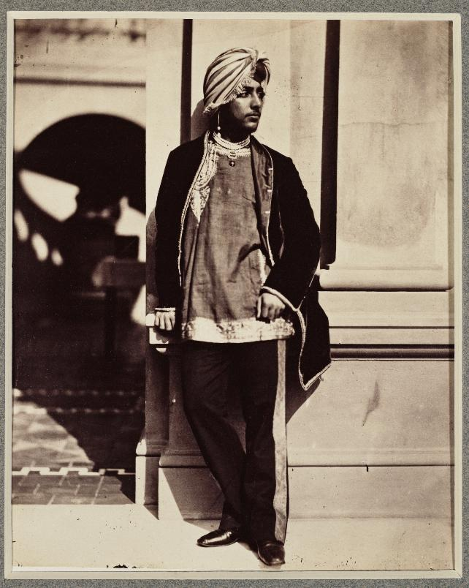
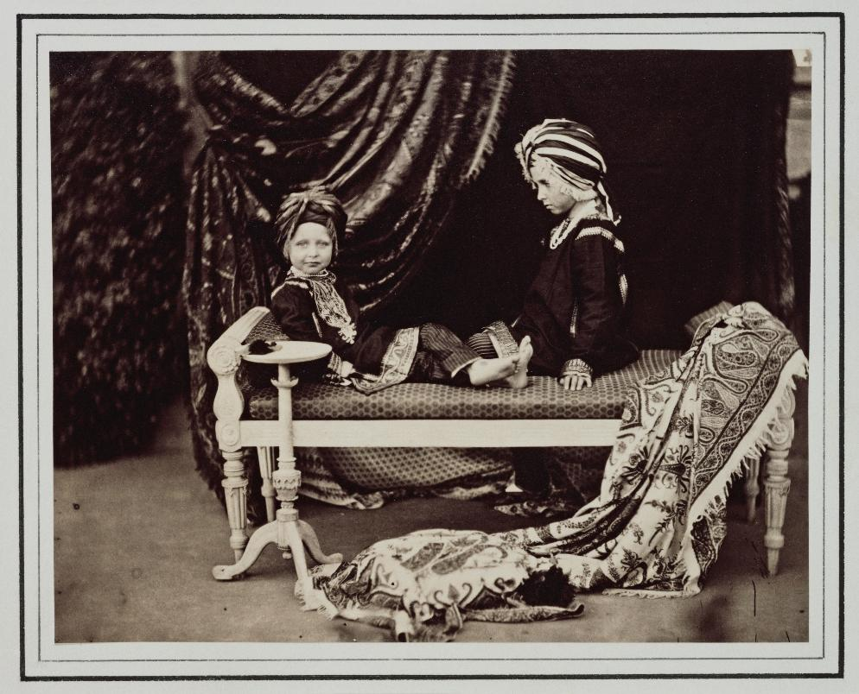
Prince images
© Royal Collection Enterprises Ltd 2026 Royal Collection Trust
© Royal Collection Enterprises Ltd 2026 Royal Collection Trust
Listen to audio from Mishka
Notes:
Transcript
Mishka: These two photographs were taken in England around 1850. The one on the left is of Duleep Singh. After he was taken from his mother, he converted to Christianity, and was placed in the care of a British official and his wife. When Duleep was about 16 years old, he moved to England. The monarch in Britain at that time was Queen Victoria. Queen Victoria met Duleep when he arrived in England, and she was very impressed with him. He was very handsome, his manners were those of a prince, and she was very impressed that he had converted to Christianity and spoke English well. She spent lots of time with him and he became close friends with her family. The photo on the right shows two of Queen Victoria's sons, Arthur and Alfred. Look closely at what they're wearing. These are traditional clothes from South Asia, probably from the part of South Asia that Duleep came from. It's very possible that Duleep Singh gave Queen Victoria's sons this clothing as a gift. These images show that Duleep Singh had a very unusual life. He was born into a powerful family in South Asia that ruled over the Sikh Empire. He became Maharaja, the ruler of the Sikh empire, but lost his empire at a young age. And now he was living in Britain, spending lots of time with the British royal family, while, Duleep’s former kingdom in Punjab was controlled by British powers.

Slide 13
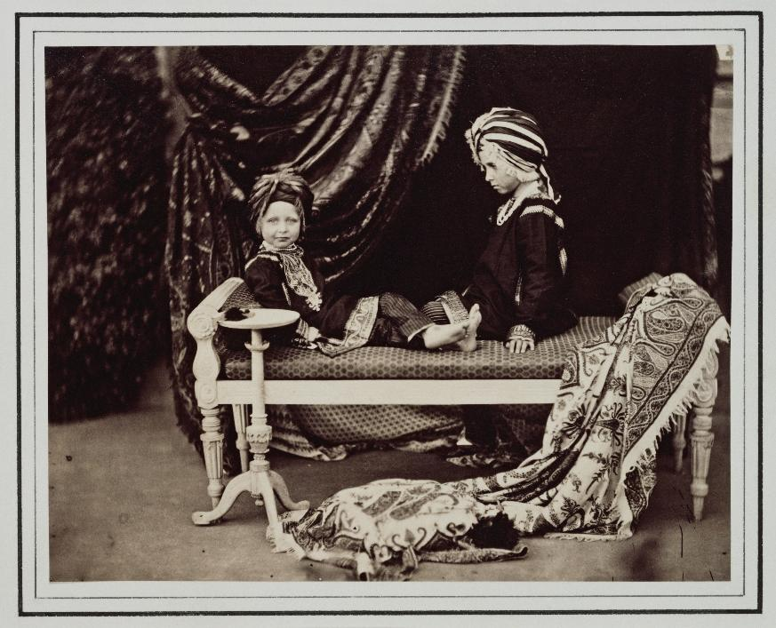
ENGLISH PRINCES
Photo of Prince Arthur and Prince Alfred in North Indian clothing
BACKGROUND NOTES
After Duleep was separated from his mother he was raised by a British couple. He converted to Christianity.
In 1854, aged around 15, he came to England and met Queen Victoria. She wrote that he was “extremely handsome… speaks English perfectly, and has a pretty, graceful and dignified manner". She also wrote that he was one of the “poor deposed Indian Princes.”
Duleep became close friends with the royal family. Victoria's children grew up knowing him well. When Duleep had his own children, she became godmother to several of them. She continued to have a close relationship with Duleep and his family throughout her life.
Questions
Q | Describe what you can see in this photograph.
Q | Compare the photographs of Duleep Singh and the two English princes.
Q | In what ways is Duleep Singh’s friendship with the royal family complicated?
WHAT CAN WE LEARN FROM THIS SOURCE?
This photograph shows two of Queen Victoria's sons, Prince Arthur and Prince Alfred. They were heirs to the British throne.
They are wearing traditional North Indian clothing, possibly from the area that Duleep Singh came from. The clothing might have been a gift from Duleep, given as a sign of friendship. It is the type of clothing an Indian Prince might wear.
This photo can also feel uncomfortable. It shows British royals dressing up and pretending to rule a country that Britain had taken over, while the real royal family had been removed.
Q | How does the fact that Duleep Singh had lost the Sikh Empire to British powers change how we might view the photograph?
© Royal Collection Enterprises Ltd 2026 Royal Collection Trust
Key dates: 1854
Notes:
Answers
Describe what you can see in this photograph.
There are two young boys sat on a bench wearing South Asian clothes. There is a heavy rug draped on the bench and a draped piece of fabric across the backdrop. One boy looks out at us, the other looks at the other boy. The two young boys are princes.
In what ways is Duleep Singh’s friendship with the Victoria and her family complicated?
Duleep Singh’s friendship with Queen Victoria and her family was complicated because it took place after Britain had taken over his kingdom and removed him from power. Although Victoria showed him affection and support, she also encouraged choices that suited British interests, such as converting to Christianity and keeping him apart from his mother. Their relationship mixed genuine friendship with empire and control, making it both caring and deeply unequal.
How does the fact that Britain had recently taken over the Sikh Empire change how we might view the photograph?
British viewers might have seen this photograph as a charming image of the young princes dressed in ‘exotic’ Indian clothing, showing the royal family’s interest in the wider empire. Sikh viewers, however, might have viewed it very differently. The clothes represented a kingdom that had recently been taken over by Britain, and seeing British princes wearing Sikh royal dress could have been a painful reminder of lost power and culture.
Some people might see this photo as the royal family admiring Duleep’s culture. How accurate do you think that is?
Britain presented itself as liberal and inclusive but also created unequal systems. Victoria was fascinated by India and made friends with South Asians, such as Duleep Singh, who she admired but at the same time she over saw a system that took his Empire, re-cut the Koh-I-Noor diamond to fit a European idea of beauty and oversaw a government that offered the promise of citizenship to people of India but failed to deliver.

Slide 14
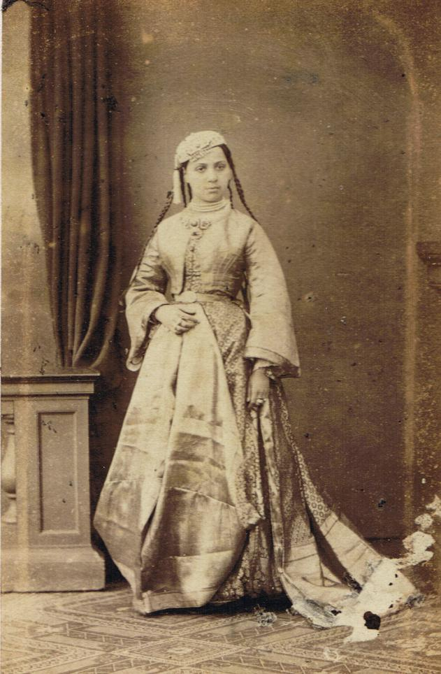
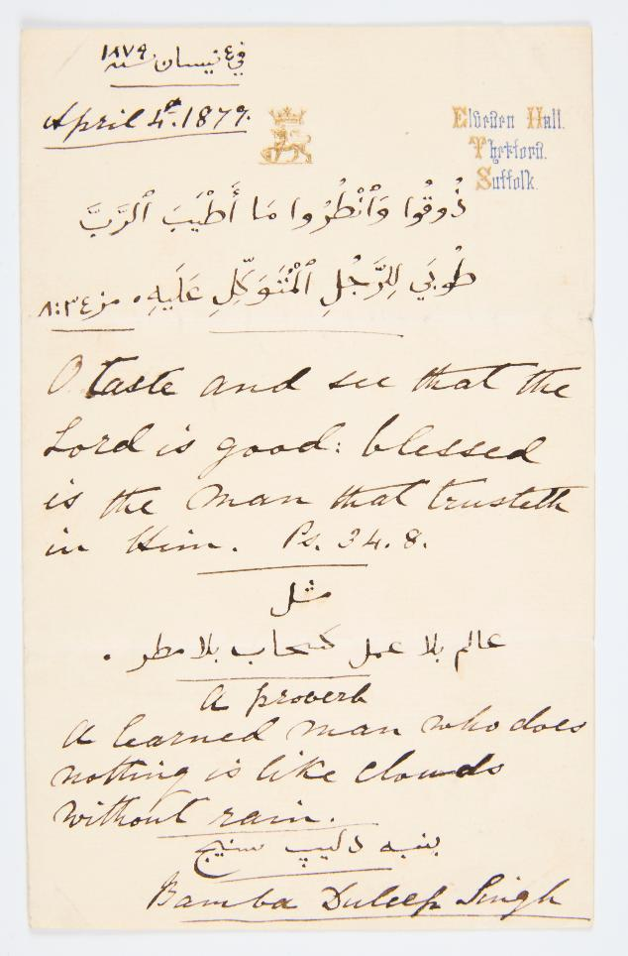
Bamba image and letter
© Peter Bance Collection
© Peter Bance Collection
Listen to audio from Mishka
Notes:
Transcript
Mishka: This is a photograph of a young girl called Bamba Müller. Bamba means pink in Arabic. She is a new character in our story and is also very important. She was born in Cairo in Egypt. Her mother was an enslaved woman from Ethiopia. Her father was a German banker. Bamba lived with her mother but was educated at a school in Cairo run by American missionaries. These were people who travelled to different countries to spread Christianity. Bamba became a young teacher at the missionary school. In the 1860s Duleep Singh was looking for a wife. He wanted a Christian wife who came from the eastern hemisphere. Duleep Singh visited Bamba’s school in Cairo and the missionaries introduced him to Bamba. Not long after this they got married. This was a huge change for Bamba. Bamba became a Maharani, a queen. They travelled to England and settled down. Bamba and Duleep had several children together, including three strong, independent daughters. Those daughters will be the focus of the rest of our story.

Slide 15
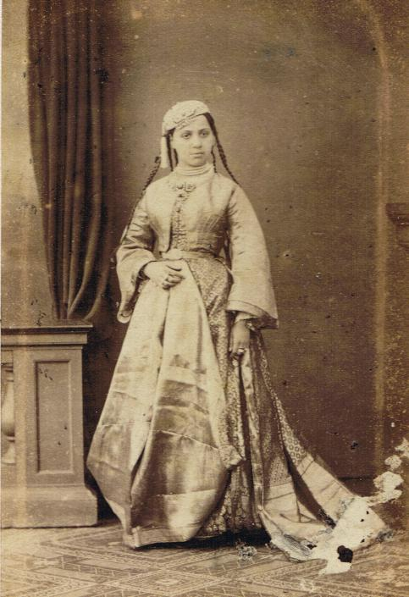
MAHARANI BAMBA DULEEP SINGH
Portrait of Bamba Duleep Singh, a young Christian woman who married Duleep Singh
Questions
BACKGROUND NOTES
WHAT CAN WE LEARN FROM
THIS SOURCE?
Q | How would you describe Bamba?
Bamba Müller was born in Cairo in 1848. Her mother was an enslaved Ethiopian woman, and her father was a German banker. She was educated by Christian missionaries who taught her to read the Bible in Arabic. She became a teacher and taught other girls how to read.
In 1864, Maharaja Duleep Singh was 25 years old and wanted to find a Christian wife. He visited Cairo and Bamba's school. He saw Bamba and asked her to marry him. Bamba liked her simple life, and her work at the school, so she refused at first. But she was persuaded to marry him. She was just 16 when they got married and Bamba became a Maharani. They travelled to England.
Bamba and Duleep settled at Elveden Hall in Suffolk. They had seven children, although one baby died shortly after birth.
Life in England was difficult for Bamba. She missed her friends in Cairo and Duleep was not always a good husband. Bamba became lonely and was often unwell. In 1887, while caring for her sick daughter Sophia, Bamba also became ill and died aged 39.
This photograph was taken shortly after Bamba married Duleep.
This portrait shows her at the start of her new life in England. She was now a Maharani and had joined British royal circles.
Her clothing reflects her new status. It reveals a mixture of Arabic, Punjabi and English elements. These represent the different cultures that shaped her life:
• childhood in Cairo
• marriage into a Sikh royal family
• new life in England.
The jewellery Bamba wears also reflects her new husband’s culture. In this photo she is wearing a bazuband around her neck, very similar to the one that Jind Kaur owned.
Bamba also wrote letters in both English and Arabic showing how she belonged to more than one culture.
Q | Why do you think a formal portrait might have been taken of Bamba shortly after she arrived in London?
Q | Why do you think Bamba wore a bazuband as a necklace rather than an arm band?
Q | How might this photograph have shaped how people in Britain saw Bamba, Duleep Singh, or the Sikh royal family?
© Peter Bance Collection
Key dates: c. 1864
Notes:
Answers
What is a portrait?
A portrait is an image of a person. It could be a painting, a drawing, a photograph, an engraving or another art form. A portrait can show just someone’s head, their head and part of their body or their whole body from head to toe.
Why do you think a formal portrait might have been taken of the new Maharani Duleep Singh shortly after her arrival in London.
They could have taken the photograph because Bamba was starting a very important new life. She had just married a Maharaja, and people wanted to show what she looked like as a Maharani. The portrait helped everyone see her new clothes and her new role, and it was a way to remember this big moment. The photograph could also promote the fact that she was the new wife of Maharaja Duleep Singh amongst her new peers in the elite social circles.
Why do you think Bamba wore a Bazuband as a necklace?
The Bazuband would have been a gift from Duleep Singh. Her outfit has long sleeves so you wouldn’t have been able to see the Bazuband if she wore it on her arm. She might not know how it was traditionally worn or she might have decided that she preferred it as a necklace and wanted to include it in her outfit.
How might this photograph have shaped how people in Britain saw Bamba, Duleep Singh, or the Sikh royal family?
Because Bamba is shown dressed formally, wearing clothing that mixes Arabic, Punjabi, and English styles, British viewers might have seen her as someone who was exotic but also willing to fit into British society. Her royal title and elegant appearance would have made her seem respectable and interesting, especially to people who were fascinated by the wider British Empire.
It also could have influenced how people saw Duleep Singh. By showing his young wife looking graceful and “proper” in British-style portraiture.
More broadly, the image may have shaped how the Sikh royal family was viewed. Instead of being seen as rulers who lost their empire through British takeover, they could be shown as polite, well‑dressed, and part of British society. This made it easier for people in Britain to see empire as gentle or civilised, rather than as something that caused suffering, separation, and loss for families like theirs.

Slide 16
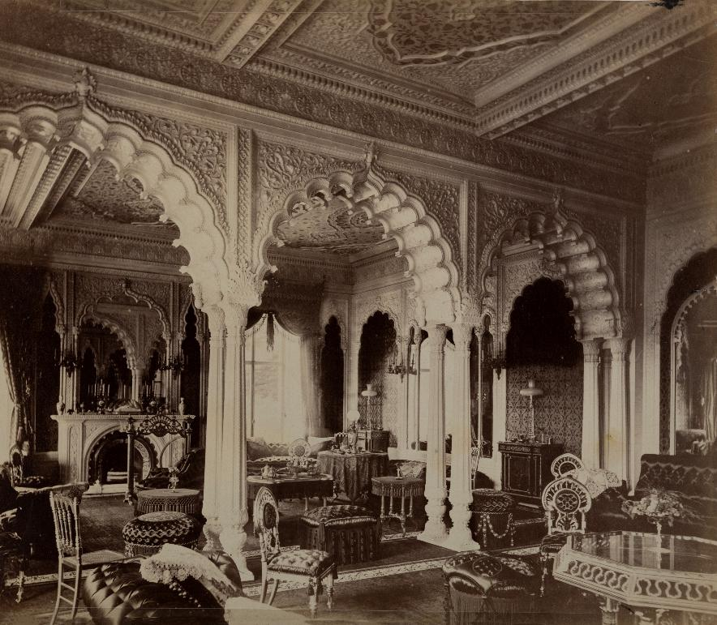
Wooden horse image
© Peter Bance Collection
© Historic Royal Palaces
Listen to audio from Mishka
Notes:
Transcript
Mishka: Bamba and Duleep had seven children. Five of them grew to adulthood, two boys and three girls. The image on the left shows what their family home looked like on the inside. Their home was a grand English country house in Suffolk, but Duleep redecorated it on the inside to look like the palaces that he was familiar with from India. The house was full of objects from India and Duleep told his children's stories about his mother, he sang them lullabies, and one of these lullaby's was about a British prince who also lost his kingdom. One of the family toys was a wooden rocking horse, which you can see in this image. This is a useful and wonderful object with which to understand how this family's life was shaped by different cultures. Rocking horses are a traditional toy in Britain, but this one is decorated with a saddle and a bridle of the kind that an Indian prince's horse would wear. And this shows us that the children stayed connected to their father's South Asian heritage even though they were born and lived in England. They also owned things that came from Egypt, connecting them with their mother's heritage. These pictures also show us that this family generally had quite a rich and comfortable lifestyle. Most children in Victorian England did not have the same experiences growing up.

Slide 17
INDIAN ROCKING HORSE
A rocking horse that belonged to the Duleep Singh family
BACKGROUND NOTES
Questions
Duleep Singh and Bamba Müller lived together in a large country house in Suffolk called Elveden Hall. Duleep redesigned the inside to look like a Mughal palace similar to the palaces he grew up in in Punjab.
The children lived partly like a wealthy English family. They were raised as Christians, kept dogs and horses, and enjoyed sports. But they were also surrounded by animals from India, Indian and Egyptian objects and clothing, and stories from the Sikh Empire. The family travelled abroad frequently and brought back clothing and gifts from their journeys. They filled their home with objects from different cultures.
Q | Describe the rocking horse. What colours, patterns and shapes do you see?
Q | What does this rocking horse tell us about the childhood of the Duleep Singh children?
WHAT CAN WE LEARN FROM THIS SOURCE?
Q | How might growing up with different cultures have shaped the Duleep Singh children’s sense of identity?
This rocking horse belonged to the Duleep Singh children. The fact that it has survived for over 150 years tells us it was a well‑loved and important toy. It is made of wood and beautifully decorated. The saddle and bridle look like the ones that a prince in India might have used on a real horse.
Rocking horses are a traditional British toy. This one was made in India and brought to England. It shows how the family’s mixed heritage remained part of their daily life. Even while growing up in an English country house.
Not every child in the Victorian period would have had a toy this special. It shows that these children had a privileged upbringing.
Q | Do you think the Duleep Singh children had a happy childhood?
© Historic Royal Palaces
Key dates: 1870s
Notes:
Answers
Describe the rocking horse, what colours, patterns and shapes do you see?
The rocking horse is black with a bright blanket under the saddle and a decorative bridle. The bridle looks as though it is gold and it has circles that look like they might have held jewels or gems if this was a real horse and a real bridle. It’s eyes are outlined in red and there is a pattern on its neck.
What does this rocking horse tell us about the childhood of the Duleep Singh children?
This rocking horse brings together the different cultures that shaped their family. The children were born in England, but they grew up surrounded by objects and clothes that reflected their parents’ heritage. Even though the children grew up in a grand house with lots of beautiful things, their father, Duleep Singh, had lost his kingdom and huge personal wealth to the government that gave him an allowance. The toy shows both their wealthy life in Britain and the unfair history that forced their family to move there in the first place.
How might growing up with different cultures have shaped the Duleep Singh children’s sense of identity?
Growing up between multiple cultures may have shaped the Duleep Singh children’s identity in many ways. Surrounded by different traditions, objects and stories from both their parents’ backgrounds and their life in Britain, their identity may have felt privileged but also complicated as they found their own voices.
Do you think the Duleep Singh children had a happy childhood?
It is hard to say if the Duleep Singh children had a happy childhood. Some things suggest they did. They had nice homes, expensive toys like the rocking horse, and did not have to work like many children at the time.
However, there were also difficult parts to their childhood. They were not able to travel to their father’s place of birth and their family had lost a great deal, many choices about their lives were made by British government, not by their parents. This may have made it hard for them to understand who they were or where they belonged.
So, even though their childhood looked comfortable, it may not have been happy in every way. Their lives show that wealth and toys do not always mean happiness.

Slide 18
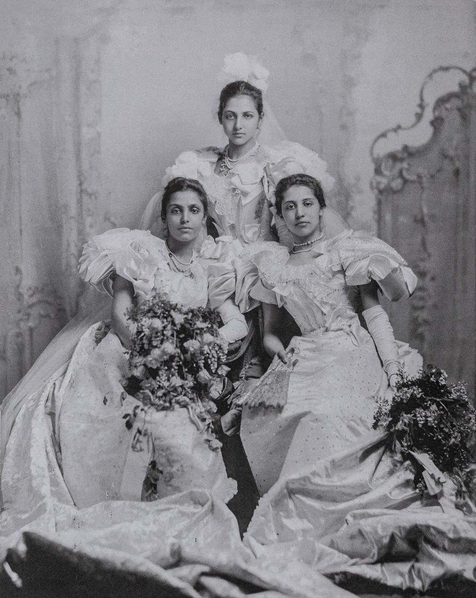
Indian Princesses image
Listen to audio from Mishka
© Peter Bance Collection
Notes:
Transcript
Mishka: This is a photograph of Duleep and Bamba's three daughters. The oldest daughter was Princess Bamba, named after her mother. She's on the left. The middle daughter, Princess Catherine, is at the top. And Princess Sophia, the youngest daughter, is on the right. Despite growing up in a country house with lovely toys, parts of their childhood had been very difficult.
While they were growing up, Duleep, their father, started to have disagreements with the British government. He thought they owed him more money and he was angry at the way he had been treated. In 1886 he tried to take his whole family back to India to live in Punjab but he was arrested on the way. He sent his family back in England but he went to Paris and stayed abroad and kept planning his return to India. He converted back from Christianity to the Sikh faith. In 1887, the children's mother, Bamba, died in England. Duleep stayed away and married someone new, and Queen Victoria chose a guardian to look after the children. Duleep Singh died six years later.
This photo shows them in 1895, a few years after their father died. They are dressed in beautiful gowns for their debutante ball - a special party held for elite young women when they were old enough to enter society and attend public events. A few years after this photograph was taken, the sisters decided to visit India themselves. They wanted to go to Lahore and other parts of Punjab to see the land that had belonged to their father and grandfather. At this time, India was ruled by the British. The sisters saw that the British treated people in India harshly and things were unfair. They met people who were fighting for better rights for the Indian people, including strong women leaders who were fight for the rights of women in India.
The sisters made several trips to India, which began to make them see the world and themselves differently. Although they still thought of England as their home and remained close to the royal family, they started to feel more connected to their father's heritage and questioned the treatment of Indians by the British Empire. They took up causes that helped Indians as well as other groups, such as women fighting for their rights against injustice and oppression. All three sisters became devoted to fighting for what they believed in. They tried to use their elite position in society to help other people. The rest of our story will take a closer look at each of these inspiring women.

Slide 19
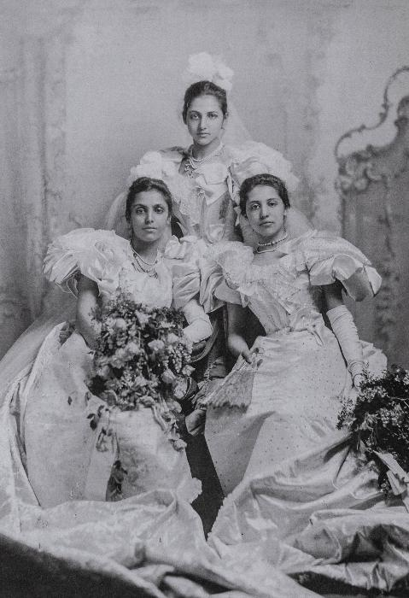
LAST PRINCESSES OF PUNJAB
Portrait of Princesses Bamba, Catherine and Sophia Duleep Singh
Questions
BACKGROUND NOTES
WHAT CAN WE LEARN FROM
THIS SOURCE?
Duleep and Bamba had three daughters, Princesses Bamba, Catherine, and Sophia.
As the children grew up, Duleep started to have lots of disagreements with the British government. He started to feel angry at the way he had been treated.
In 1886, he tried to take his family to India. He wanted to take back the land he ruled when he was a child. But he was arrested on their journey. He sent his family back to England. He stayed abroad and kept planning his return to India. He converted back to the Sikhi faith.
In 1887, the children’s mother Bamba died in England. Duleep stayed away and remarried. Queen Victoria chose a guardian to look after the children. Duleep died six years later.
In the early 1900s, the sisters travelled to India themselves. At this time, the British ruled in India. They saw that the British treated many Indian people unfairly and harshly. The sisters met people who were fighting for better rights. This experience had a strong impact on the sisters and influenced their later lives.
Q | Describe what you can see in this image?
This photo was taken in 1895. The sisters are wearing their formal court dresses. It was taken at their court debut.
Court debuts were events where young women were officially presented to the monarch. The event welcomed them into high society.
This photo reveals the type of life that these three women had. They wore fancy clothing and attended high profile events. This photograph was taken a few years after their father died. It shows that they were still connected to the royal family even after his death.
The sisters were often featured in newspapers.
One article described them in this image as: “very distinguished in their lovely Court Gowns of white and silver”.
Q | How were the princesses’ viewed by British Society?
Q | Why do you think the sisters wanted to visit India?
Q | Why do you think the sisters started fighting for better rights after they visited India?
© Peter Bance Collection
Key dates: 1895
Notes:
Answers
Describe what you can see in this image?
There are three young women of South Asian heritage looking out at us from the photograph. The youngest stands behind and the other two sit in front. The two in front hold large bunches of flowers. There were fancy dresses with puffy sleeves that reach the floor. They look like they are made of expensive fabric. They also wear gloves that reach up to their elbows. Around their necks are strings of large pearls. This looks like a formal event
How were the princesses’ viewed by British Society?
The princesses were viewed by British society as high‑status members of the aristocracy, admired for their beauty but often exoticised because of their mixed heritage. They were welcomed into royal circles, invited to major social events, and praised in the press during occasions such as their court debut but were also noticed as being ‘different’.
In what ways did their social status both support and limit the princesses as they later became activists?
Their high social status supported the princesses by giving them visibility, influence and access to powerful networks, which helped their voices be taken seriously when they campaigned for change. However, their status also limited them, as they relied on an allowance from the Government to fund their them. British society expected upper‑class women, especially those linked to the monarchy, to behave politely, avoid controversy and remain loyal to the Empire. Challenging injustice risked damaging their reputations, their financial security and their place within the royal world, making their activism both bold and difficult.
What parts of their lives were influenced by their Sikh heritage? What parts were shaped by Britain?
Their sense of identity and justice were shaped by their South Asian heritage. When they travelled to India, they saw first‑hand how unfairly many Indians were treated under British rule, which influenced the causes they later supported.
At the same time they grew up inside royal circles, took part in high‑society events like their court debut, and were described in the press in ways that reflected Victorian ideas about class and empire. Their education, friendships, and opportunities were all influenced by the British world around them, even though they were often seen as “different” because of their heritage.

Slide 20
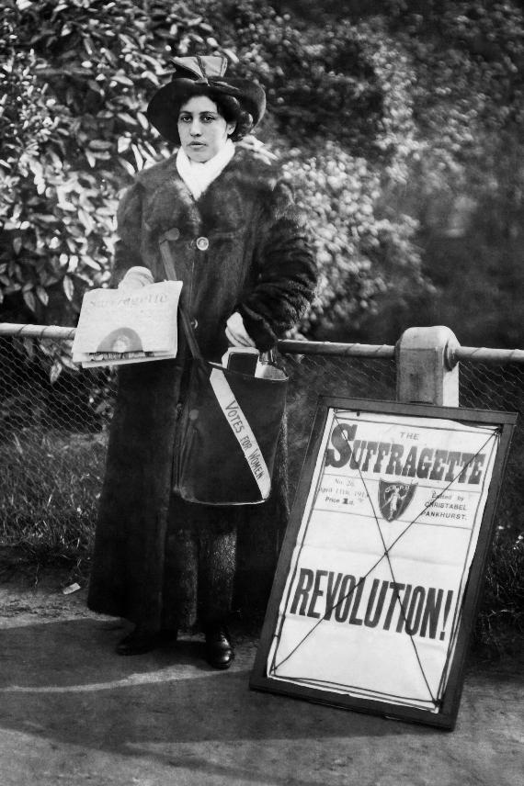
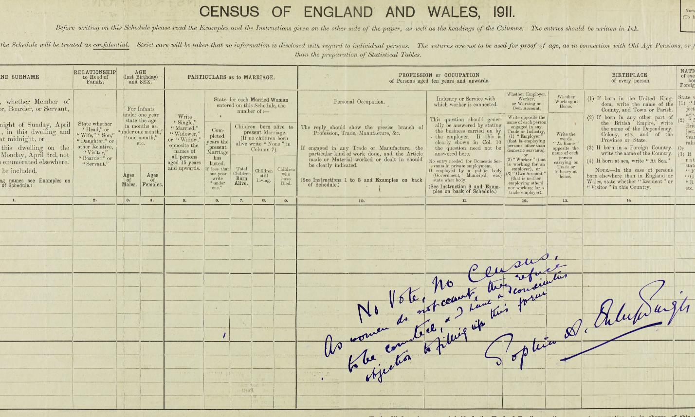
Sophia images
© Peter Bance Collection
The National Archives, UK
Listen to audio from Mishka
Notes:
Transcript
Mishka: The youngest of the three sisters, Princess Sophia Duleep Singh, joined the campaign for women to have the right to vote. At that time, women could not vote in Britain. She joined the Suffragette movement and attended many different types of protests. On the left, you can see a photograph of Sophia selling a newspaper called the Suffragettes. The document on the right is a census form from 1911. This was a form sent to every person in the country in Britain. Everyone had to fill in their details to help the government count how many people lived in the area, what they did, and what their age was. We still complete census every 10 years today, and it is illegal not to fill out the forms. However, Sophia and many other suffragettes refused to fill their census forms as a protest. On this form, Sophia wrote, “No vote, no census. As women do not count, they refuse to be counted.” At one point, Sophia also stopped paying her taxes, claiming that if she didn't have the right to vote, she shouldn't have to pay taxes. She was taken to court, but she kept fighting.
Women finally had the equal right to vote from 1928, when Sophia was 51. In her later years, Sophia encouraged her goddaughter to fight for equality and said, “When you are allowed to vote, you are never ever to fail to do so. You don't realise how far we've come.” Sophia died in 1948, age 72.

Slide 21
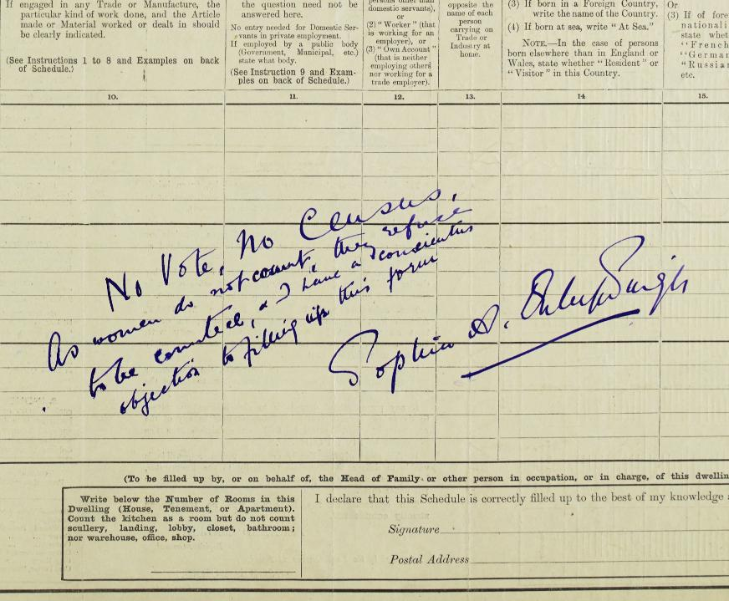
PRINCESS SOPHIA’S PROTEST
A document that Sophia used to protest for women’s rights
BACKGROUND NOTES
Princess Sophia was the youngest daughter of Duleep Singh and Bamba.
After her trip to India, she wanted use her status to help other people. In 1909, Sophia joined the Suffragettes, who were fighting for women to get the right to vote. They used bold actions demand change.
As part of this, Sophia sold copies of The Suffragette newspaper outside Hampton Court Palace. She was also part of a group of people who stopped paying tax. Their slogan was: 'No Vote, No tax!'
Later, she volunteered as a nurse to care for Indian soldiers who had fought in WWI.
Questions
Q | What is a census?
Q | Why did Sophia refuse to fill it in?
Q | What do you think she meant by writing “No Vote, No Census”?
WHAT CAN WE LEARN FROM THIS SOURCE?
This document is a census - a form to help count all of the people living in Britain. Everyone is legally required to complete the census.
However, Sophia refused to complete it. She did this as a protest because women did not have the right to vote. Across her form she wrote: “No Vote, No Census, As women do not count, they refuse to be counted.”
Sophia wanted to show how unfair it was that women could not vote.
This census shows Sophia’s courage and how she used peaceful protest to demand equality.
Q | What might be the risks for Sophia refusing to complete the census or pay tax?
The National Archives, UK
Key dates: 1911
Notes:
Answers
What is a census?
A census is an official process when the government count everyone in the country and ask some basic questions to better understand the population.
Why did Sophia refuse to fill it in?
Sophia refused to fill it in as a protest against women not having the right to vote.
What do you think she meant by writing “No Vote, No Census”?
Sophia mean that if her opinions or her vote didn’t count to the government then she didn’t want her head to be counted in the Governments National Census.
What might be the risks for Sophia refusing to complete the census or pay tax?
Sophia risked being fined. She also risked her financial security as she was reliant on the Government for her allowance and on the Queen for her grace and favour home at Hampton Court Palace. If she started to tight against the government she risked the withdrawal of their support and stability.
.

Slide 22
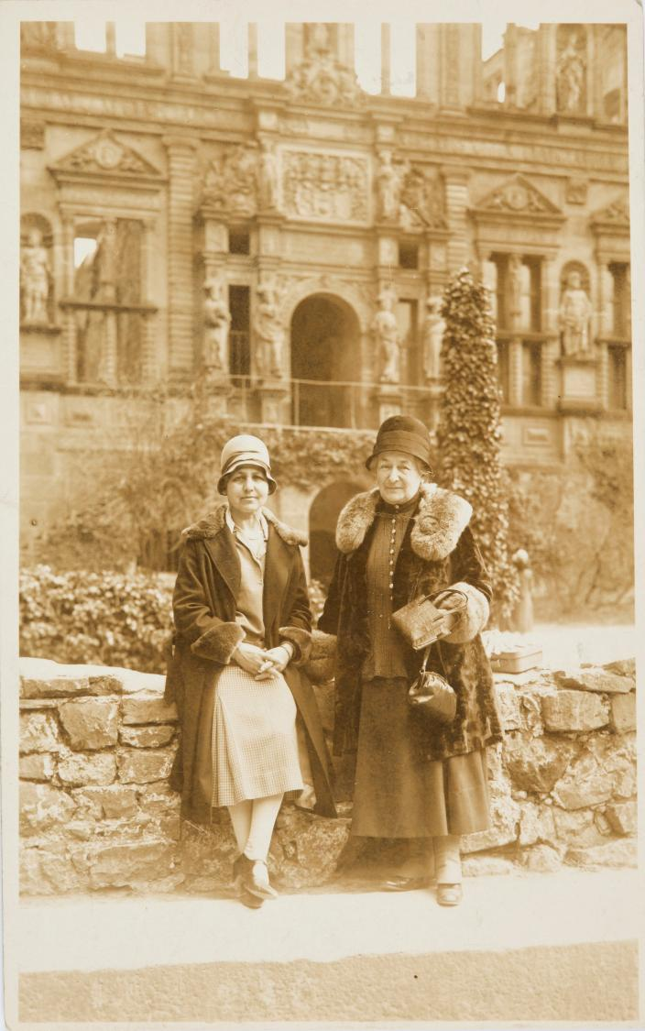
Catherine images
Listen to audio from Mishka
© Peter Bance Collection
Notes:
Transcript
Mishka: In this photograph you can see Princess Catherine Duleep Singh standing with her closest friend and companion Lena Schaffer. Catherine was the middle daughter and she preferred a quiet life away from newspapers, royal courts and elite society. Catherine went to the University of Oxford with her older sister Bamba. Here they studied European languages including French and Italian. They were accompanied by a German woman called Lina Schaffer. Catherine and Lina stayed close and later on chose to live together. At that time there was a lot of judgement and prejudice about same-sex relationships and these were not spoken about openly. Catherine and Lena moved to Germany and lived a quiet life together. They had a close, loving relationship. Even though LGBTQ+ relationships were not often spoken about in the past, this photograph suggests that they did exist. In 1937, Lena died and Catherine was heartbroken.
During the Second World War, Catherine helped Jewish families who wanted to leave Nazi Germany. She offered them a home and jobs in England so that they could live here. She also moved back to England with some of these families. Catherine died in 1942, aged 71. Her last wish was for some of her ashes to be buried alongside her friend Lena Schaffer.

Slide 23
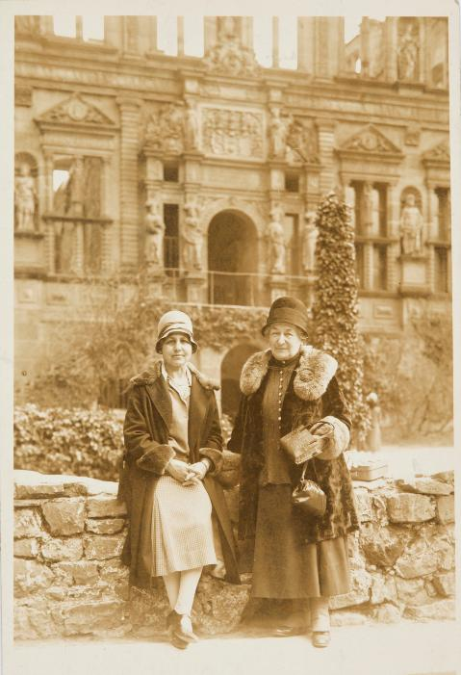
PRINCESS CATHERINE’S PHOTO
Photograph of Catherine and Lina in Germany
Questions
BACKGROUND NOTES
WHAT CAN WE LEARN FROM
THIS SOURCE?
This photograph shows Princess Catherine with Lina Schäfer.
The picture helps us see a personal side of Catherine. She is not shown as a princess in a public setting but as a woman building a life with someone she cared about.
At the time, society did not accept romantic relationships between women. Relationships like Catherine and Lina's were often hidden.
This means that photographs like this are especially important. They suggest that LGBTQ+ relationships existed, even if they were not spoken about openly.
This photo also reminds us that Catherine was independent and chose her own way to help others. She decided to move away from England and India. Her sisters worked to help people publicly, Catherine helped people directly around her.
Q | Describe what you can see in this photograph?
Princess Catherine was the second daughter of Duleep and Bamba. She studied at Oxford and was not interested in living in high society.
She became very close friends with Lina Schäfer, a German governess. They moved to Germany together and built a quiet life. Their letters and actions show that they had a deep, loving relationship. At the time, there was a lot of judgement and prejudice towards same-sex relationships.
When Lina died in 1937, Catherine was heartbroken and returned to England. At this time, the Nazis were in power in Germany. Catherine helped Jewish families who were being persecuted to move to England, where she gave them a home and helped them
find work.
Catherine died in 1942. One of her final wishes was to have a part of her ashes buried beside Lina's grave. In 1949, her sister Princess Bamba carried out this wish.
Q | Why do you think Catherine and Lina might have chosen to live quietly in Germany?
Q | Why is it sometimes hard to see LGBTQ+ people in history?
Q | Why do you think Catherine chose to help Jewish families escape Germany?
© Peter Bance Collection
Key dates: c.1920s-1930s
Notes:
Answers
Describe what you can see in this photograph.
There are two women standing in front of an abandoned building. They sit on a low stone wall. They stand close to one another and look like they know each other. They are wearing heavy jackets so it might be cold or autumn. The jackets are lined with fur so their clothing might be quite expensive.
Why do you think Catherine and Lina might have chosen to live quietly in Germany?
Catherine and Lina may have chosen to live quietly in Germany so they could have more privacy and freedom in their relationship. At the time, same‑sex relationships were often misunderstood or judged, and many people avoided labels because of the stigma attached. Living away from the expectations of British high society may have allowed them to build a life together without as much pressure or attention.
Why is it sometimes hard to see LGBTQ+ people in history?
It can be hard to see LGBTQ+ people in history because many felt they had to hide who they were to stay safe. Their stories were often left out of records or written in ways that did not clearly say who they loved or how they identified. Also, the words we use today, like “LGBTQ+,” did not exist in the past, so people described themselves in different ways or wouldn’t necessarily identify with labels we use today.
Why do you think Catherine chose to help Jewish families escape Germany?
Like her sisters, Catherine may have wanted to use her status and resources to help others. However, unlike them, she lived a quieter life and avoided public attention. Rather than speaking out, Catherine seemed to prefer helping people directly around her. She may also have related to the experiences of Jewish families, who were forced to leave their homeland.

Slide 24
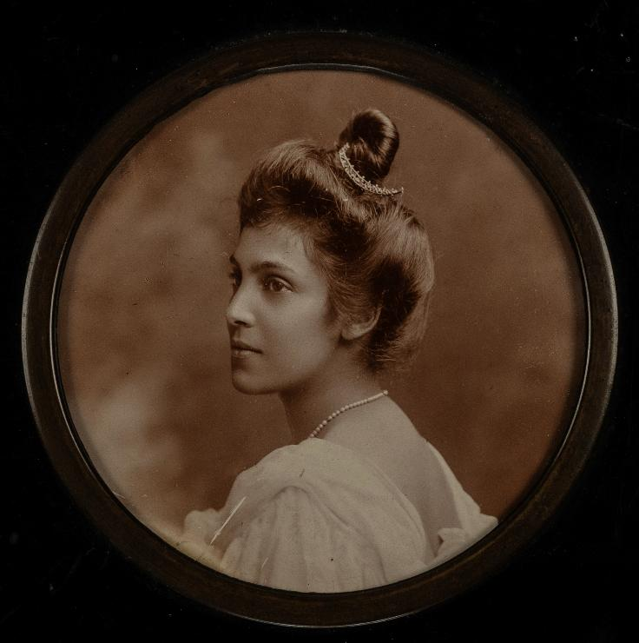
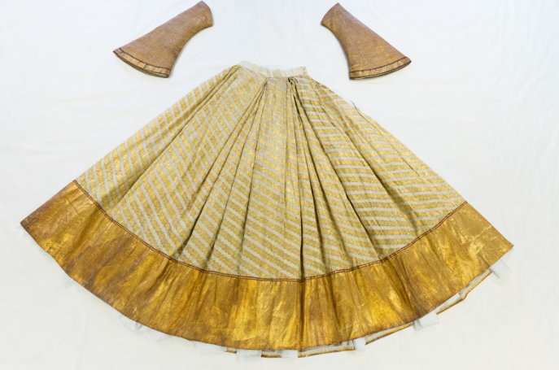
Bamba images
© Peter Bance Collection
© The Whitworth, The University of Manchester / Historic Royal Palaces
Listen to audio from Mishka
Notes:
Transcript
Mishka: The oldest sister, Princess Bamba Duleep Singh, was named after her mother, Maharani Bamba. Here is a photograph of her on the left. She wanted to become a doctor, but it was difficult for women to do this at the time. There weren't many places where women could study medicine. Bamba moved to Chicago to study medicine at a course specially designed for women. But the course was shut down, and she could not complete her studies. Bamba chose instead to move to South Asia and make a home in Lahore, which had been the capital of her father and grandfather's kingdom in Punjab. It is where the Court of Lahore was, which we saw in the painting at the start of the story. Bamba decided to spend the rest of her life trying to get back her father's lost kingdom and to collect as many things as she could which had belonged to her family to keep them safe. Bamba died in Lahore in 1957, aged 91. Princess Bamba was the last living member of her family. With her death, the last of her family was gone, but Bamba had spent her life carefully preserving as much as she could of her family's history in the form of pictures, letters, papers, and objects, like the beautiful skirt and sleeves that you can see above. Today, we can use objects like this to help us understand more about the Duleep Singh family. And how empires shaped their lives and many others across the world. But perhaps most importantly, the family lives on through all the people today who continue to be inspired by their lives, including you.

Slide 25
PRINCESS BAMBA’S CLOTHING
Lehenga and sleeves
BACKGROUND NOTES
Questions
Princess Bamba was the eldest daughter of Duleep and Bamba. She wanted to study medicine, but her college closed shortly after she arrived. Instead, she moved to Lahore, which had been the capital of her father’s and grandfather's kingdom. She spent the rest of her life travelling between Lahore and England.
Bamba tried to get back land that had been taken from her father and protect the history of the Sikh empire. She cared deeply about her family’s story and wanted to make sure it was not forgotten. She collected letters, photographs, documents, and special objects that had belonged to her family. By keeping these things safe, she was protecting her family’s memories. Her brothers and sisters died before her. Bamba was the last living descendant of Maharaja Ranjit Singh.
Q | How do you know this is a special piece of clothing?
Q | Why do you think Bamba collected objects like this?
WHAT CAN WE LEARN FROM THIS SOURCE?
Q | What item of clothing would you feel proud to inherit?
This skirt is similar to a Lehenga (a traditional Indian skirt). It belonged to Bamba when she lived in Lahore. The sleeves would have been attached to a blouse. The fabric suggests that it would have been very expensive.
When she died, Bamba left this skirt to her goddaughter.
This is one object from Bamba’s original collection. She kept and shared items like this to help preserve her family’s story. The skirt shows her connection to her South Asian heritage and demonstrates how Bamba used clothing and personal objects to remember and pass on her family’s history.
Q | Bamba wanted most of her collection to stay in Lahore after she died. Why do you think this was?
© The Whitworth, The University of Manchester / Historic Royal Palaces
Key dates: Sleeves mid 1800s, Lehenga late 1800s
Notes:
Answers
How do you know this is a special piece of clothing?
The skirt is made out of a fine muslin material that would have been very expensive. It has been made by hand and the stitching is very fine showing the skill of the crafts person. It has a large gold border and is made with gold threads showing that the person who wore it was important.
Why do you think people adapt clothes over time?
People adapt clothes to fit them better, to keep up with changing fashion or to reflect their identity or personality
|What item of clothing would you feel proud to inherit?
Perhaps there is something you have seen someone in your family or wider community wear that you would love to wear. Perhaps it is from a special occasion or a significant moment. Perhaps there is someone you admire whose shoes you might literally like to walk in?
Why do you think Bamba wanted her heirlooms and artworks to remain in Lahore after her death?
Bamba’s heirlooms are a lasting reminder of Ranjit Singh’s empire and her own determination to honour it.

Slide 26

VOCABULARY LIST
British Empire | a large group of countries that were once ruled or controlled by Britain
Census | when the government counts all of the people in a country
Commissioned | when someone is officially asked or paid to do a job, like painting a portrait
Converted | changed from one religion or faith to another
Deposed | removing someone from power (like a king being forced to stop ruling)
East India Company | a British company that traded goods and fought to take control of parts of India
Enslaved | forced to work without freedom or choice
Exile | having to spend time away from your home or country
Guardian | an adult who looks after children when their parents aren’t able to
Heirs | people who are next in line to receive money, land or power
Heritage | traditions, culture and history passed down
High society | people who are rich and powerful in a certain country
Kaur | A title often given to Sikh girls and women
Khalsa army | the Sikh Empire's powerful army made up of soldiers from different religions and backgrounds

Slide 27
VOCABULARY LIST
Maharaja | a royal title for men, literally meaning ‘great ruler’
Maharani | a royal title for women, literally meaning ‘great ruler’
Missionaries | people who travel to different areas to teach others about their religion
Mughal | a powerful Muslim empire that ruled areas of Asia from 1576 to 1720
Punjab | The land ruled by Maharaja Ranjit Singh, which is now divided between modern day Afghanistan, Pakistan and India
Prejudice | judging people unfairly, perhaps based on gender, religion or sexuality
Privileged | having certain advantages, such as money or power
Refugees | people who are forced to leave their home due to danger
Sikh Empire | A regional power based in the Punjab region, including parts of modern-day India and Pakistan
Sikh | someone who follows the Sikh tradition and its practices
Sikhi | The principles and practice of the Sikh faith
Singh | A title often given to Sikh boys and men
The Suffragettes | people who campaigned for women to gain the right to vote in the early 20th century

